Slide 1


RHE Parent Information 2026
Notes:
Have post it notes and pens ready for parents to use throughout the session

Slide 2
Relationship Education
Aims of the Session
Understanding the why and statutory requirements
How RHE is implemented
To ensure parents and carers understand why Relationships and Health Education is important
Notes:
Share what the changes are and what RSHE is
-Relationships Sex and Health are 3 strands
- In primary schools we mostly focus on Relationship and Health
- We do not ‘teach’ sex education - in Year 6 we discuss ‘Puberty’
- We will hold another session for Parents in Yr 6 where they can see what their children will learn
-

Slide 3
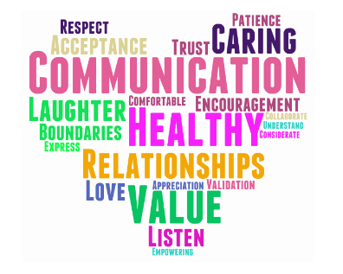
Relationship Education
In September 2020, the Department of Education made it compulsory that all primary age children were taught Relationships and Health Education (RHE).
This subject is designed to equip your child with the knowledge to make informed decisions about their wellbeing, health and relationships as well as preparing them for
a successful adult life.
Notes:
DFE has made RHE compulsory in all primary schools the same as other subjects such as English, Maths, History, Geography etc
DFE tell us what has to covered legally before children leave primary school
Each year groups have age related lessons and topic appropriate for that particular age and stage of that group of children

Slide 4

Relationship Education
Why do you think RHE is important?
How can we move RHE to the centre of our curriculum?
Notes:
Schools are more than a academic place. Why does it help our children
Area that difficulties, having the education and discussions, tolent adult. Protected characteristics

Slide 5

Relationship Education
Why is RHE important?
At Inspire, we believe that the essential aim of Relationships Education should be to provide pupils with the knowledge and skills to enable them to make informed and responsible choices in later life, emphasising the benefits of a healthy lifestyle.
We believe that Relationships Education should contribute to promoting the spiritual, moral, cultural, mental and physical development of pupils at school and of society and preparing pupils for the opportunities, responsibilities and experiences of adult life.
We also believe that Relationships Education should be taught within a climate of trust, respect and appropriate confidentiality, in which pupils and adults feel able to talk openly and honestly.
Notes:
Today’s children and young people are growing up in an increasingly complex world and living their lives seamlessly on and offline. This presents many positive and exciting opportunities, but also challenges and risks. In this environment, children and young people need to know how to be safe and healthy, and how to manage their academic, personal and social lives in a positive way.
This is why Relationships Education is compulsory in all primary schools in England and Relationships and Sex Education compulsory in all secondary schools, as well as making Health Education compulsory in all state-funded schools.
Relationships Education in primary schools should teach the fundamental building blocks and characteristics of positive relationships, with particular reference to friendships, family relationships, and relationships with other peers and adults.

Slide 6

Changing name to RHE
RSHE covers the teaching of relationships, sex education and health education.
The sex education part of the curriculum is not a statutory requirement in primary schools (minus what children learn within the Science curriculum) therefore it has been decided that as a trust, we will be naming the subject ‘RHE’ incorporating just the Relationships and Health education.

Slide 7

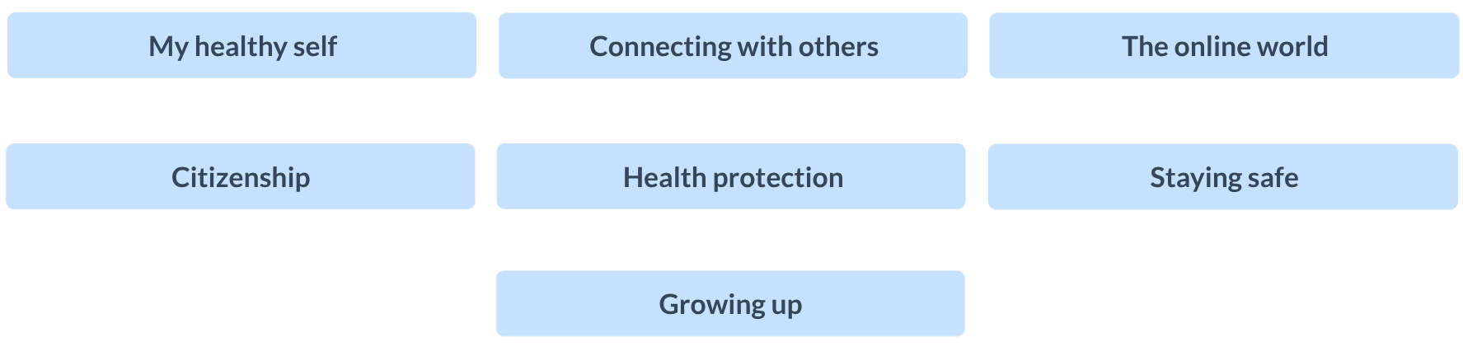

Kapow Resource
Kapow follows a spiral curriculum that revisits key ideas, increases in depth of knowledge and uses prior knowledge.
Notes:
Introduce what the kapow curriculum is and how it has been developed. Speak about how every year group looks at all of the topics and they are consistently built upon and developed - the spiral curriculum.

Slide 8
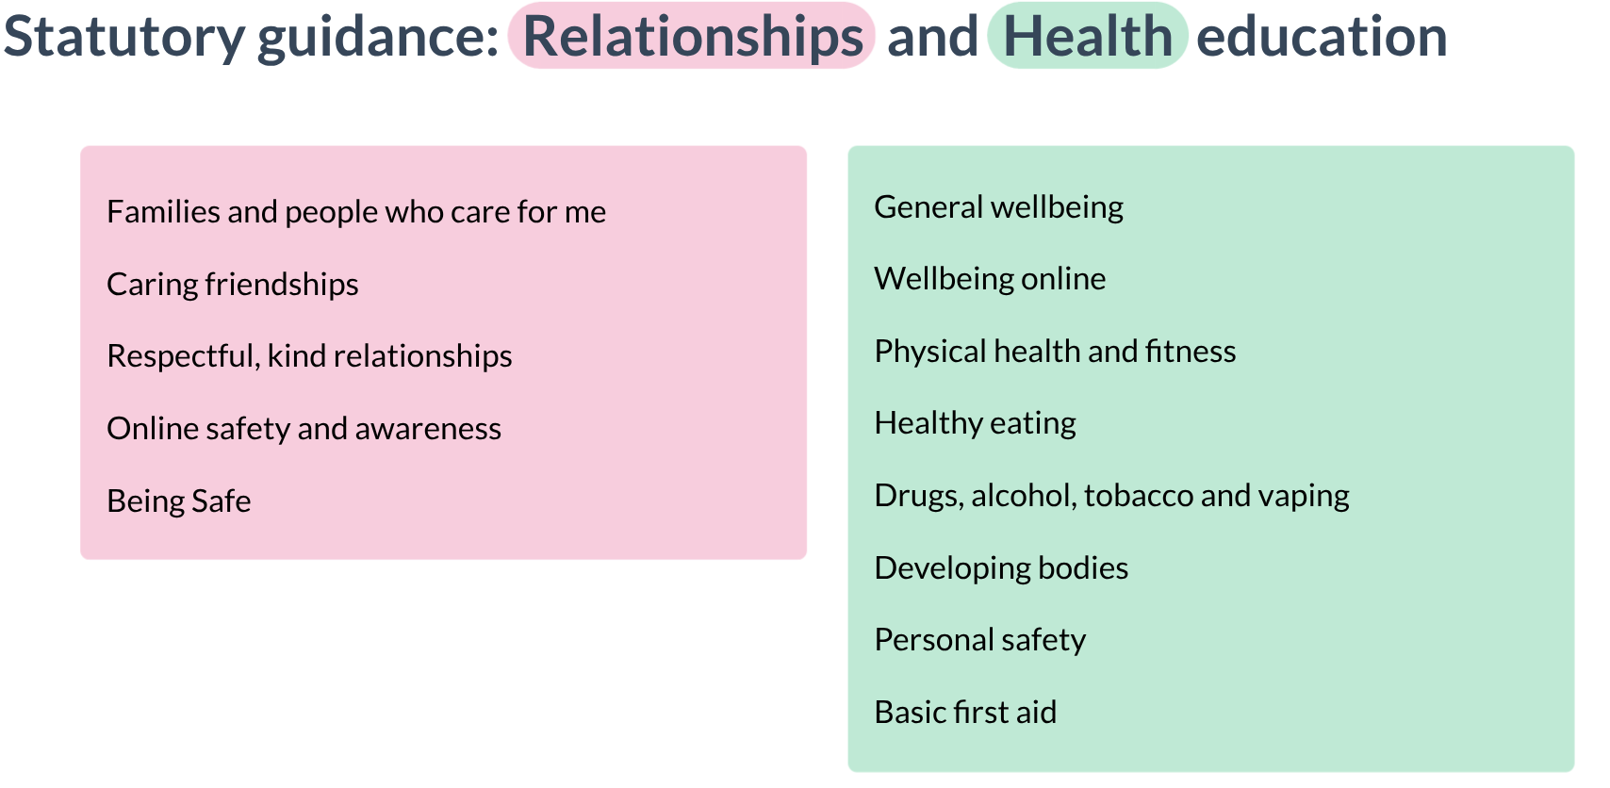
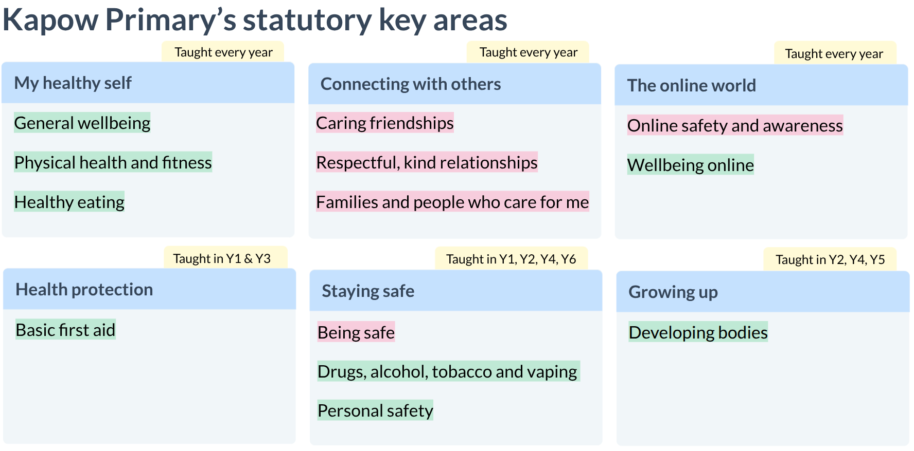
Statutory guidance
Notes:
Discuss what is statutory in the RHE curriculum

Slide 9
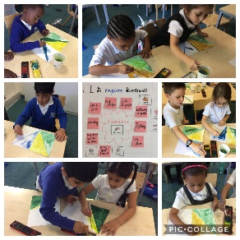
How will my child learn?
Children will learn in the same way as they would an English or Maths lesson, through discussion, activities and a skill based curriculum.
We give them factual information that will be not interfere with your home values and faith.
We allow them to build their social skills and collaboration using our Kagan structures.

Slide 10

Parent and Home values
Our Curriculum is built on facts and information
It allows children to intertwine home values and school values
Enables all children to build upon their social skills through collaborative learning
Respects everyone's views, children are encouraged to share and listen to different opinions

Slide 11

Can I withdraw my child?
Parents can not withdraw from the relationships or health education (RHE)
Parents can not withdraw from the science curriculum
(includes content on human development, which there is no right to withdraw from)
Parents can only withdraw their children from parts or all of the Sex Education in Year 6 in writing
A meeting will be arranged with a senior leader to discuss any worries/concerns
Children will be given alternative work to complete.
Notes:
Pupils can't be withdrawn from required subjects
Parents can't withdraw their child from relationships or health education.
However, if you choose to teach sex education you must allow parents to withdraw their children from part or all of it, unless you feel there are 'exceptional circumstances'.
Read our discussion guide to help you feel confident when talking to parents who want to withdraw their children from relationships and sex education (RSE) under the new requirements.
If a pupil is withdrawn, it's your responsibility to make sure they receive appropriate, purposeful education during the withdrawal period.
Withdrawing pupils
Parents have the right to request that their child be withdrawn from some or all of the sex education aspect of RSE – any requests and the decisions made should be recorded.
Headteachers should first discuss the request with parents, to clarify the reasoning behind it and to explain the benefits of receiving this education and any detrimental effects withdrawal may have on the pupil.
After these discussions, schools should respect the parent’s request to withdraw their child, up to, and until, three terms before the child turns 16 – after this point, schools should make arrangements for the pupil to receive sex education should the pupil want to.
Primary schools that choose to deliver sex education must automatically grant a request for withdrawal.
There is no right to withdraw from relationships education at primary or secondary level.
Pupils can't be withdrawn from required subjects
Parents can't withdraw their child from relationships or health education.
However, if you choose to teach sex education you must allow parents to withdraw their children from part or all of it, unless you feel there are 'exceptional circumstances'.
Read our discussion guide to help you feel confident when talking to parents who want to withdraw their children from relationships and sex education (RSE) under the new requirements.
If a pupil is withdrawn, it's your responsibility to make sure they receive appropriate, purposeful education during the withdrawal period.
Withdrawing pupils
Parents have the right to request that their child be withdrawn from some or all of the sex education aspect of RSE – any requests and the decisions made should be recorded.
Headteachers should first discuss the request with parents, to clarify the reasoning behind it and to explain the benefits of receiving this education and any detrimental effects withdrawal may have on the pupil.
After these discussions, schools should respect the parent’s request to withdraw their child, up to, and until, three terms before the child turns 16 – after this point, schools should make arrangements for the pupil to receive sex education should the pupil want to.
Primary schools that choose to deliver sex education must automatically grant a request for withdrawal.
There is no right to withdraw from relationships education at primary or secondary level.
Pupils can't be withdrawn from required subjects
Parents can't withdraw their child from relationships or health education.
However, if you choose to teach sex education you must allow parents to withdraw their children from part or all of it, unless you feel there are 'exceptional circumstances'.
Read our discussion guide to help you feel confident when talking to parents who want to withdraw their children from relationships and sex education (RSE) under the new requirements.
If a pupil is withdrawn, it's your responsibility to make sure they receive appropriate, purposeful education during the withdrawal period.
Withdrawing pupils
Parents have the right to request that their child be withdrawn from some or all of the sex education aspect of RSE – any requests and the decisions made should be recorded.
Headteachers should first discuss the request with parents, to clarify the reasoning behind it and to explain the benefits of receiving this education and any detrimental effects withdrawal may have on the pupil.
After these discussions, schools should respect the parent’s request to withdraw their child, up to, and until, three terms before the child turns 16 – after this point, schools should make arrangements for the pupil to receive sex education should the pupil want to.
Primary schools that choose to deliver sex education must automatically grant a request for withdrawal.
There is no right to withdraw from relationships education at primary or secondary level.

Slide 12
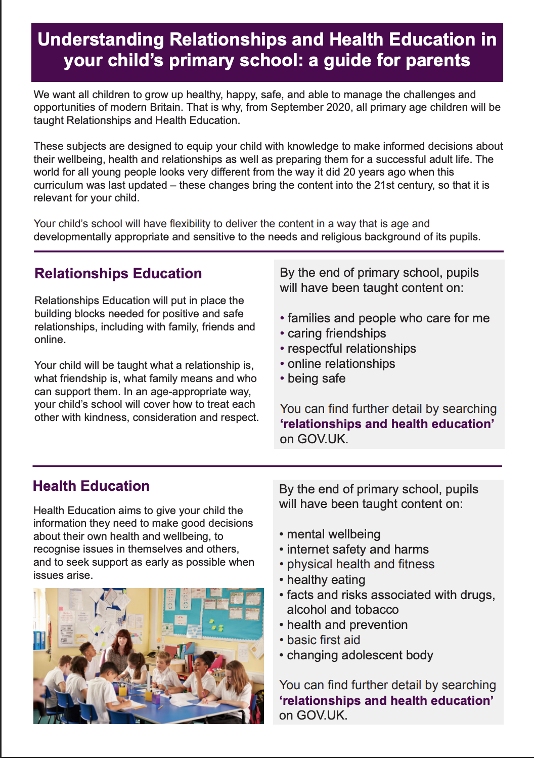
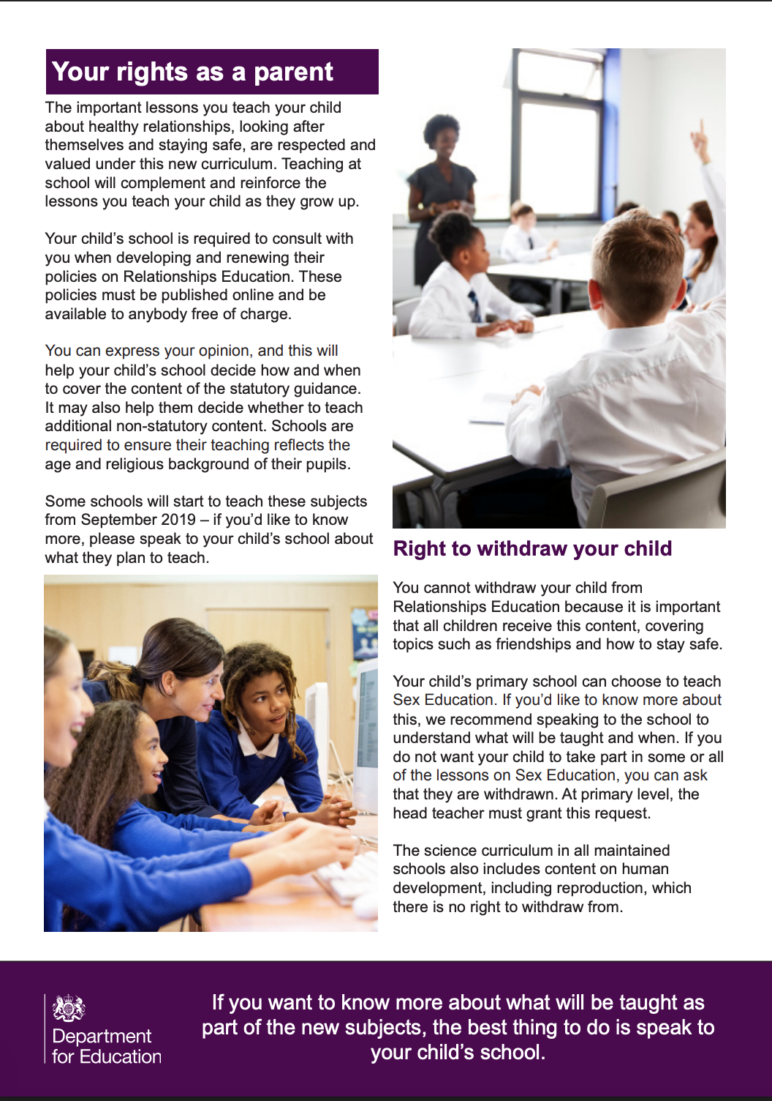
Notes:
Guidance for parents in different languages – urdu, Somali, Punjabi, arabic
Letter
Workshop
Consultation
Curriculum shared
Resources shared
: Schools will be required to consult with parents when developing and reviewing their policies for Relationships Education and RSE, which will inform schools’ decisions on when and how certain content is covered. Effective engagement gives the space and time for parents to input, ask questions, share concerns and for the school to decide the way forward. Schools will listen to parents’ views, and then make a reasonable decision as to how they wish to proceed. When and how content is taught is ultimately a decision for the school, and consultation does not provide a parental veto on curriculum content.
Will my child be taught sex education at primary? This is too young.
A: We are not introducing compulsory sex education at primary school.
We are introducing Relationships Education at primary, to put in place the building blocks needed for positive and safe relationships of all kinds. This will start with family and friends, how to treat each other with kindness, and recognising the difference between online and offline friendships.
Many primary schools choose to teach sex education (which goes beyond the existing national curriculum for science), and we recommend that they do so, tailored to the age, physical and emotional maturity of their pupils. In those instances we recommend you discuss this with the school, to understand what they propose to teach and how. If you continue to have concerns, you have an automatic right to withdraw your child from these sex education lessons.
Q: Does the new Relationships Education and RSE curriculum take account of my faith?
A: The subjects are designed to help children from all backgrounds build positive and safe relationships, and to thrive in modern Britain.
In all schools, when teaching these subjects, the religious background of pupils must be taken into account when planning teaching, so that topics are appropriately handled. Schools with a religious character can build on the core required content by reflecting their beliefs in their teaching.
In developing these subjects, we have worked with a number of representative bodies and faith organisations, representing all the major faith groups in England. Several faith organisations produce teaching materials that schools can choose to use.
Q: Do I have a right to withdraw my child from Relationships and Sex Education?
A: Parents will continue to have a right to request to withdraw their child from sex education delivered as part of RSE in secondary schools which, unless there are exceptional circumstances, should be granted up to three terms before their child turns 16. At this point, if the child themselves wishes to receive sex education rather than be withdrawn, the school should make arrangements for this to happen in one of the three terms before the child turns 16 - the legal age of sexual consent.
There is no right to withdraw from Relationships Education at primary or secondary as we believe the contents of these subjects – such as family, friendship, safety (including online safety) – are important for all children to be taught.
Q: Has the government listened to the views of my community in introducing these subjects?
A: A thorough engagement process, involving a public call for evidence and discussions with over 90 organisations, as well as the public consultation on the draft regulations and guidance, has informed the key decisions on these subjects. The consultation received over 11,000 responses from teachers, schools, expert organisations, young people and parents – these responses have helped finalise the statutory guidance.
Q: Will my child be taught about LGBT relationships?
A: Pupils should be taught about the society in which they are growing up. These subjects are designed to foster respect for others and for difference, and educate pupils about healthy relationships.
Pupils should receive teaching on LGBT content during their school years. Teaching children about the society that we live in and the different types of loving, healthy relationships that exist can be done in a way that respects everyone. Primary schools are strongly encouraged and enabled to cover LGBT content when teaching about different types of families.
Secondary schools should cover LGBT content in their RSE teaching. RSEshould meet the needs of all pupils, whatever their developing sexuality or identity – this should include age-appropriate teaching about different types of relationships in the context of the law.
Q: What support will schools receive to deliver these subjects well?
A: We are investing in a central support package to help teachers introduce these subjects well and with confidence. This will include a new online service, featuring access to high quality resources, innovative training materials, case studies and an implementation guide, available from Spring 2020.
There will also be training available for teachers through existing regional networks, offering opportunities to improve subject knowledge and build confidence.
We’re working with expert organisations, schools and teachers to develop this support.
Q: Where can I find out more information about what will be taught in my child’s school?
A: If you want to know more about what will be taught as part of the new subjects, the best thing to do is speak to your child’s school. We have also published parent guides, which explain what the subjects are, and parents’ rights.
These subjects are designed to equip your child with knowledge to make informed decisions about their wellbeing, health and relationships as well as preparing them for a successful adult life. The important lessons you teach your child about healthy relationships, looking after themselves and staying safe, are respected and valued under this new curriculum.
Teaching at school will complement and reinforce the lessons you teach your child as they grow up. Your child’s school will have flexibility to deliver the content in a way that is age and developmentally appropriate and sensitive to the needs and religious background of its pupils.

Slide 13
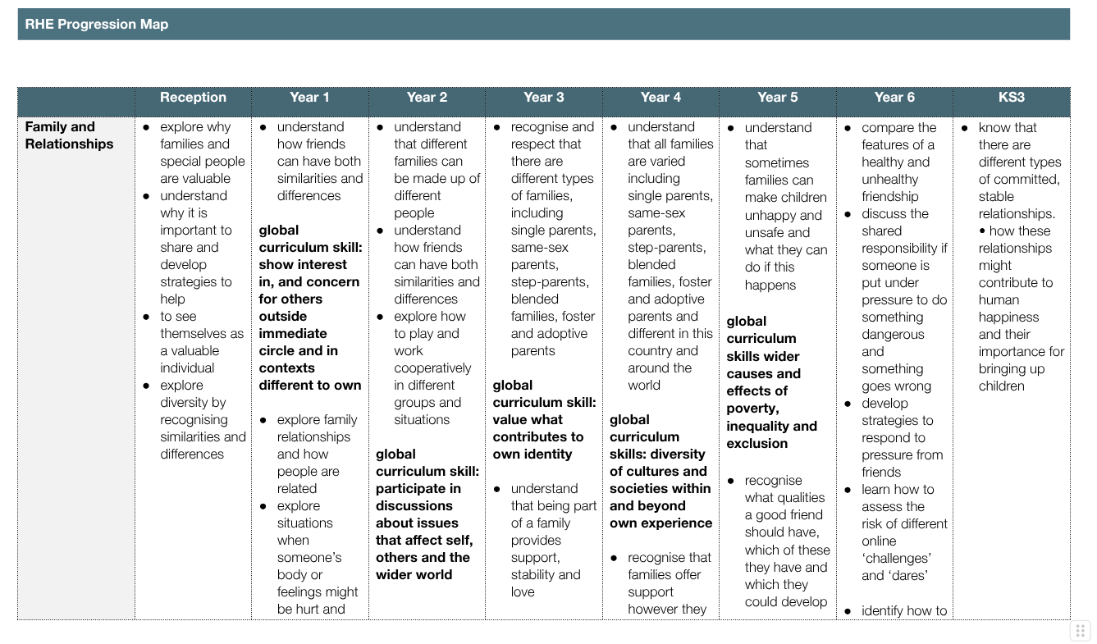
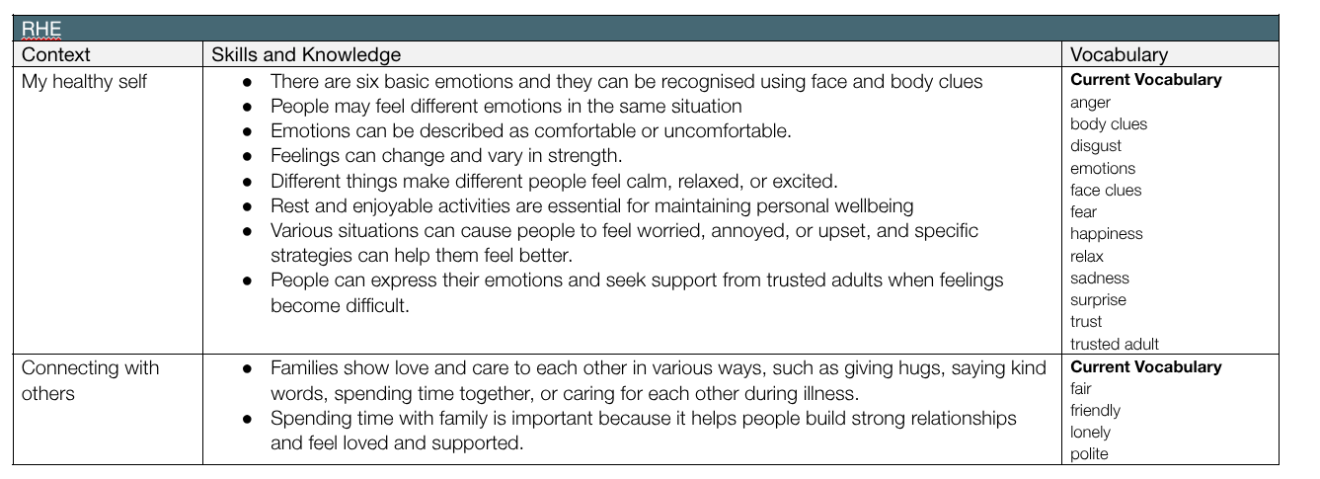
Progression Map
This map shows what each year group are going to be doing under each topic.
This map is for each term and topic for each year group. It has what vocabulary the children will be learning as well as what protected characteristics they will be covering.

Slide 14
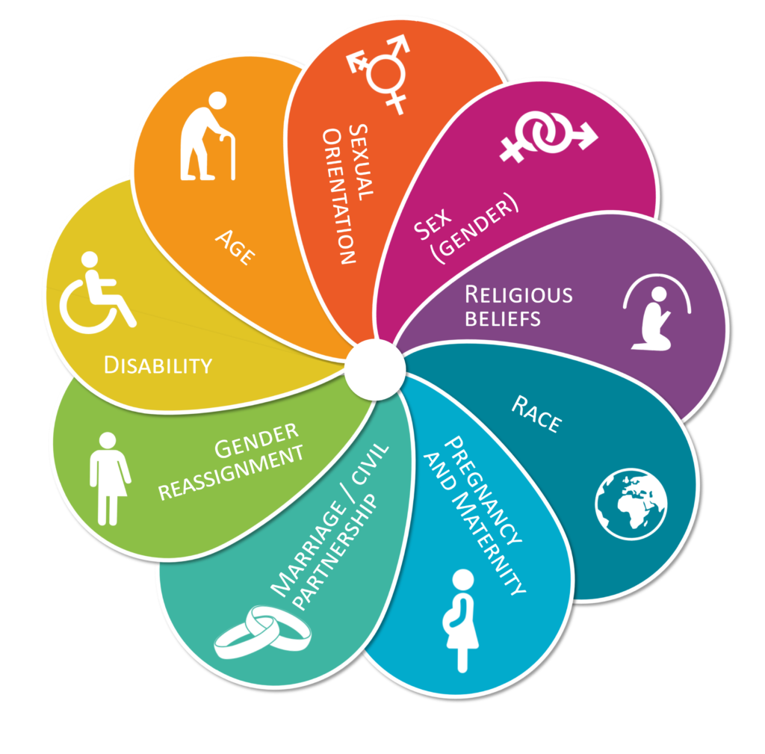
Protected Characteristics
Protected Characteristics have been woven into the RHE Progression map and is taught through other Curriculum areas as well
Notes:
Note to speaker - ensure you know which topics are taught in each year group from the Progression map as parents may ask questions about certain topics e.g- gender reassignment

Slide 15

Ground Rules
Any questions?
Thank you for writing your questions on the post-its
Thank you for being sensitive and respectful
Please speak to us afterwards if you have any personal questions

