Slide 1
LI: To describe how living things are classified according to their observable characteristics
- I can compare animals’ similarities and differences
I can sort and group animals based on their features
- I can give reasons for the way I have classified animals

Slide 2
Task:
Complete your KWL sheet.
What do you know?
What do you want to learn?
Leave ‘L’ blank and we will add to this each week.

Slide 3
Key Vocabulary
classification
kingdom
phylum
order
plants
flowering plants
conifers
ferns
mosses
algae
animals
vertebrates
invertebrates
mammals
birds
fish
reptiles
amphibians
arthropods
insects
arachnids
myriapods
crustaceans
sponges

Slide 4
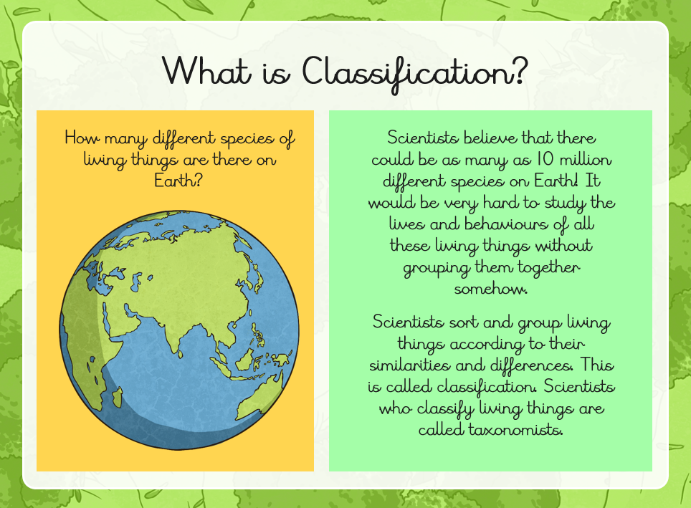

Slide 5
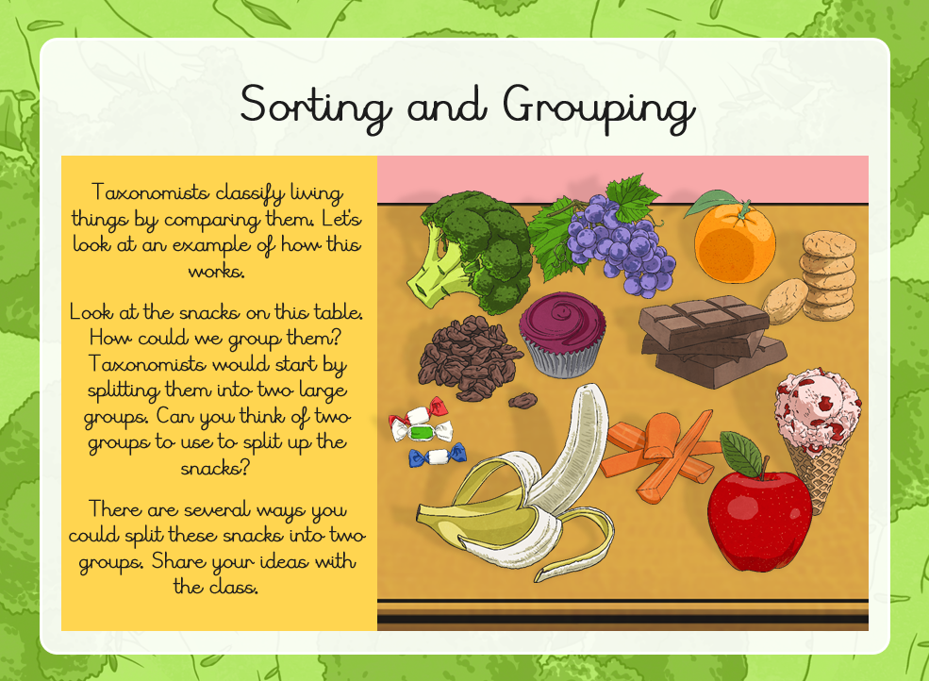

Slide 6
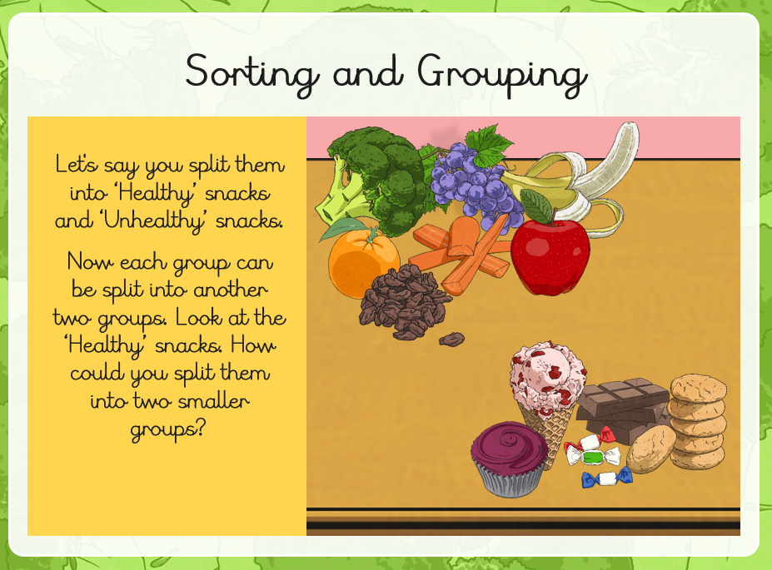

Slide 7
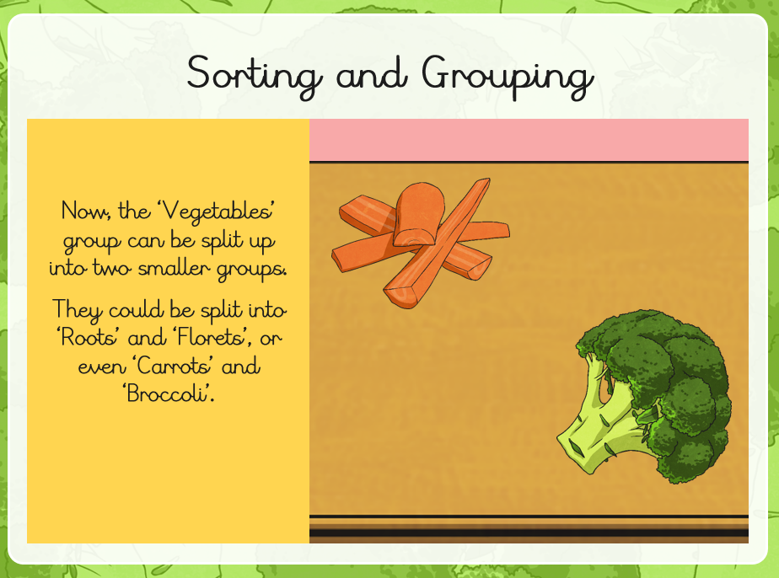

Slide 8
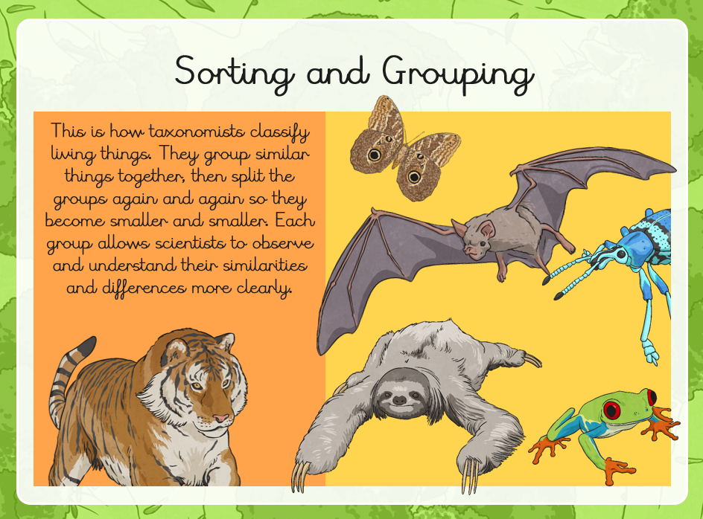

Slide 9
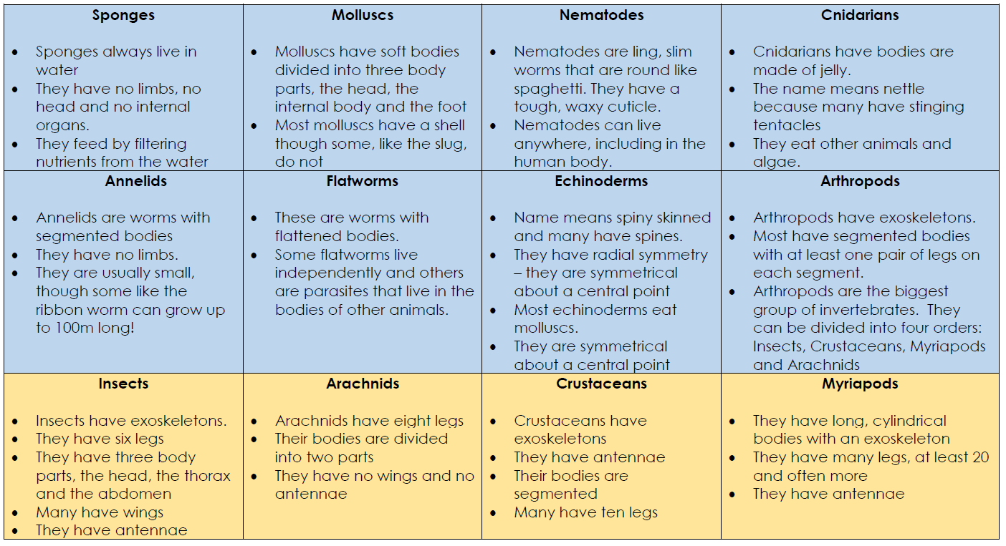
Work in pairs or groups to sort the animals in the pictures into the appropriate class or, in the case of arthropods, the appropriate order. Be clear about the reasons why you have classified the animals into particular classes/orders.

Slide 10
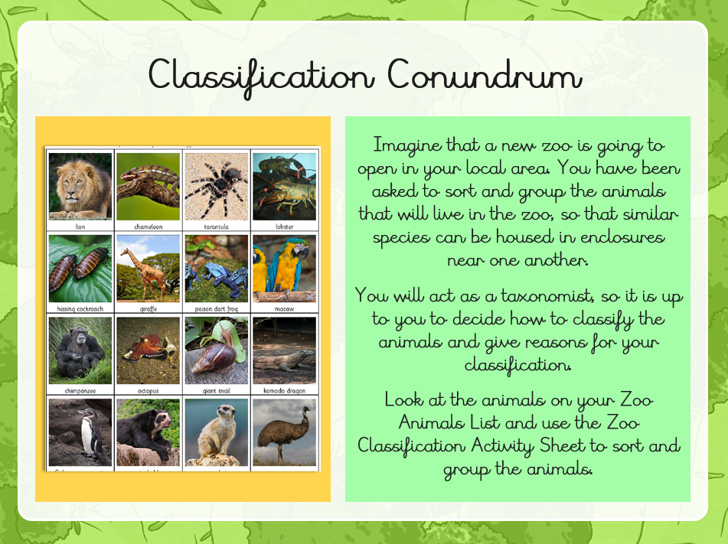

Slide 11
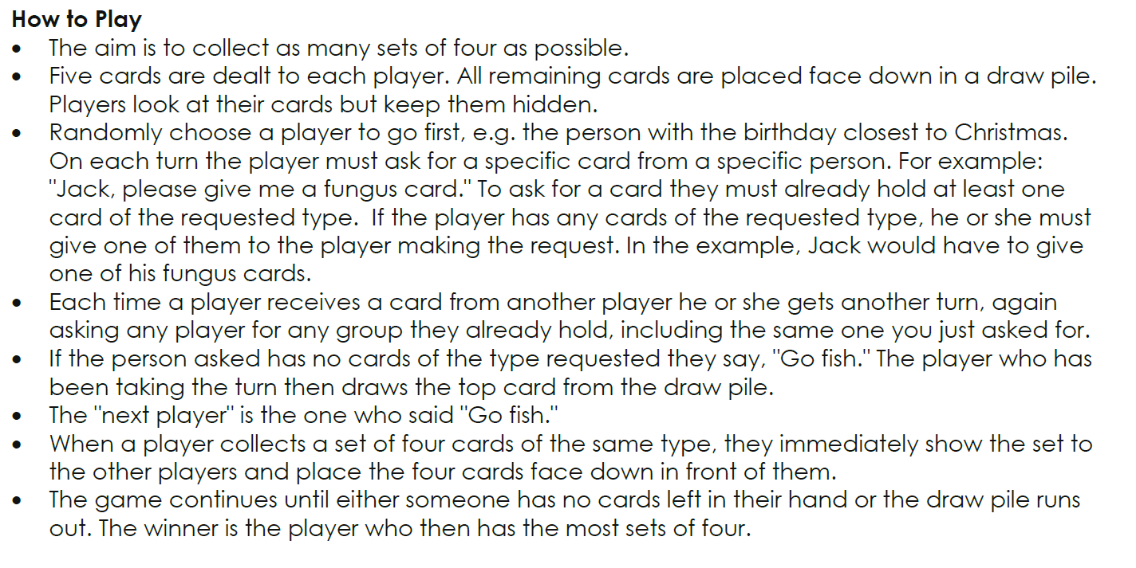
Plenary – Go Fish!

Slide 12
Next step…
Why is classifying living things considered useful?

