Slide 1
Starter: Number sequences
0.4 0.8 ___ ___ 2.0
___ 1.7 ____ 2.5 2.9
125 150 ___ ___ 225
Challenge yourself

Slide 2
LI: to add and subtract negative numbers

Slide 3
Key Vocabulary: Negative Positive More than Less than Difference Overdrawn

Slide 4
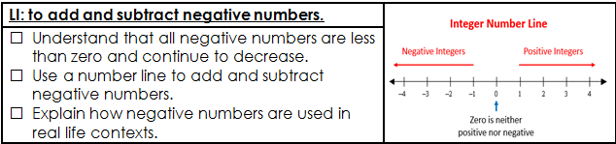

Slide 5
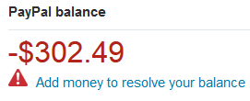
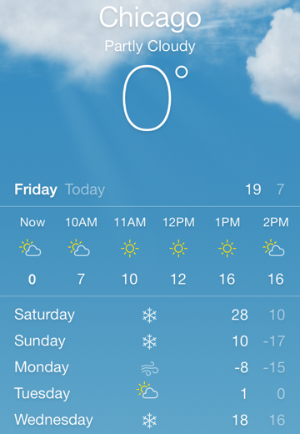
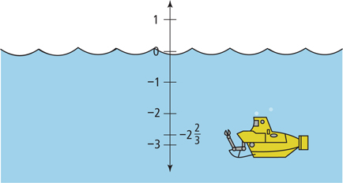
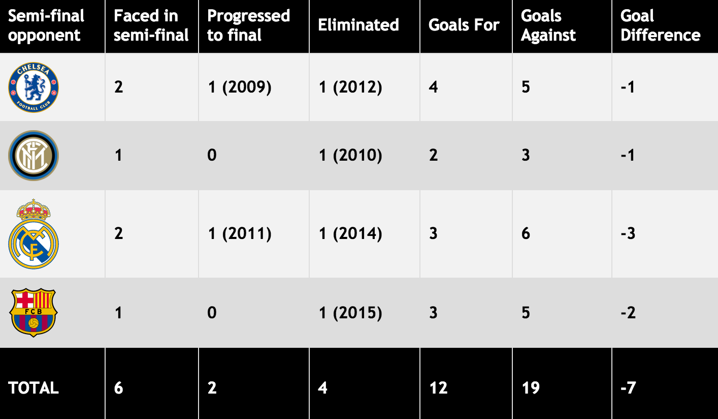
Where do see negative numbers in real life situations?

Slide 6
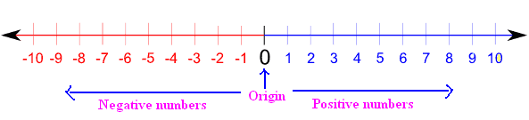
0 is very important when looking at negative numbers, as this is what splits the positive from the negative.

Slide 7
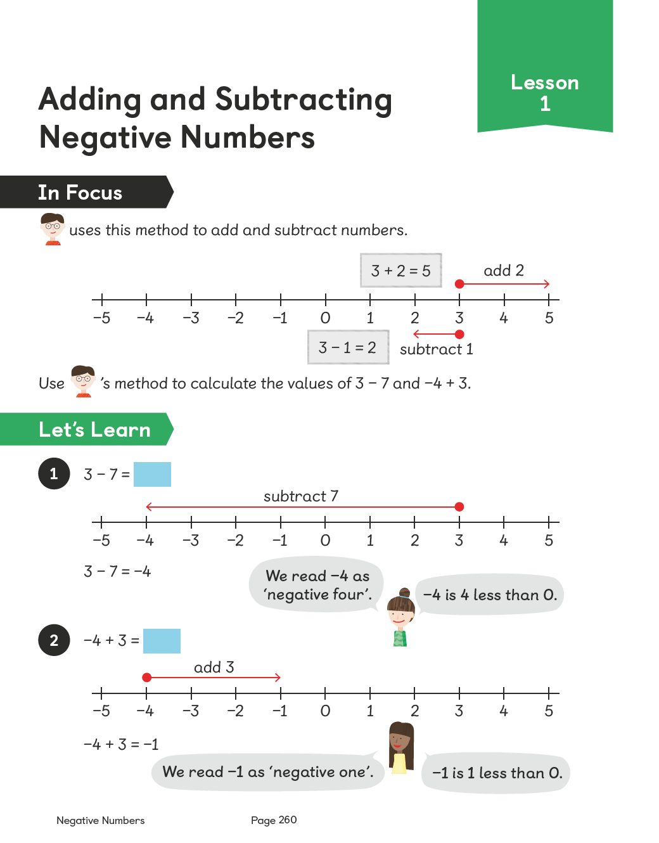

Slide 8
I do

Slide 9
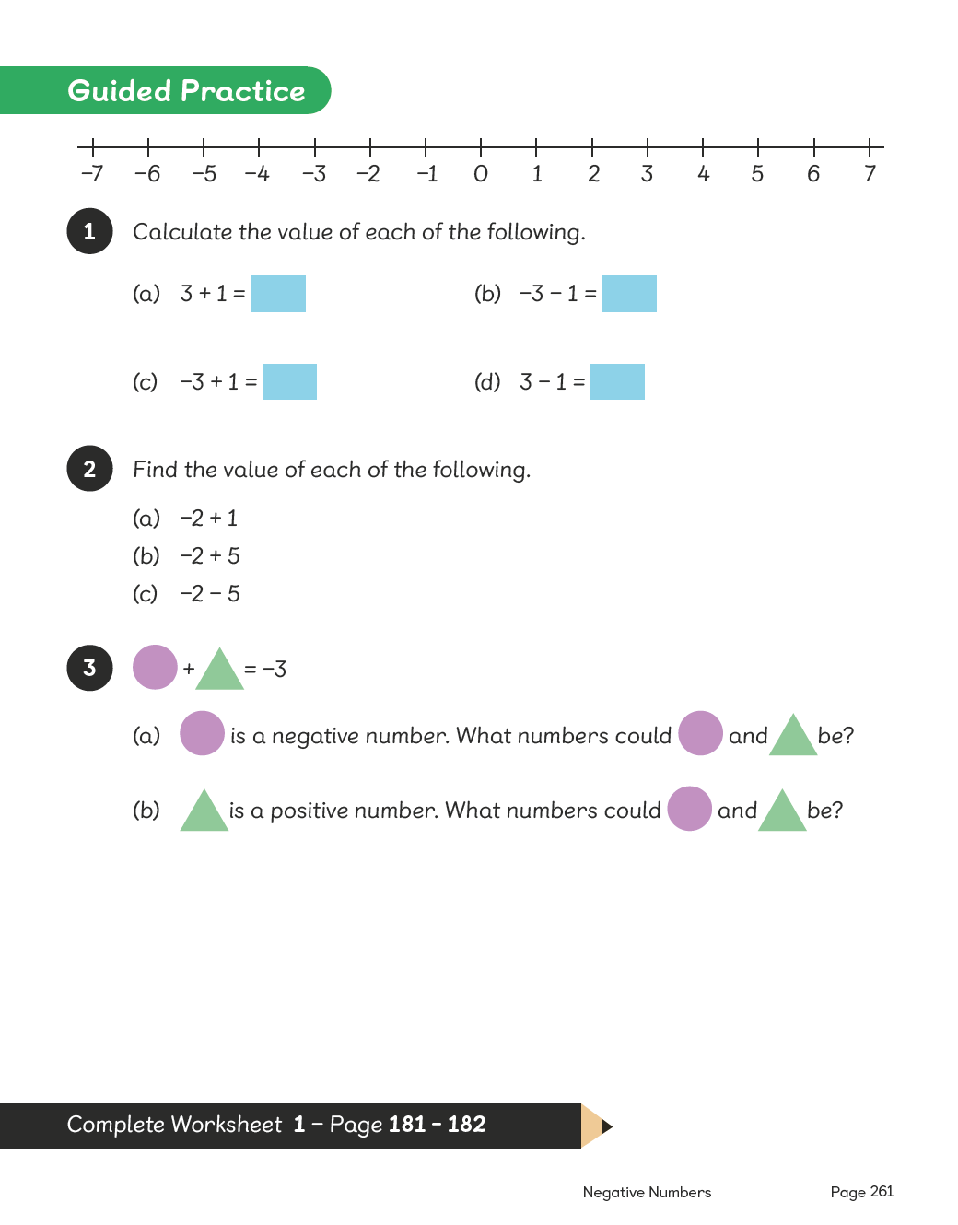
We do

Slide 10
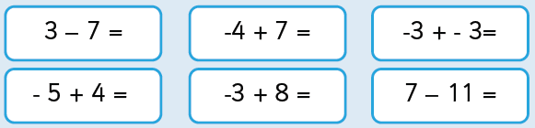
You do
Order these numbers from smallest to largest.
10 242 0 -2 -12 -5 18 -100

Slide 11
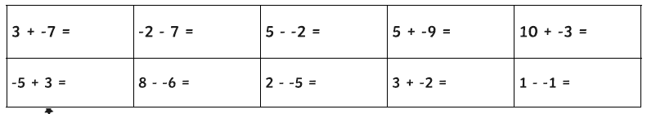
Have a go at these fluency questions with your partner. You can draw a numberline on your whiteboards to help you.

Slide 12
Mini-plenary

Slide 13
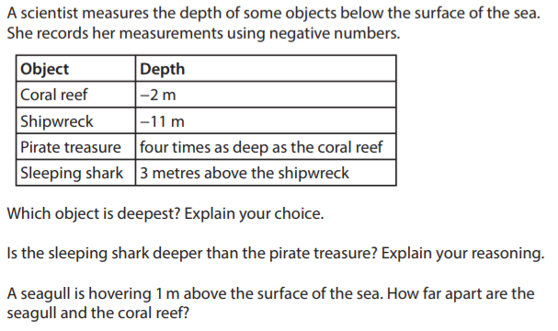
Plenary

Slide 14
LI: to use negative numbers in context

Slide 15
Number sequences
0.6 ___ 1.8 2.4 ___
1 and 2/5 ___ ___ 2 2 and 1/5
12 6 0 ____ ____
Challenge yourself

Slide 16
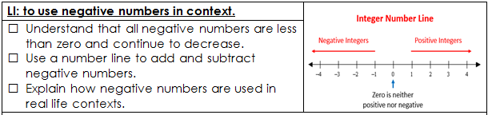

Slide 17
New reasoning prompts…

Slide 18
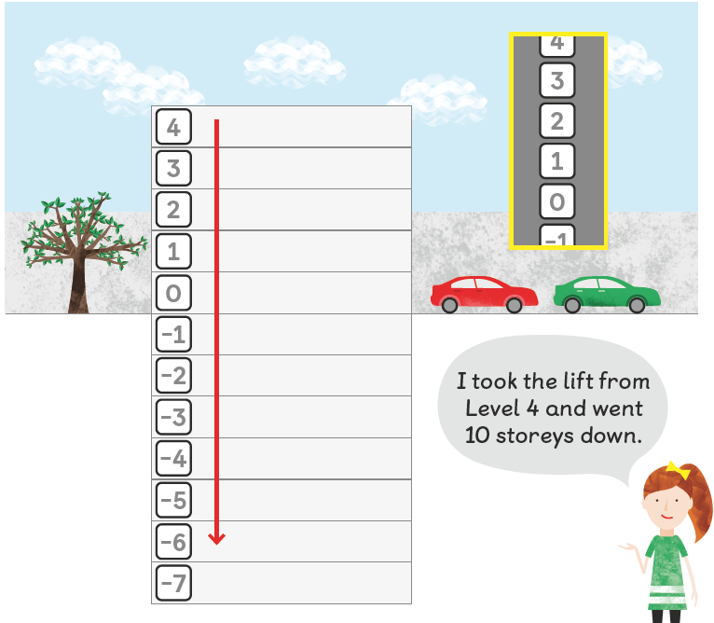


Slide 19
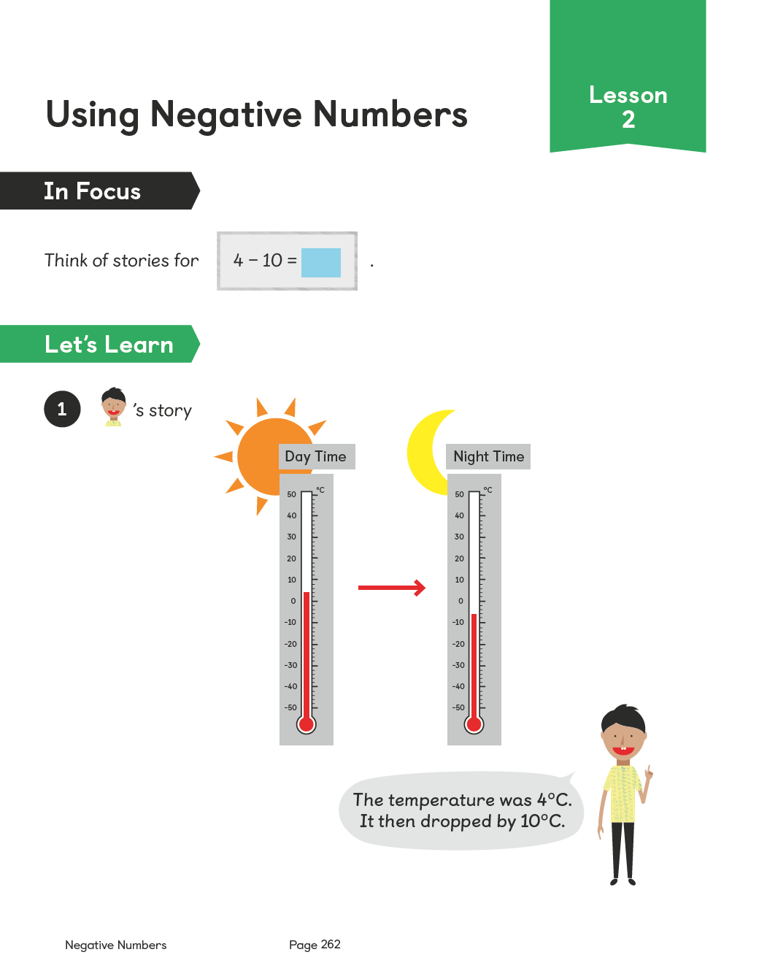

Slide 20
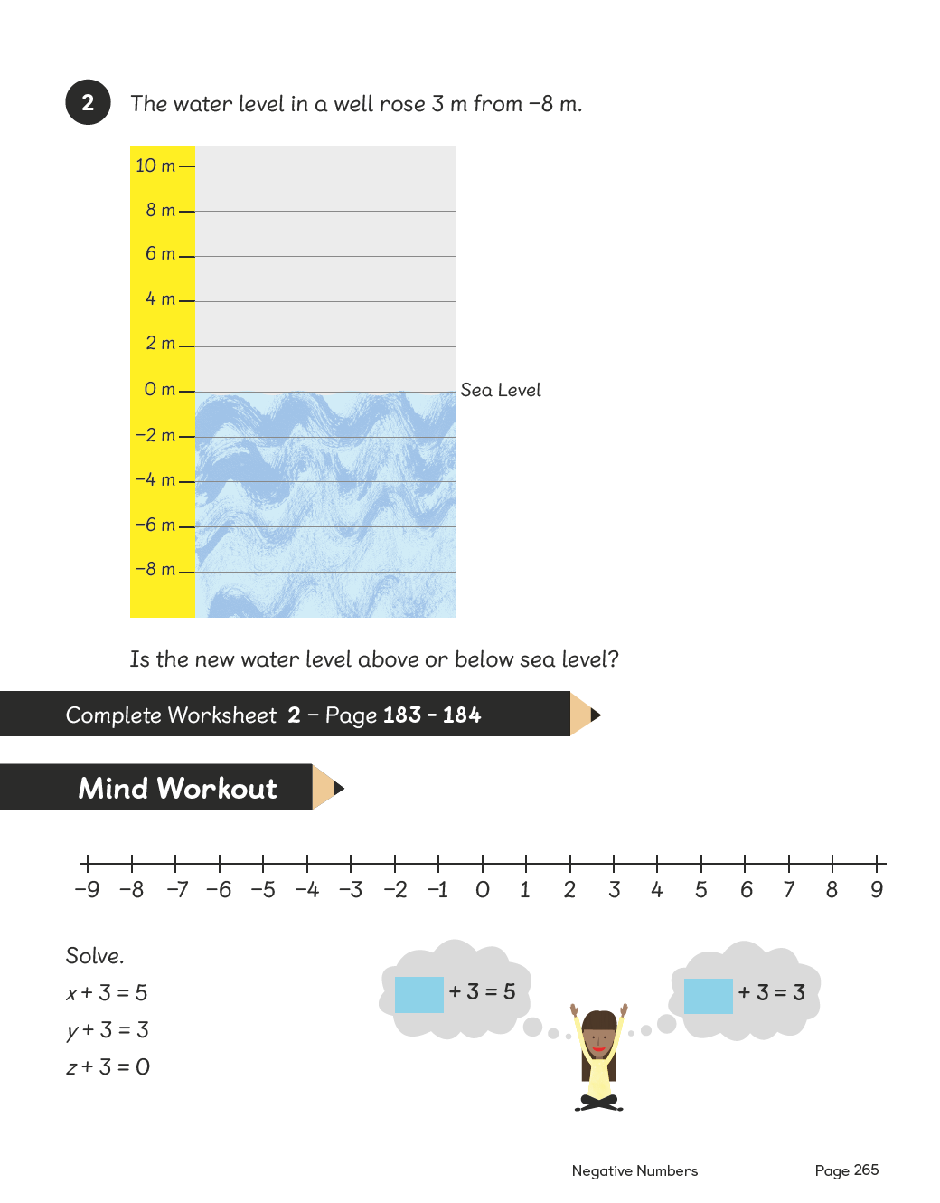

Slide 22
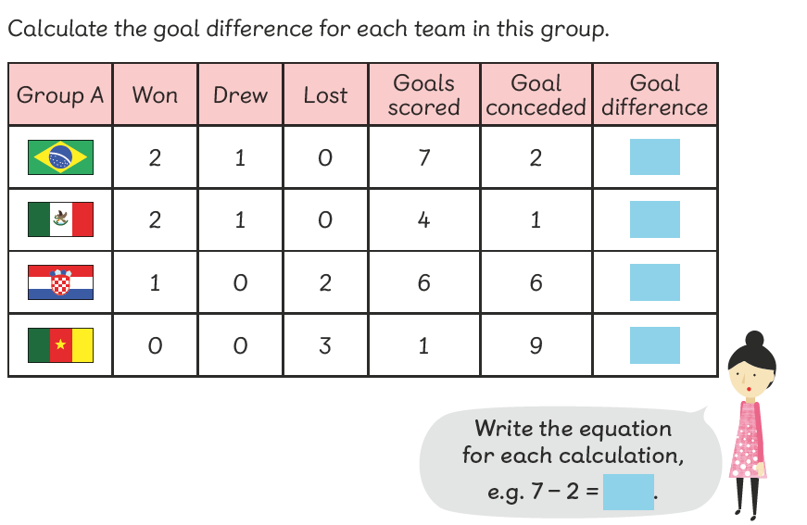

Slide 23
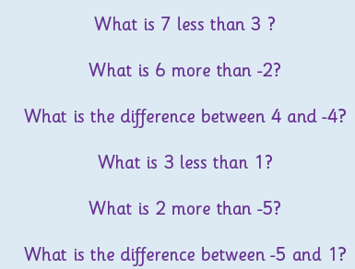
You do
Rosie has - £25.00 in her account.
She gets paid £30 on Monday.
How much money will she have on Monday?
Challenge
Tia has £15.50 in her bank account.
She buys some items which cost £35 altogether.
How much money is left in her account?

Slide 24
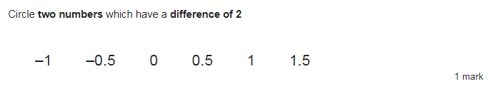
Plenary
Is there more than one answer?

Slide 25
LI: to add and subtract whole numbers

Slide 26
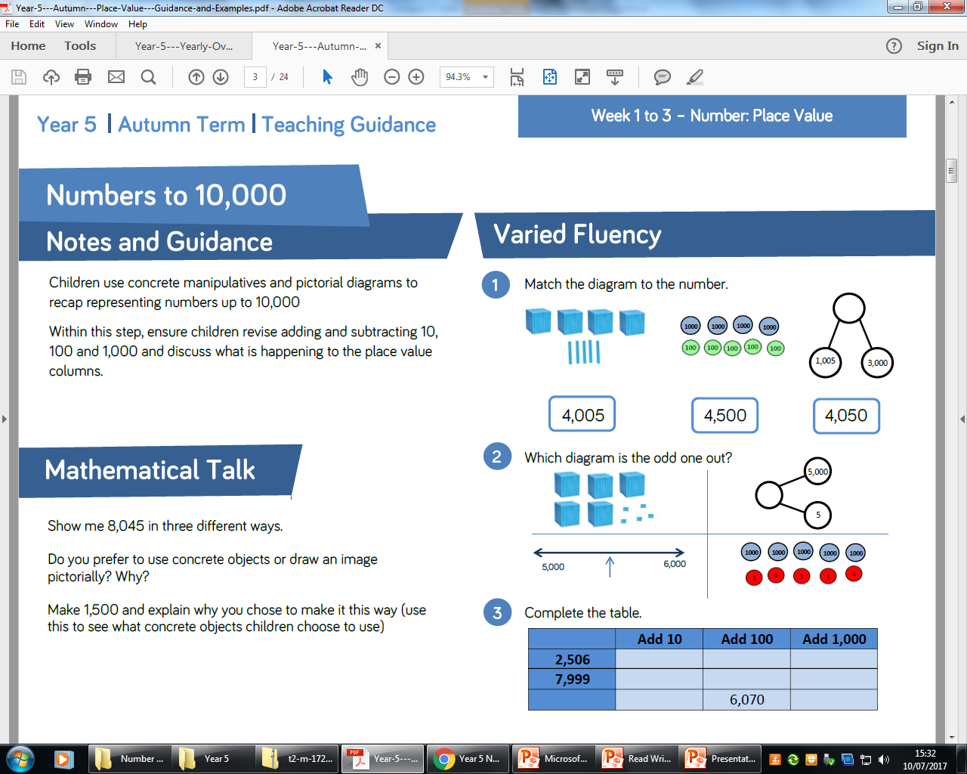
Talk partners
Notes:
Children use concrete manipulatives and pictorial diagrams to recap representing numbers up to 10,000 Within this step, ensure children revise adding and subtracting 10, 100 and 1,000 and discuss what is happening to the place value
columns.

Slide 27
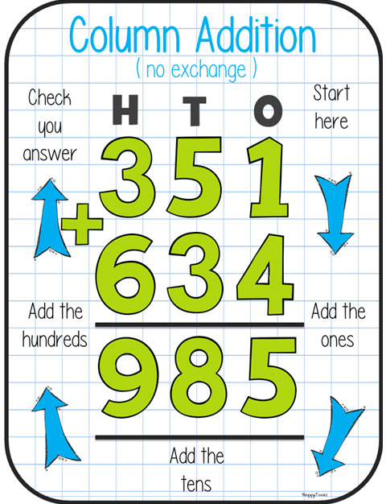
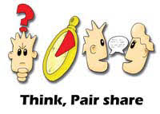
Written addition
What skills and knowledge do we need to apply?
When is it used in real life?
The skills we need are…
This is useful in real life when…

Slide 28
I do
Does it make a difference which way around the numbers are?
Why?
How can I check that my answer is correct?
836,235 + 33,615
912,234 + 24,567

Slide 29
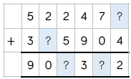
We do/Rally coach
Partner A
456,409 + 41,788 =
Partner B
345,806 + 16,884 =
Challenge

Slide 30
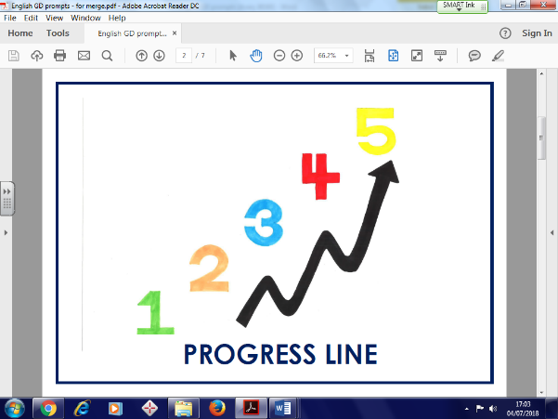
You do
Challenge
Convince me
Three four digit numbers
total 12435.
What could they be?
Applying the skill
Ken is playing a game. He has 4,289 points.
Then he scores another 355 points.
Ken’s target is 6,000 points.
How many more points does Ken need to reach his target?
602,597 + 339,784 =
378,920 + 587,499 =
942,381
966,419

Slide 31

Does it make a difference which way around the numbers are in subtraction?
I do
836,235 - 124,615
912,234 - 24,567

Slide 32
We do/Rally coach
Partner A
145,009 - 31,128 =
Partner B
345,806 - 26,244 =

Slide 33
You do
602,597 - 339,784 =
378,920 - 57,499 =

Slide 34
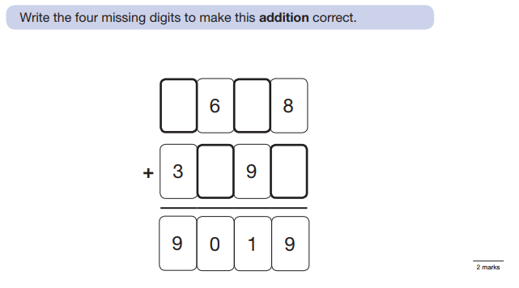
Mini-plenary

Slide 35
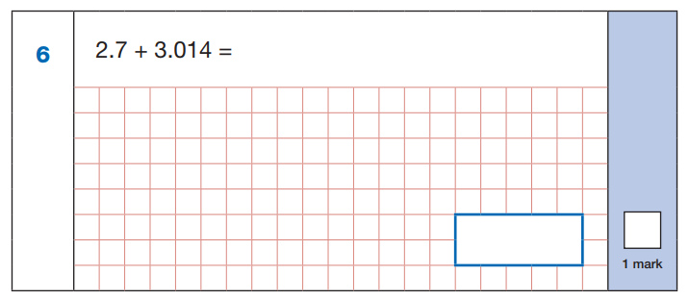
What is similar and different about this question?

Slide 36
LI: to use written methods to add and subtract decimal numbers.

Slide 37
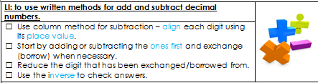

Slide 38
I do
4.25 + 3.009 =
315.7 – 5.228 =
How do I align the digits?

Slide 39
We/you do
58.5 – 32.07 =
85.009 + 7.6 =
305.39 – 87.087 =

Slide 40
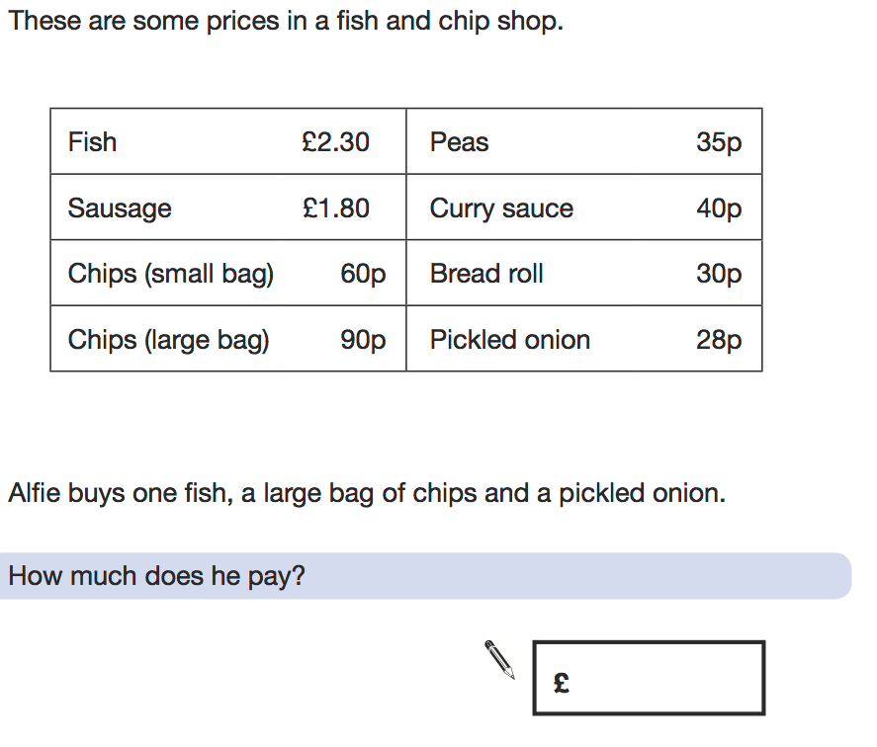
Mini-plenary

Slide 41
LI: to add and subtract whole numbers with up to 3 decimal places solving multi-step problems

Slide 42
Number sequences
1.42 1.46 ___ ___ 1.58
___ 0.98 ____ 1.02 1.04
-28 -22 ___ ___ -4 ___ ___
Challenge yourself

Slide 43
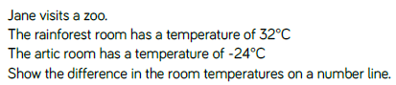
When counting forwards in tens from any positive one-digit number, the last digit never changes.
When counting backwards in tens from any positive one-digit number, the last digit does change.
Can you find examples to show this?
Explain why this happens.

Slide 44
Problem solving
There were 2 408 people on board a cruise ship. At the next port, it takes on 557 more passengers, but 379 people get off. How many passengers are on board the ship now?
If 658 of these passengers are children, how many adults are on board?

Slide 45


T model
Liam has two different sizes of rectangle.
He makes this pattern with them.

Slide 46
T model
A four bedroom house costs £450,000
A three bedroom house costs £199,000 less.
How much does the three bedroom house cost?
What method did you use to find the answer?

Slide 47
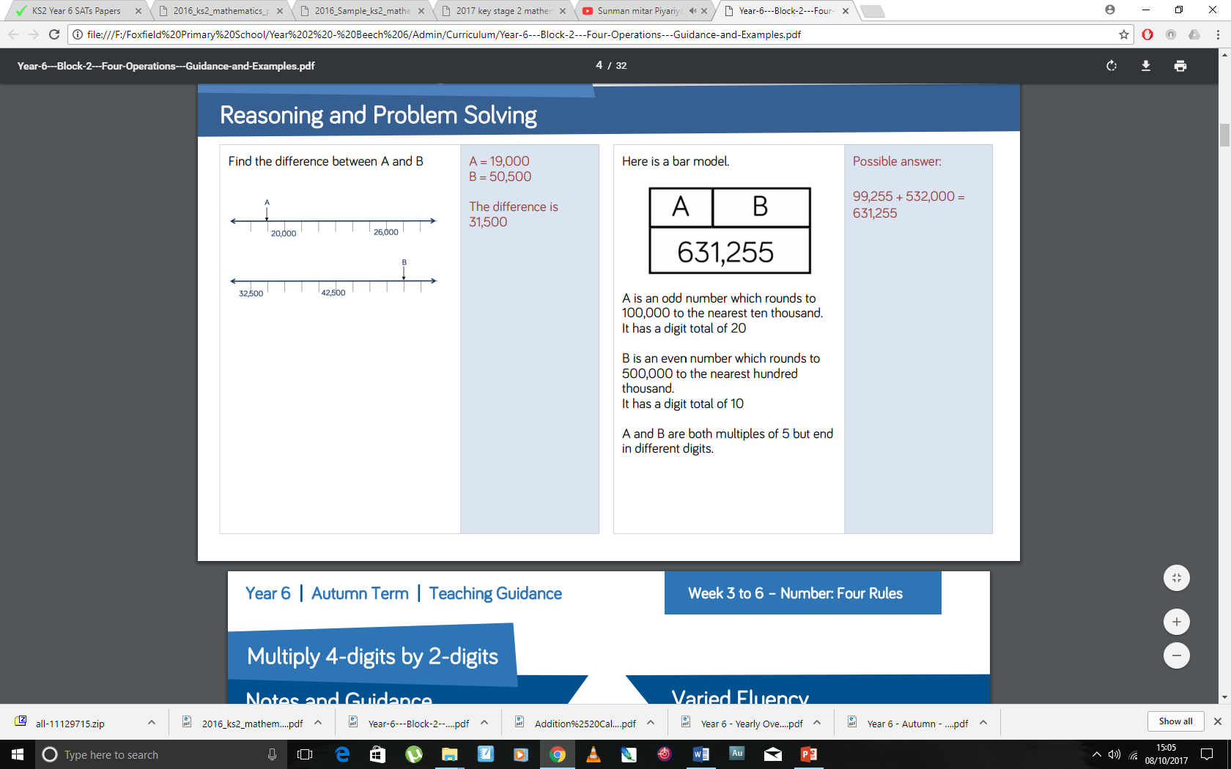
Plenary
30

