Slide 1
Whole Class Reading
- Clarifying
Day 1

Slide 2
LI: To clarify meanings to understand a text
STS:
Read the text in short excerpts, identifying new, difficult or unclear words or phrases.
Use different methods to clarify meaning, including making connections
To support and actively listen to others

Slide 3
Reading behaviours and strategies
Learning behaviours
These will help a reader engage with a text and read more independently.
Support and actively listen to others
Discuss and explain your ideas
Take responsibility for your own and your group’s learning
Reading strategies
These will help a reader get a deeper understanding of texts.
Predicting
Inferring
Asking questions
Evaluating
Clarifying
Making connections
Summarising

Slide 4
Support and actively listening to others
SUPPORT | ACTIVE LISTENING
Great reading, good thinking I like the way you… when you read You’ve really improved in… This is hard to think about. That’s a good way to think about it. Would you like to offer an opinion? Which strategy might help you here? | Good point / good idea Oh yes / no! That’s interesting, do you think so? I hadn’t thought of that point Can you explain further? Tell me more…

Slide 5
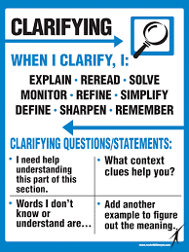
Clarifying
I think that means… I didn’t understand… What does […] mean? I need to reread this part because… […] is a tricky word so I need to… I didn’t understand […] so I could… Let’s reread this part because it didn’t make sense.

Slide 6
I DO…
There comes a time when we heed a certain call
When the world must come together as one
There are people dying
And it's time to lend a hand to life
The greatest gift of all
Sentence stems examples
I think that means… I didn’t get… so I … I didn’t understand the part where… This doesn’t make sense so I … This is a tricky word because… I can identify the root word…. so maybe it means… My partner thinks it might mean… and/but I agree/disagree
Notes:
Model using the toolkit created last lesson.
Read the text and highlighting the words you want to clarify (you can use the visualiser and underline the text if you wish).
Model how to clarify the meaning. Does the sentence as a whole help? Can you break the word down? What do I know already that can help me work it out? Can I use a dictionary?

Slide 7
WE DO…
Sentence stems examples
I think that means… I didn’t get… so I … I didn’t understand the part where… This doesn’t make sense so I … This is a tricky word because… I can identify the root word…. so maybe it means… My partner thinks it might mean… and/but I agree/disagree
We can't go on pretending day by day
That someone somewhere will soon make a change
We're all a part of God's great big family
And the truth, you know
Love is all we need
Notes:
As a class, discuss this part of the song.

Slide 8

YOU DO… Independent reading
Continue reading the song with your shoulder partner to the end.
Identify new, difficult or unclear words and phrases. Think about how you might clarify the meaning:
Read around the word, look at the context of the sentence/line as a whole
Break the word down into parts and think about the meaning of each part
Look in a dictionary
Make connections to what you know already
Notes:
Provide post it notes
Chn to write their ideas and clarification onto post-it notes.

Slide 9

Plenary
Let’s hear some of your ideas
Notes:
Using the sentence stems, share some ideas as a class

Slide 10
Whole Class Reading
- Inferring
Day 2

Slide 11
LI: to use clues to make inferences.
STS:
Look at the image and make inferences about the character, setting and mood.
Justify inference using evidence from the image
Discuss and explain your ideas to others

Slide 12
Reading behaviours and strategies
Learning behaviours
These will help a reader engage with a text and read more independently.
Support and actively listen to others
Discuss and explain your ideas
Take responsibility for your own and your group’s learning
Reading strategies
These will help a reader get a deeper understanding of texts.
Predicting
Inferring
Asking questions
Evaluating
Clarifying
Making connections
Summarising

Slide 13
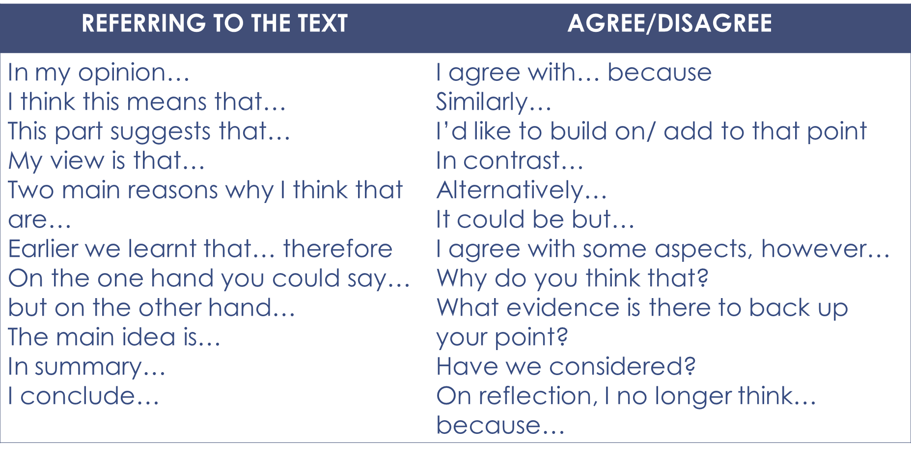
Discuss and explain your ideas

Slide 14
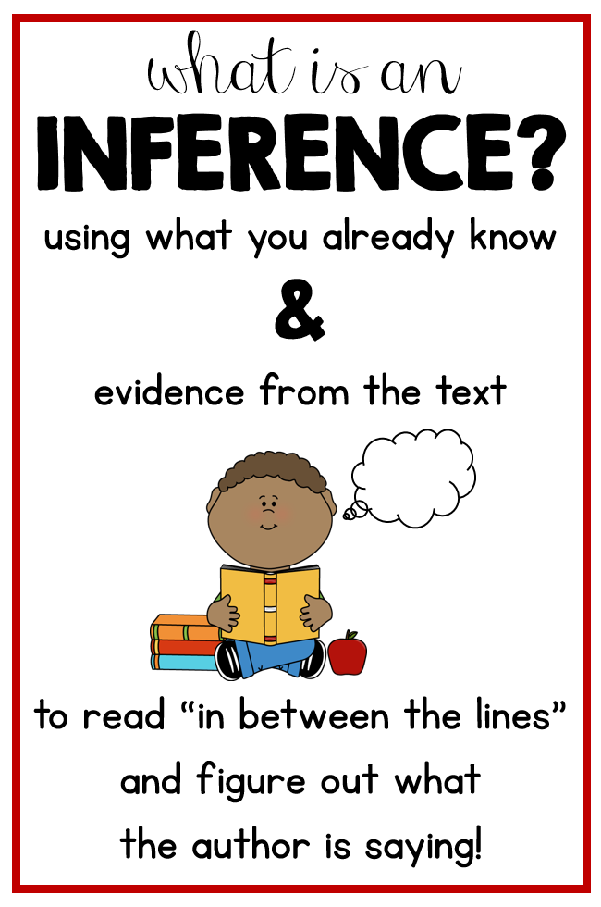
What does it mean to infer?

Slide 15
Inference
INFERENCE STEMS
The word ______ tells me that… The part ______ tells me that… This makes me think that… I think this character ________ I think the setting is…. I think the mood is... I think the writer’s viewpoint is… I think this character’s viewpoint is… | because…

Slide 16

I DO
Inference Stems
The word _____tells me that… The part ______ tells me that… This makes me think that… I think this songwriter ________ I think the setting is…. I think the mood is... I think the writer’s viewpoint is… I think this songwriter’s viewpoint is… | because…
There comes a time when we heed a certain call
When the world must come together as one
There are people dying
And it's time to lend a hand to life
The greatest gift of all
Notes:
THINK ALOUD – Teacher model

Slide 17
WE DO- Let’s infer together
Inference Stems
The word _____tells me that… The part ______ tells me that… This makes me think that… I think this songwriter ________ I think the setting is…. I think the mood is... I think the writer’s viewpoint is… I think this songwriter’s viewpoint is… | because…
We can't go on pretending day by day
That someone somewhere will soon make a change
We're all a part of God's great big family
And the truth, you know
Love is all we need
Notes:
TALK PARTNERS Using inferences Stems

Slide 18
YOU DO – Independent reading
Inference Stems
The word _____tells me that… The part ______ tells me that… This makes me think that… I think this songwriter _______ I think the setting is…. I think the mood is... I think the writer’s viewpoint is… I think this songwriter’s viewpoint is… | because…
Stop after each line and make inferences about the writer’s thoughts, feelings and motives behind action. Explain your reasoning using evidence from the text.
Notes:
Mixed ability partner reading with same text. Focus on use of oral strategies.

Slide 19

Plenary
Let’s discuss some inferences you have made with your partner.

Slide 20

Whole Class Reading
- Inferring
Day 3

Slide 21
LI: to use clues to make inferences.
STS:
Look at the image and make inferences about the character, setting and mood.
Justify inference using evidence from the image
Discuss and explain your ideas to others

Slide 22
Reading behaviours and strategies
Learning behaviours
These will help a reader engage with a text and read more independently.
Support and actively listen to others
Discuss and explain your ideas
Take responsibility for your own and your group’s learning
Reading strategies
These will help a reader get a deeper understanding of texts.
Predicting
Inferring
Asking questions
Evaluating
Clarifying
Making connections
Summarising

Slide 23
Inference
INFERENCE STEMS
The word ______ tells me that… The part ______ tells me that… This makes me think that… I think this character ________ I think the setting is…. I think the mood is... I think the writer’s viewpoint is… I think this character’s viewpoint is… | because…

Slide 24
I DO
Inference Stems
The word _____tells me that… The part ______ tells me that… This makes me think that… I think this songwriter ________ I think the setting is…. I think the mood is... I think the writer’s viewpoint is… I think this songwriter’s viewpoint is… | because…
I see trees of green
Red roses too
I see them bloom
For me and you
And I think to myself
What a wonderful world
Notes:
THINK ALOUD – Teacher model

Slide 25
WE DO- Let’s infer together
Inference Stems
The word _____tells me that… The part ______ tells me that… This makes me think that… I think this songwriter ________ I think the setting is…. I think the mood is... I think the writer’s viewpoint is… I think this songwriter’s viewpoint is… | because…
The colours of the rainbow
So pretty in the sky
Are also on the faces
Of people going by
I see friends shaking hands
Saying, "How do you do?"
They're really saying
"I love you"
Notes:
TALK PARTNERS Using inferences Stems

Slide 26
YOU DO – Independent reading
Inference Stems
The word _____tells me that… The part ______ tells me that… This makes me think that… I think this songwriter________ I think the setting is…. I think the mood is... I think the writer’s viewpoint is… I think this songwriter’s viewpoint is… | because…
Stop after each line and make inferences about the writer’s thoughts, feelings and motives behind action. Explain your reasoning using evidence from the text.
Notes:
Mixed ability partner reading with same text. Chn complete selfie’s in their books.

Slide 27
Plenary
Let’s discuss some inferences you have made with your partner.

Slide 28
Whole Class Reading
- Big Picture
Day 4

Slide 29
LI: to use clues to make inferences.
STS:
Look at the image and make inferences about the character, setting and mood.
Justify inference using evidence from the image
Discuss and explain your ideas to others

Slide 30
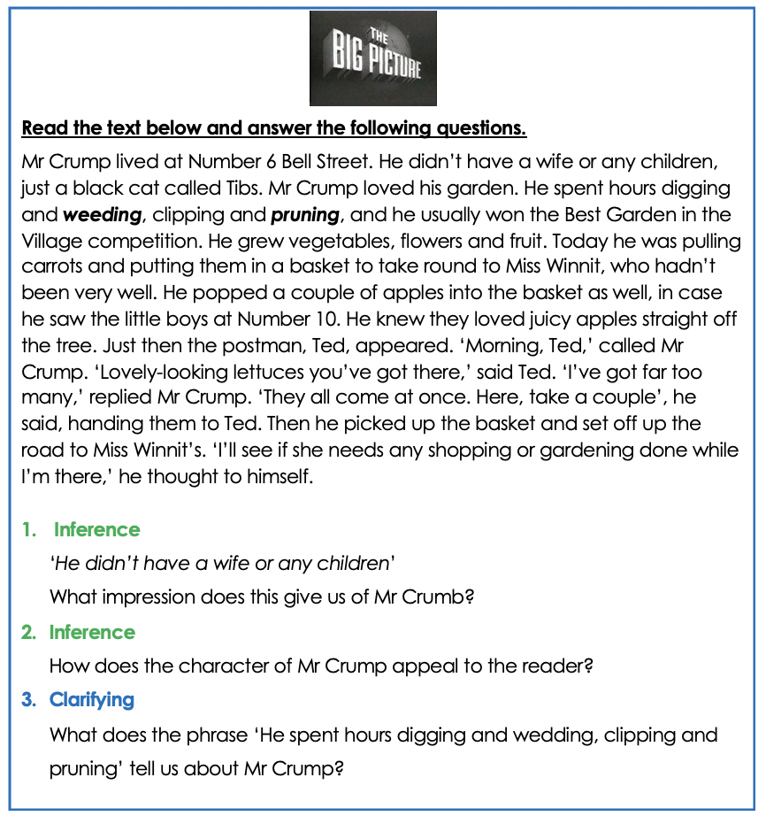

BIG PICTURE COMPRENSHION

