Slide 1

Curriculum

Slide 2

Your project this half term
You will create a spoken word or poem or rap in small groups.
We will be looking at:
What makes a good performance.
Looking at different genres of music.
Writing your own music.
Designing a background.
Practicing your performance and performing to an audience.
Evaluating.

Slide 3
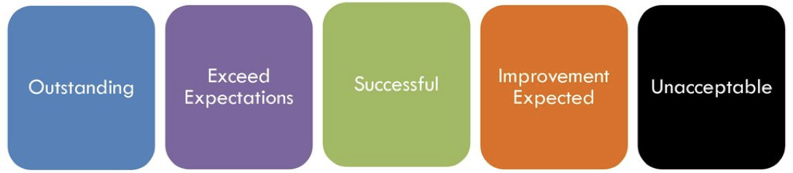
LI: to critique a visual stimulus
In today’s lesson we will watch a range of Spoken word performances and dance choreography.
We will then rate it explaining our opinions.

Slide 4




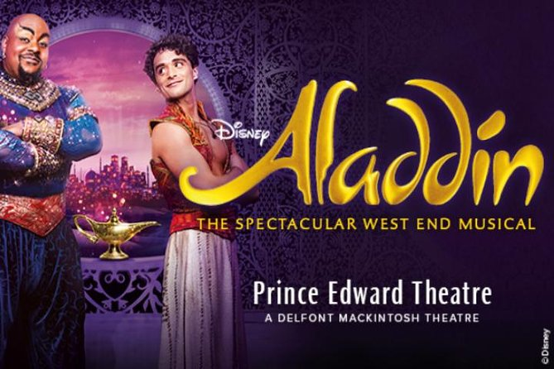


Notes:
Do you recognise any of these images?

Slide 5
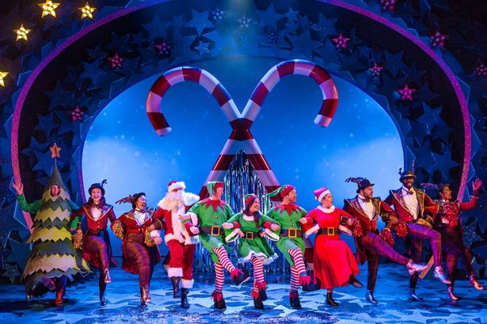
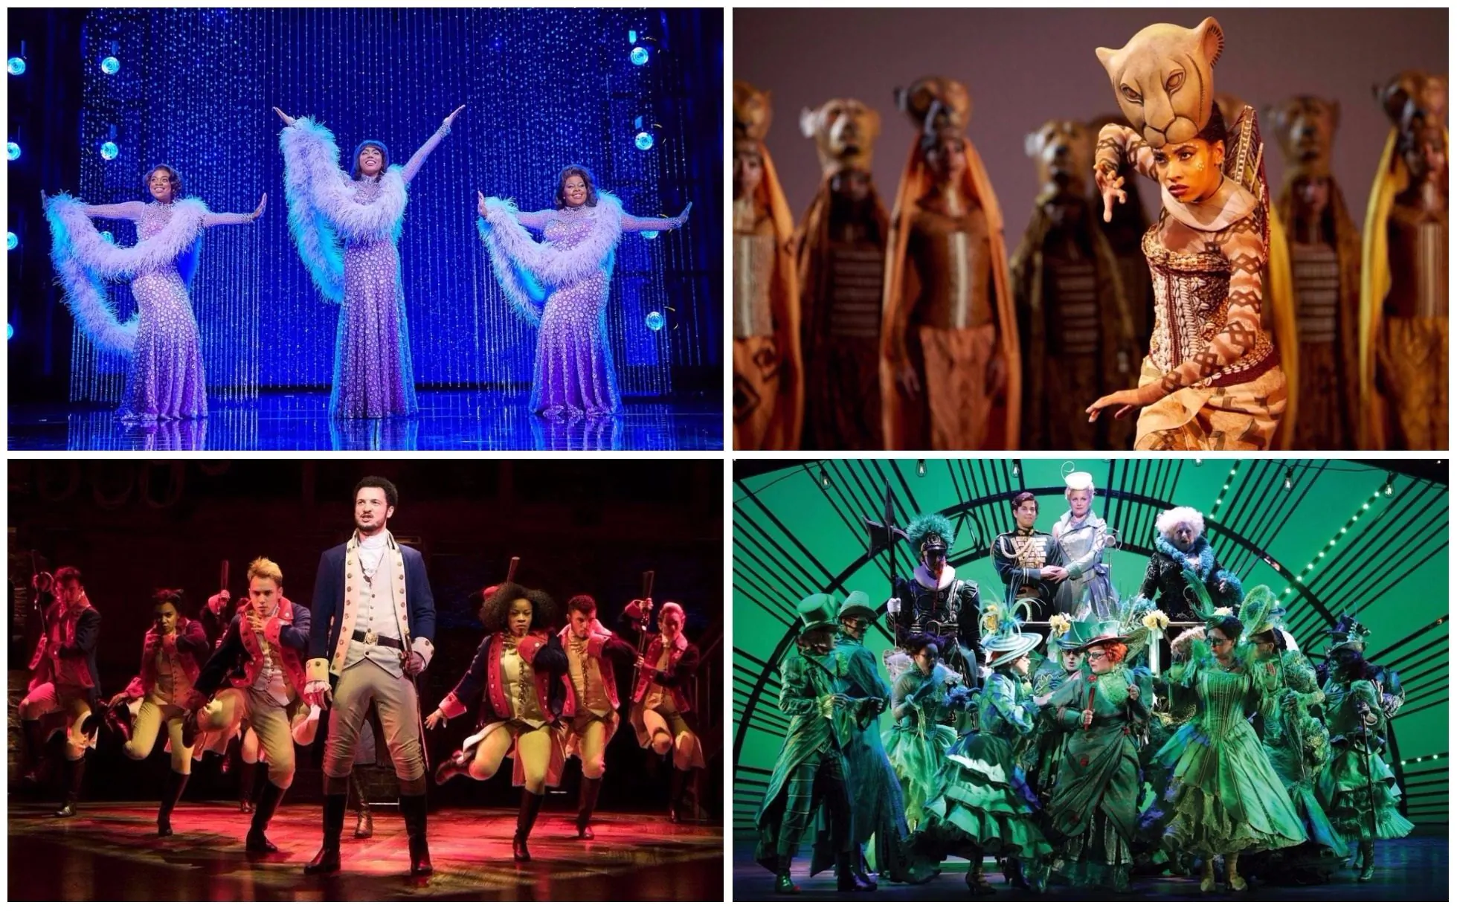

Have you been to any performances before such as pantomimes, shows, theatre ?
How does it feel being in the audience?
Did you enjoy it? Why ?
I think it is outstanding because of the way....
I think it exceeded my expectations because...
I think it was successful and not outstanding due to...
I think an improvement is expected because it did not...

Slide 6
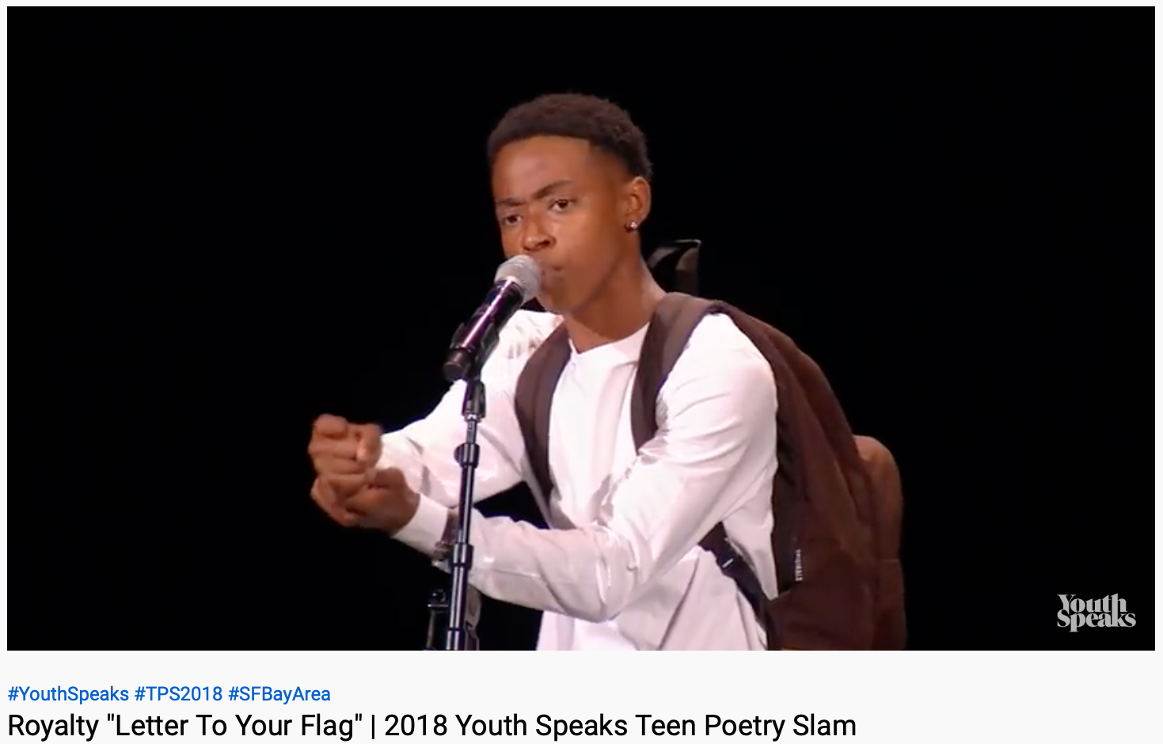
Let’s watch some performances
https://www.youtube.com/watch?v=lJBo9jdUJiY&t=15s
I think it is outstanding because of the way....
I think it exceeded my expectations because...
I think it was successful and not outstanding due to...
I think an improvement is expected because it did not...

Slide 7
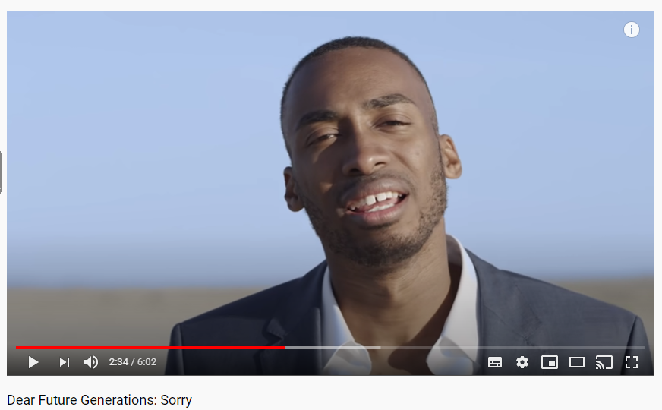
Let’s watch some performances
https://www.youtube.com/watch?v=eRLJscAlk1M
I think it is outstanding because of the way....
I think it exceeded my expectations because...
I think it was successful and not outstanding due to...
I think an improvement is expected because it did not...

Slide 8
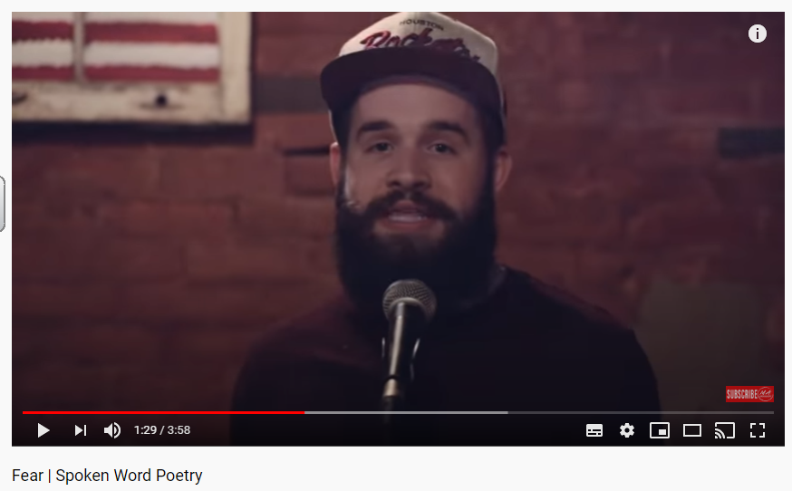
Let’s watch some performances
https://www.youtube.com/watch?v=IWw-B9_gAlw
I think it is outstanding because of the way....
I think it exceeded my expectations because...
I think it was successful and not outstanding due to...
I think an improvement is expected because it did not...

Slide 9
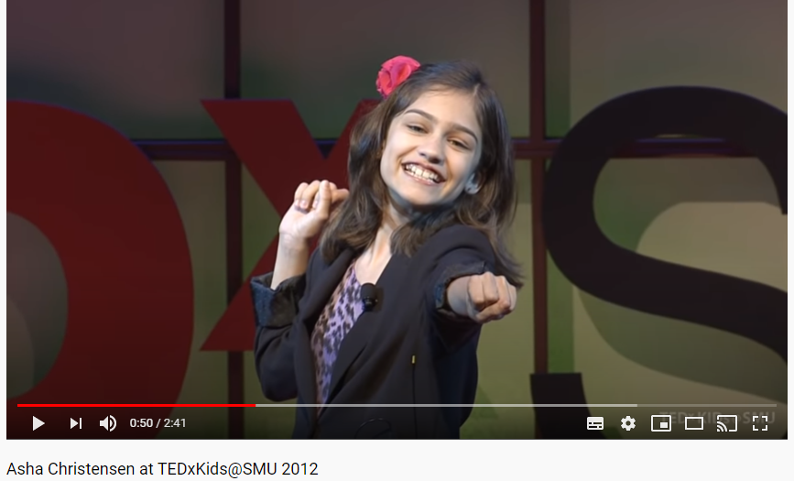
Let’s watch some performances
https://www.youtube.com/watch?v=rtnEnEqjk0E
I think it is outstanding because of the way....
I think it exceeded my expectations because...
I think it was successful and not outstanding due to...
I think an improvement is expected because it did not...

Slide 10
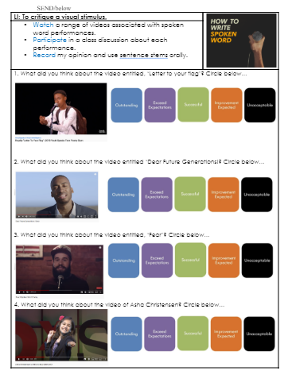
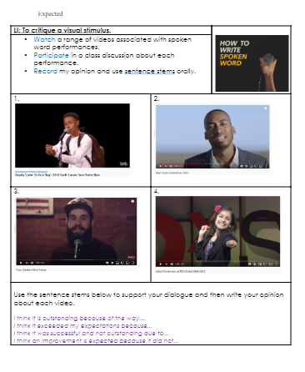
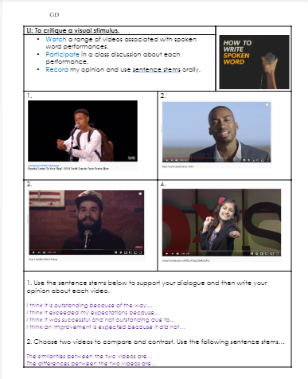
Remember to use the sentences stems and to write in full sentences.

