Slide 1

LI: TO REFLECT ON CRITICAL THINKING STEMS
Identify the importance of random acts of kindness in the world
Discuss why someone would carry out a random act of kindness
Reflect on the impact of such acts, especially in the current world situation

Slide 2
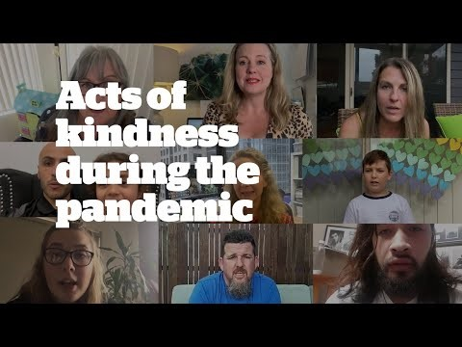
Watch the video think about why people are doing this and what impact it has on others.

Slide 3
You have question stems on the next few pages. Look through these stems and think carefully about how you would answer them appropriately.
“Why are people influenced by this?”
People are influenced by these random acts of kindness as they are a way of spreading joy and positivity in the world during these unprecedented times we are living through. Seeing that a small act can bring so much happiness can influence others to participate and carry on the trend to bring happiness in to other people’s lives.

Slide 4
In today’s lesson we would like you to create six questions about these Random Acts of Kindness and then answer those questions carefully. Thinking about the way you answer them. Look back at the example we have on here to help you ensure you are completing them well. Use the sentence stems on the next two pages and create one question from each colour.

Slide 5
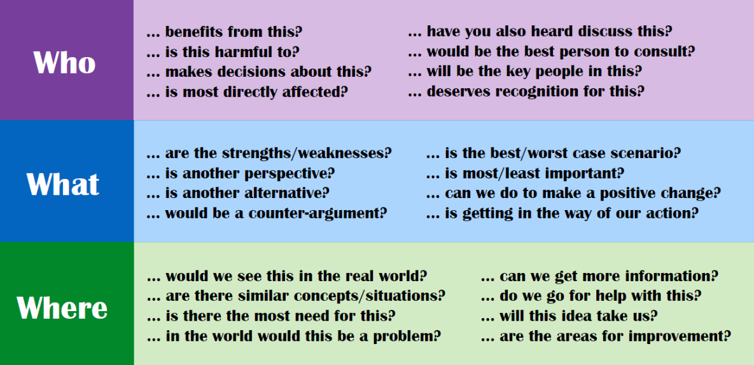

Slide 6
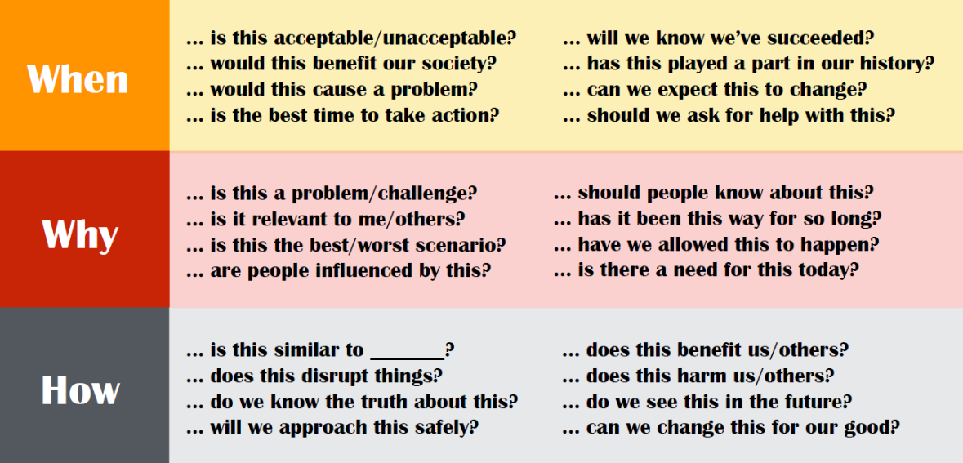
Notes:
After giving the children time to answer their questions now pick a few children and ask them the questions. As a class pick the answer apart and think critique appropriately.

Slide 7
Finally, answer these two questions to the best of your ability.
Why are random acts of kindness important in the world?
What are the effects of such acts?

Slide 8
Your completed work will have eight questions answered. Six you have created yourself and the two from the previous slide.

