Slide 1
LI: To infer meaning and comment on language choice
Ask appropriate open-ended questions.
Use the text to inform responses.
Infer and evaluate meaning from quotes using in the text.

Slide 2
What doe it mean to infer?
To come to a conclusion based on evidence available to you.
Today you are going to seek to infer why Charlie Mackesy has created certain sentences and why he has chosen the words that he has used.

Slide 3
“Isn’t it odd. We can only see our outsides, but nearly everything happens on the inside.”
Here, I think the author is trying to tell us that even though the outside appearance is what we see, it isn’t a true reflection of a person, as it is what is on the inside that counts. I think this because when we experience a feeling or a thought it is an internal process and is something that cannot be seen by ourselves or others. It can be inferred that this thought amazes/baffles the narrator from the word(s) “isn’t it odd”.

Slide 4
The writer has used some brilliant sentence stems in this work
Your task today is to pick three of the sentences from the book, on the next page, then explain why the author has written that sentence and infer what he means by it.
Also think carefully about the language he has used and what emotions it brings out for you.

Slide 5
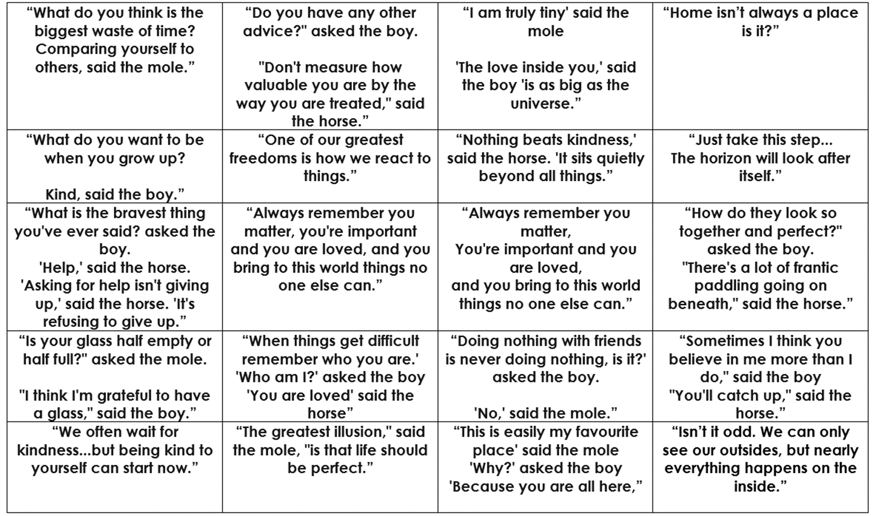

Slide 6
Once you have completed three paragraphs, one for each different sentence, answer these two questions to complete your work.
Why do we ask questions?
Why does the author purposely leave the reader with lots of unanswered questions?
Your completed work should include three paragraphs from the sentences on your page and answers for both of the questions above.

