Slide 1
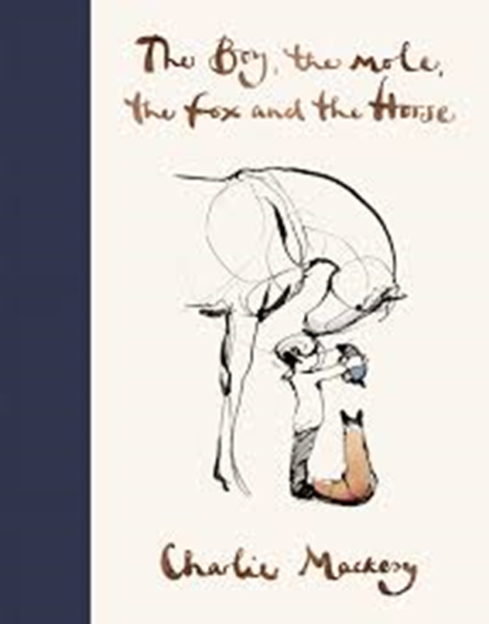
LI: to identify and analyse the language features of poetry
A brief look at structure
A longer focus on language features

Slide 2
The structure of a poem
There are many different ways to structure poetry, but there are some common elements that are usually placed into poems.
These can be:
Meter, which is the rhythm pattern;
Feet, which are patterns in lines of poetry;
Stanzas, which represent a group of lines with correlating themes.
However, our main focus is free verse and structure is rarely important....

Slide 3
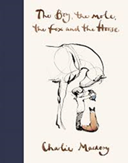
Free Verse
Free verse is an open form, which means it has no predetermined structure and no prescribed length.
Since there's no rhyme scheme and no set metrical pattern, there are no specific rules for line breaks or stanza divisions.
Poems tends to follow the rhythm of natural speech.

Slide 4
Language features of free verse poetry
Language features are a different matter to the lack of prescribed structure, mainly because poets who write free verse will use all the language tools they can lay their hands on.
The main ones are:
Repetition (often with variation)
Patterns of stressed and unstressed syllables (referred to as blank verse)
Alliteration (the same letter or sound at the beginning of adjacent or closely connected words)
Occasional internal rhyme (rhyme occurring inside a line)
Occasional rhyme at the ends of lines (words rhyming with previous line ends)
Patterns of assonance (syllables in which the vowel sounds are the same)
Imagery and figurative language by the tonne!

Slide 5
Writing Free Verse
Free verse is one of the simplest, and yet most difficult, type of poetry to write.
While it doesn’t constrict the poet with rules about form, it requires him or her to work hard at creating a piece that is beautiful and meaningful without any specific guidelines about rhyme and meter.
We will not dwell on every language feature mentioned in the previous slide, but we will have a look at a few that might help you when writing your own poems.
These are tips, not rules!

Slide 6
Alliteration
You can use alliteration in free verse to create a particular mood, feeling, or sound to the poem, especially when combined with careful word choice. For example, the word “licking” forces your tongue to the front of your mouth when you say it, like a lick!
Here is an example of how this might work:
Summer Lollipop
Licking a lolly slowly,
sunlight lapping at the lazy lake.
Lovely evening,
lovely lolly,
lazy life.

Slide 7
Figurative Language
Hopefully you won’t need to be reminded too much of the types of figurative language you have covered and what the terms mean. However, here is a list:
Metaphor/Simile/idiom/Onomatopoeia/Personification and Hyperbole.
We use figurative language to create an image or a sound experience that will bring a piece of writing to life.
Let’s look at personification, because this one could be useful….

Slide 8
Personification
Sometimes giving an inanimate object human characteristics can breath new life into it. (See, I just did it!) Have you ever heard someone say that the sun was peeking out from somewhere, or that the clouds were lazy, or the water licked the shore? That’s personification.
Let’s try it here:
Night crept in,
slow and smooth.
It smothered the city
in darkness.
Lights in windows
of tall buildings blinked,
One. Two. Again.
And opened
their bright eyes.
The night takes on the persona of a thief creeping through the darkness, and the lights blink their eyes. There are two different personifications working in this poem, bringing it to life.

Slide 9
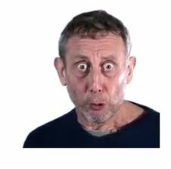
In the next lesson….
You will be generating language for your own poems!

