Slide 1

Year 6 School Journey to Magdalen Farm,
Winsham, Maudlin
Chard, Somerset TA20 4PA
1st - 3rd November 2022

Slide 2
Departure- Tuesday 1st November 2022
Children to arrive at school by 7:30am (with a packed lunch- this will be provided by the school kitchen if your child is eligible for FSM)
LFD tests to be completed in school by every child (with parent supervision) and any medication handed over to staff to be stored securely
Coach will depart at 8:15am
Journey to Magdalen Farm will take between 3 1/2 and 4 hours
Expected arrival time between 12:00 and 1:00pm

Slide 3
Return – Thursday 3rd November 2022
Coach will leave Magdalen Farm after lunch at 12:45pm
Children are expected to return between 5:00 and 6:00pm. If the coach is delayed due to traffic we will keep parents informed via Teachers2Parents text messages.

Slide 4
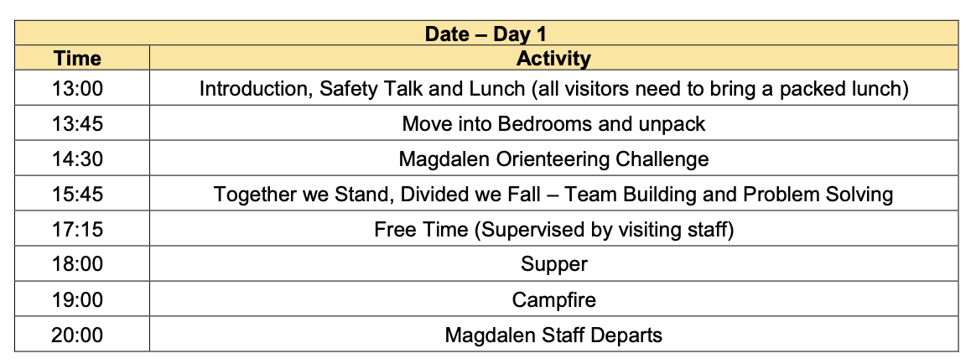
Example Itinerary - Day 1

Slide 5
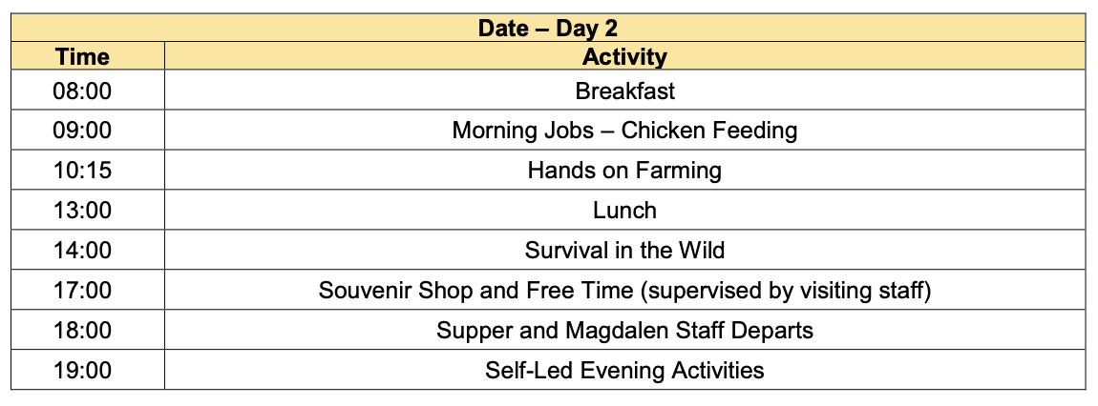
Day 2

Slide 6
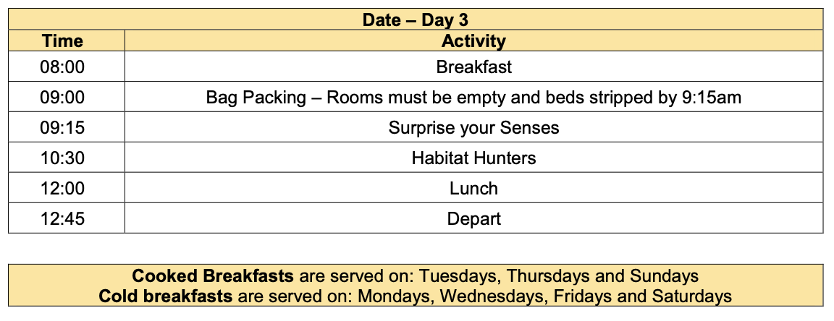
Day 3

Slide 7
Accommodation Rules
No food or drink to be consumed in bedrooms
Mobile phones and electronic devices are not permitted

Slide 8
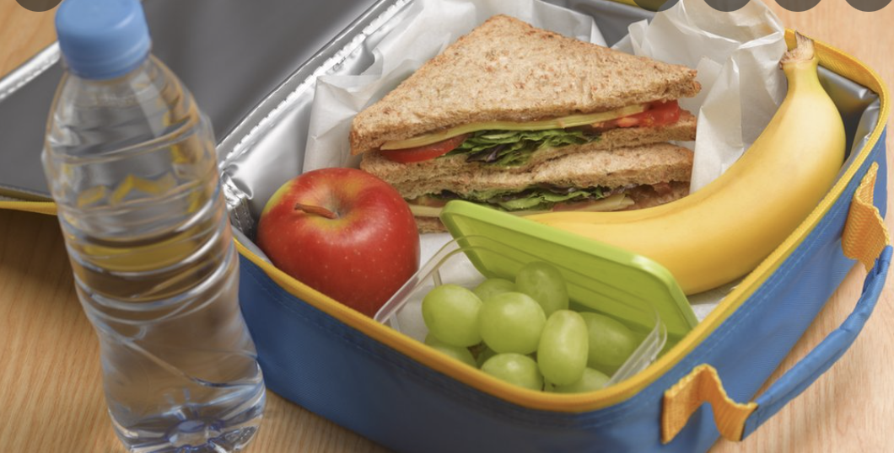
Please pack a healthy packed lunch for the first day.
Please ensure that your child has a healthy and energy filled packed lunch along with a refillable water bottle for the first day of their visit unless you are advised otherwise. Please do NOT include any nut items as Magdalen has a no nuts policy.

Slide 9

An example menu – Day 1
Lunch
Please bring a packed lunch with you.
Dinner
Option 1: Pigsty pie - organic Magdalen pork topped with rooty mash, with pickled red cabbage and greens from the garden
Option 2: Veg patch pie topped with rooty mash, with pickled red cabbage and greens from the garden Pudding: Jam roly-poly and custard

Slide 10
Day 2
Breakfast
Scrambled eggs and home-made baked beans, cereals, toast and preserves
Lunch
Option 1: Magdalen organic pork and apple burger in a bun with home-made ketchup, carrot and cucumber sticks
Option 2: Veggie burger in a bun with home-made ketchup, carrot and cucumber sticks
Dinner
Option 1: Mag ‘n’ cheese: macaroni cheese, magdalen style, with salad Option 2: Baked potato with mixed bean chilli, cheese, coleslaw and salad Pudding: Dorset apple cake and cream

Slide 11
Day 3
Breakfast
Cereals, toast and preserves
Lunch
Tomato soup and cheesy muffin

Slide 12

Can Magdalen cater for any special diets?
Menu choices reflect many different dietary requirements however our cooks can cater for any special dietary requirements providing we receive this information from school staff at least two weeks prior to any stay. Dietary requirements include vegetarians, vegans, those with allergies, faith related requirements such as pork free diets, and those requiring wheat or dairy free diets etc.

Slide 13
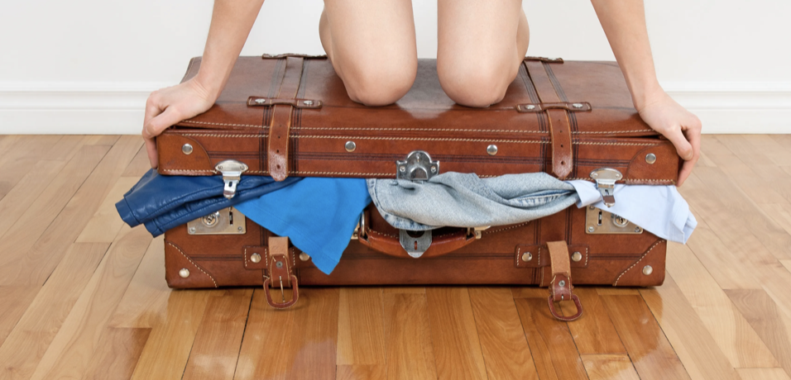
What should I pack?
A good waterproof jacket – large enough to fit over several layers of clothing
Waterproof over trousers- check Lidl!
Wellington boots or walking boots with thick socks
Water bottle labelled with child’s name
Warm hat e.g. woolly hat
Warm gloves

Slide 14
What should I pack?
Plenty of layers of warm, comfortable old clothing (jeans are not good for outdoor activities as they do not dry quickly), non-cotton tracksuit type clothing is best. Clothing that can be worn in many layers is much more flexible and allows adjustment to the weather and conditions.
Thick socks (including a long thick pair to wear with Wellingtons)
Underwear (plus spares!)
Pyjamas
Backpack (for packed lunch on first day, clip boards etc)

Slide 15
What should I pack?
Outdoor shoes such as trainers (designated to only be worn outside the building) – These are ESSENTIAL if your group will be doing the Low Ropes Challenge Activity (wellies and converse-style canvas trainers are not suitable)
Indoor shoes such as slippers or trainers (designated to only be worn inside the building)
Trainers or shoes to wear on the coach
Warm coat (If waterproof jacket is a thin material)
Towel and wash kit with toothbrush and toothpaste

Slide 16
What should I pack?
Torch and spare batteries
Camera (optional)
A card game or book for quiet time e.g. top trumps- no electronic devices please
Three spare plastic bags to take home dirty laundry, muddy waterproofs and muddy wellies
Teddy bear!
NB Mobile phones are not permitted

Slide 17

Will my child be able to take regular medication?
Please discuss any medical requirements with school staff before the trip. Only staff under parental instruction can administer medication and Magdalen will provide a secure storage location and fridges if required. It is a good idea that you check your child’s tetanus is up to date.
Please bring your child’s medication in the original packaging with your child’s name clearly labelled.

Slide 18
What happens if my child is ill before or during a visit?
We also ask that you do not send any children to Magdalen if they have had sickness or diarrhoea within 48 hours of Tuesday 1st November 2022. Should a child have sickness or diarrhoea during their stay, parents will be expected to collect them from Magdalen Farm.
In the unlikely event of your child falling ill or has an accident during their stay, school staff will contact you to discuss any action. Please ensure that we have your latest contact details on the form sent home this week.

Slide 19
How to pay via Parent Pay
Login to your Arbor account.
Select your child’s name.
You can select to pay the whole amount or an instalment.
There will be boxes to complete like permission and emergency contact details to name a few.

Slide 20
Please speak to Mrs Dennis, Mrs Open or Mrs Coombs if you have any questions or queries about the trip.
Thank you

