Slide 1
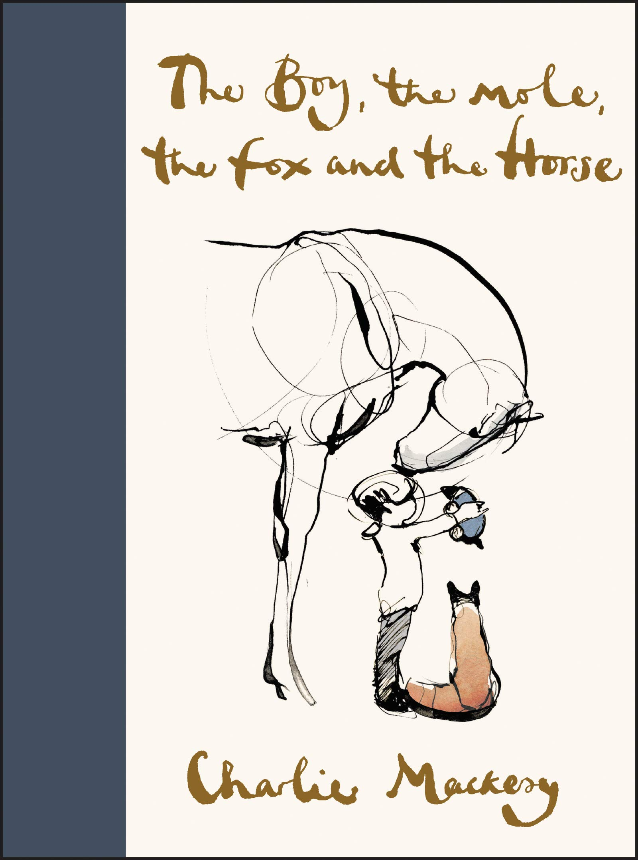
We are using sketching techniques to create an observational Drawing

Slide 2
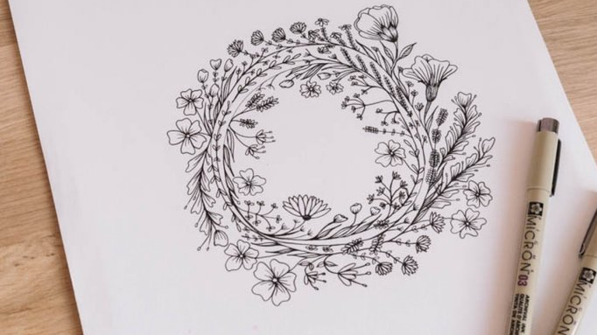
Grab a pencil
What is Line Art Drawing?
Line art is defined as the act of creating an illustration using basic strokes of varying weights and angles that demonstrate form and depth. It does not include shading or gradient, and instead, focuses solely on lines.
However, you shouldn’t think of lines simply as marks that connect point A to point B; lines can be two dimensional, three dimensional, abstract, descriptive, or implied (1). In addition, line drawings can include straight lines or curved lines, thick lines or narrow lines; they can be light and sketchy or thick and deliberate. Ultimately, that means that while line art involves fundamental techniques, it can be a powerful expression of creativity.

Slide 3
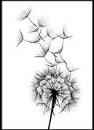
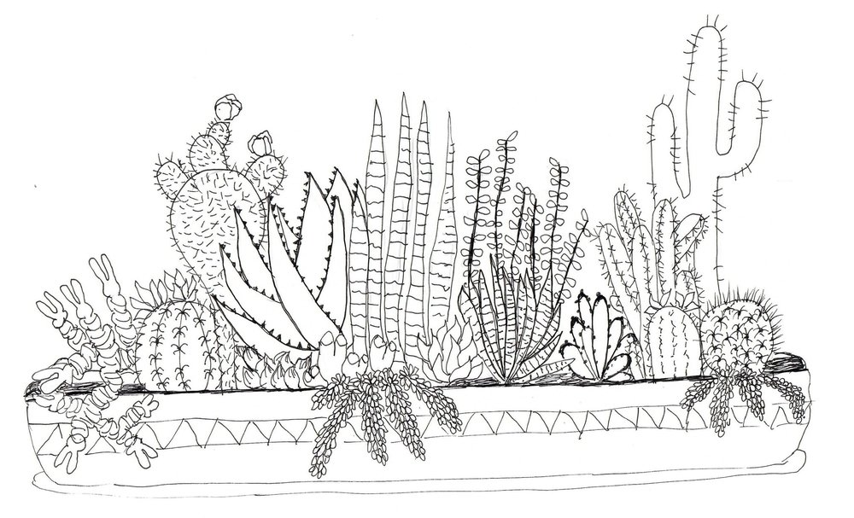
Artist Jen Dixon adds, “Every human has Doubt in recognizing their own ways of line drawing … just as important as any other artist, famous or not. Your line matters.”

Slide 4
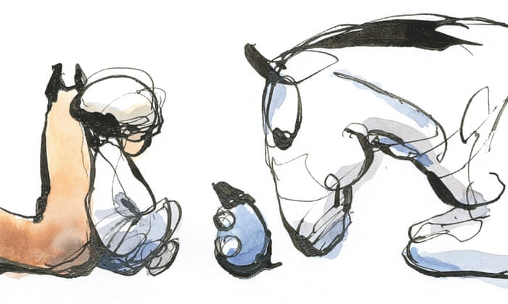
Choose one of the animals from our English learning journey book to create an observational line drawing

Slide 5
Common techniques for line drawing used in observational drawings include:
Small dashes hatching (long, parallel lines on an angle) cross-hatching (parallel lines at right angles) stippling (dots) scribbles small crosses small circles

Slide 6
Lets watch a video to learn more about line drawing techniques
https://youtu.be/Ha1sLn3jvaQ

Slide 7
Now in the style of Mackesy choose an animal from the story and sketch the outline.
Follow the techniques above and the tips from the video.
Do not use shading or different colours at this stage.
Remember, your lines matter!

