Slide 1
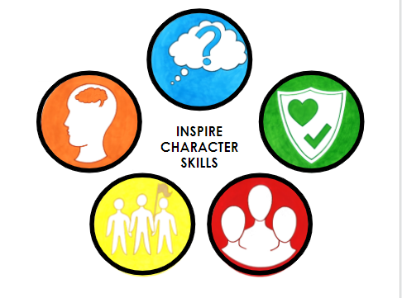

Slide 2


https://www.youtube.com/watch?v=O5oZ-P1yH7M
Attitude
Demonstrate loyalty to themselves and others
Consistently demonstrate an understanding of what is right
Honesty
Own up to mistakes
Speak the truth, even when it is difficult
Pride
Explain and demonstrate what is important to them
Recognise and celebrate their own achievements confidently
Reflective
Recognise the impact their choices have on themselves, others and the world
Identify their own strengths and next steps
Integrity

Slide 3

Drive
Set goals and plan ways to achieve them
Enjoy meeting challenges for their own sake and not for external rewards or praise
Curiosity
Explore different perspectives and ideas
Feel confident to say ‘I don’t know’ and seek solutions
Questioning
Feel confident to ask questions
Ask purposeful questions (How, What, When, Where, Why)
Researching
Answer or solve problems in a systematic way
Seek solutions using a range of sources
Critical Thinking
Making connections
Determine the importance and relevance of ideas
Wonder

Slide 4

Aspiration
Set ambitious and achievable goals
Show a desire and commitment to meet their goals
Problem Solving
Identify a problem and possible solutions
Review how well their strategy worked and change their strategy as needed
Decision Making
Identify when a decision needs to be made
Evaluate and reflect on possible options
Respect
Consistently value the ideas, opinions and feelings of others
Be aware of and care for others, their environment, and the world around them
Organisation
Look after their belongings and their environment
Think and plan ahead for possible outcomes
Leadership

Slide 5

Collaboration
Be receptive to the ideas and preferences of others
Work together to achieve a common goal
Communication
Listen to others and respond appropriately
Speak confidently when sharing their ideas, opinions and feelings with others
Empathy
Be aware of and understand the feelings and emotions of others
View a situation from the perspective of others
Kindness
Show consideration for others
Look for ways to promote peace
Sharing
Put the needs and wants of others before their own
Negotiate with others to reach a compromise
Relationships

Slide 6

Watch video:
https://www.youtube.com/watch?v=vRQkxeBDEF0
Adaptability
Respond appropriately to changes in their routines
Apply skills and strategies to a range of situations
Effort
Persist with an activity even when challenges occur
Maintain focus and high levels of energy for a period of time
Motivation
Set high expectations for themselves
Meet challenges for their own sake and take pride in their accomplishments
Reflective
Review how well their approach worked
Identify next steps and appropriate strategies to achieve them
Resilience
Recognise the value of challenge
Bounce back after difficulties
Mindset

