Slide 1
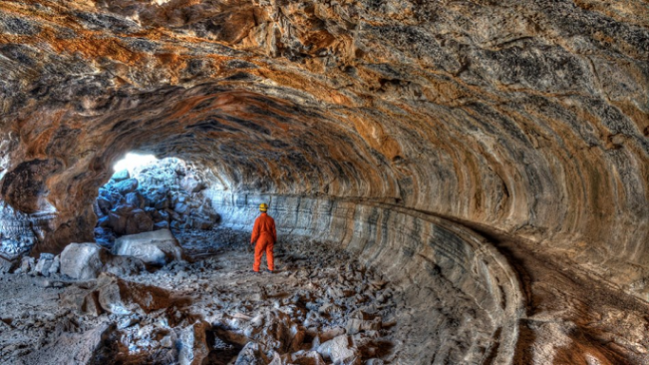
Are you ready to become geologists today?
Notes:
Geologists are scientists who study rocks.

Slide 2
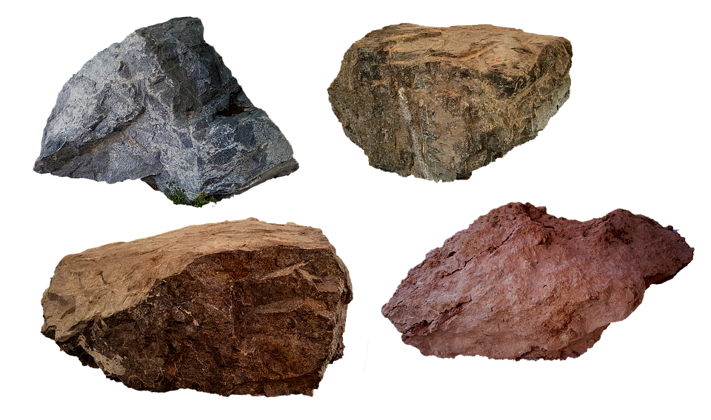
What are rocks and where do they come from?
Stems
I think rocks come from....
I agree, but…
That’s a good point!
I disagree, maybe…
Notes:
Think about where rocks come from and what they actually are.

Slide 3
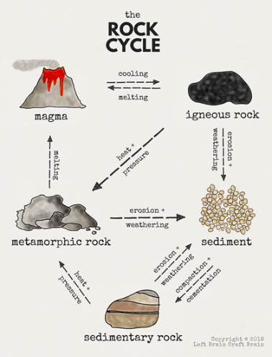
How are rocks formed?
Rocks are constantly changing in what is called the rock cycle. It takes millions of years for rocks to change.
Here is an example of the rock cycle describing how a rock can change from igneous to sedimentary to metamorphic over time.
Notes:
1. Melted rock or magma is sent to the earth's surface by a volcano. It cools and forms an igneous rock.
2. Next the weather, or a river, and other events will slowly break up this rock into small pieces of sediment.
3. As sediment builds up and hardens over years, a sedimentary rock is formed.
4. Slowly this sediment rock will get covered with other rocks and end up deep in the Earth's crust.
5. When the pressure and heat get high enough, the sedimentary rock will change into a metamorphic rock and the cycle will start over again.

Slide 4
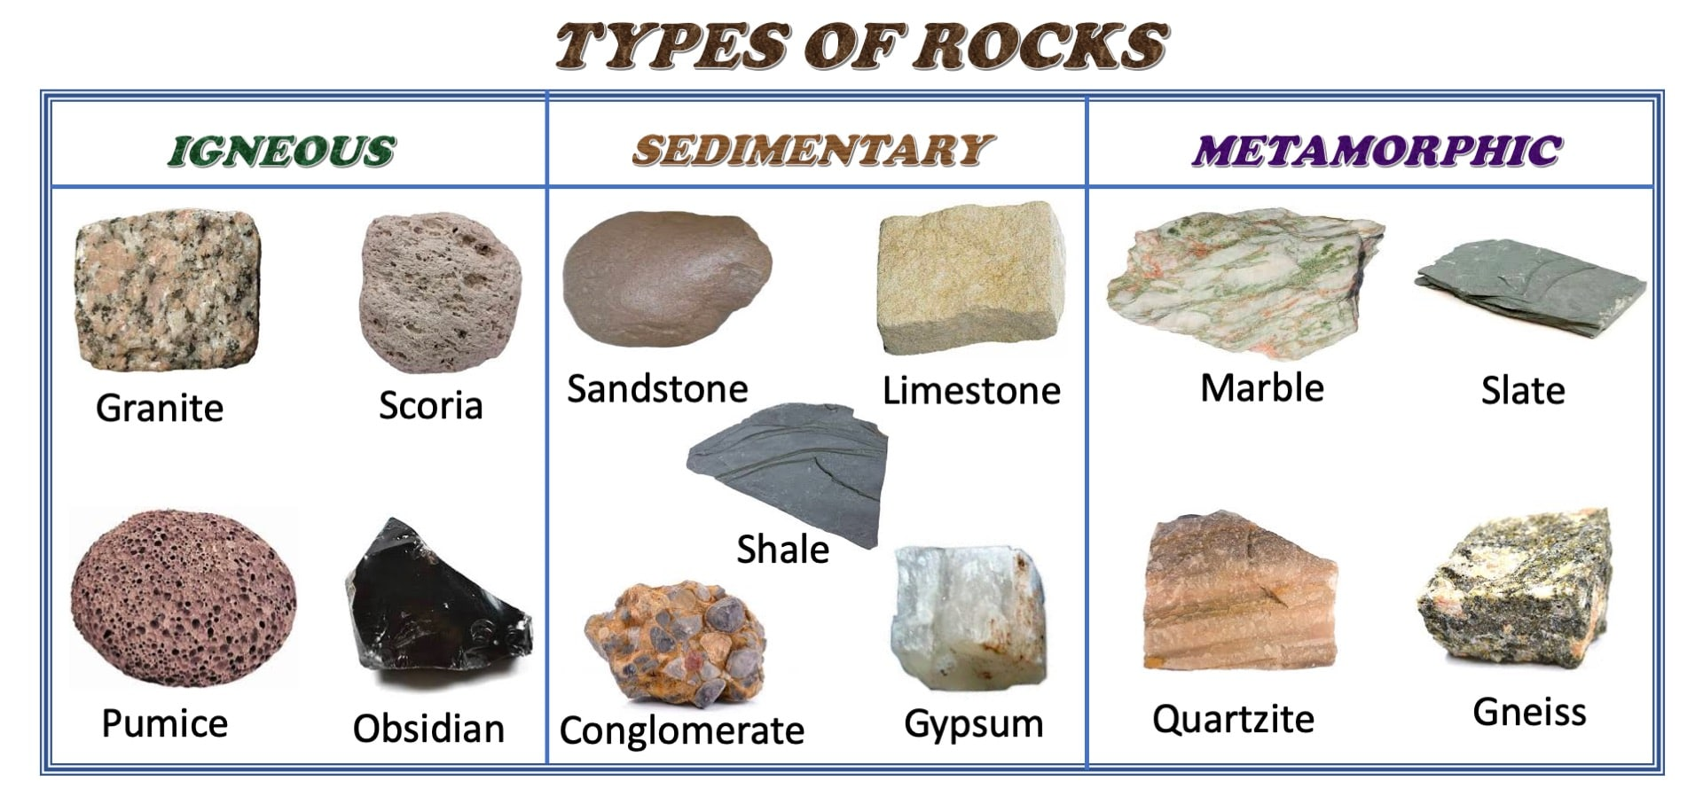
There are 3 types of rocks
Igneous rocks
This type of rock is made from lava of a volcano. Deep inside the earth, rocks are melted and become magma. When magma comes out of the volcano, it is called lava. If the lava cools quickly, it will make a smooth shiny rock. If the lava cools slowly, it will form a rock with tiny holes and gas bubbles in.

Slide 5
There are 3 types of rocks
Sedimentary rocks
This type of rock is made out of sand, shells, pebbles and other materials, which we call sediment. Slowly the sediment gathers up in layers, usually at the bottom of lakes and oceans, and is then compressed over thousands of years. Over time it turns into rocks! Fossils are usually found in this type of rock.

Slide 6
There are 3 types of rocks
Metamorphic rocks
The conditions required to form a metamorphic rock are very specific. The existing rock must be exposed to high heat, high pressure, or to a hot, mineral-rich fluid. These conditions are most often found either deep in Earth’s crust or at plate boundaries where tectonic plates collide. In order to create metamorphic rock, it is vital that the existing rock remain solid and not melt. If there is too much heat or pressure, the rock will melt and become magma. This will result in the formation of an igneous rock, not a metamorphic rock.
Notes:
What are tectonic plates?
Tectonic plates are pieces of land that connect together on the Earth's outer shell. You can think of them like a giant round puzzle that cover Earth underneath the ground. These pieces bump together and move, even though it is only a couple of centimeters a year.

Slide 7
Now we’re going to make our own rocks...

Slide 8

Now we’re going to make our own rocks...
using chocolate!!!

Slide 9


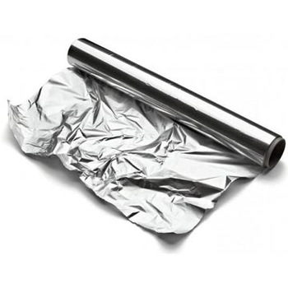
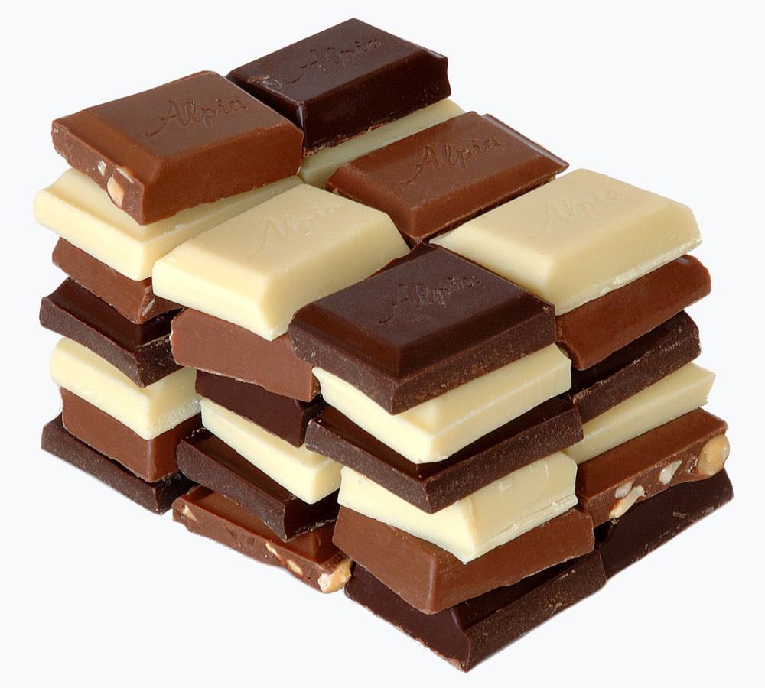
What are we going to need?
Blocks of dark and white chocolate
Aluminum foil
Hot water and a container to hold it
A grater, plastic knife or another simple scraping device

Slide 10
First we need to make rock erosion:
To start the process, we’ll be grating some chocolate as a makeshift erosion process. But leave a block or two for the igneous rocks.
Use a cheese grater or vegetable peeler to carefully shave your chocolate.
The cheese grater symbolizes erosion and weathering – wind, rain, etc. It is physically eroding the chocolate into smaller pieces, just like weathering forces do to larger bodies of rocks to form small rocks or even sand. The small pieces of chocolate represent sediment.

Slide 11
Making sedimentary rocks
Take a piece of tinfoil, fold it in half.
Then begin layering your chocolate “erosion”, first dark, then white chocolate on the one side of the piece of foil.
Make about 3 - 4 layers of the dark and white chocolate scrapings.
Then close the tin foil and put as much pressure as you can on the foil.
You are exerting pressure on the pieces of rock in order to form a sedimentary rock out of those pieces.
Observe the newly formed sedimentary rock. What do you see?

Slide 12
Making metamorphic rocks
Take a few square pieces of tinfoil and form them into “rock molds.” You can do this with your fingers or actually wrap the tinfoil halfway around a rock to help you form the proper shapes.
Take some of the remaining chocolate shavings and sprinkle them into the tinfoil molds.
Place the molds on a candle warmer and heat until the chocolate is fully melted
Let the chocolate completely cool and harden (you can quicken up this process in the freezer).
Notice the differences between the sedimentary rocks and the metamorphic rocks. What different forces were exerted on those rock shavings to form the different rocks? How are they similar?

Slide 13
Making igneous rocks
Since igneous rocks are made from magma, we want to melt the chocolate first.
In a kettle boil some water and once boiled, pour in a cup.
Wrap a square of chocolate in a piece of aluminum foil (not the chocolate erosion). Place the foil packet in the cup of hot water. Let sit until melted, about 5 minutes.
Then carefully remove the foil packet from the water, dry off and place in the refrigerator to cool until hardened, about 1 hour. Impatient? Pop it in the freezer for about 20 minutes instead.
Unwrap the igneous chocolate rock from the foil. How does it compare to the sedimentary and metamorphic rocks?

Slide 14
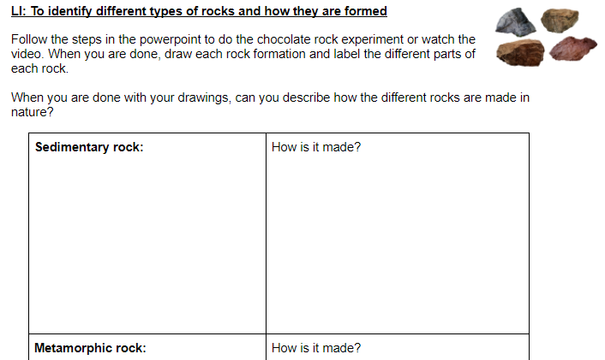

This type of rock is made out of sand, shells, pebbles and other materials, which we call sediment…

