Slide 1
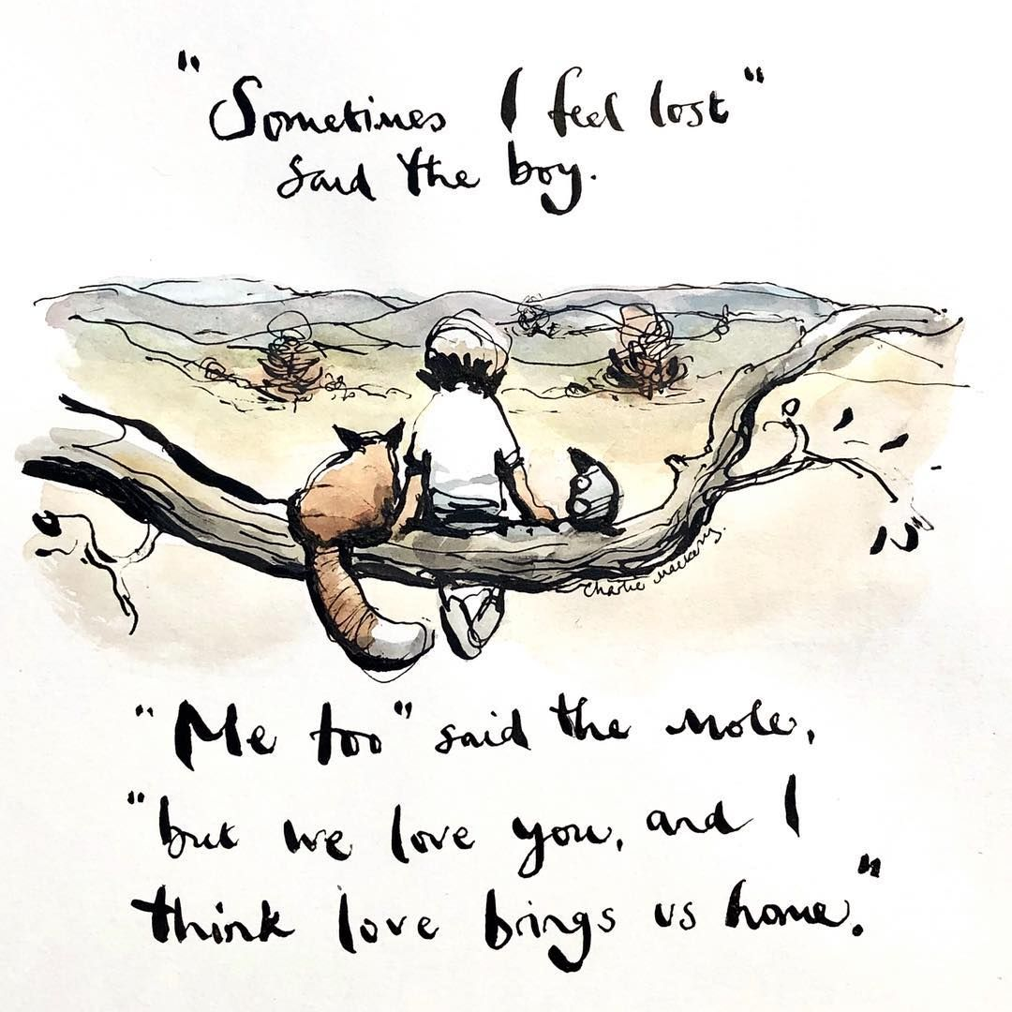
We are going to make predictions looking at the tex as well as the image.
This is the text. What predictions can we make?
I imagine that the text is about friendship and love because it says that love always brings you home.

Slide 2
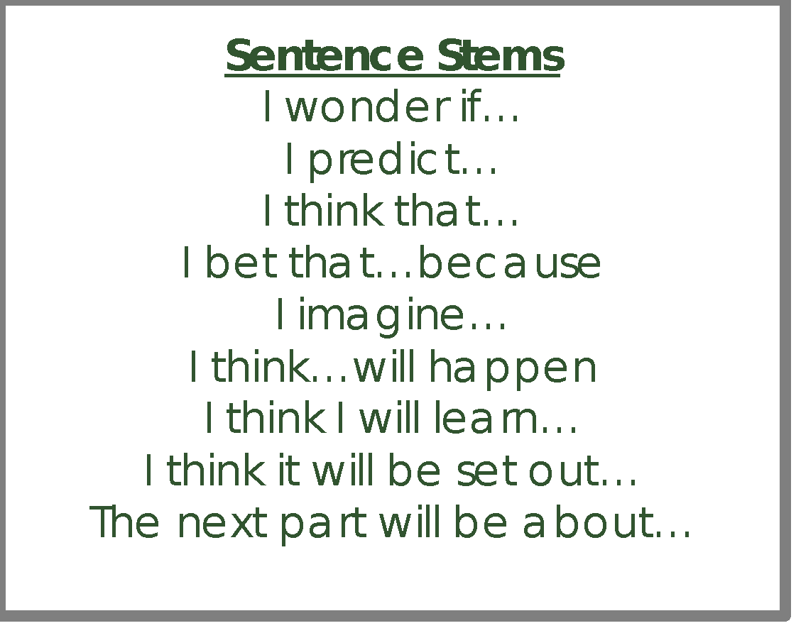
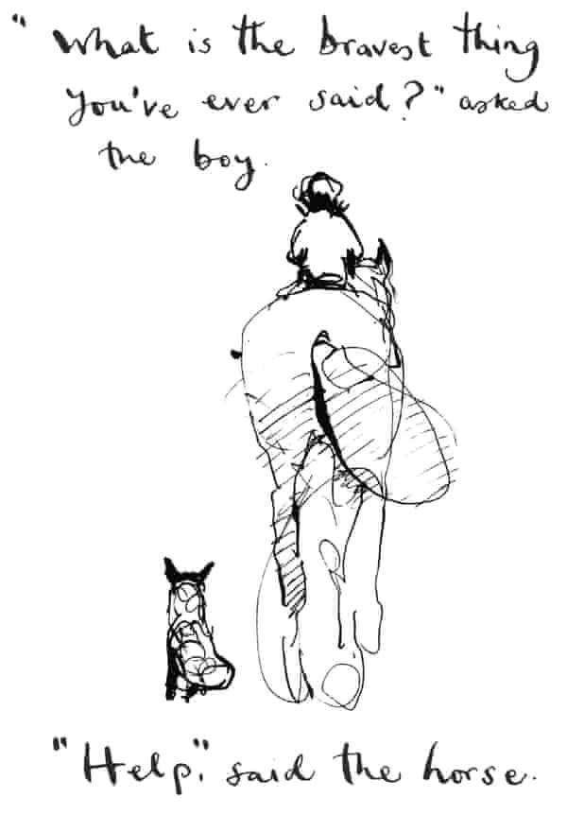
This is the text. Read it through. Look at the image.
What predictions can we make?

Slide 3
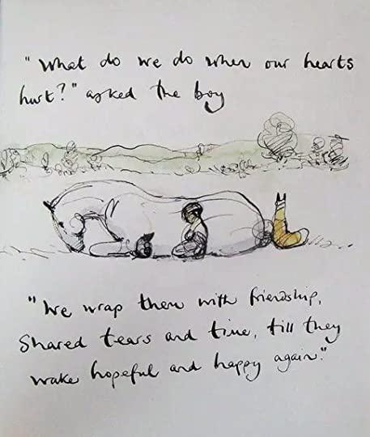
This is the text. Read it through. Look at the image.
What predictions can we make?

Slide 4


