Slide 1

Art Techniques

Slide 2
Today we’re going outside to make drawings of trees
First, we need to have a look at the following techniques you’ll be trying out today:
Large vs small scale
Blind contour drawing
Collaborative drawing
Leaf and bark rubbing

Slide 3
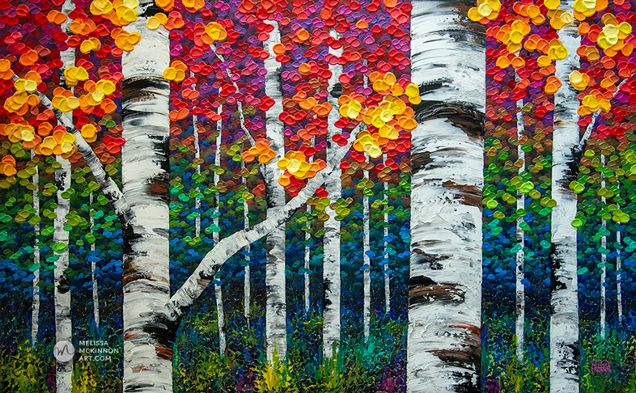
We are going to work towards creating something like this as our final art outcome

Slide 4
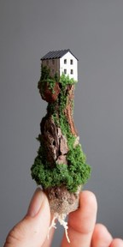
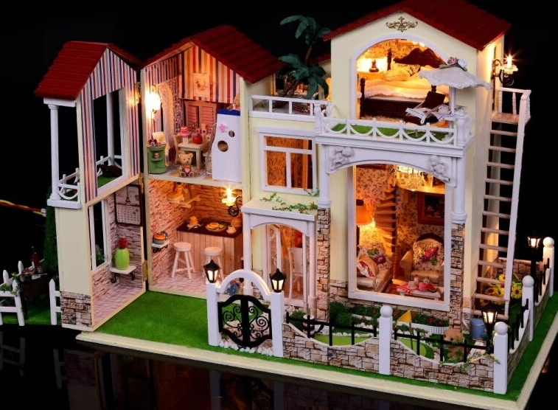
Large scale vs small scale
Large scale shows a smaller amount of area with a greater amount of detail
Small scale show a larger area with few details on it.

Slide 5
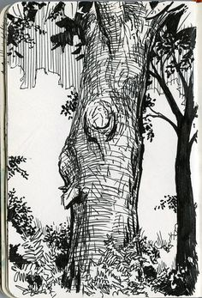
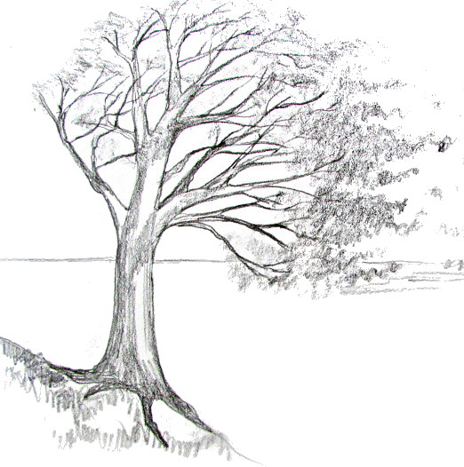
What do you think? Which one is large/small scale?

Slide 6
What do you think? Which one is large/small scale?
Small scale
Large scale

Slide 7
What do you think? Which one is large/small scale?
Can you practice small and large scale when you make your tree drawing?
Small scale
Large scale

Slide 8
Blind contour drawing
Choose an object to draw - trees in this case!
Pick a point on the object where the eye can begin its slow journey around the contour or edge of the object. Remember, the eye is like a snail, barely crawling as it begins its journey.
When the eye begins to move, so should the hand holding the pencil. At no time should you look at your hand as it draws. Try drawing the entire contour of the object without lifting your pencil form the paper.

Slide 9
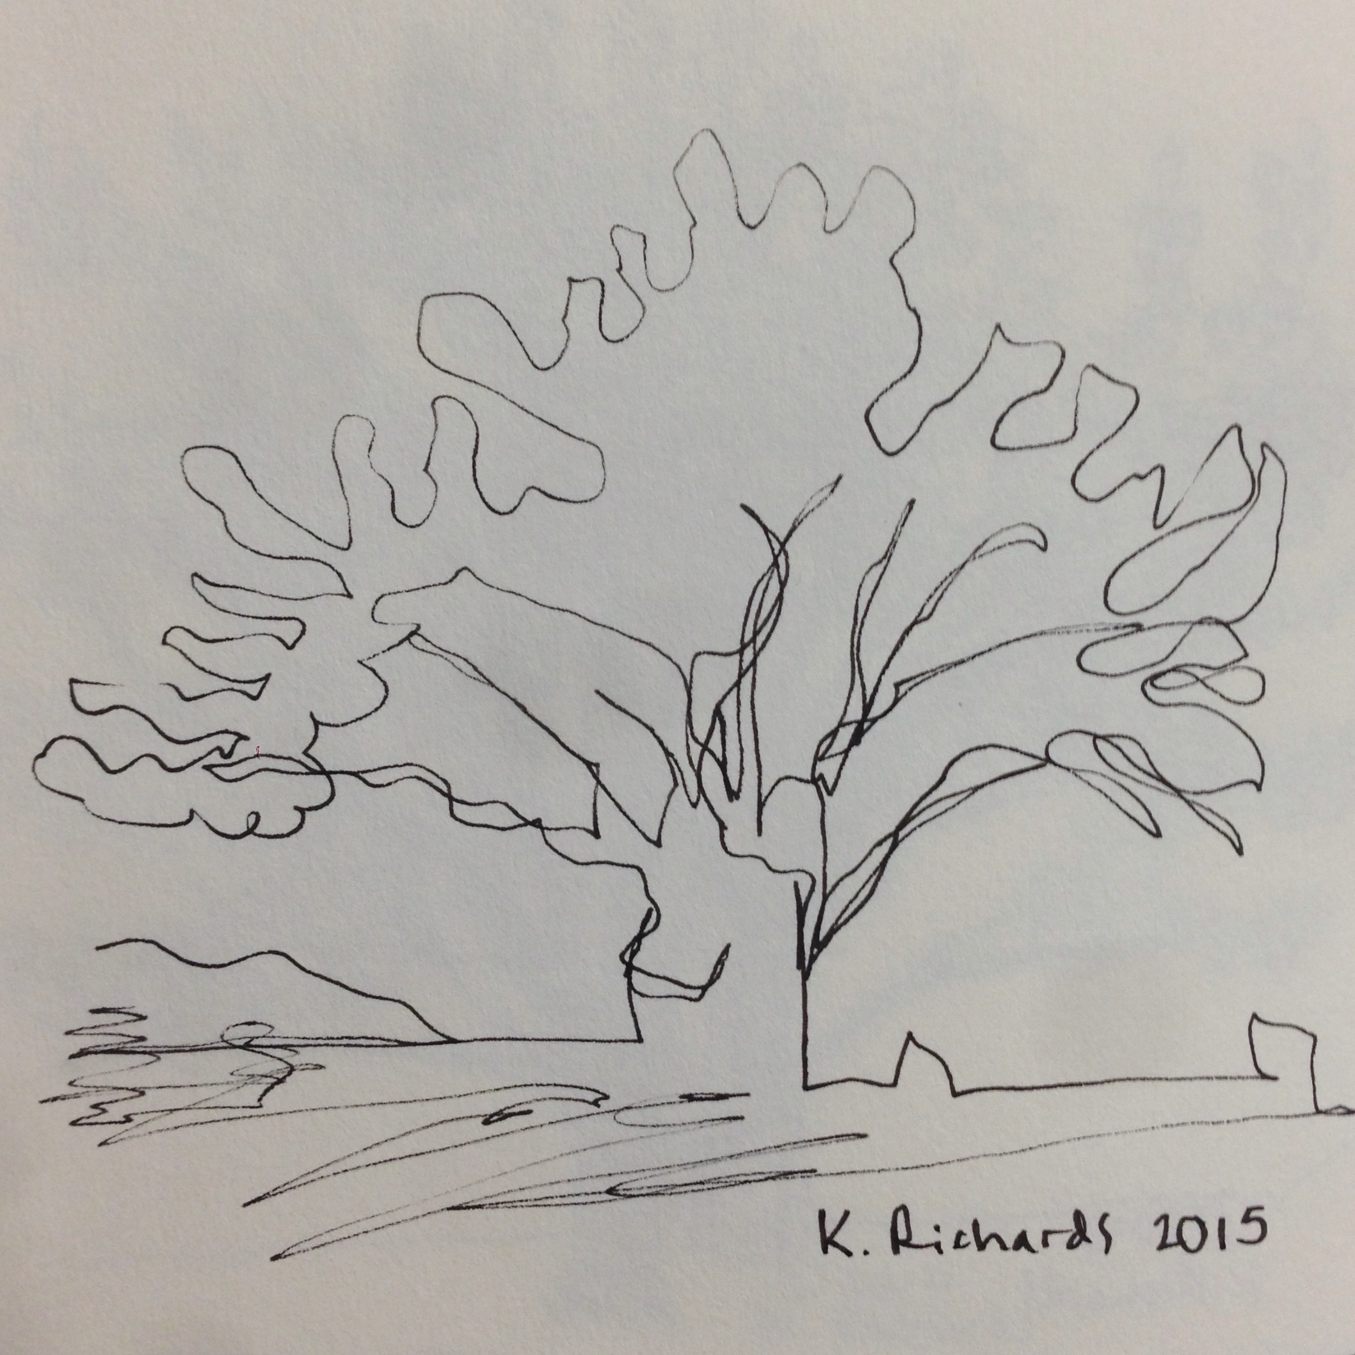
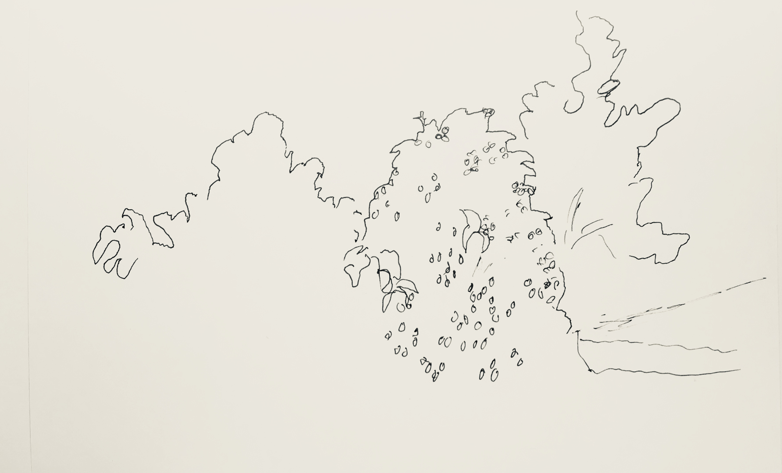
Here is an example of contour drawing.
Try your best not to lift your hand when you try this.

Slide 10
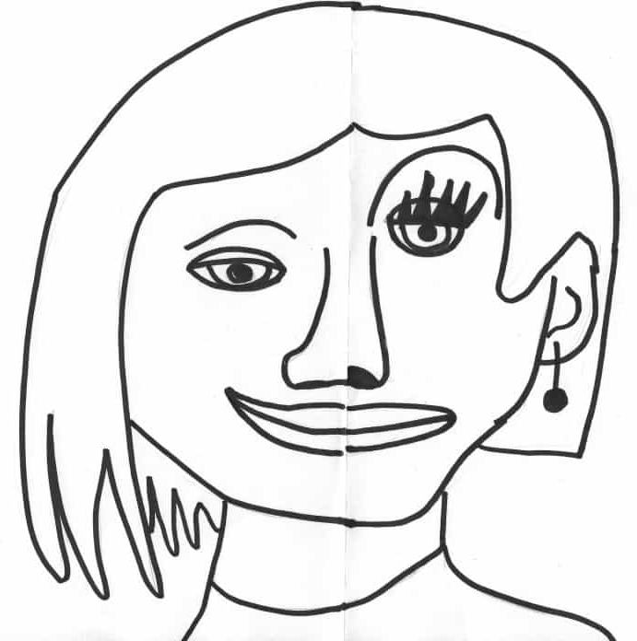
Collaborative drawing
You’re going to fold your page in half.
Then you’re going to draw one half of a tree on the one folded side.
Your friend will then finish the other half of the tree on the other side.
Make sure you draw the first half on the edge of the fold, so that when you open the page, you’ll see the full tree.

Slide 11
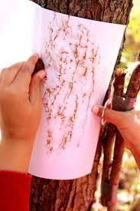
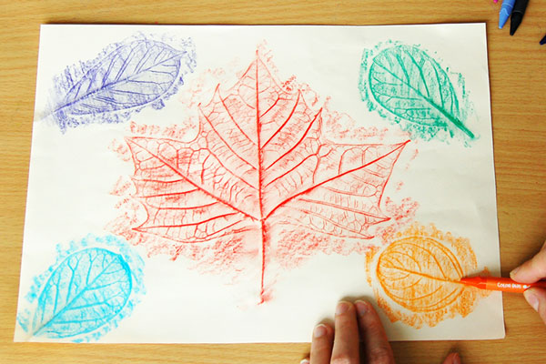
Bark and leaf rubbings
Place a page over either a leaf or the bark of a tree.
Lightly colour in on the page over the bark or leaf.
Make sure that you don’t press too hard because you might make a hole in your page.

Slide 12
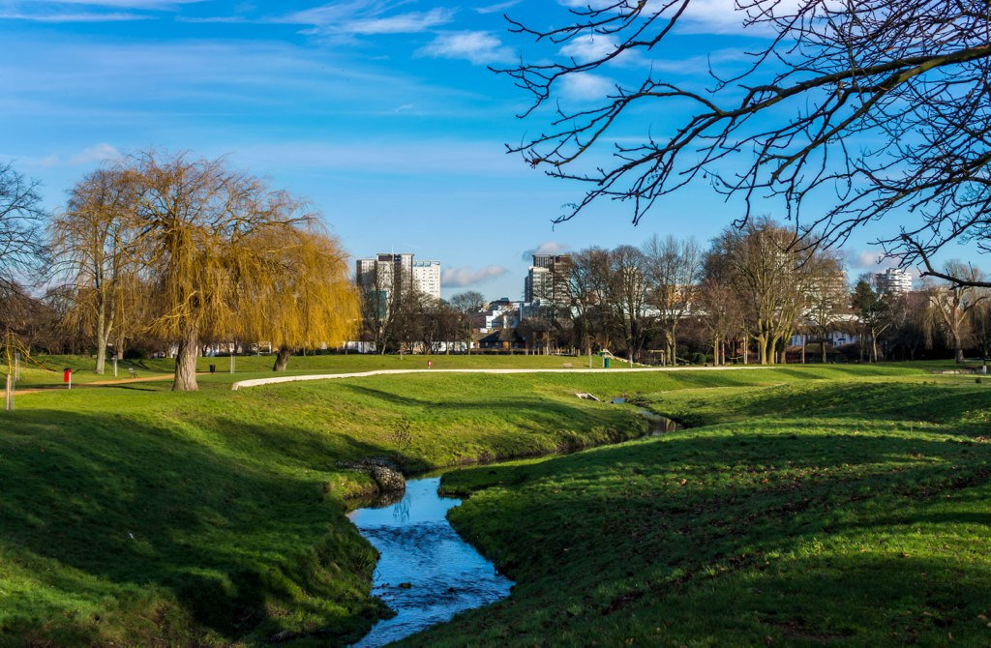
That’s it! Go and enjoy some outdoor time!

