Slide 1
Monday

Slide 2
Our reading strategy this week is to make links with our own experiences.

Slide 3
We are reading the Colour Monster

Slide 4
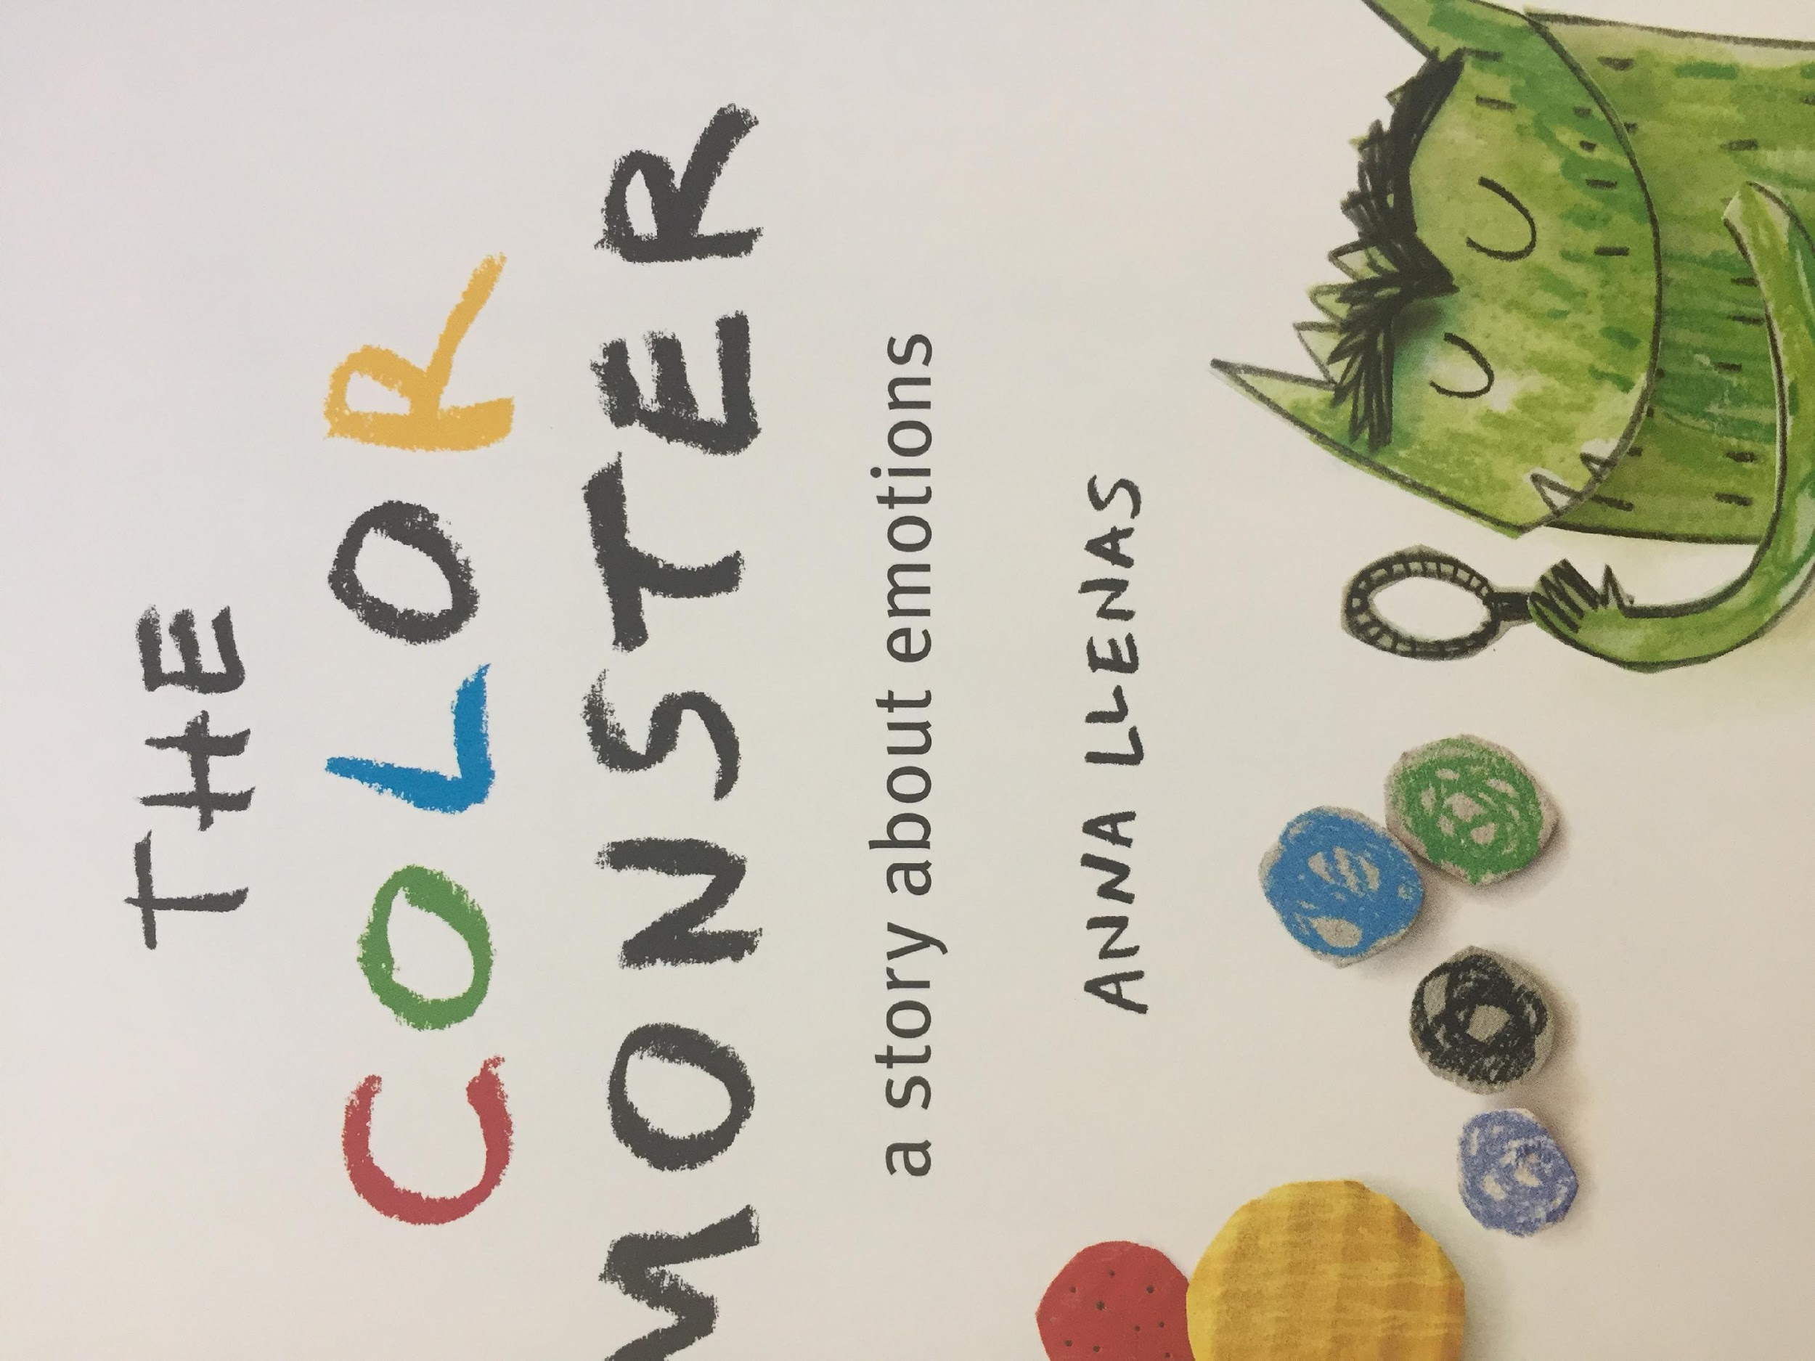
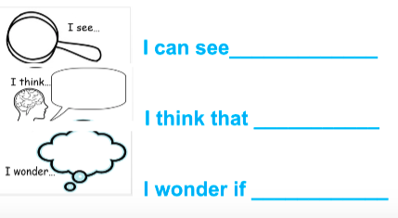

Slide 5
Talk about what you can see, what you think and what you wonder.

Slide 6
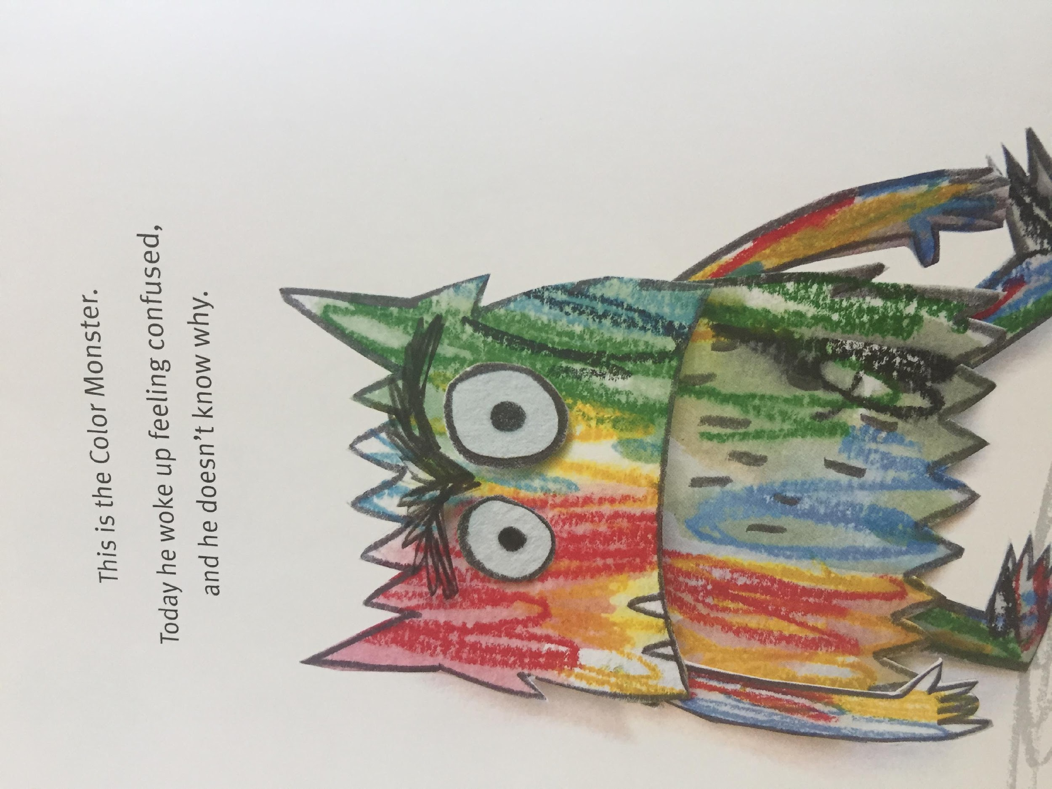

Slide 7
Tuesday

Slide 8
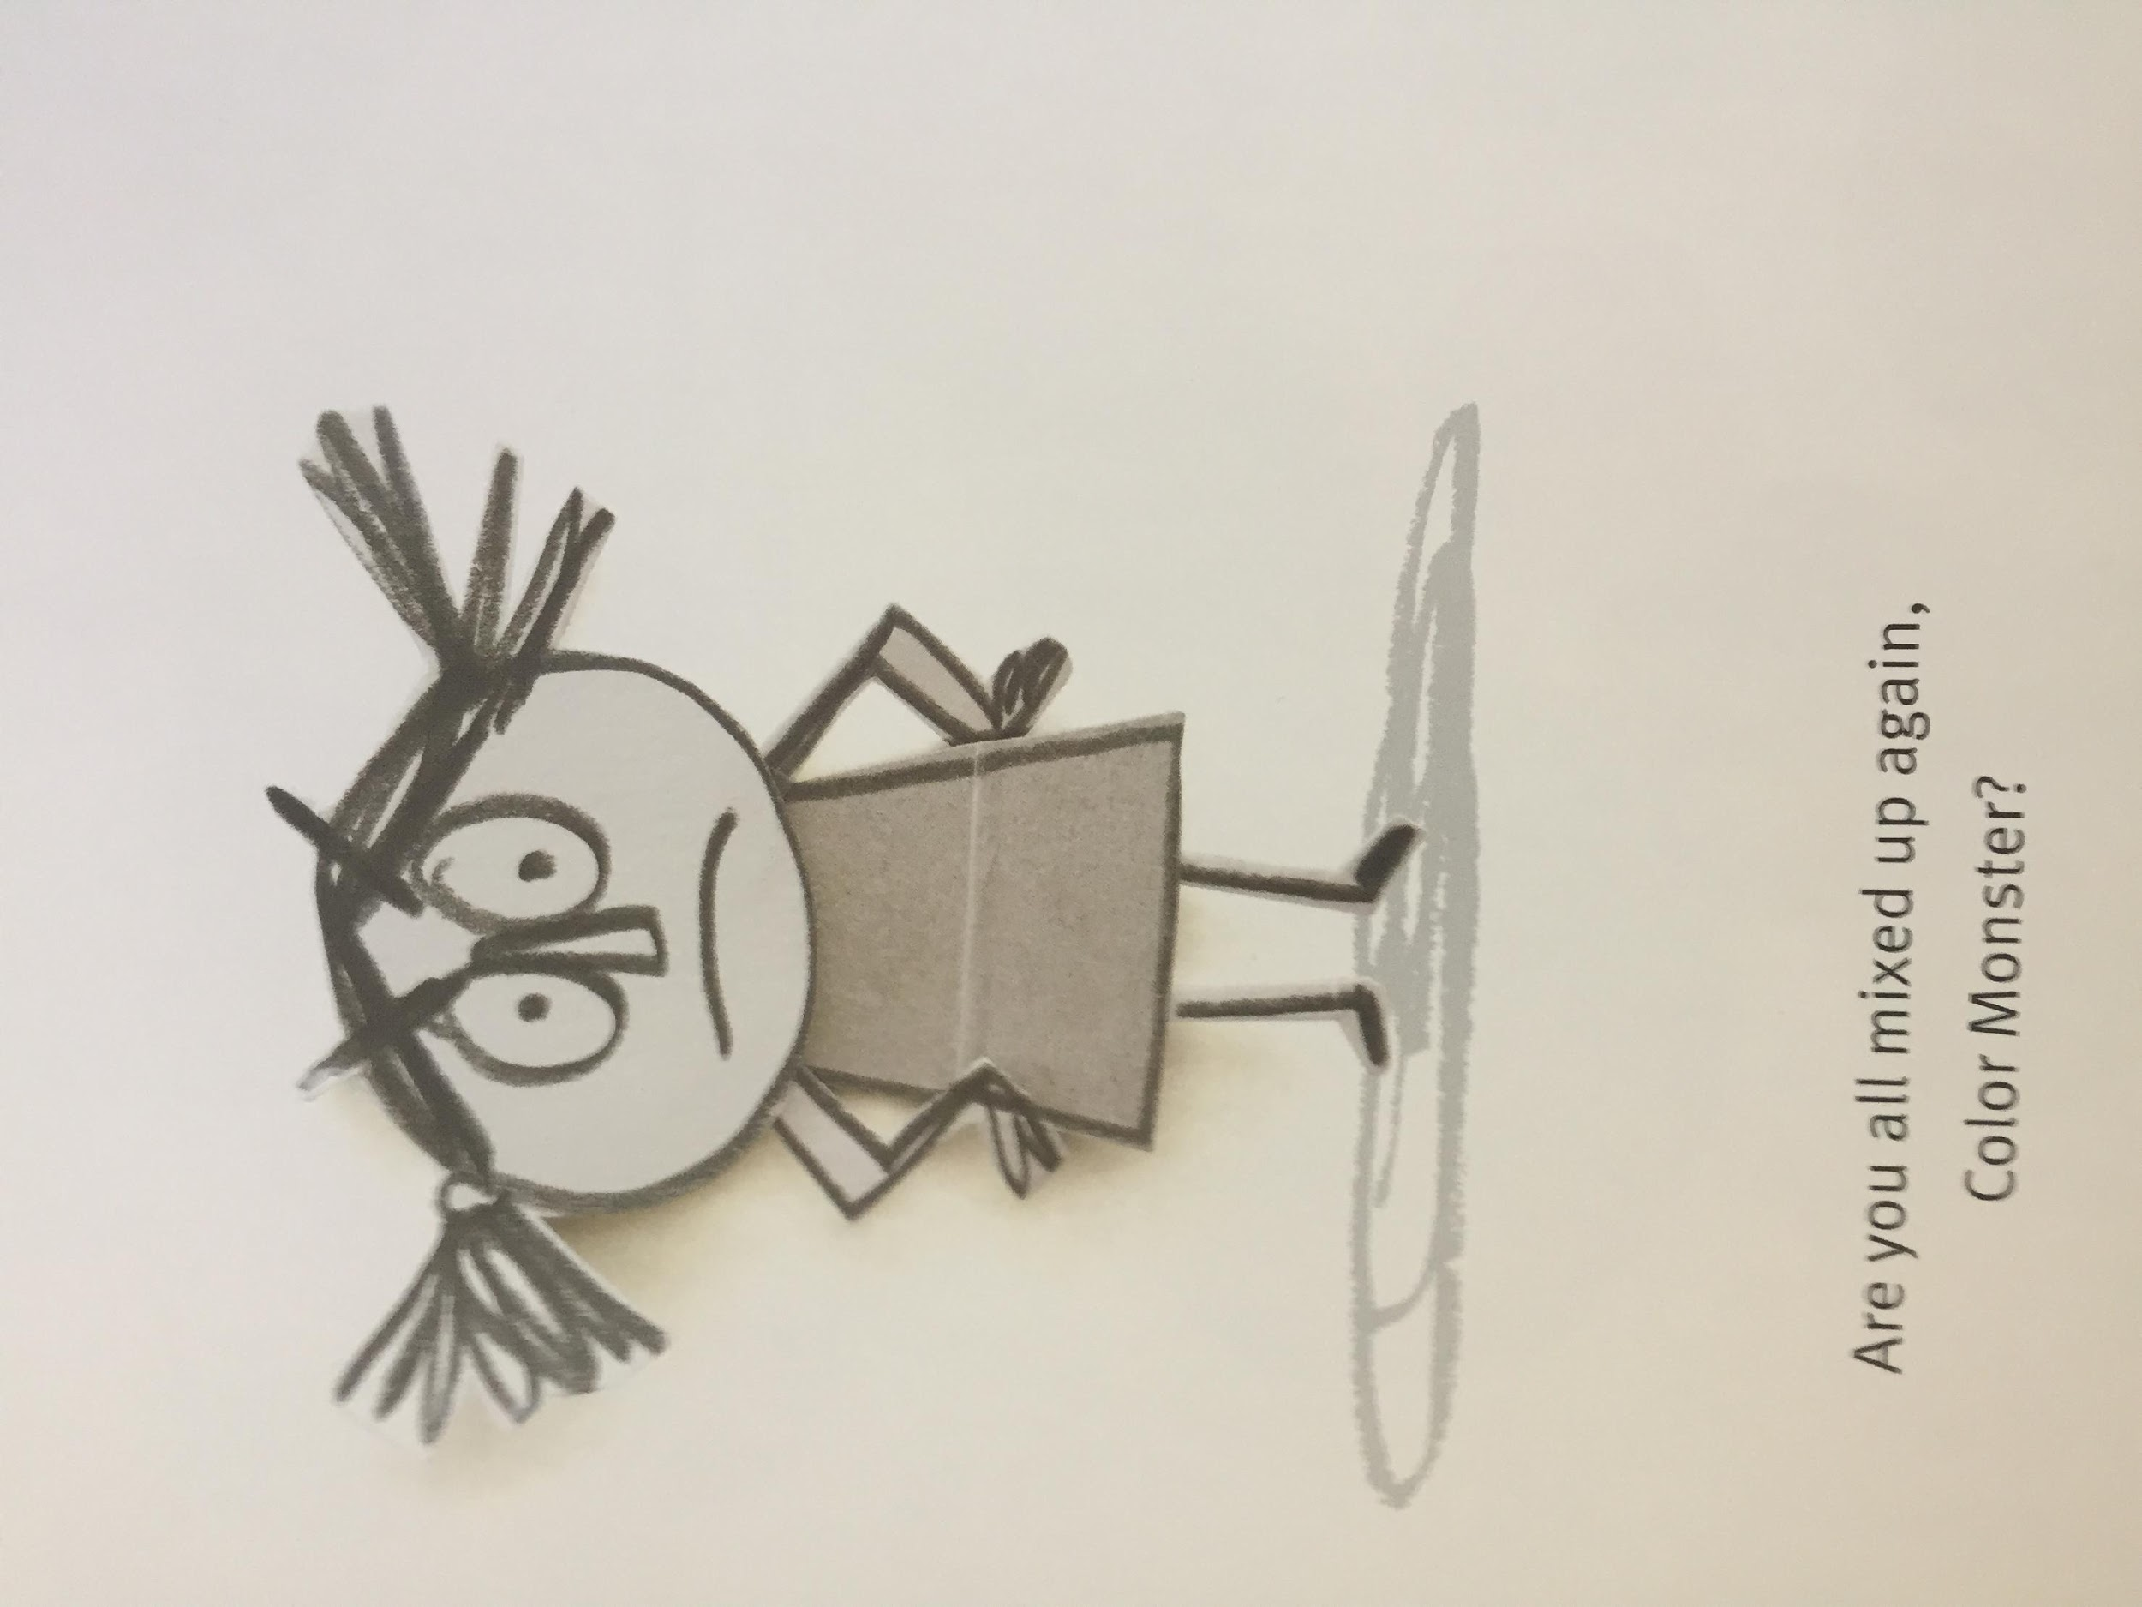
LI – to make links with our own experiences.

Slide 9
Now let’s practice some of the words we might find in the text.
confused
jumbled up
happiness
sadness
emotions

Slide 12
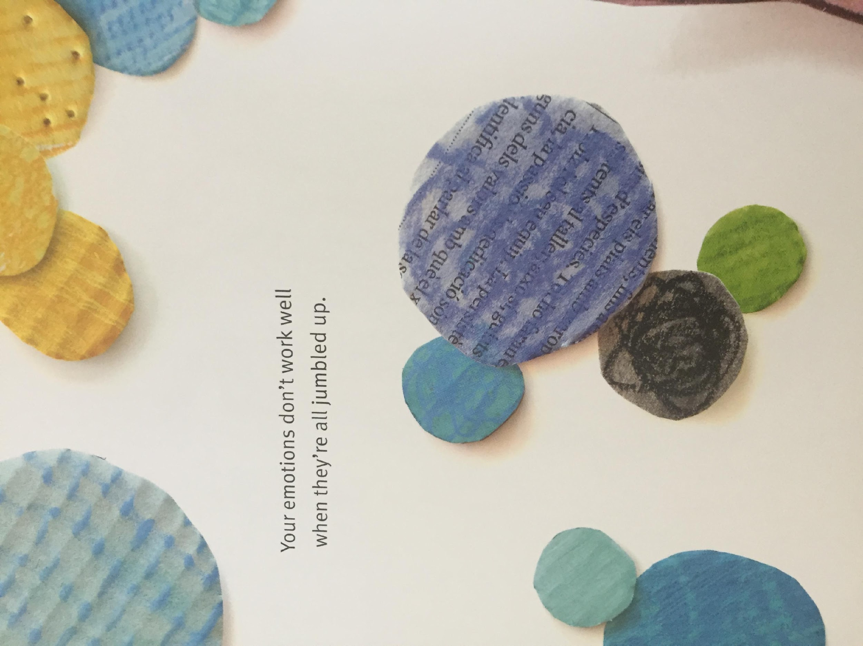

Slide 13
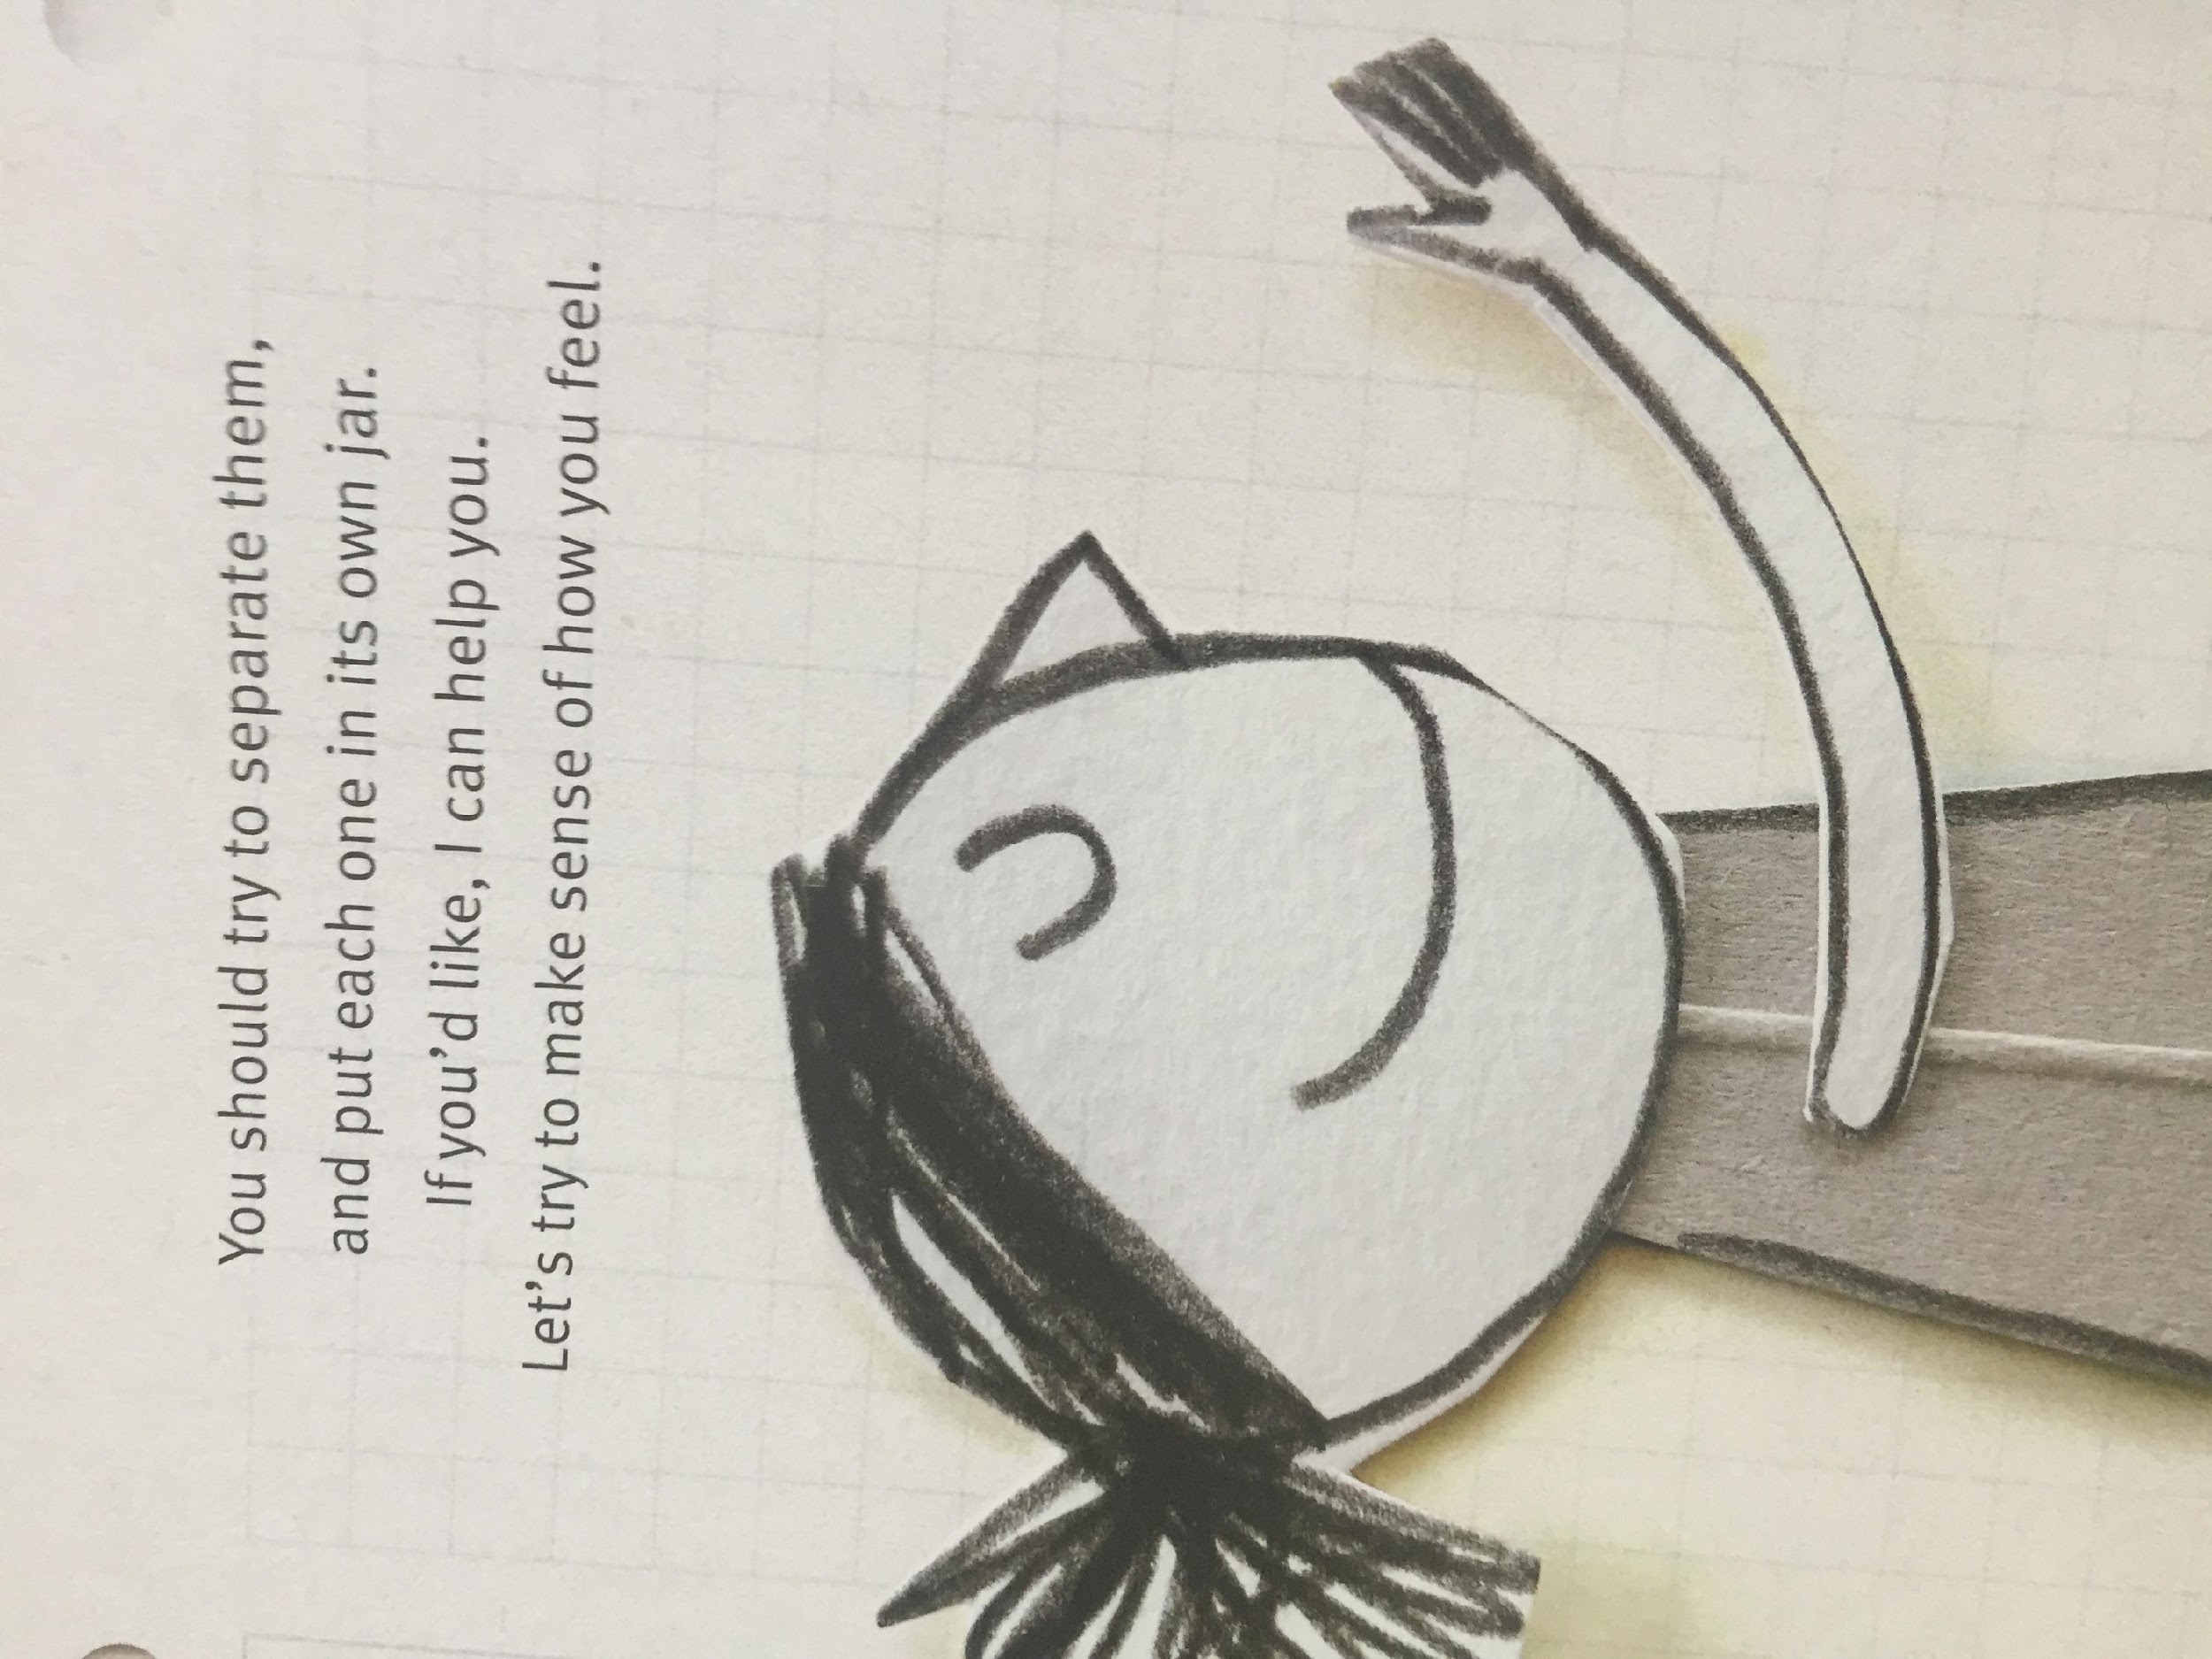

Slide 14
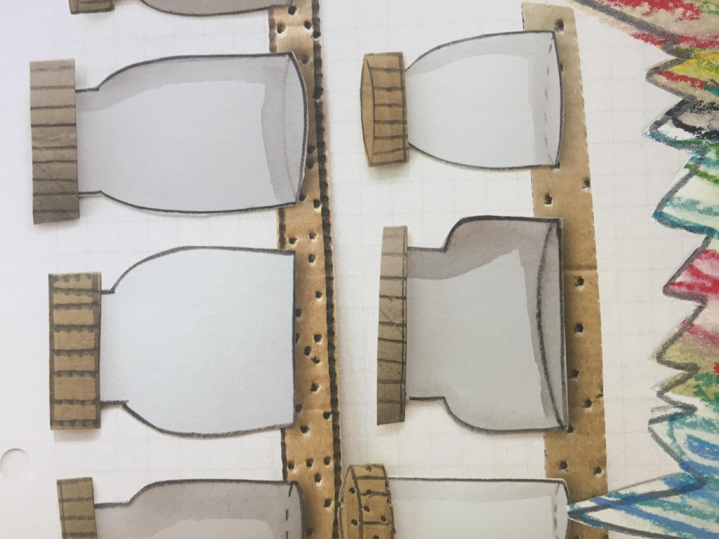
LI – to make links with our own experiences.
What does this make you think of ... ?
This makes me think of when ... because. ...
This reminds me of when ....

Slide 15
Wednesday

Slide 16
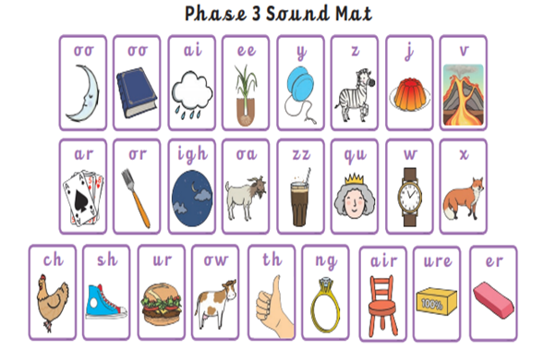
Before we start- let’s practice some of the sounds we might find in the text.

Slide 17
Now let’s practice some of the words we might find in the text.
happiness
sadness
emotions
anger
fear
calm
peace
feelings

Slide 18
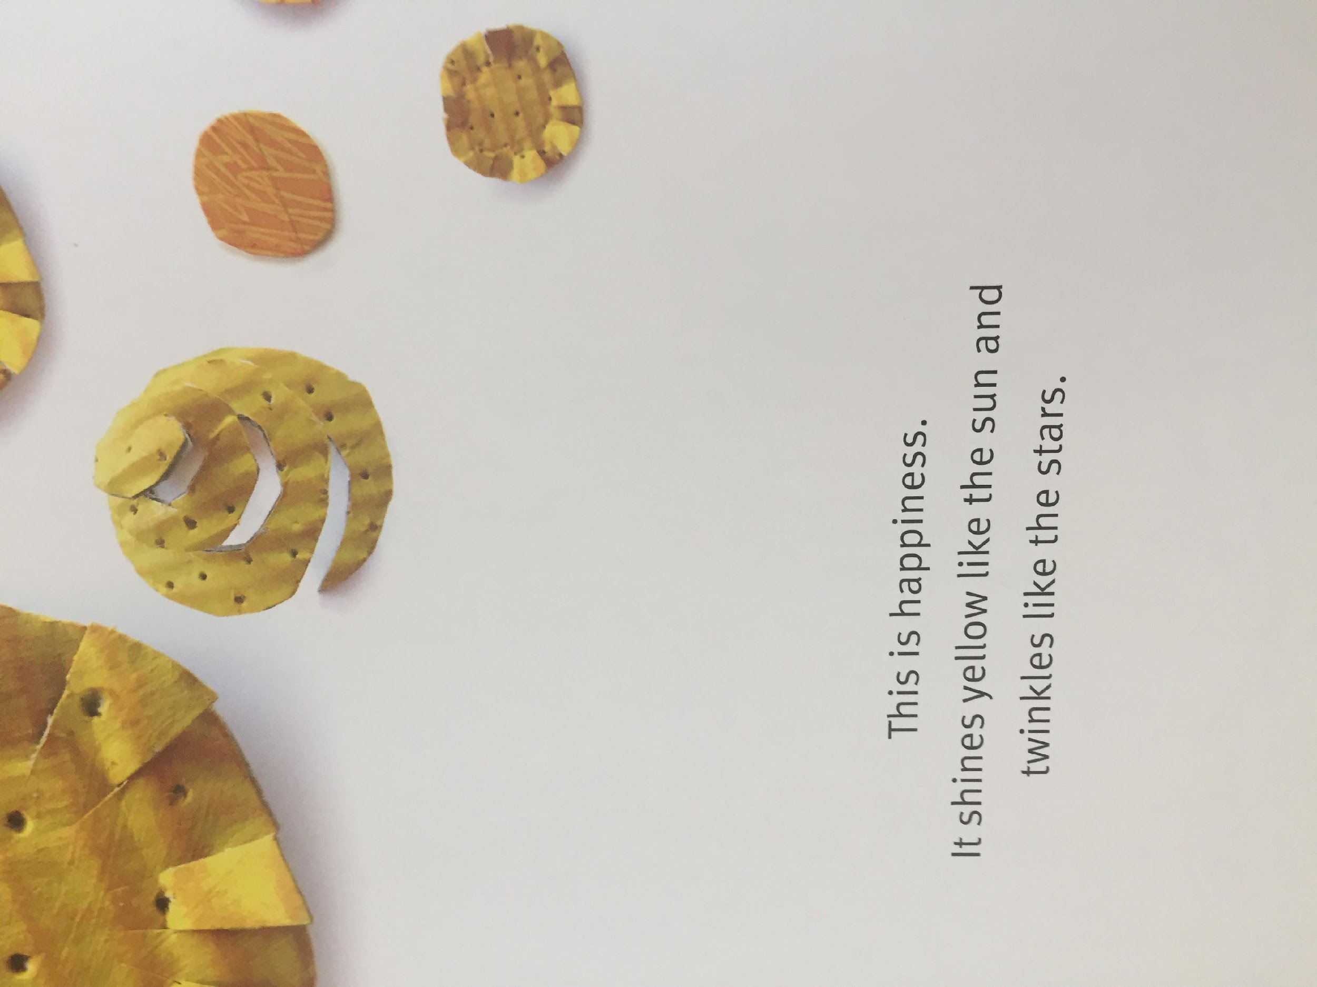
LI – to make links with our own experiences.

Slide 19
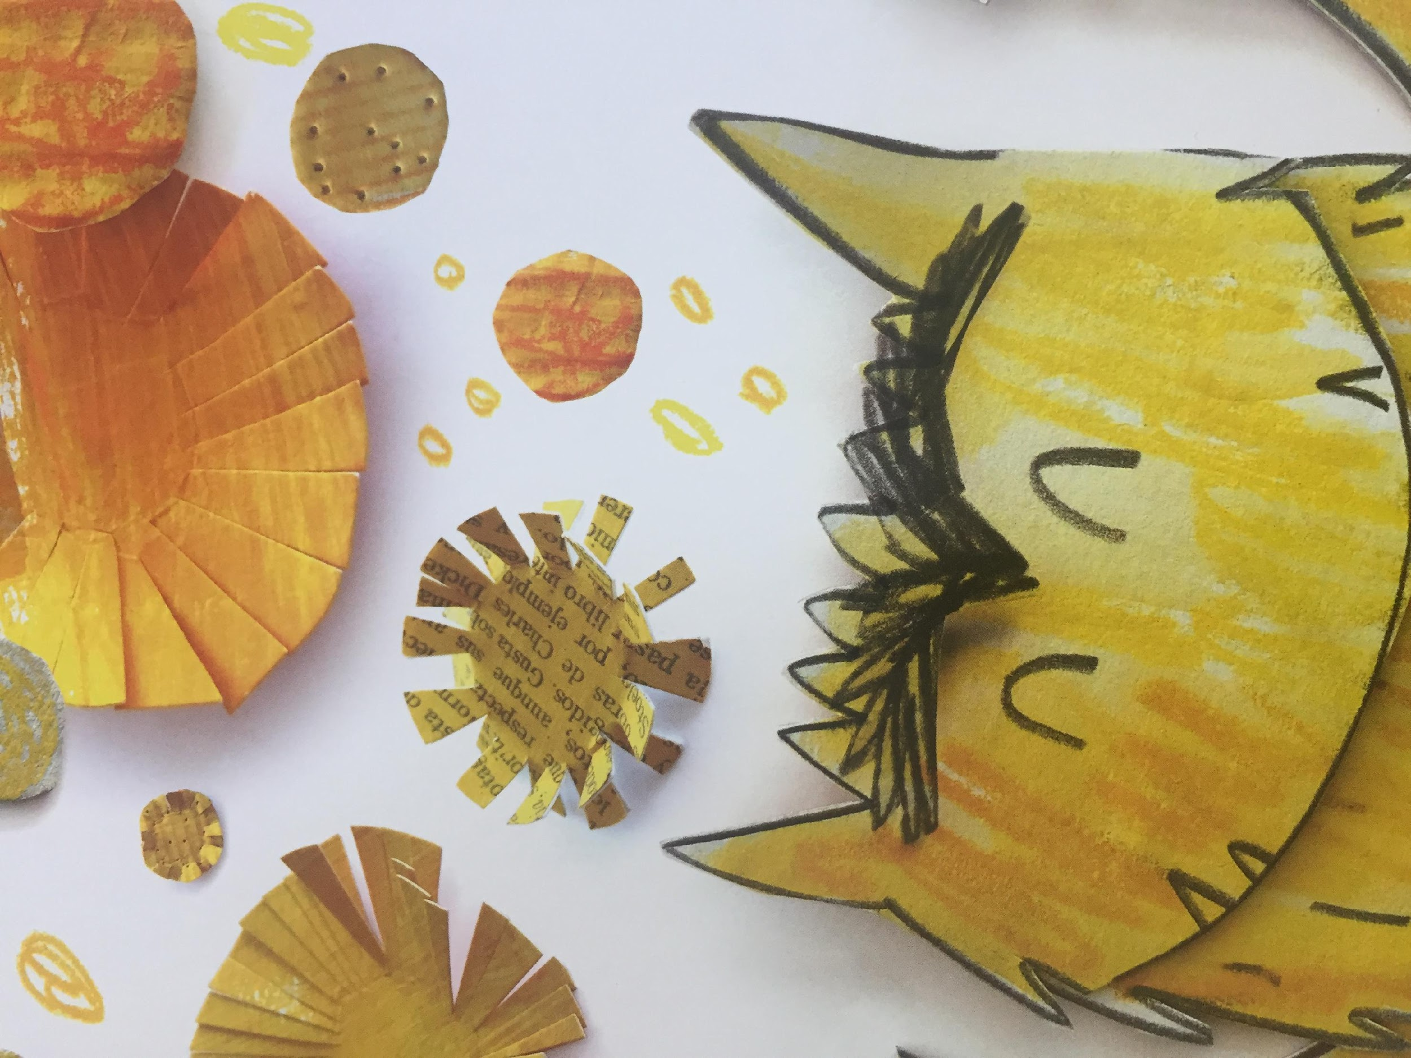
What makes you happy?

Slide 20
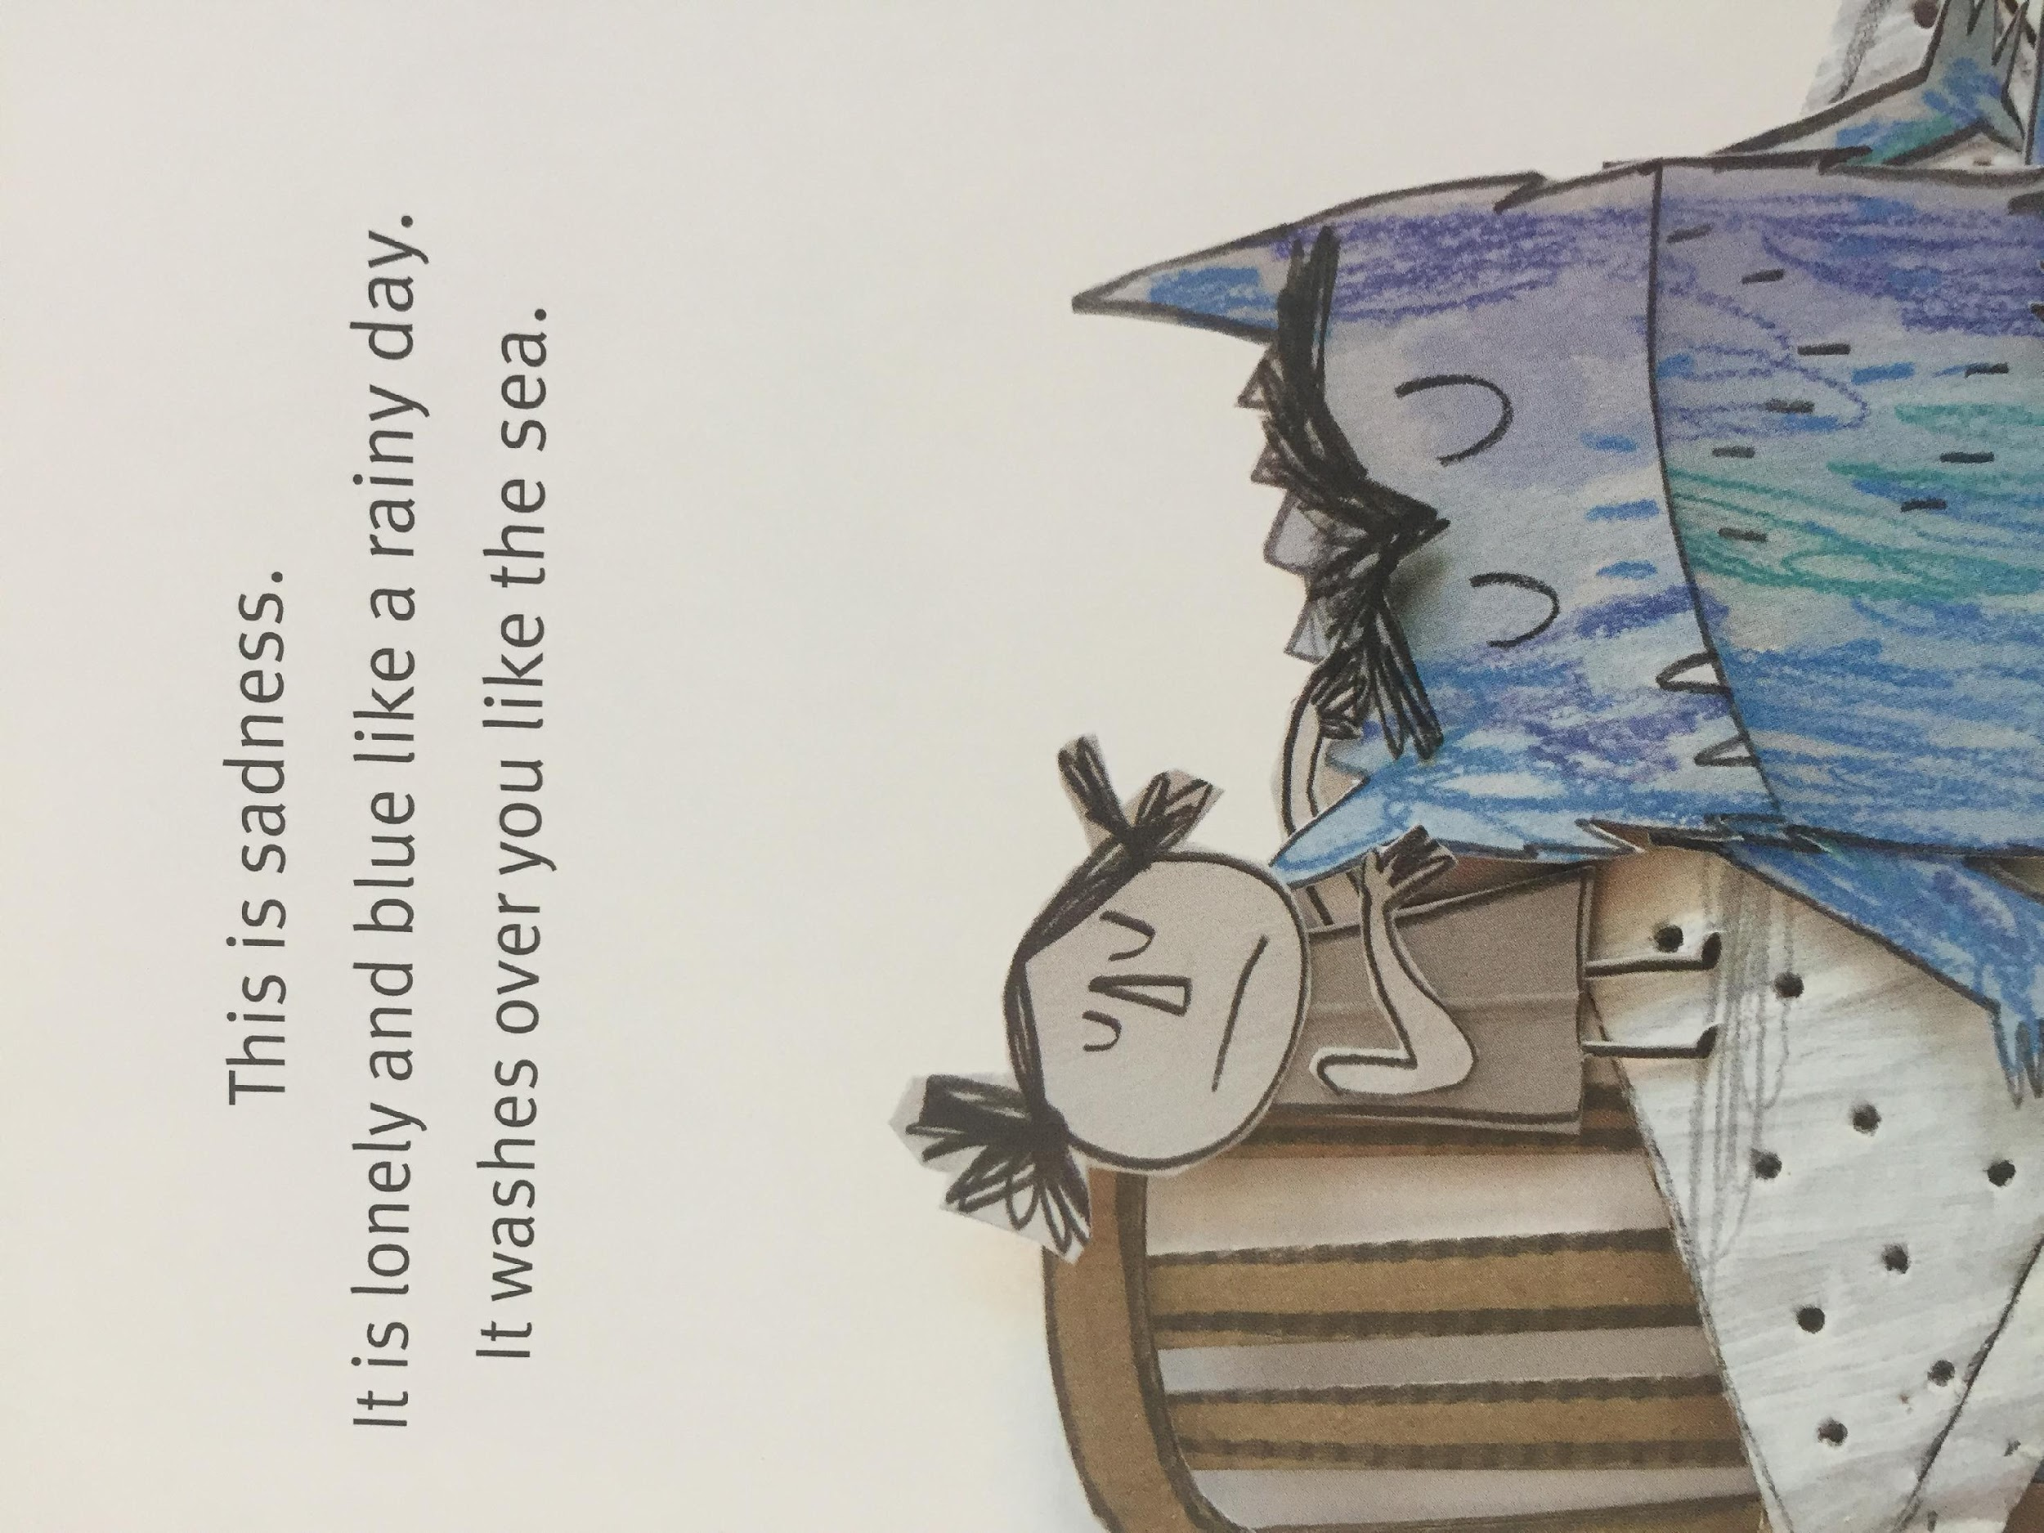
LI – to make links with our own experiences.

Slide 21
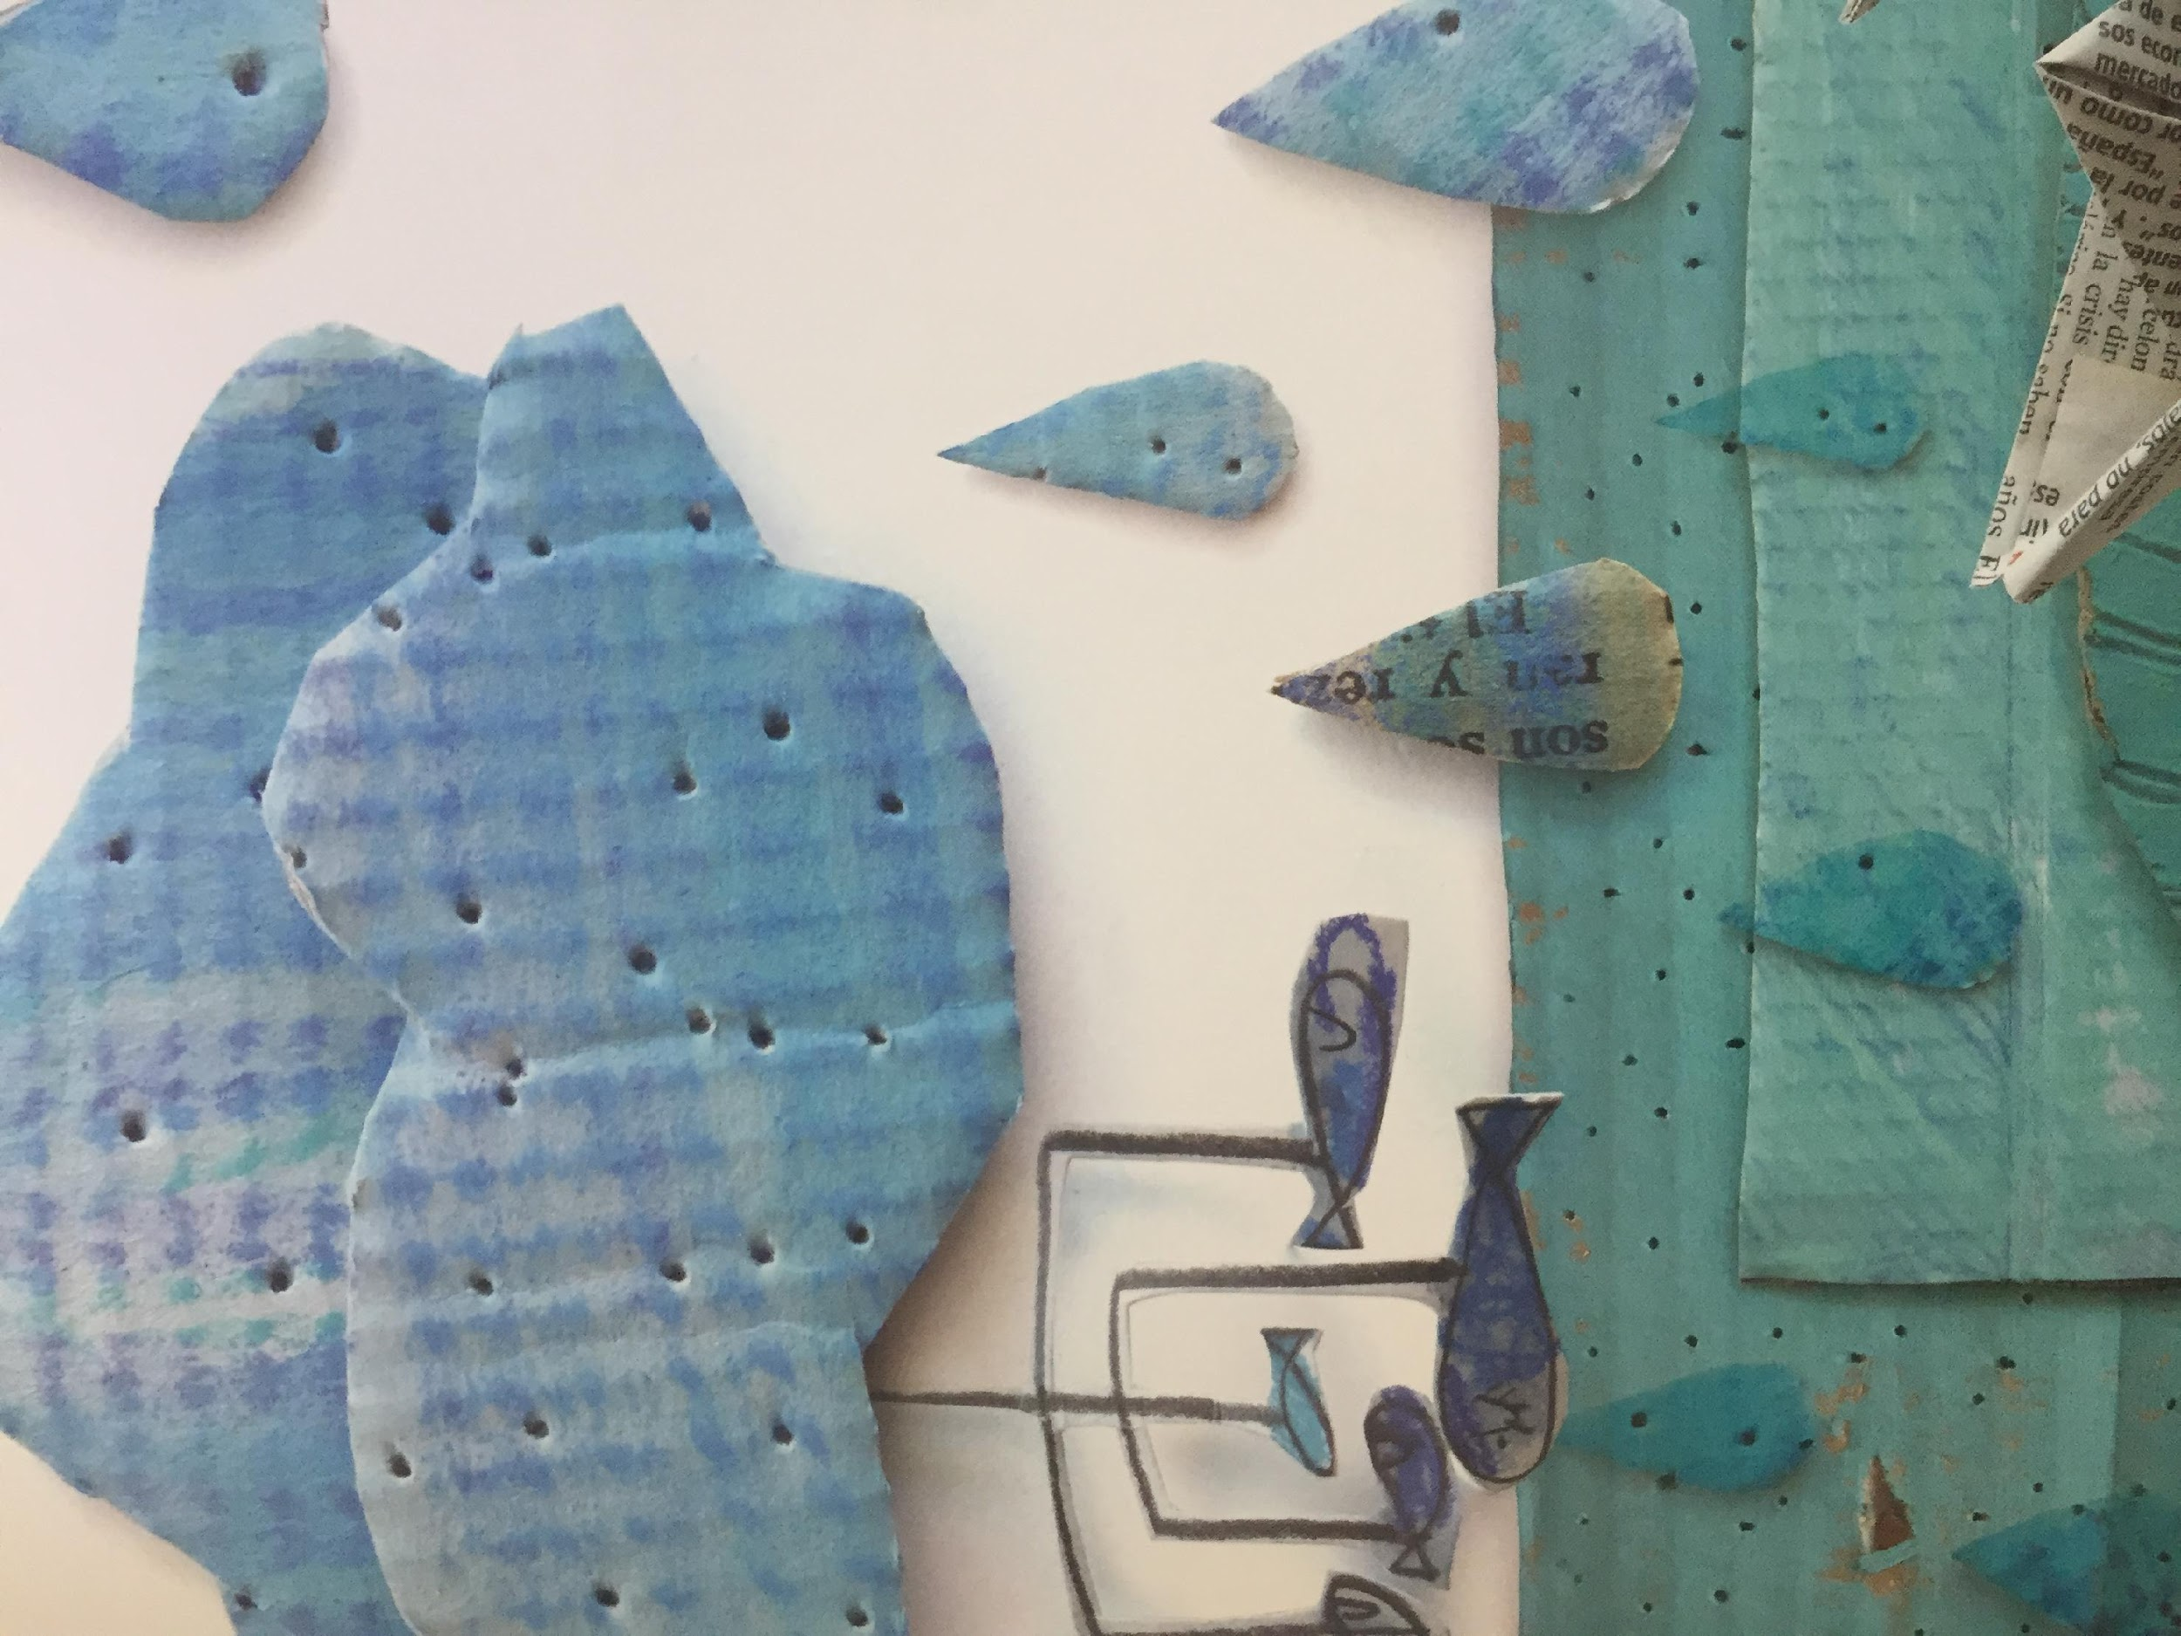
LI – to make links with our own experiences.
What makes you blue?

Slide 22
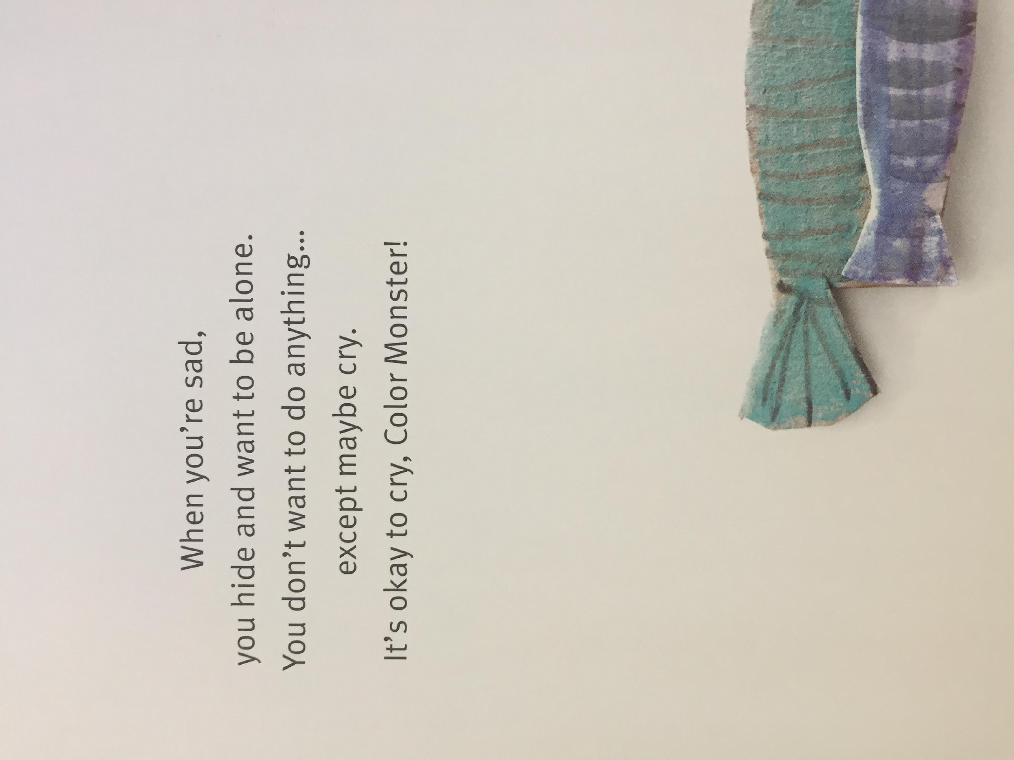
LI – to make links with our own experiences.

Slide 23
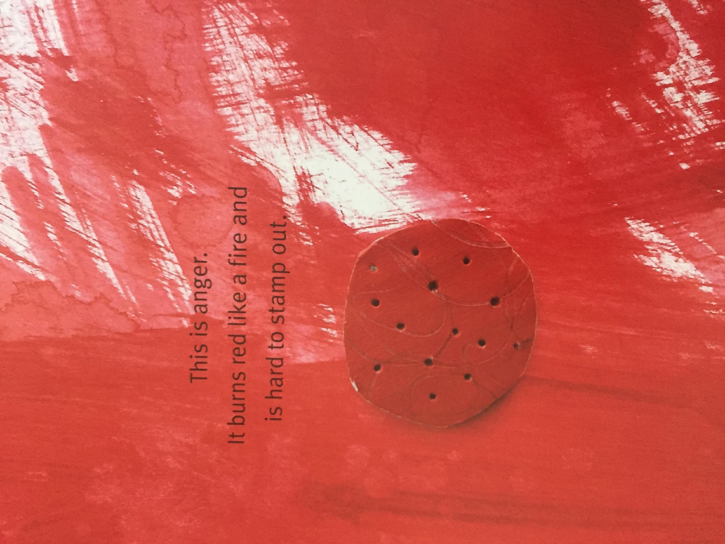
LI – to make links with our own experiences.

Slide 24
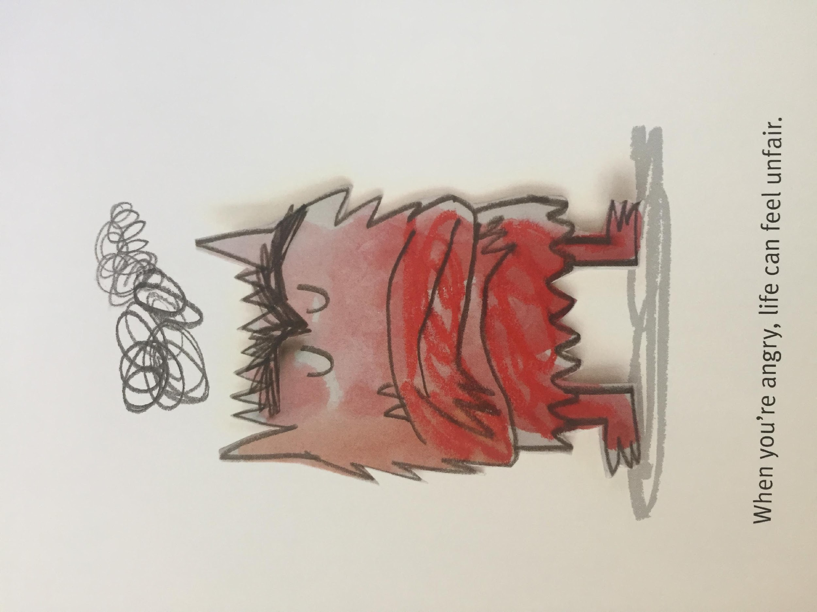
What makes you red?

Slide 25
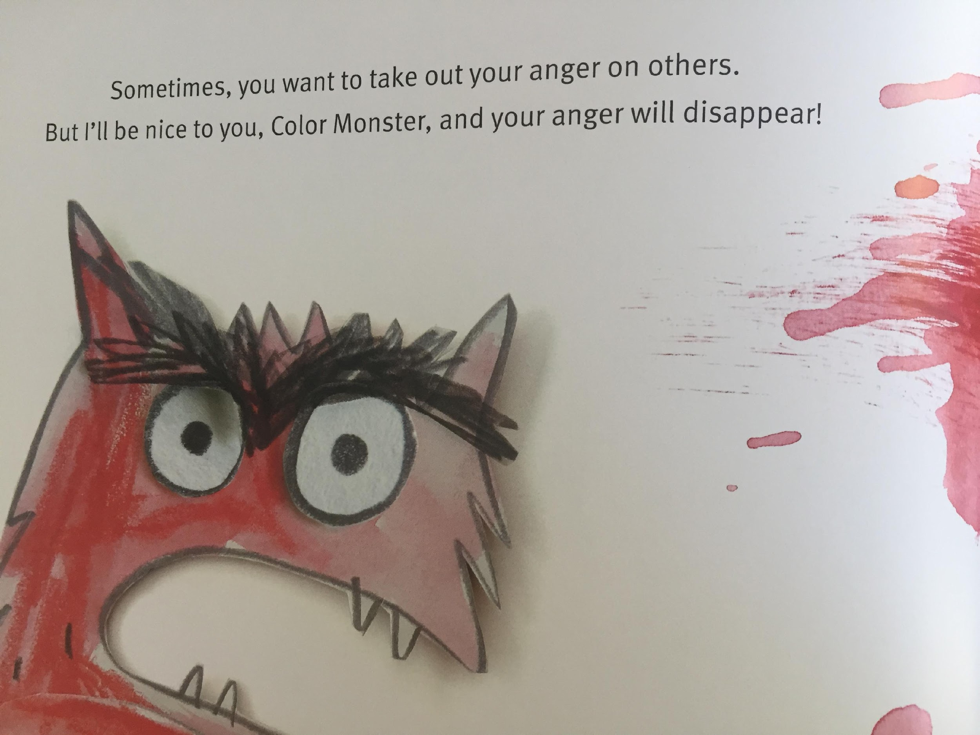

Slide 26
Thursday

Slide 27
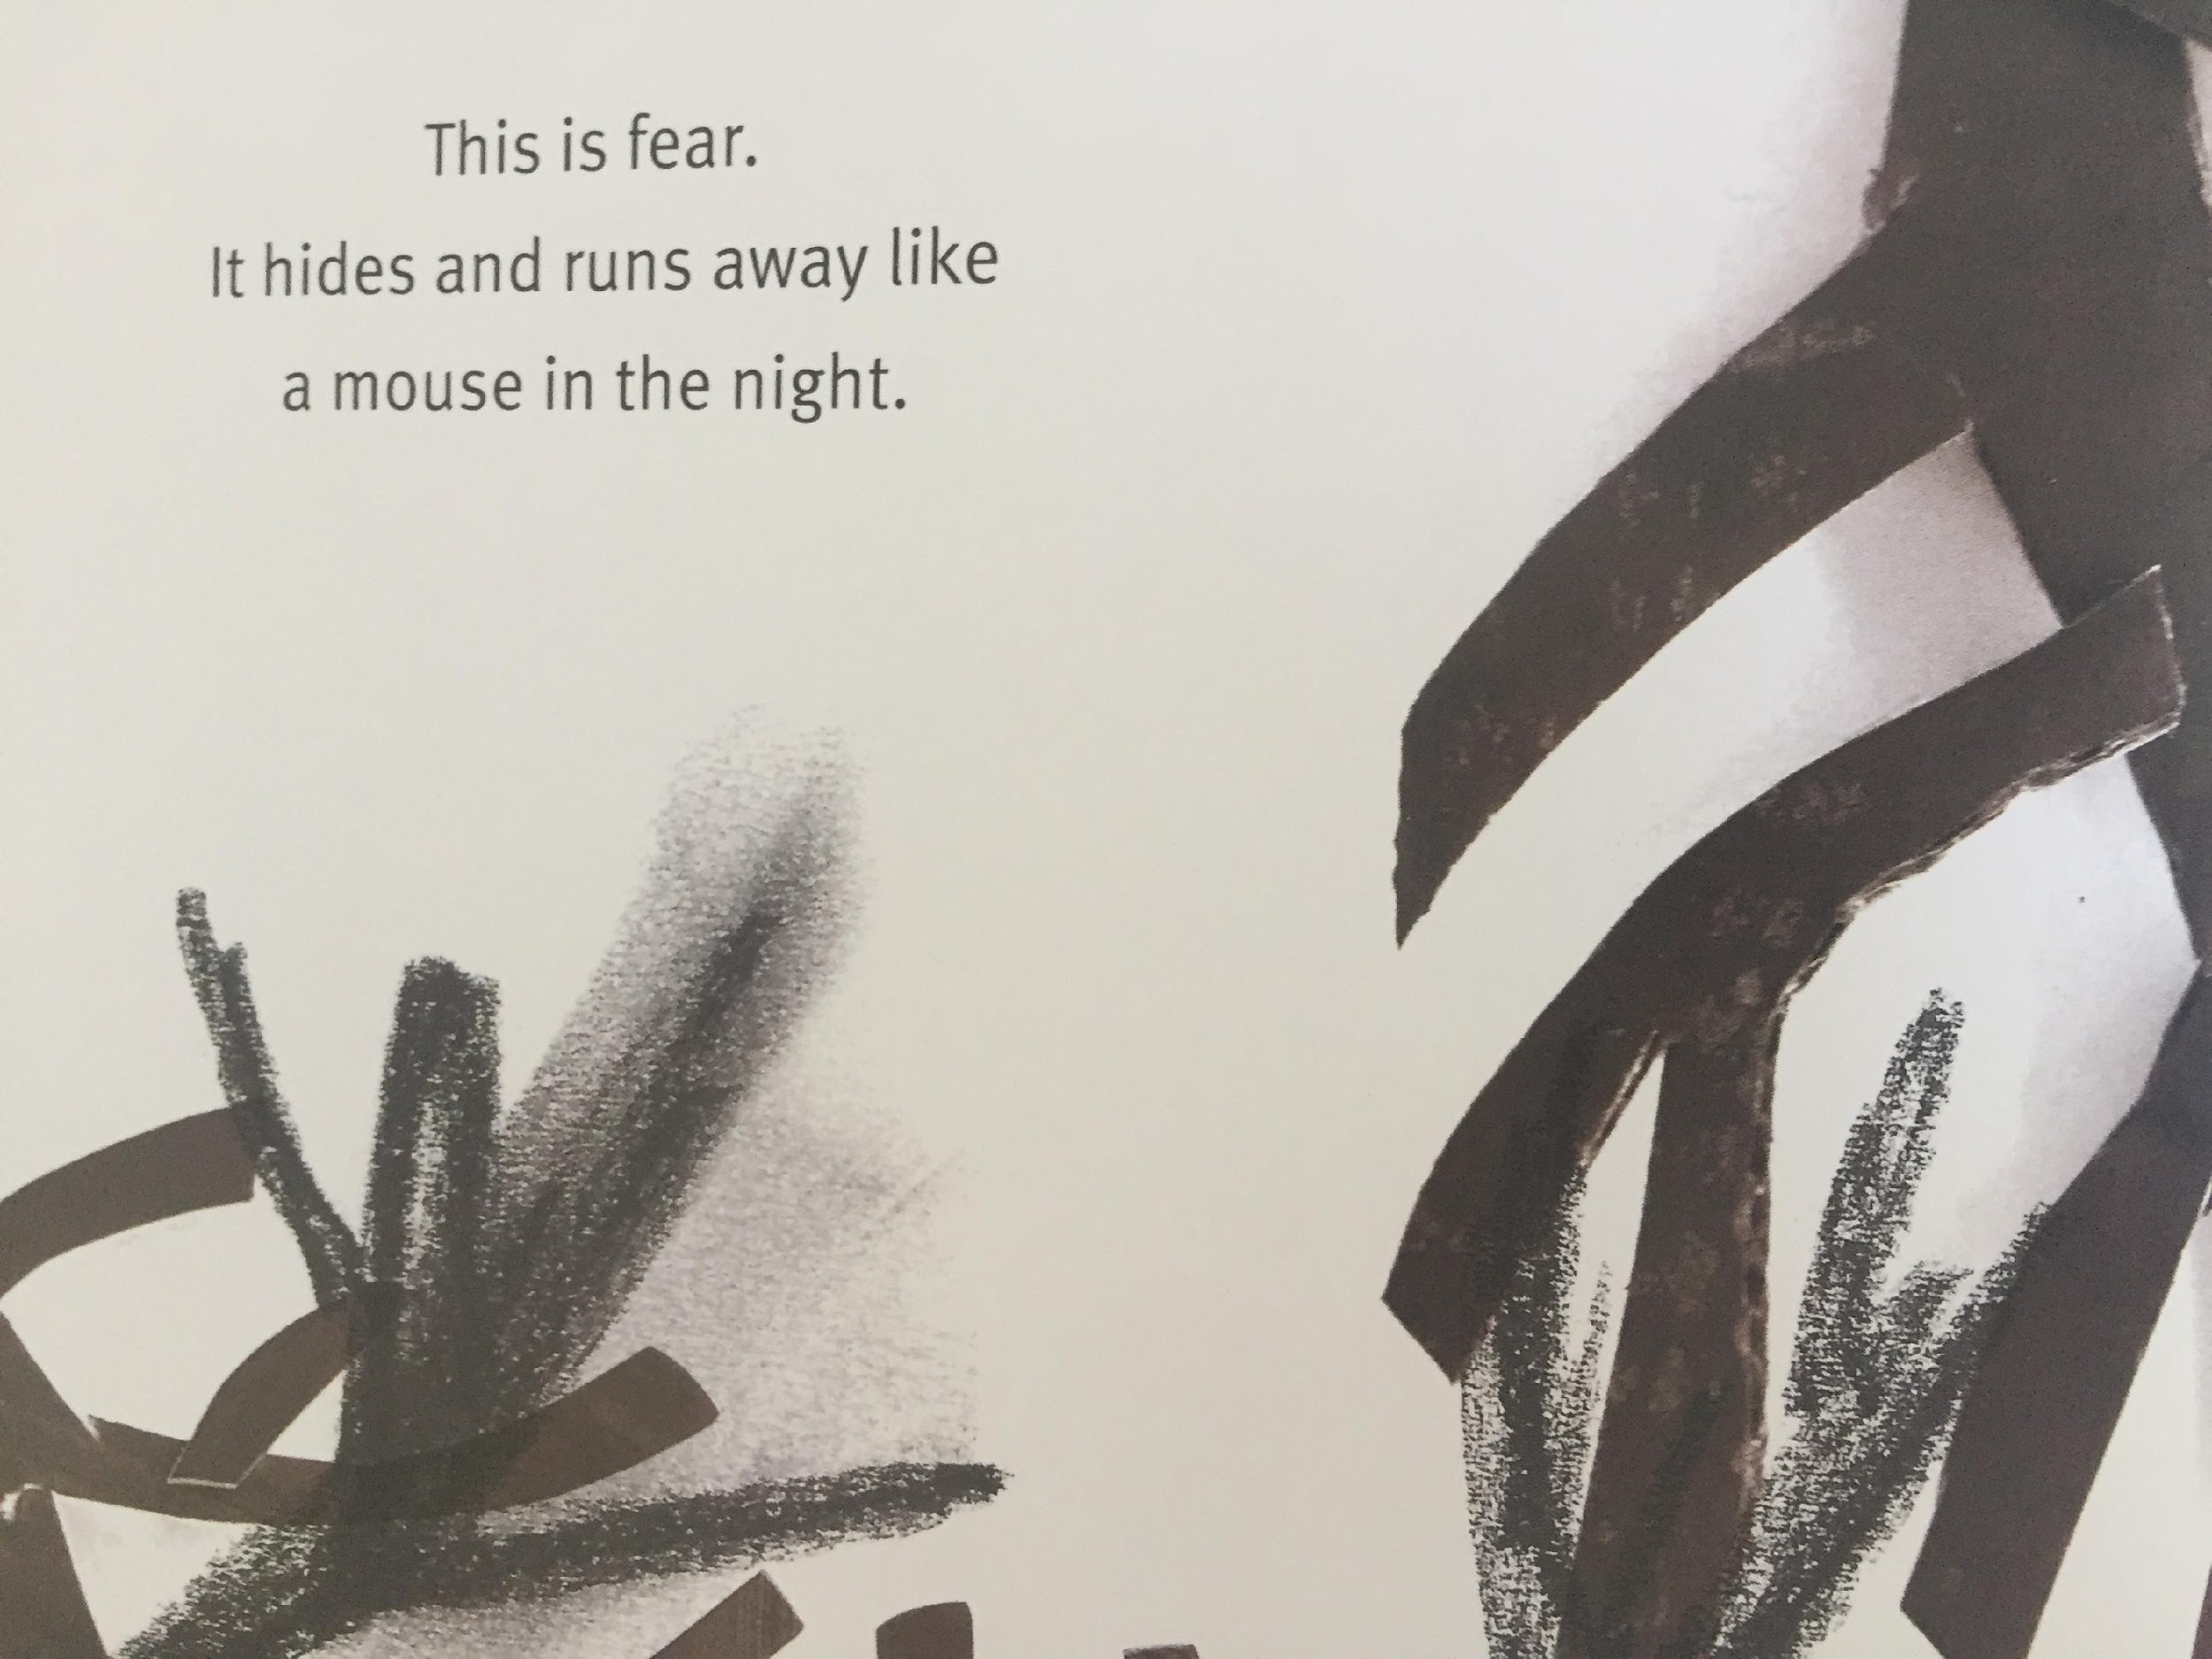
LI – to make links with our own experiences.

Slide 28
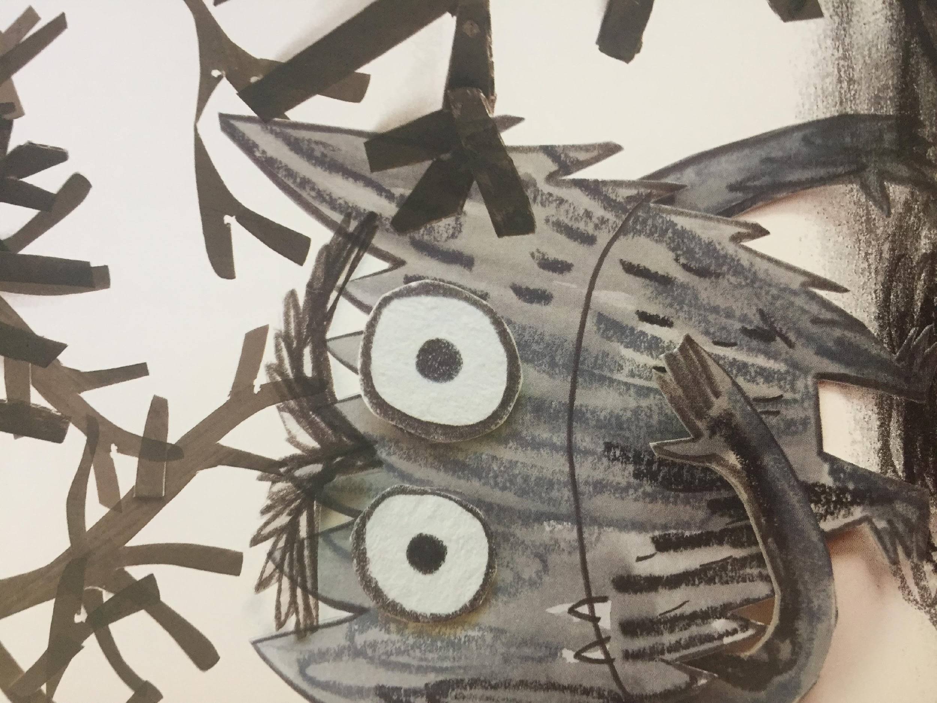
What makes you feel fear?

Slide 29
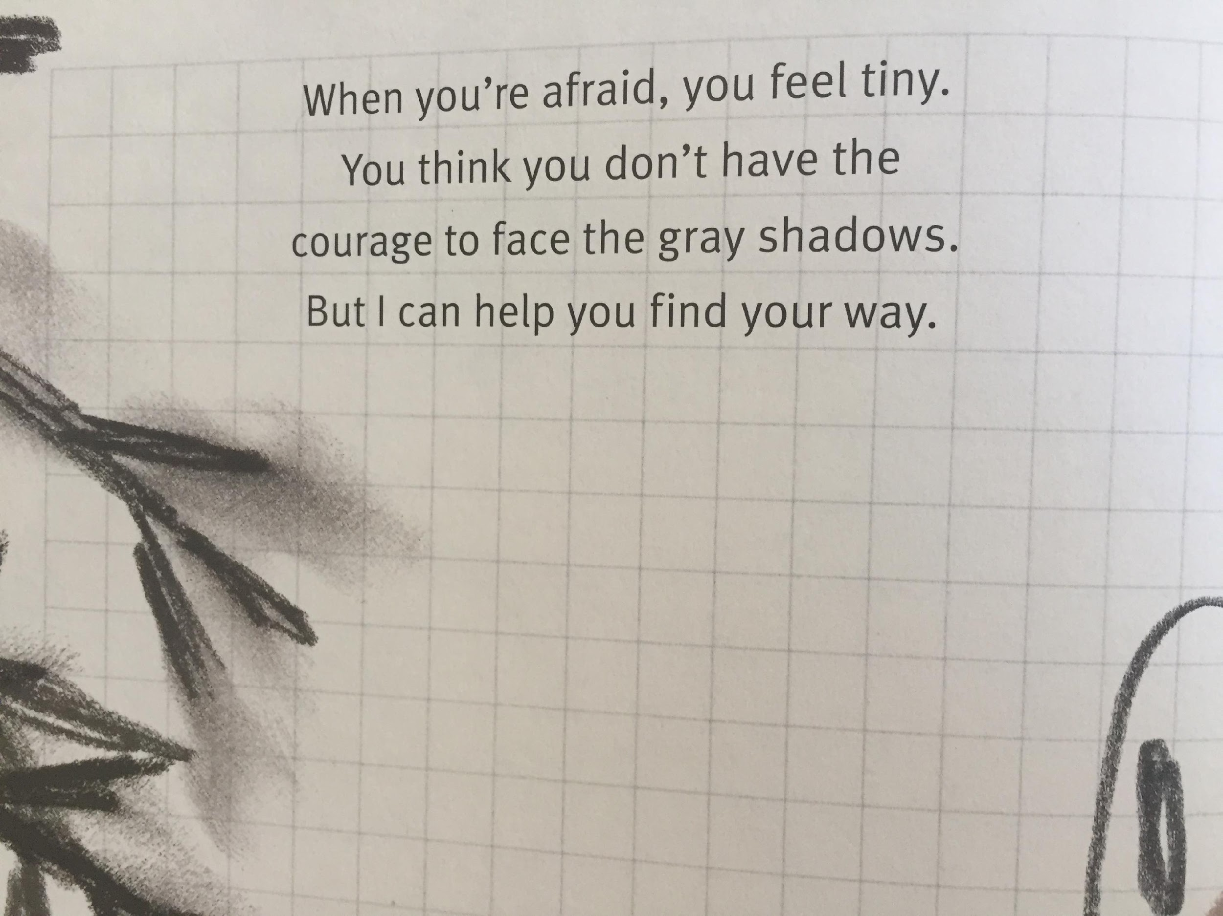
LI – to make links with our own experiences.
What does this make you think of ... ?
This makes me think of when ... because. ...
This reminds me of when ....

Slide 30
Friday

Slide 31
Now let’s practice some of the words we might find in the text.
anger
fear
calm
peace
feelings

Slide 32
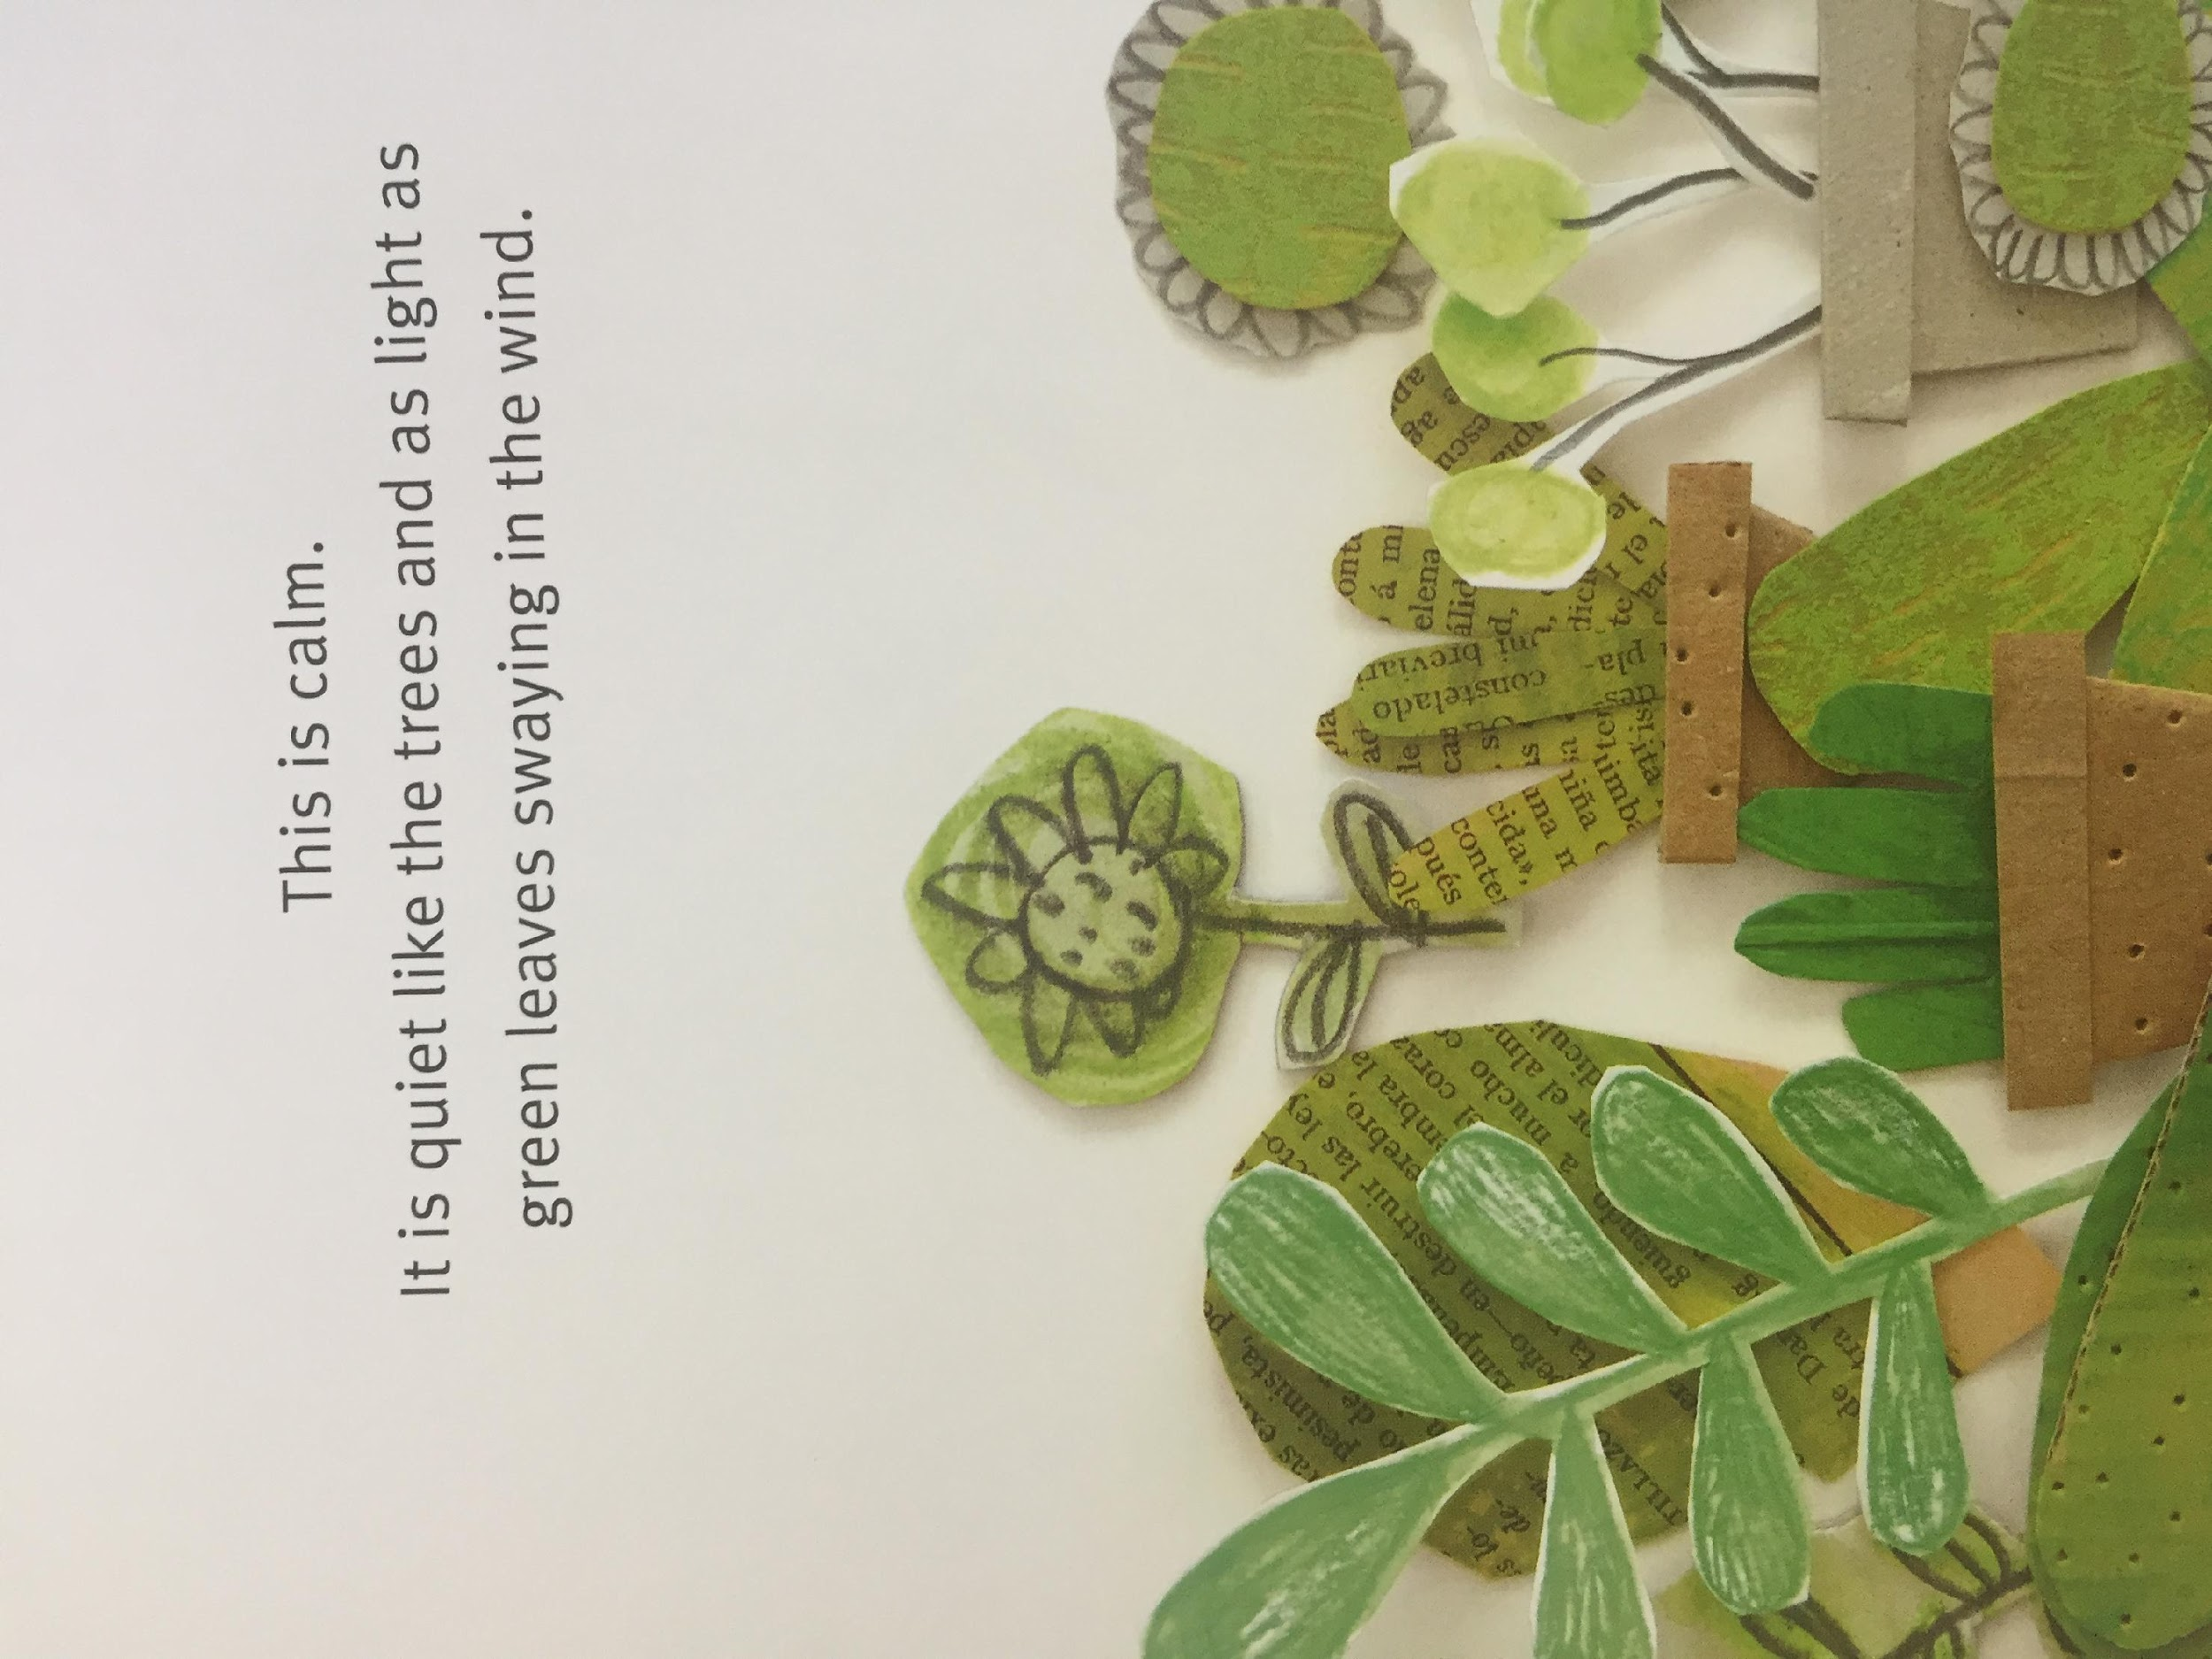
LI – to make links with our own experiences.

Slide 33
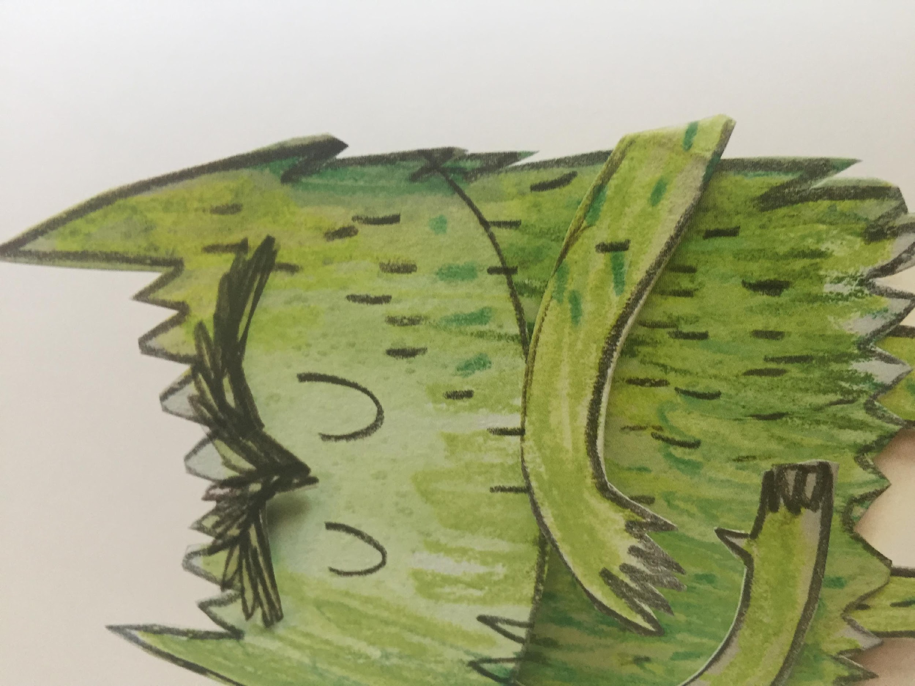
What makes you feel calm ?

Slide 34
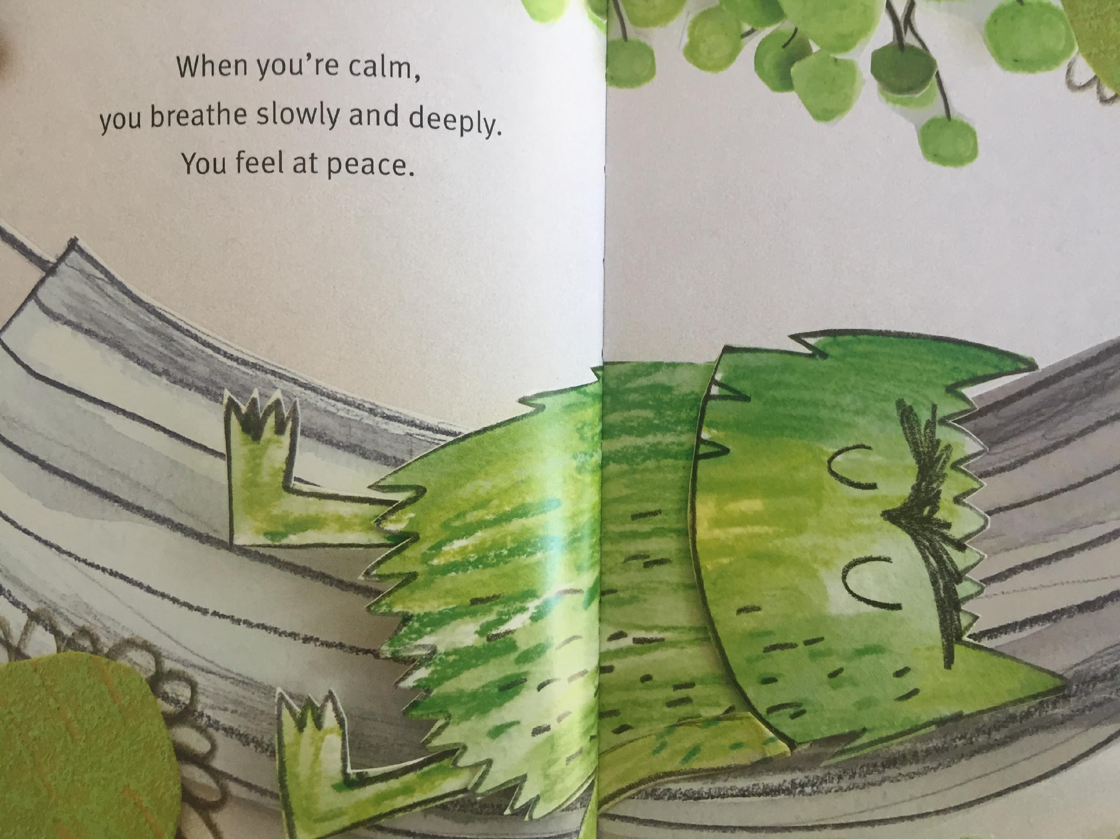
LI – to make links with our own experiences.

Slide 35
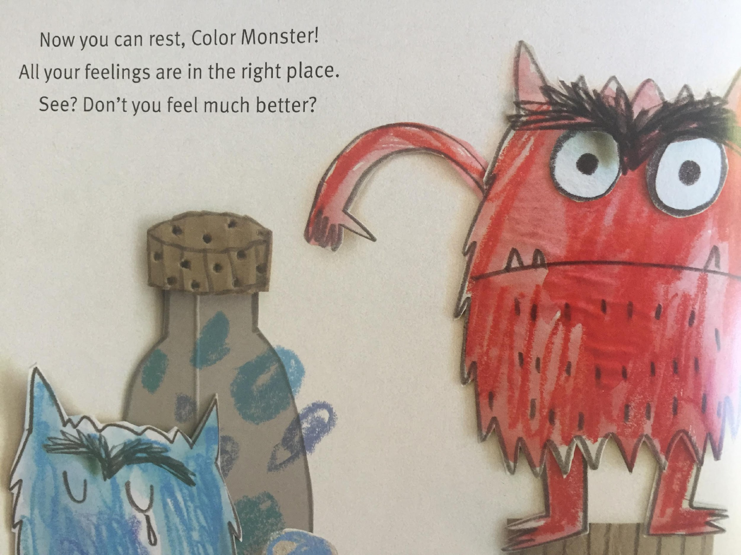

Slide 36
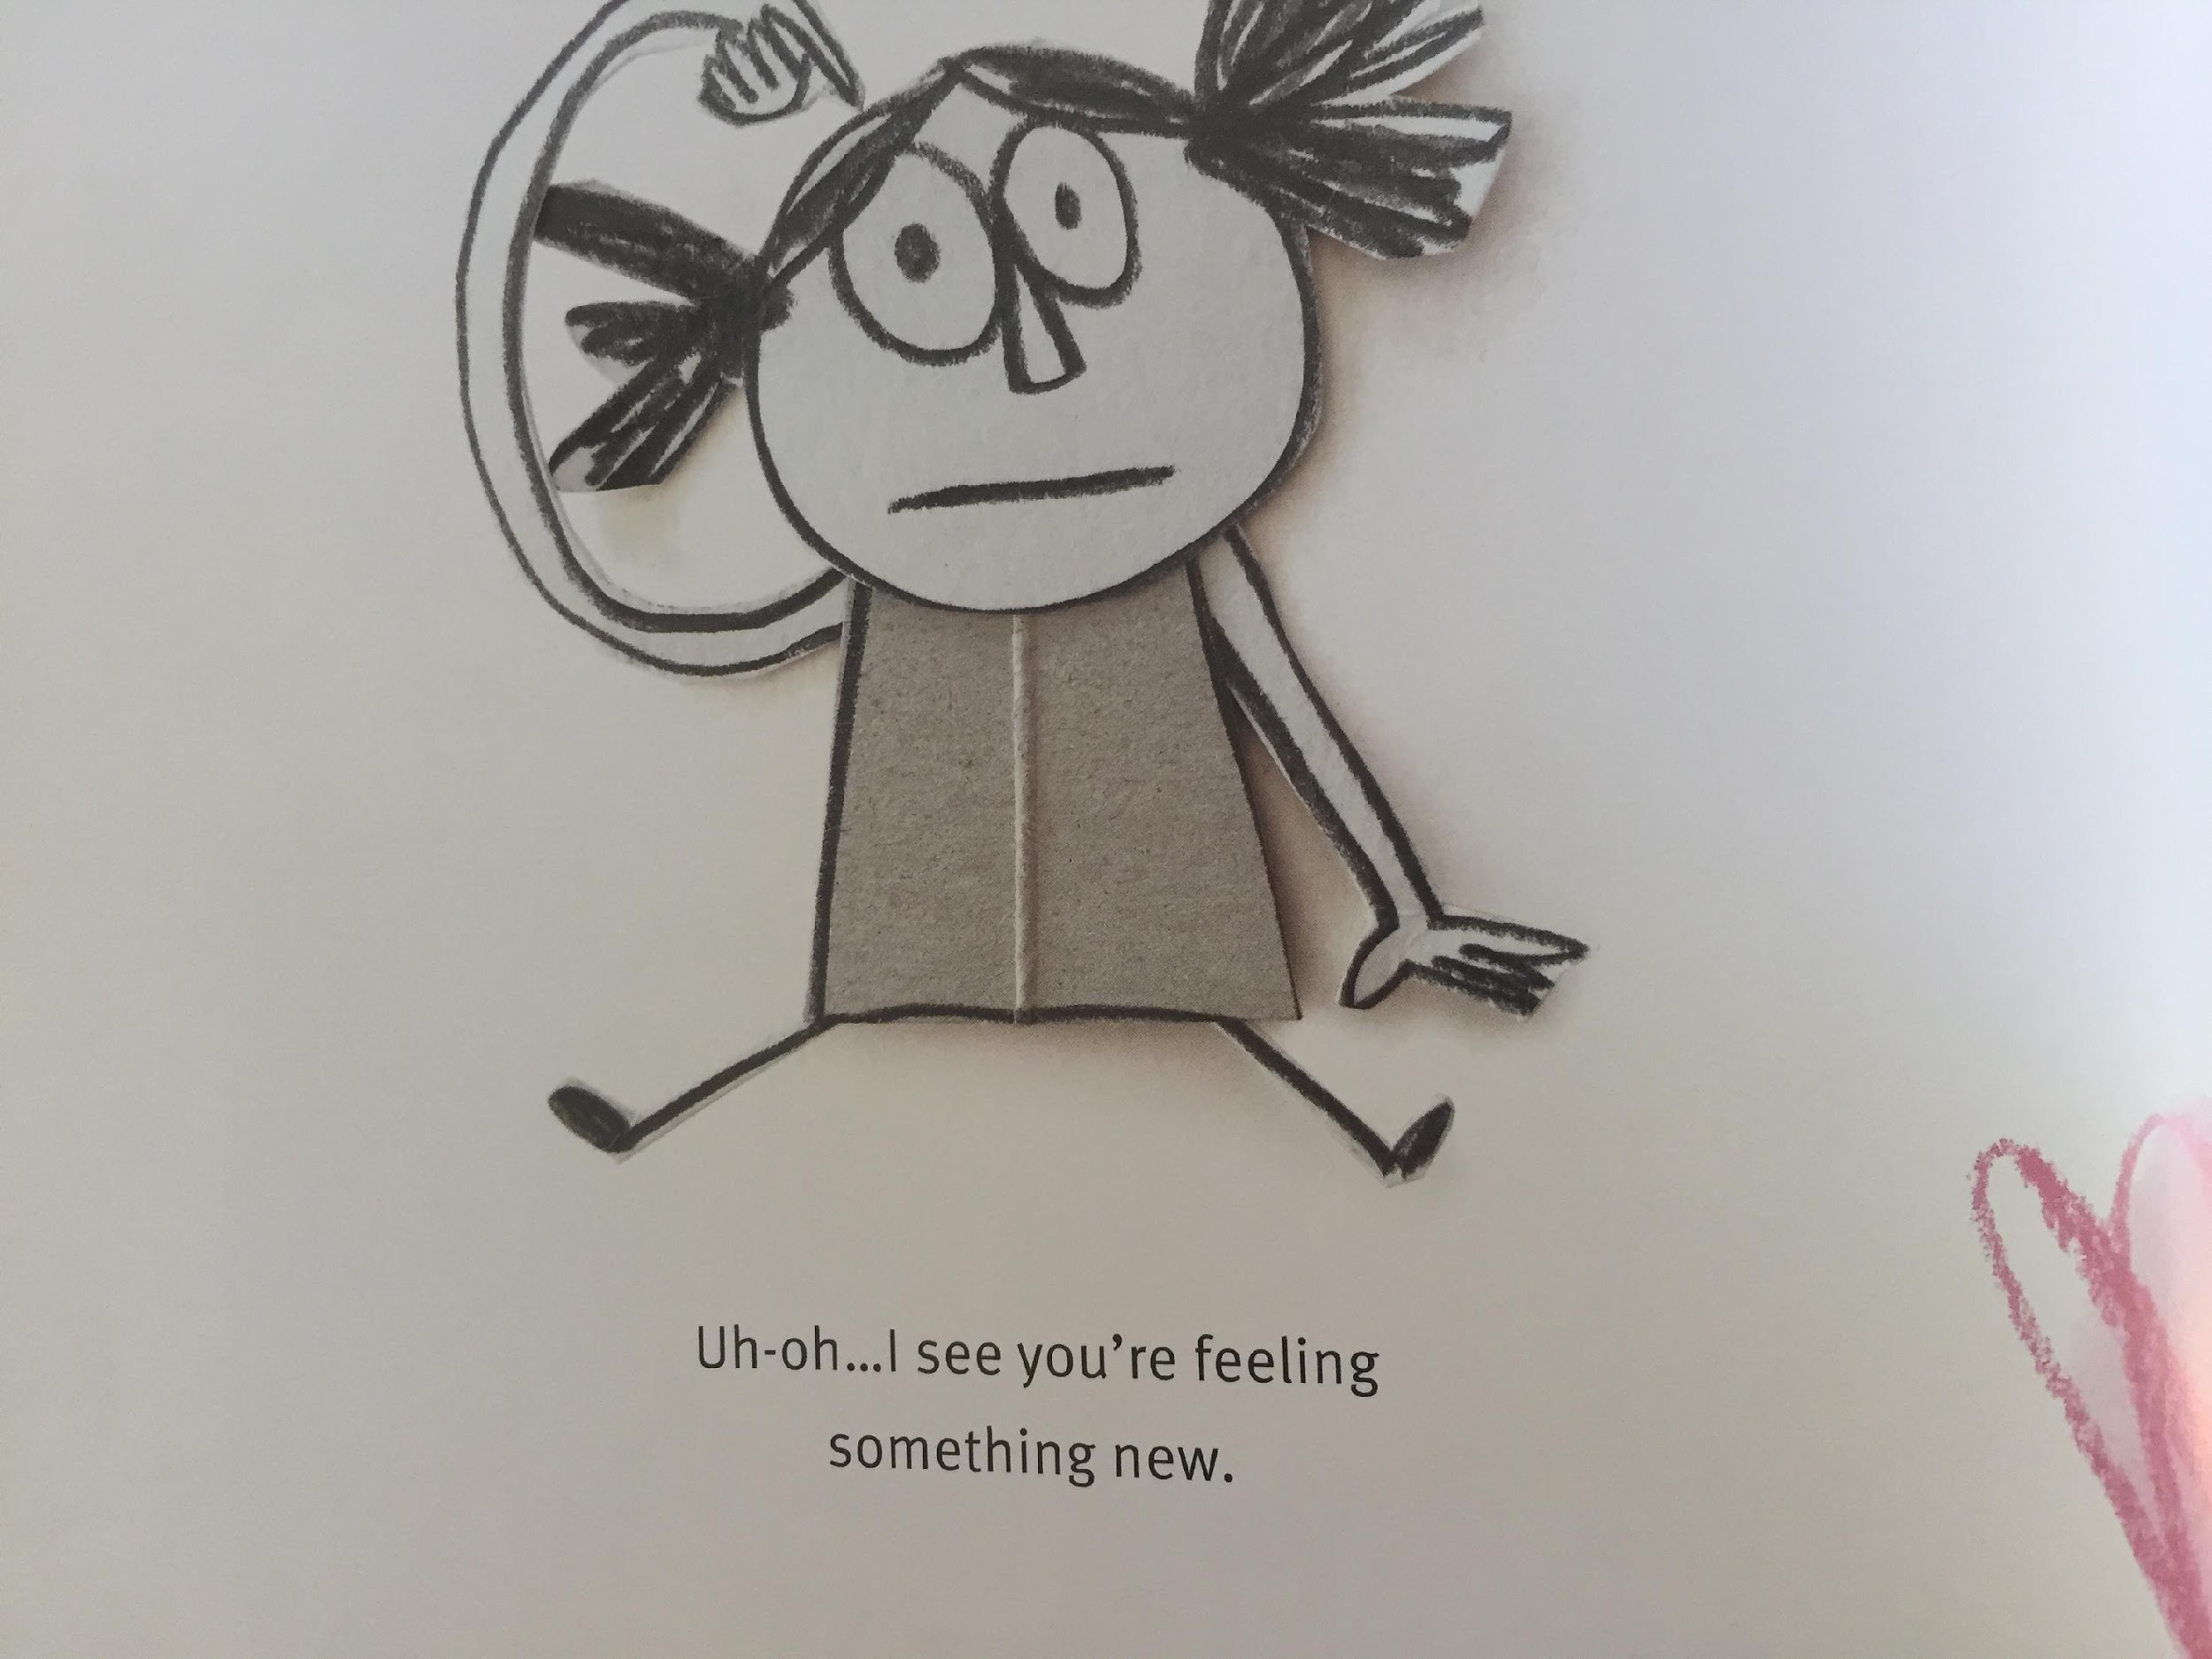
LI – to make links with our own experiences.

Slide 37
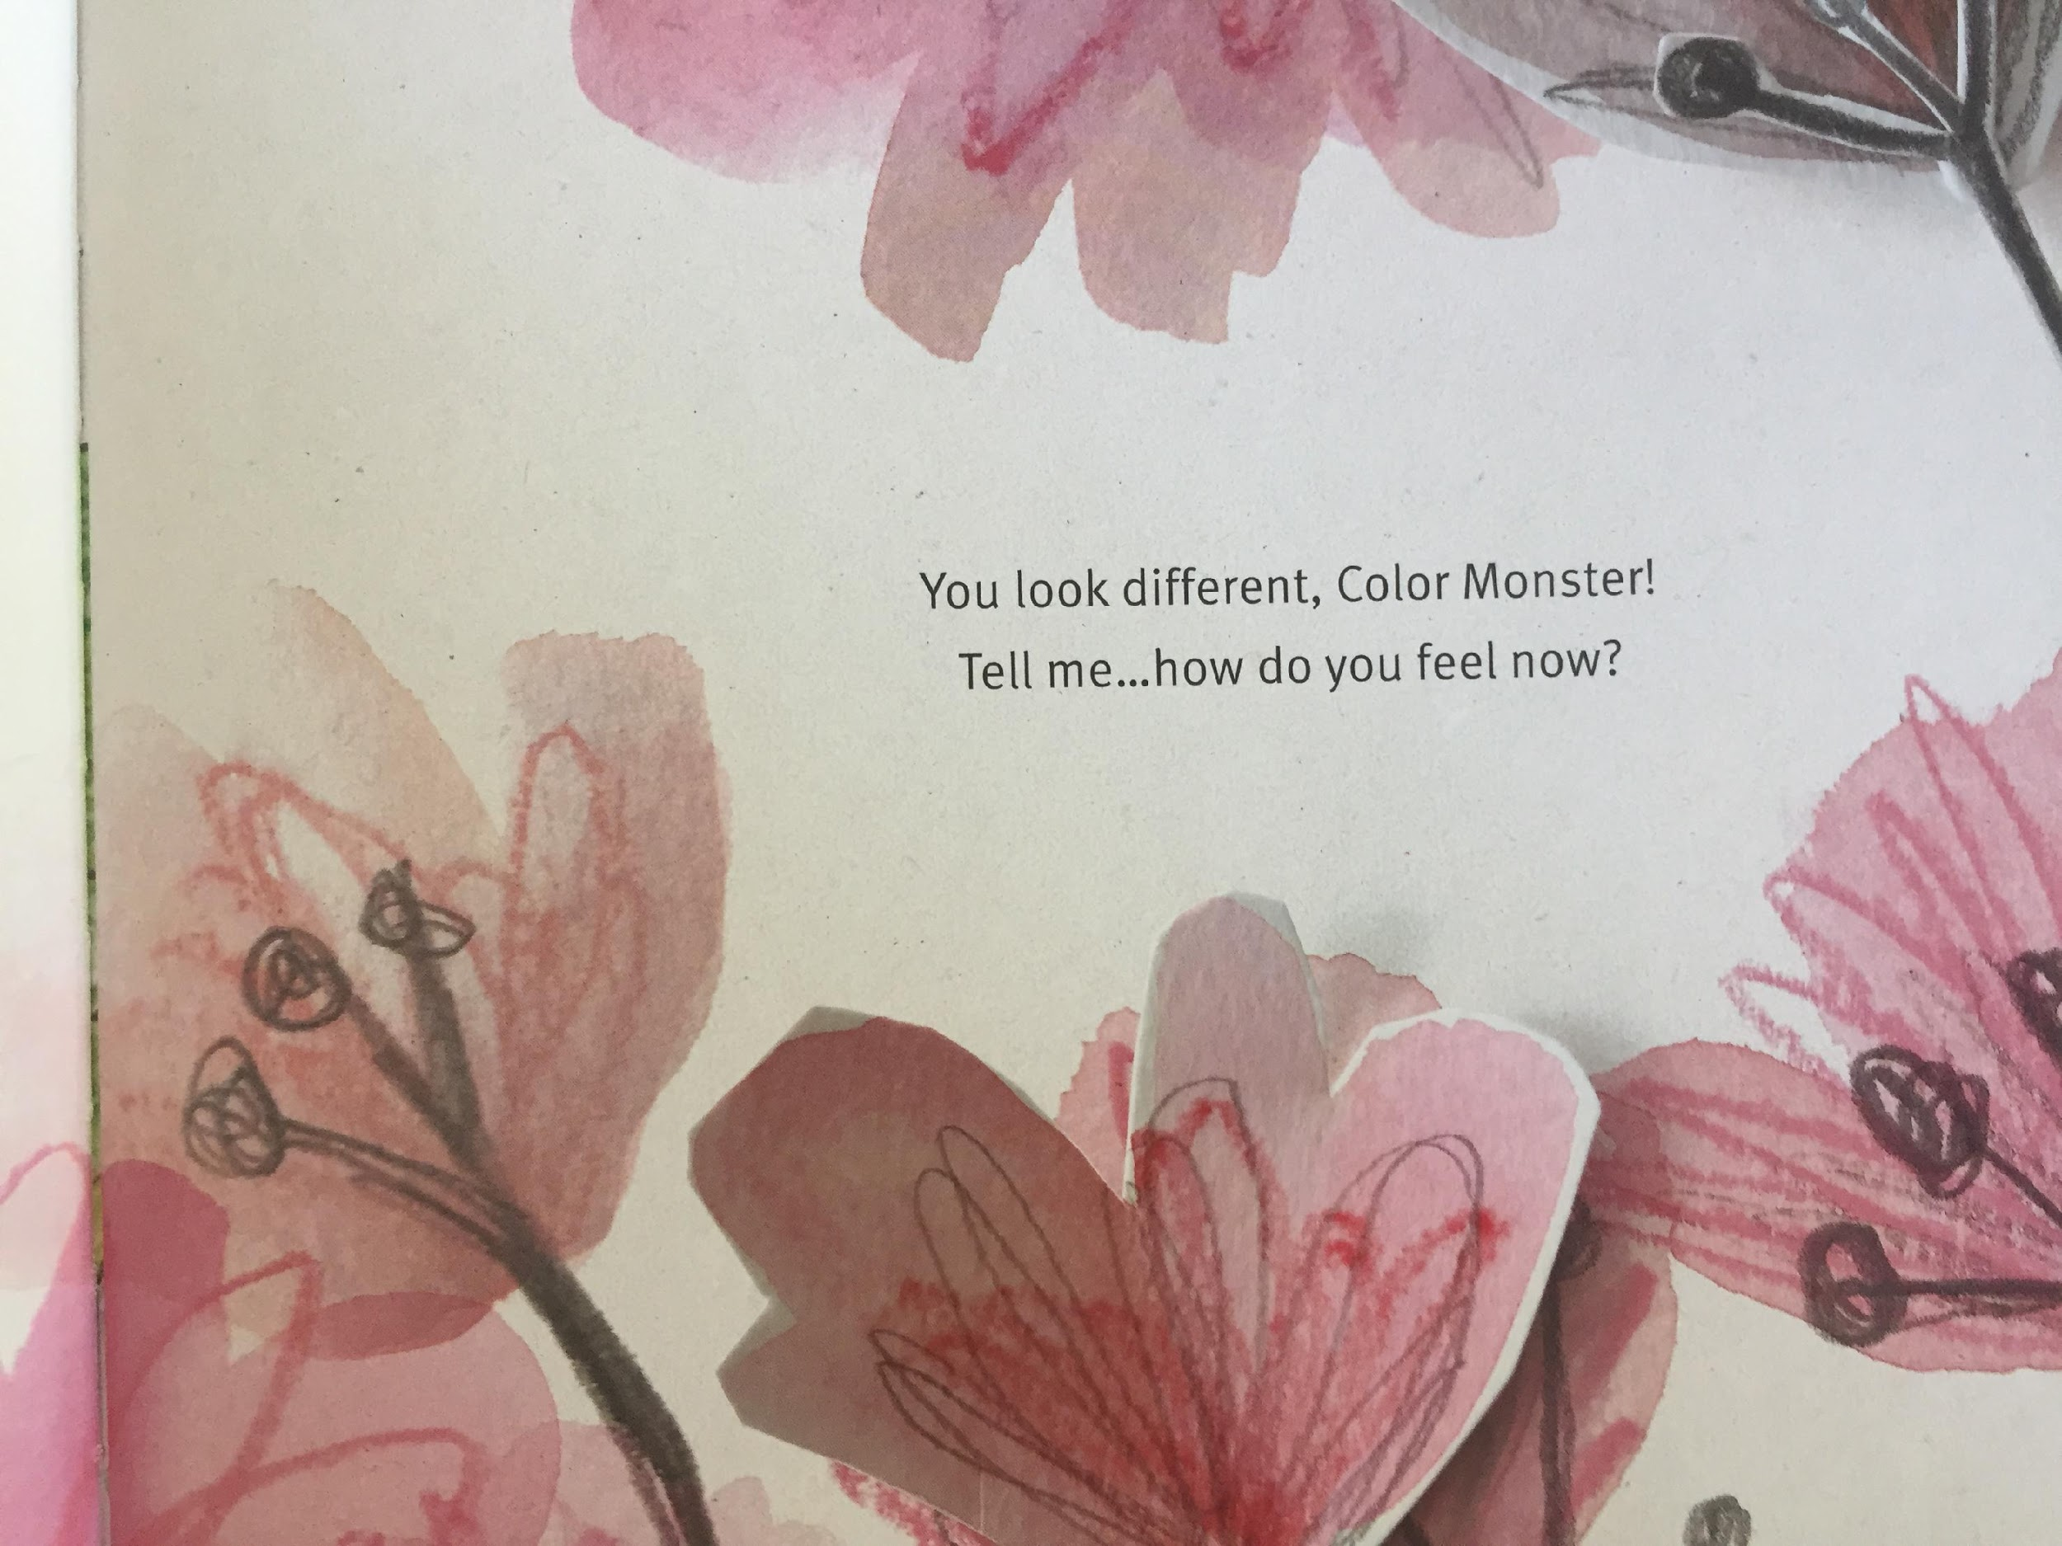
LI – to make links with our own experiences.

Slide 38
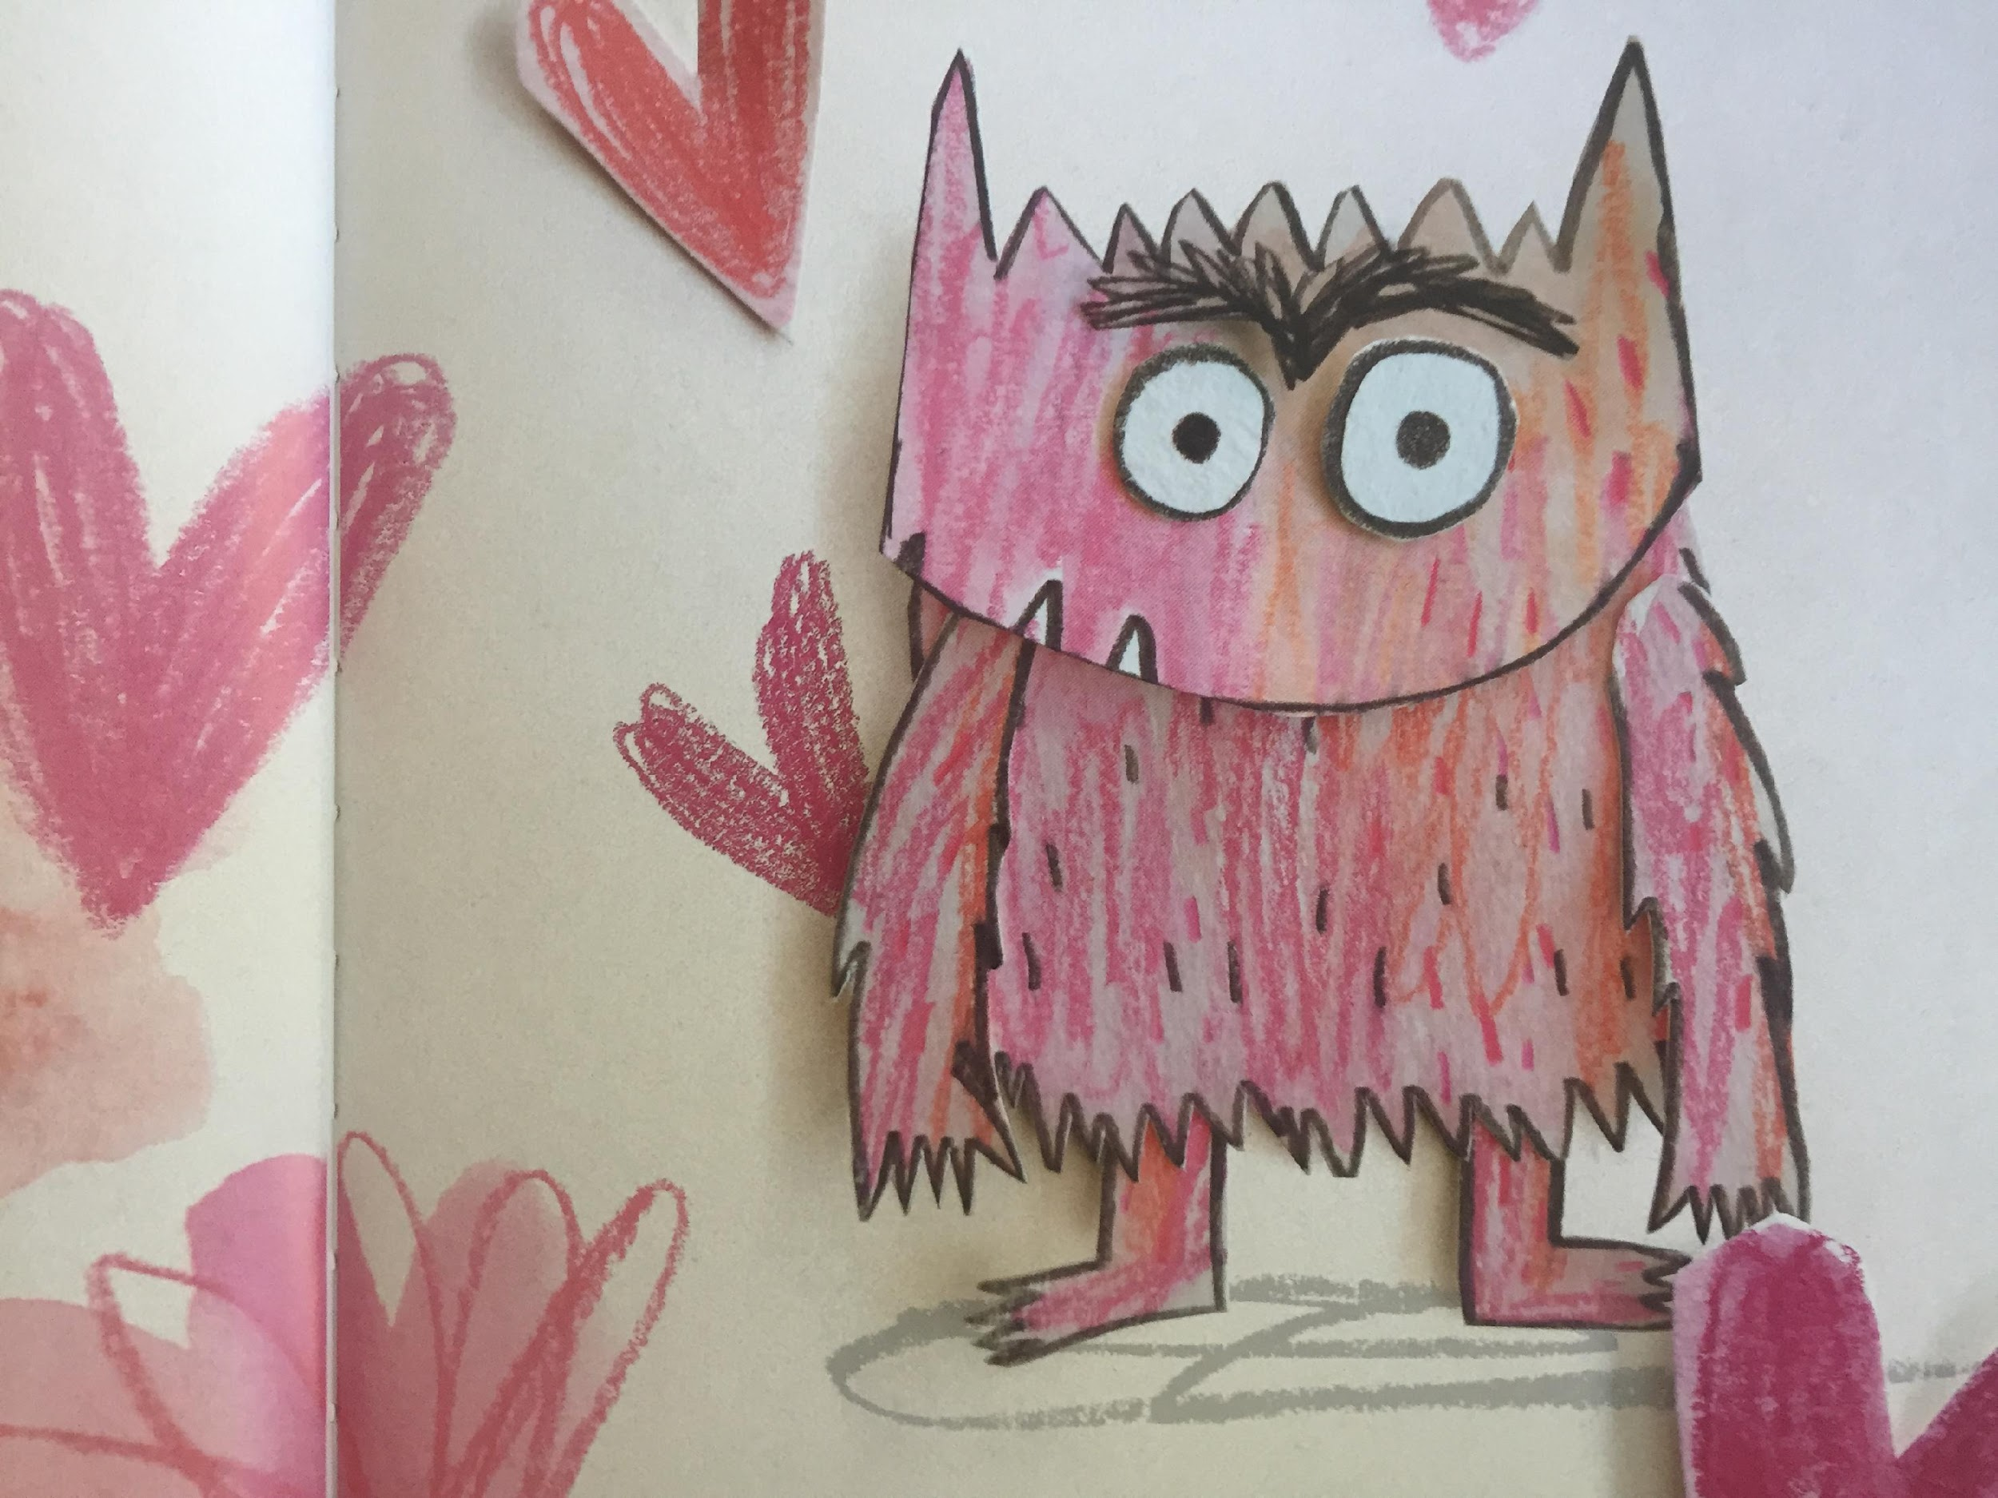
Describe a time you felt pink

Slide 39
What does this book make you think of ... ?
This makes me think of when ... because. ...
This reminds me of when ....

Slide 40


