Slide 1



How many bears are there on each plate?

Slide 2







Slide 3






Slide 4


Slide 5



Slide 6





Slide 7
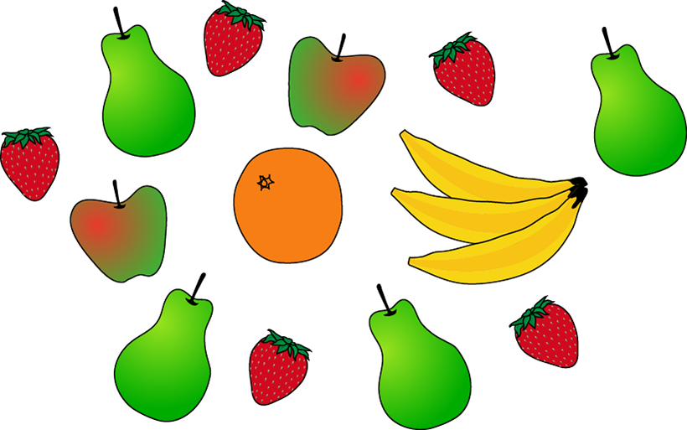
How many pears are there? How many strawberries are there?

Slide 8
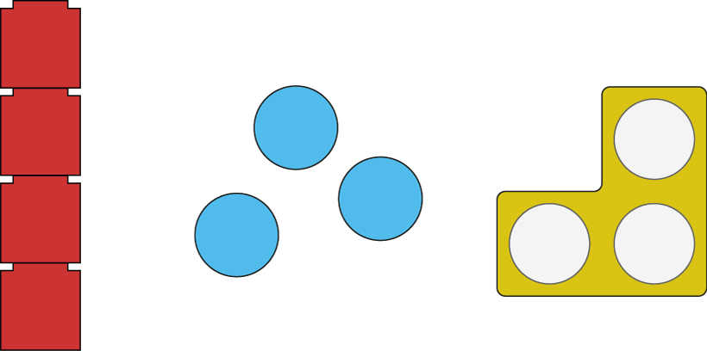
Which one does not show 3?
4
3
3

Slide 9
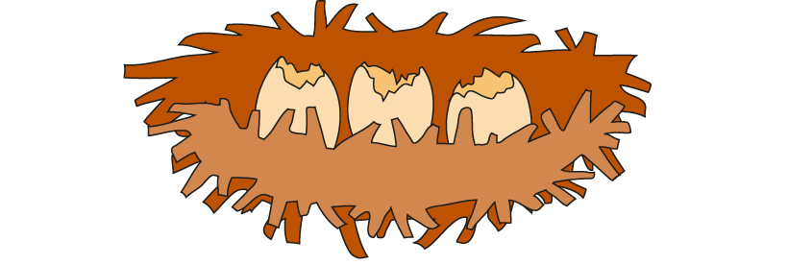
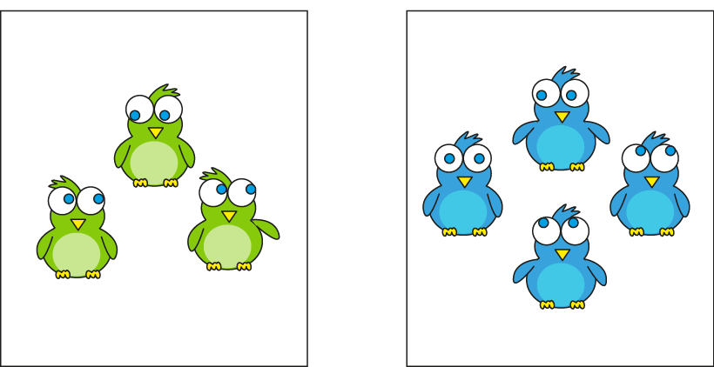
Which group of chicks match the number of eggs?
3
3
4

Slide 10
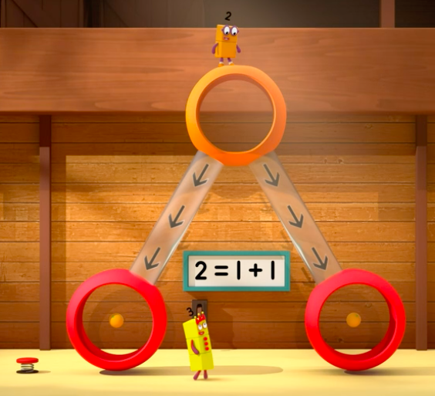
https://www.bbc.co.uk/iplayer/episode/b0blsv9r/numberblocks-series-3-fruit-salad

Slide 11
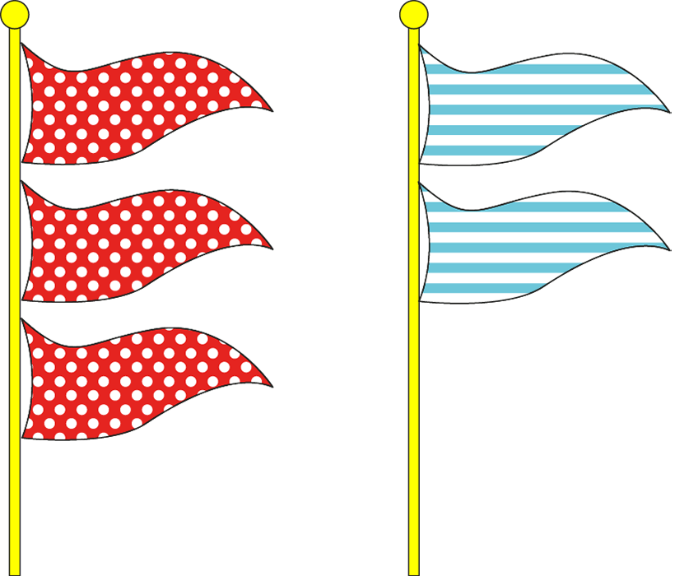
What numbers can you see?
There are ____ flags altogether.
There are ____ spotty flags and ____ stripy flags.

Slide 12

____ is the whole.
____ is a part. ____ is a part.
5 = 3 + 2

Slide 13
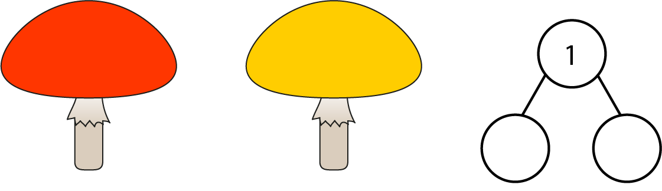
1.3 Composition: 0–5 – step 3:2
1
0
____ is the whole. ____ is a part. ____ is a part.

Slide 14

Watch the spots! Can we fill in the cherry model?
5
0
____ is the whole. ____ is a part. ____ is a part.

Slide 15
Watch the spots! Can we fill in the cherry model?
Can we partition 5 a different way?
3
2
____ is the whole. ____ is a part. ____ is a part.

Slide 16
Watch the spots! Can we fill in the cherry model?
Can you draw a different way on your whiteboard?
4
1
____ is the whole. ____ is a part. ____ is a part.

Slide 17
Watch the spots! Can we fill in the cherry model?
Can you draw a different way on your whiteboard?
1
4
____ is the whole. ____ is a part. ____ is a part.

Slide 18

____ is the whole. ____ is a part. ____ is a part.

