Slide 1
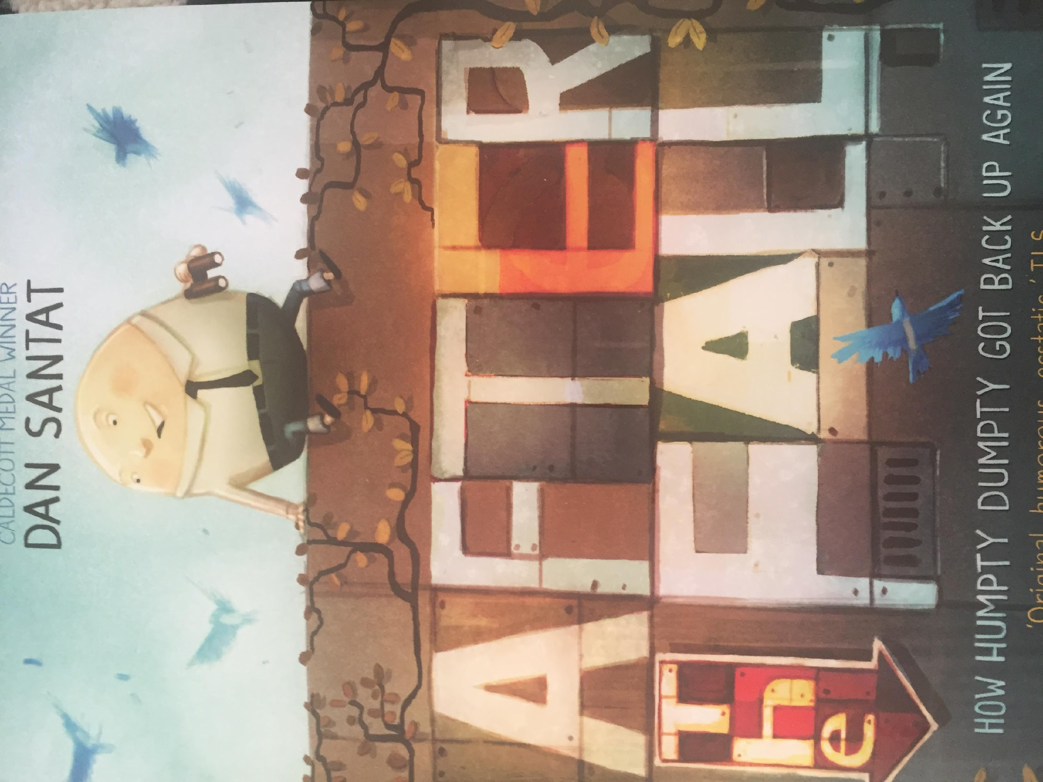
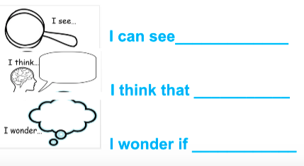

Slide 2


Slide 3
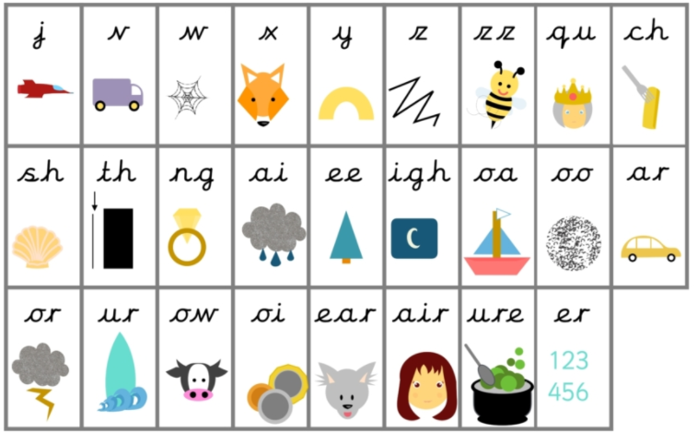
Before we start- let’s practice some of the sounds we might find in the text.

Slide 4
Now let’s practice some of the words we might find in the text.
fell
after
day
back
afraid

Slide 5
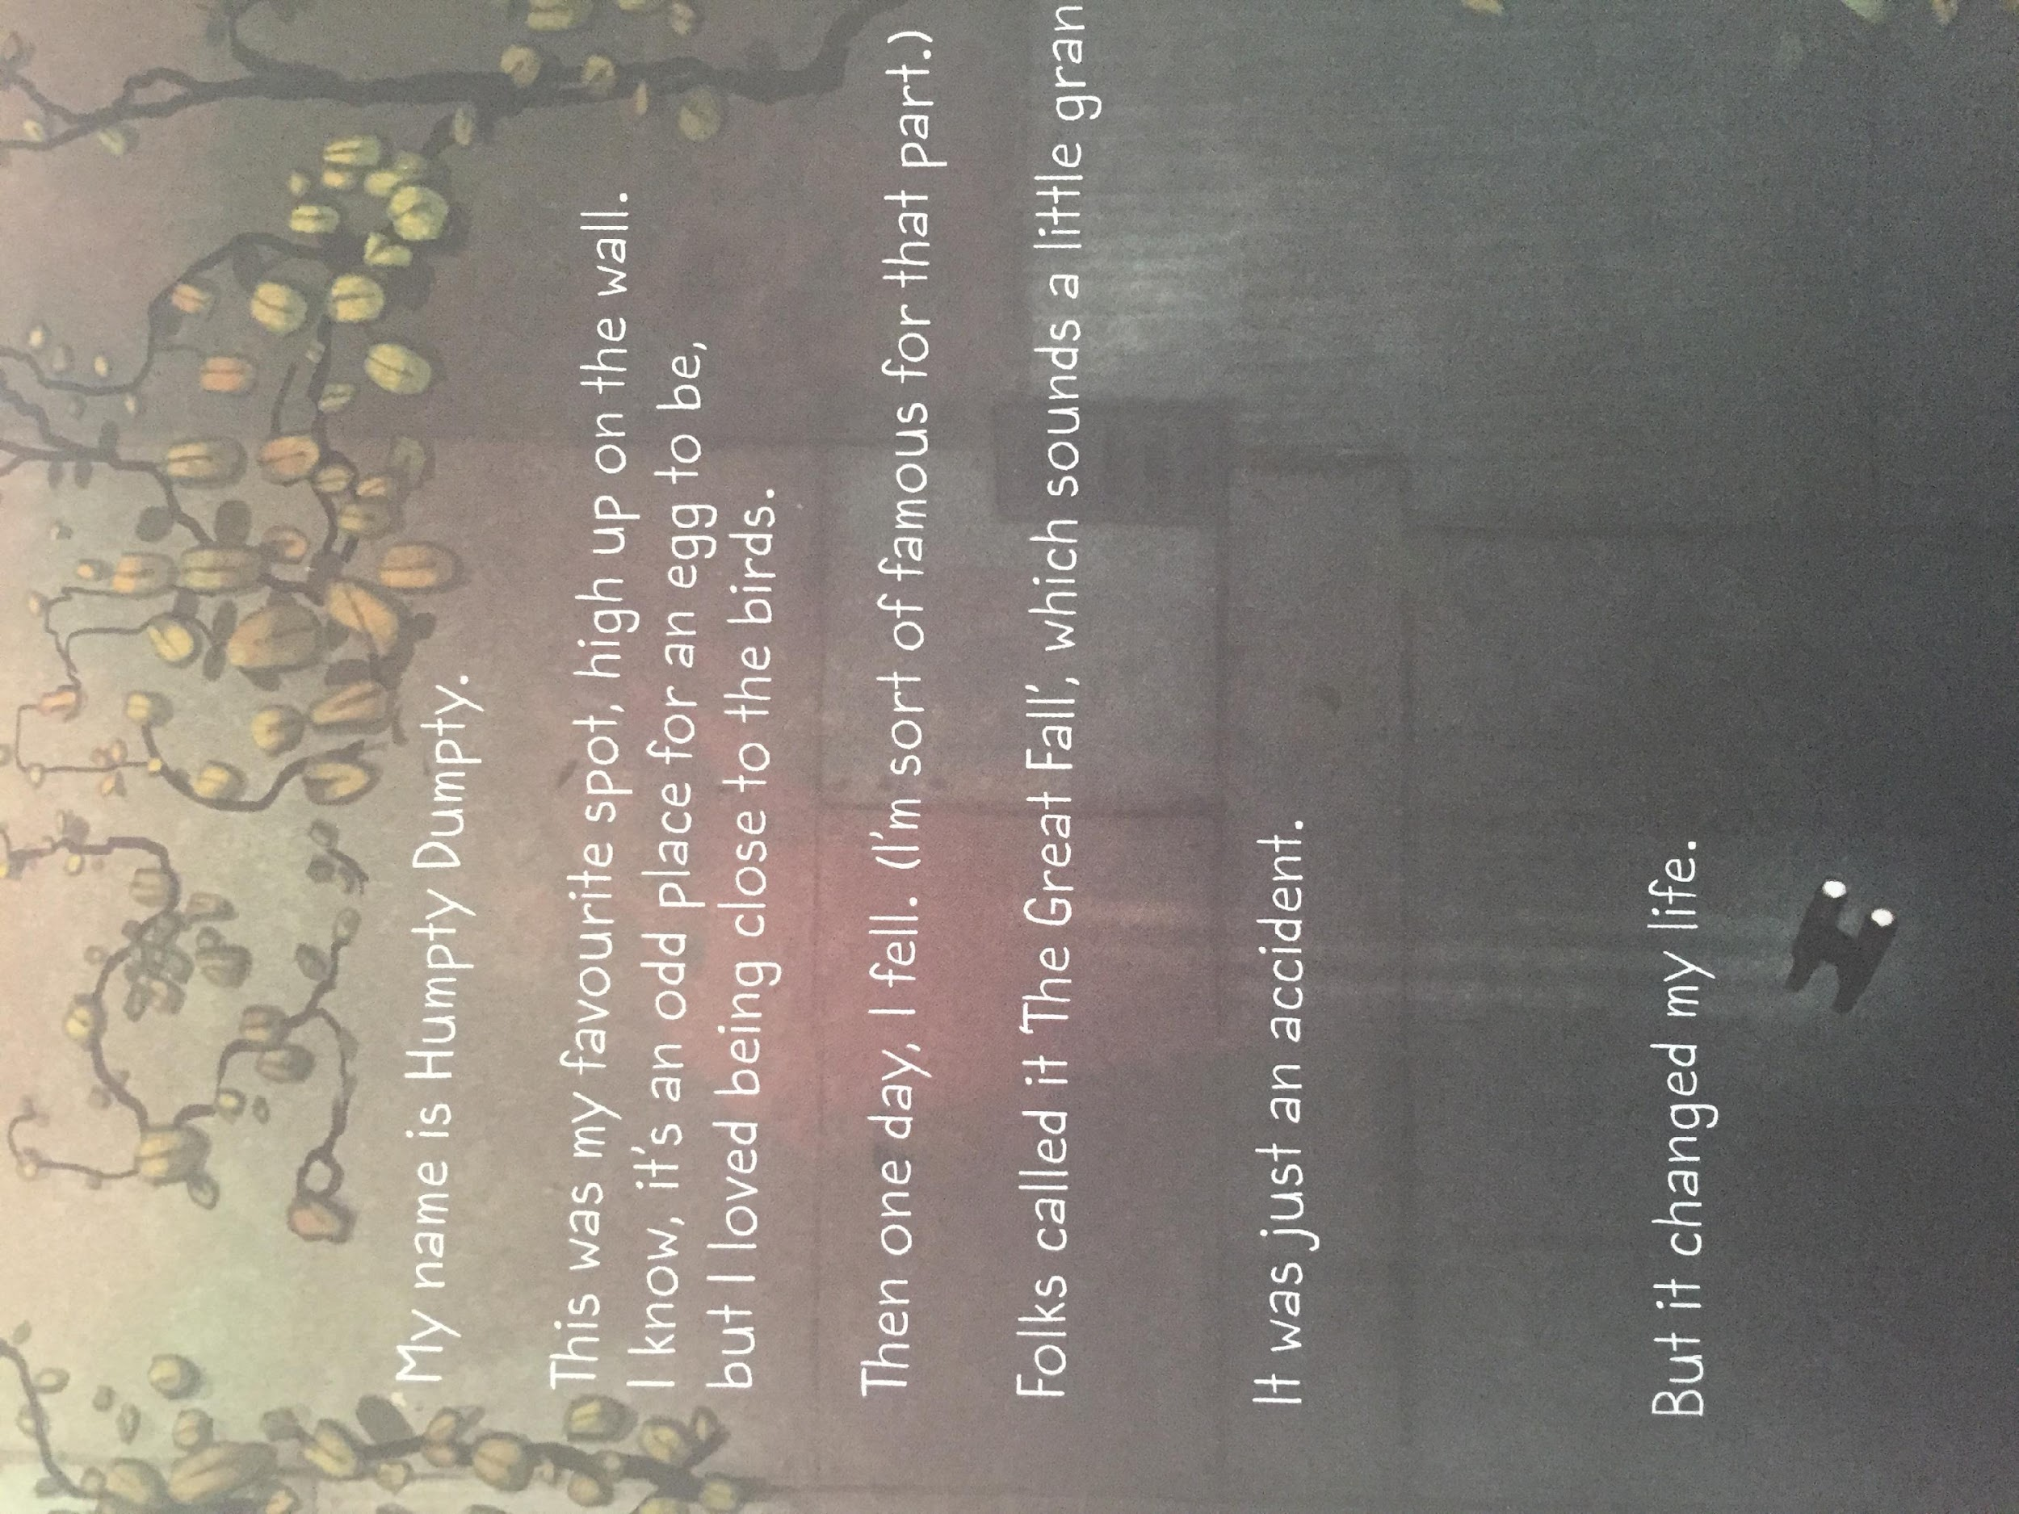

Slide 6
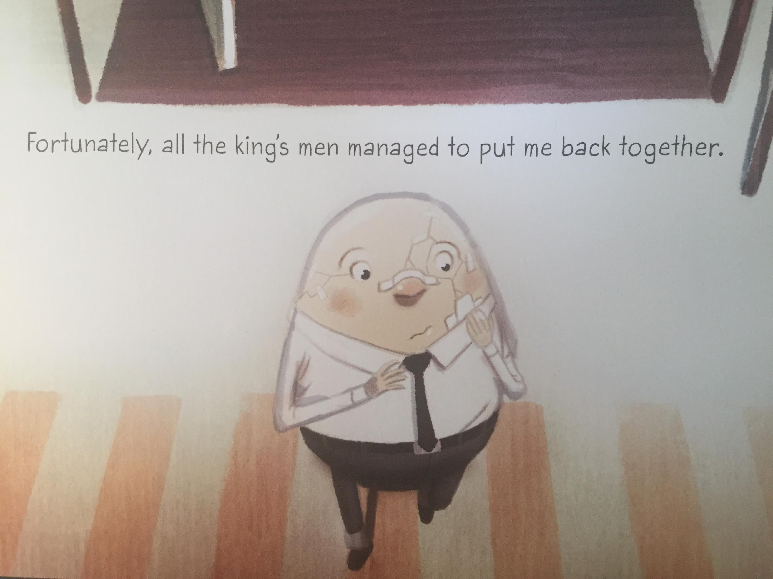

Slide 7
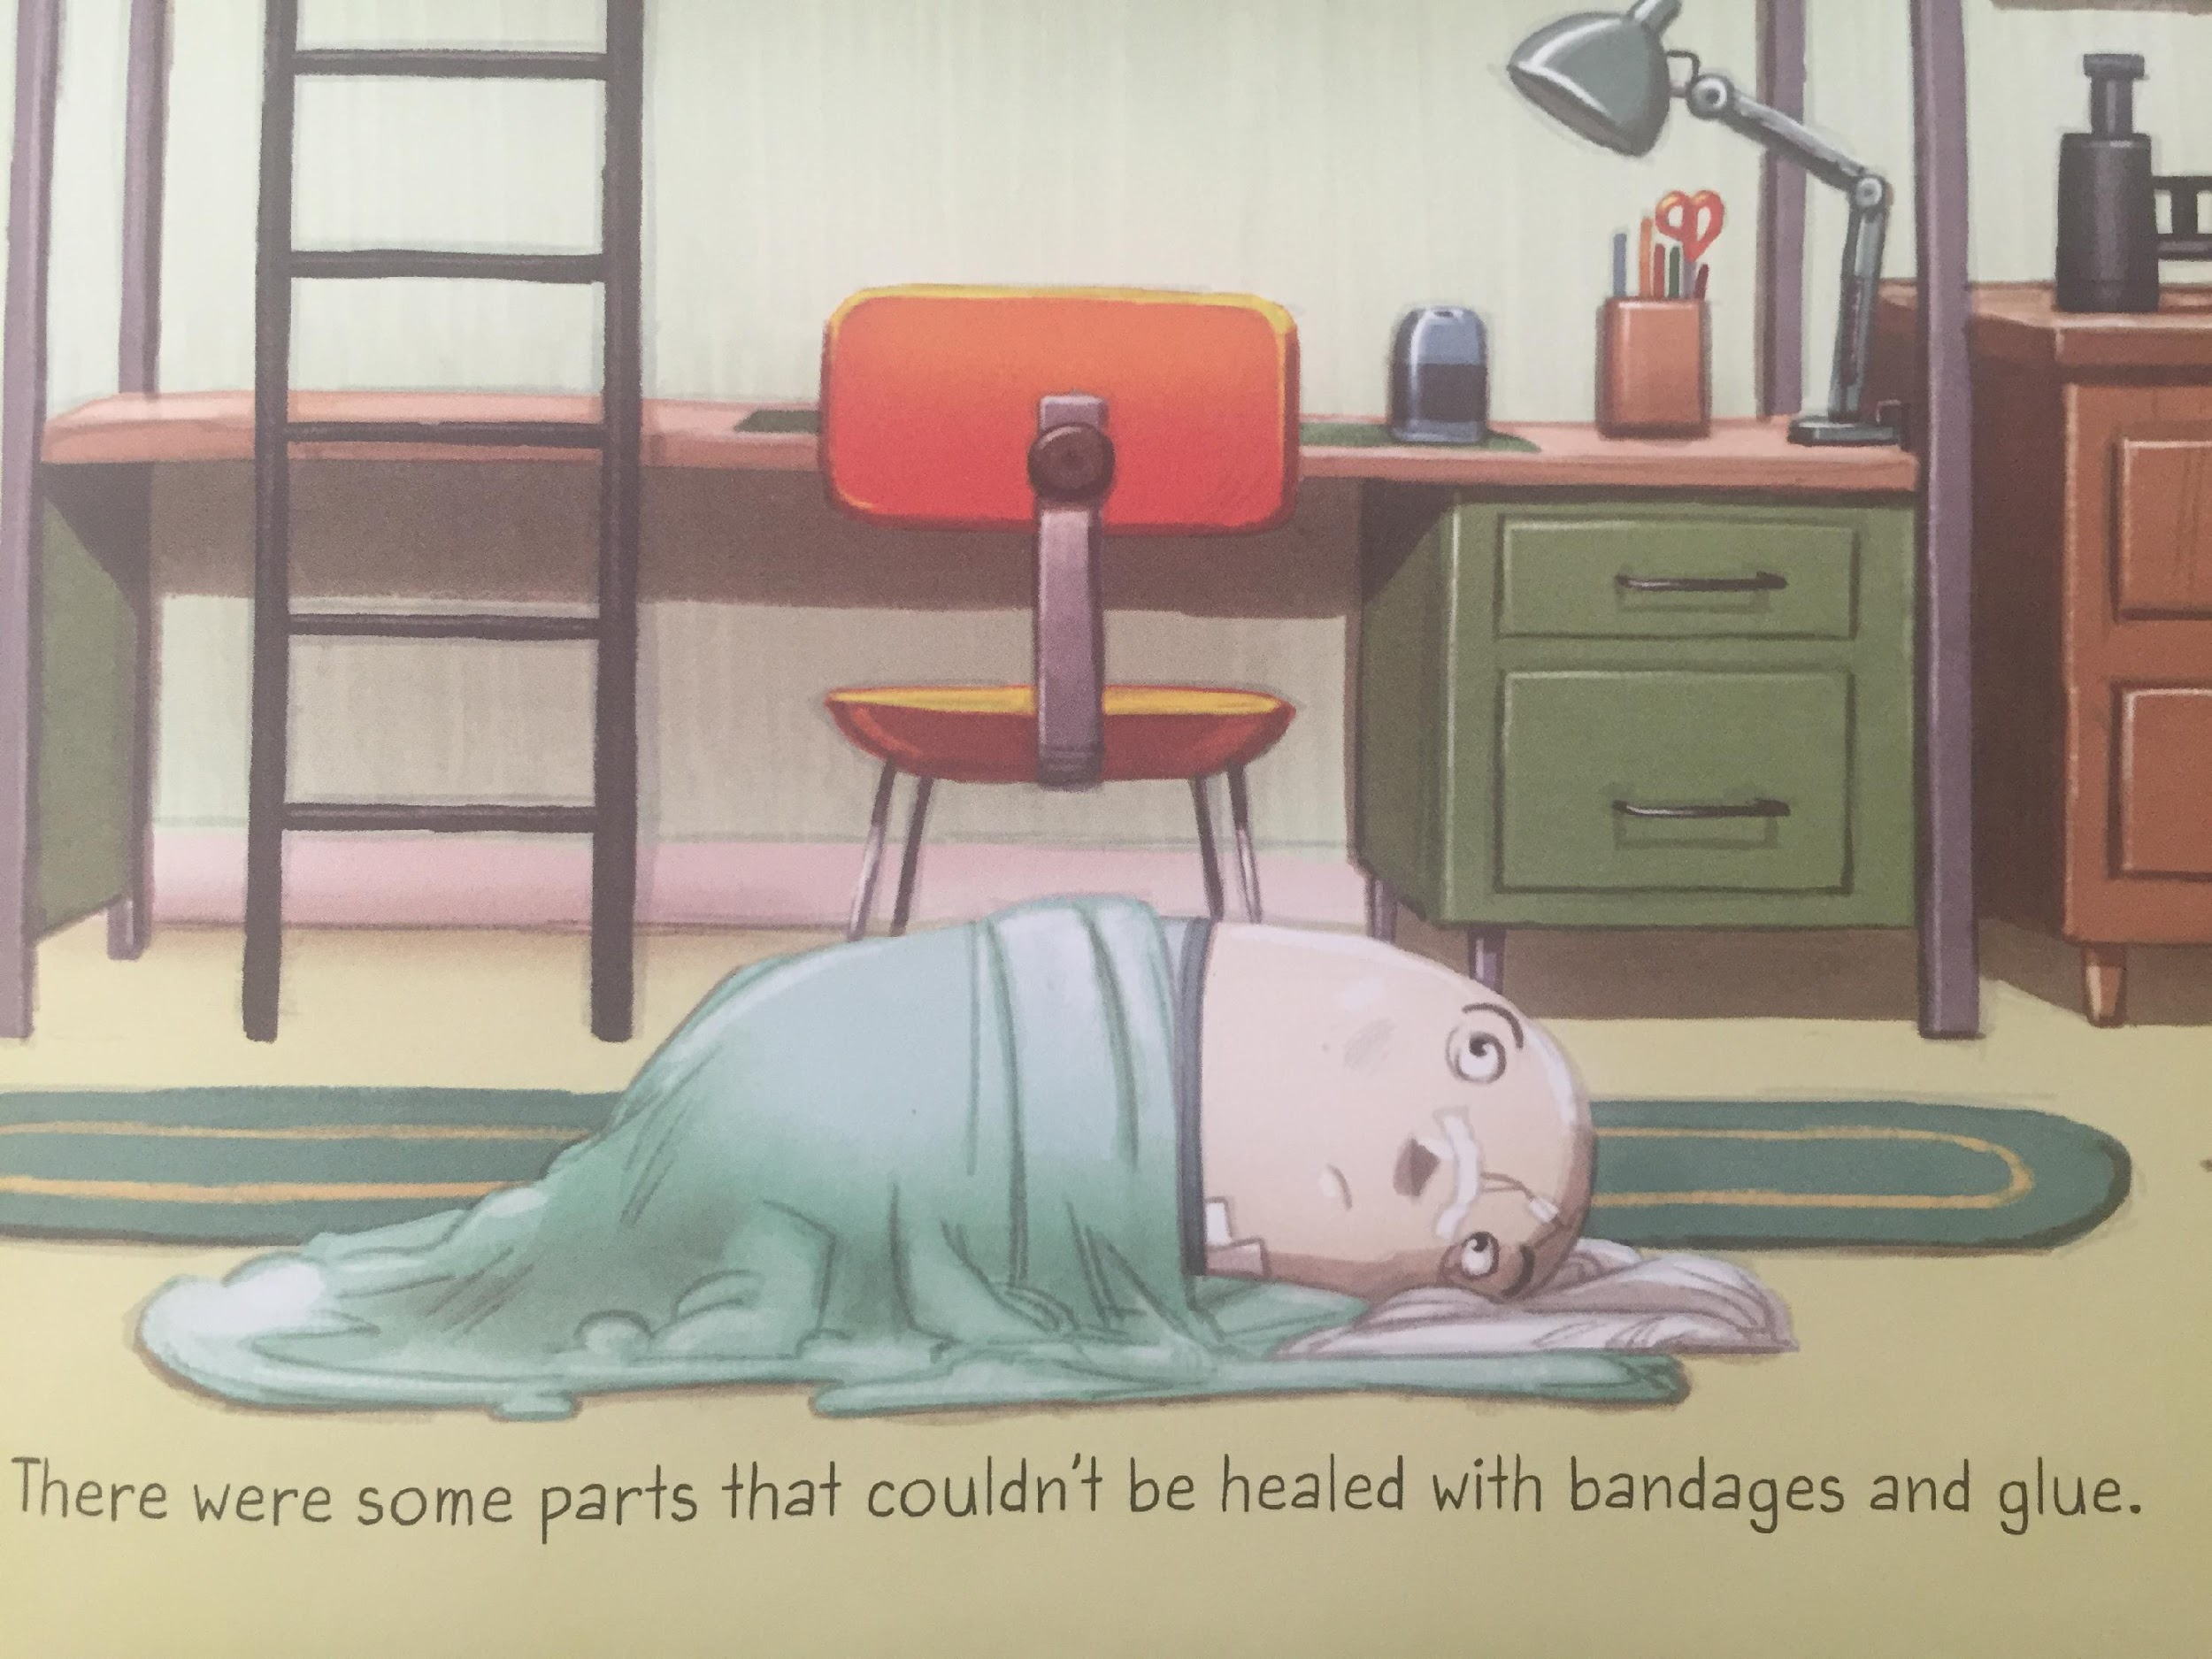
LI – to make links with my own life

Slide 8
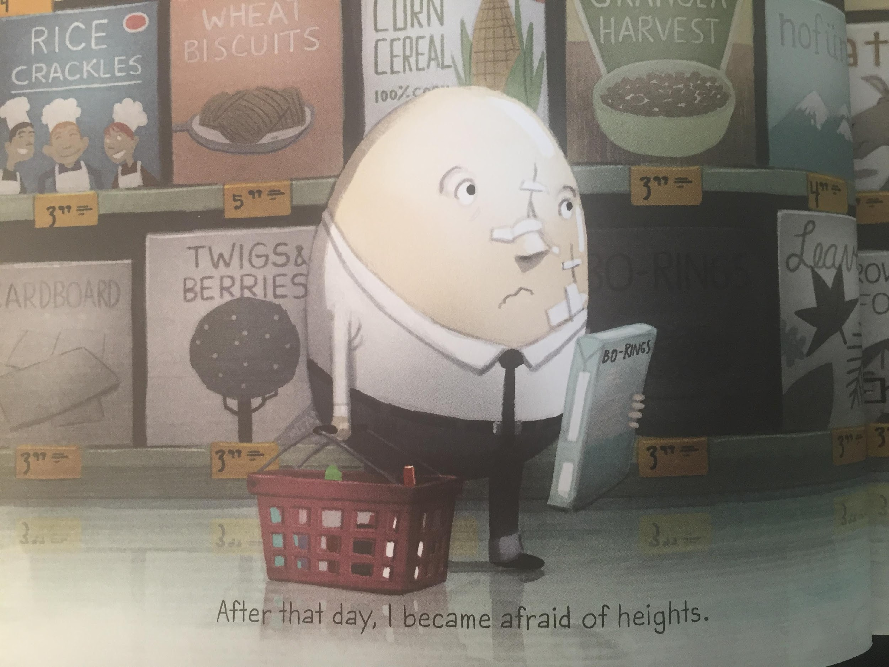
LI – to make links with my own life

Slide 9
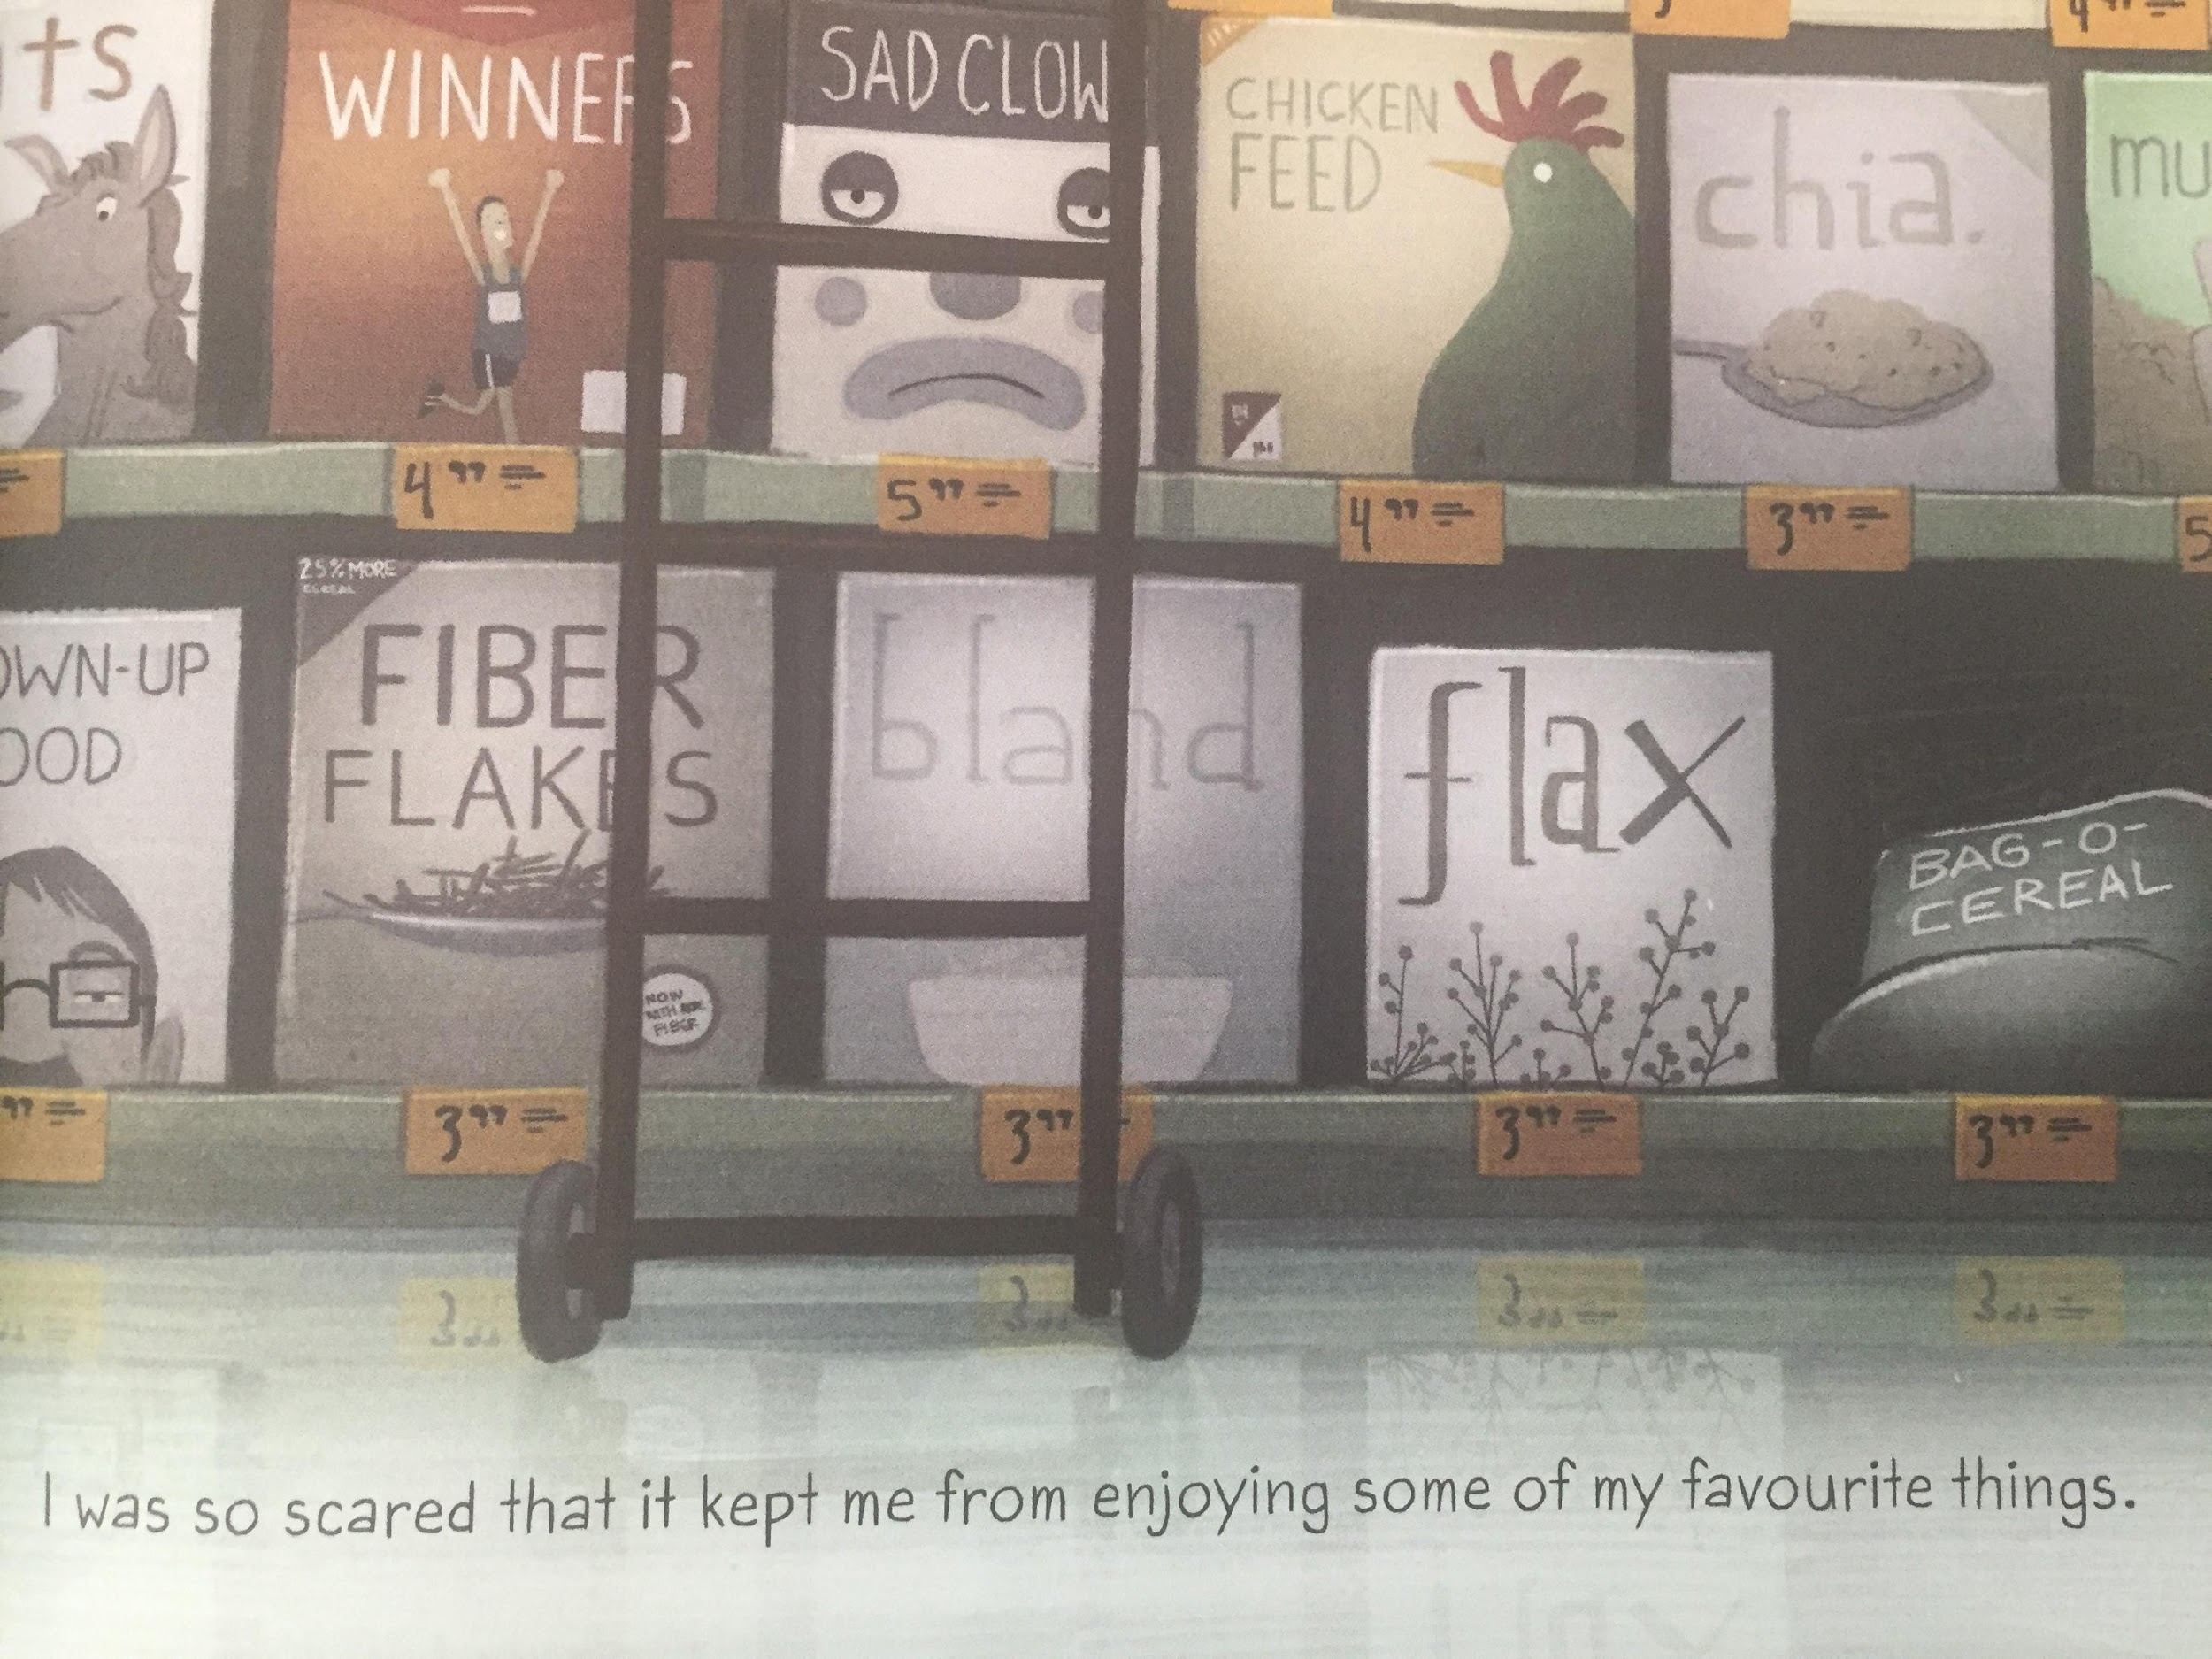

Slide 10
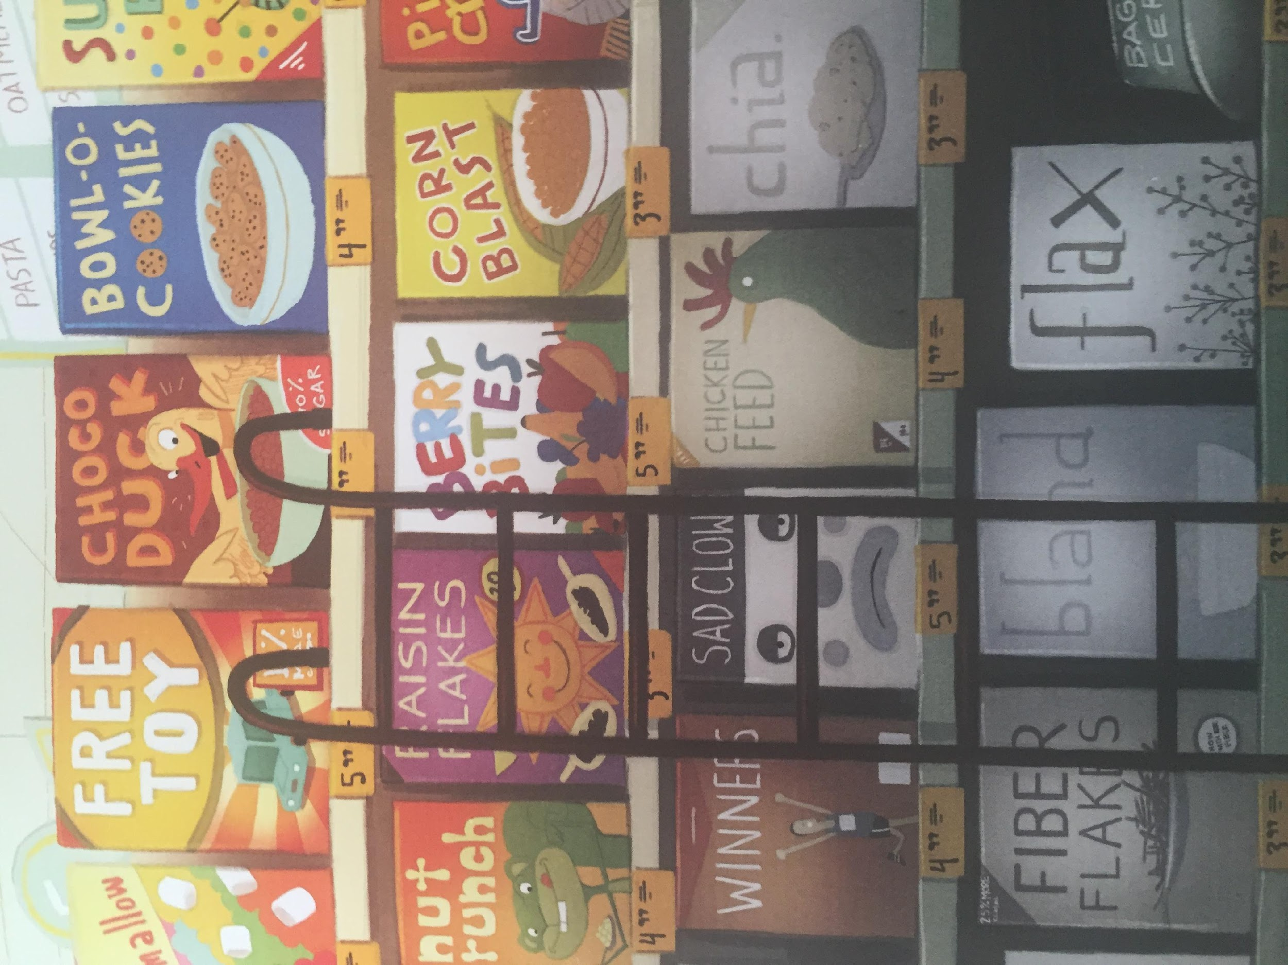
What experience does this make you think of ?
This makes me think of ... because. ...

Slide 11
Now let’s practice some of the words we might find in the text.
idea
high
bird
flew

Slide 12
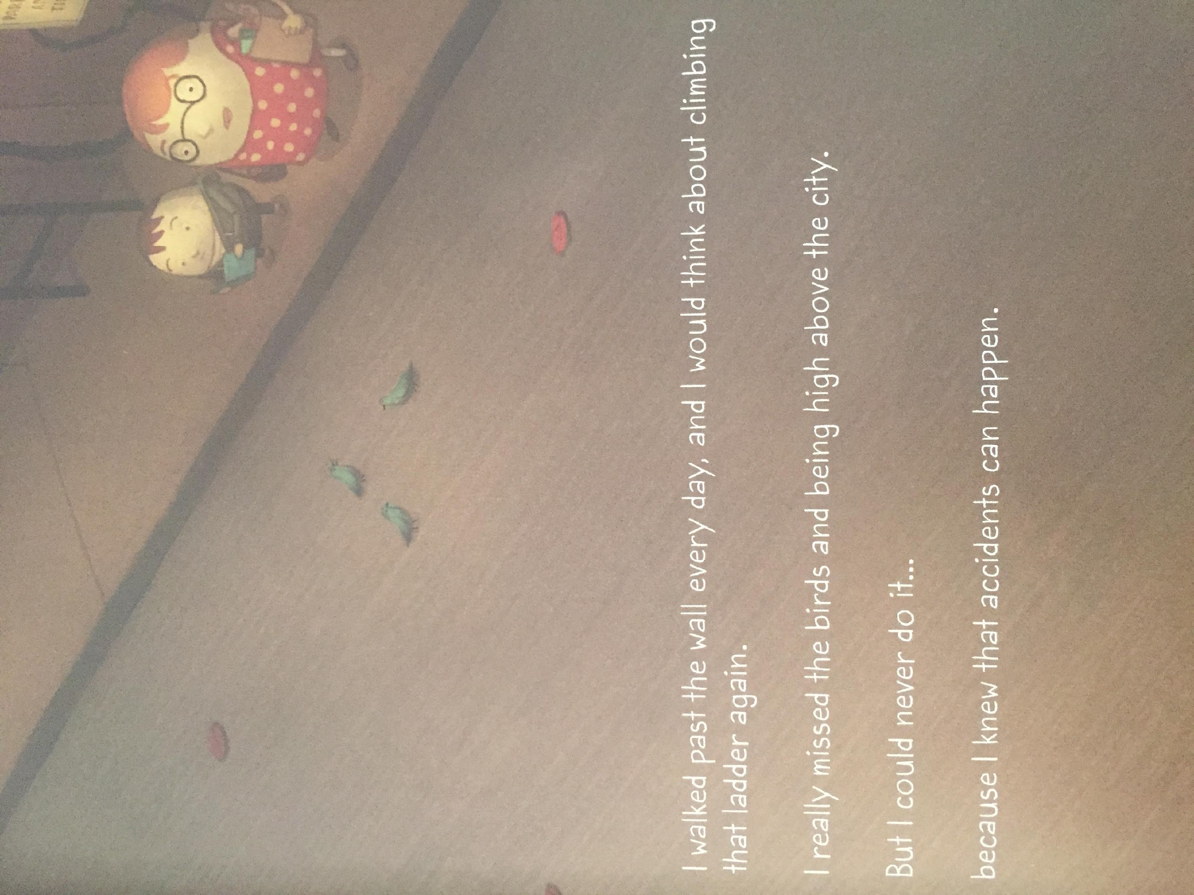
LI – to make links with my own life

Slide 13
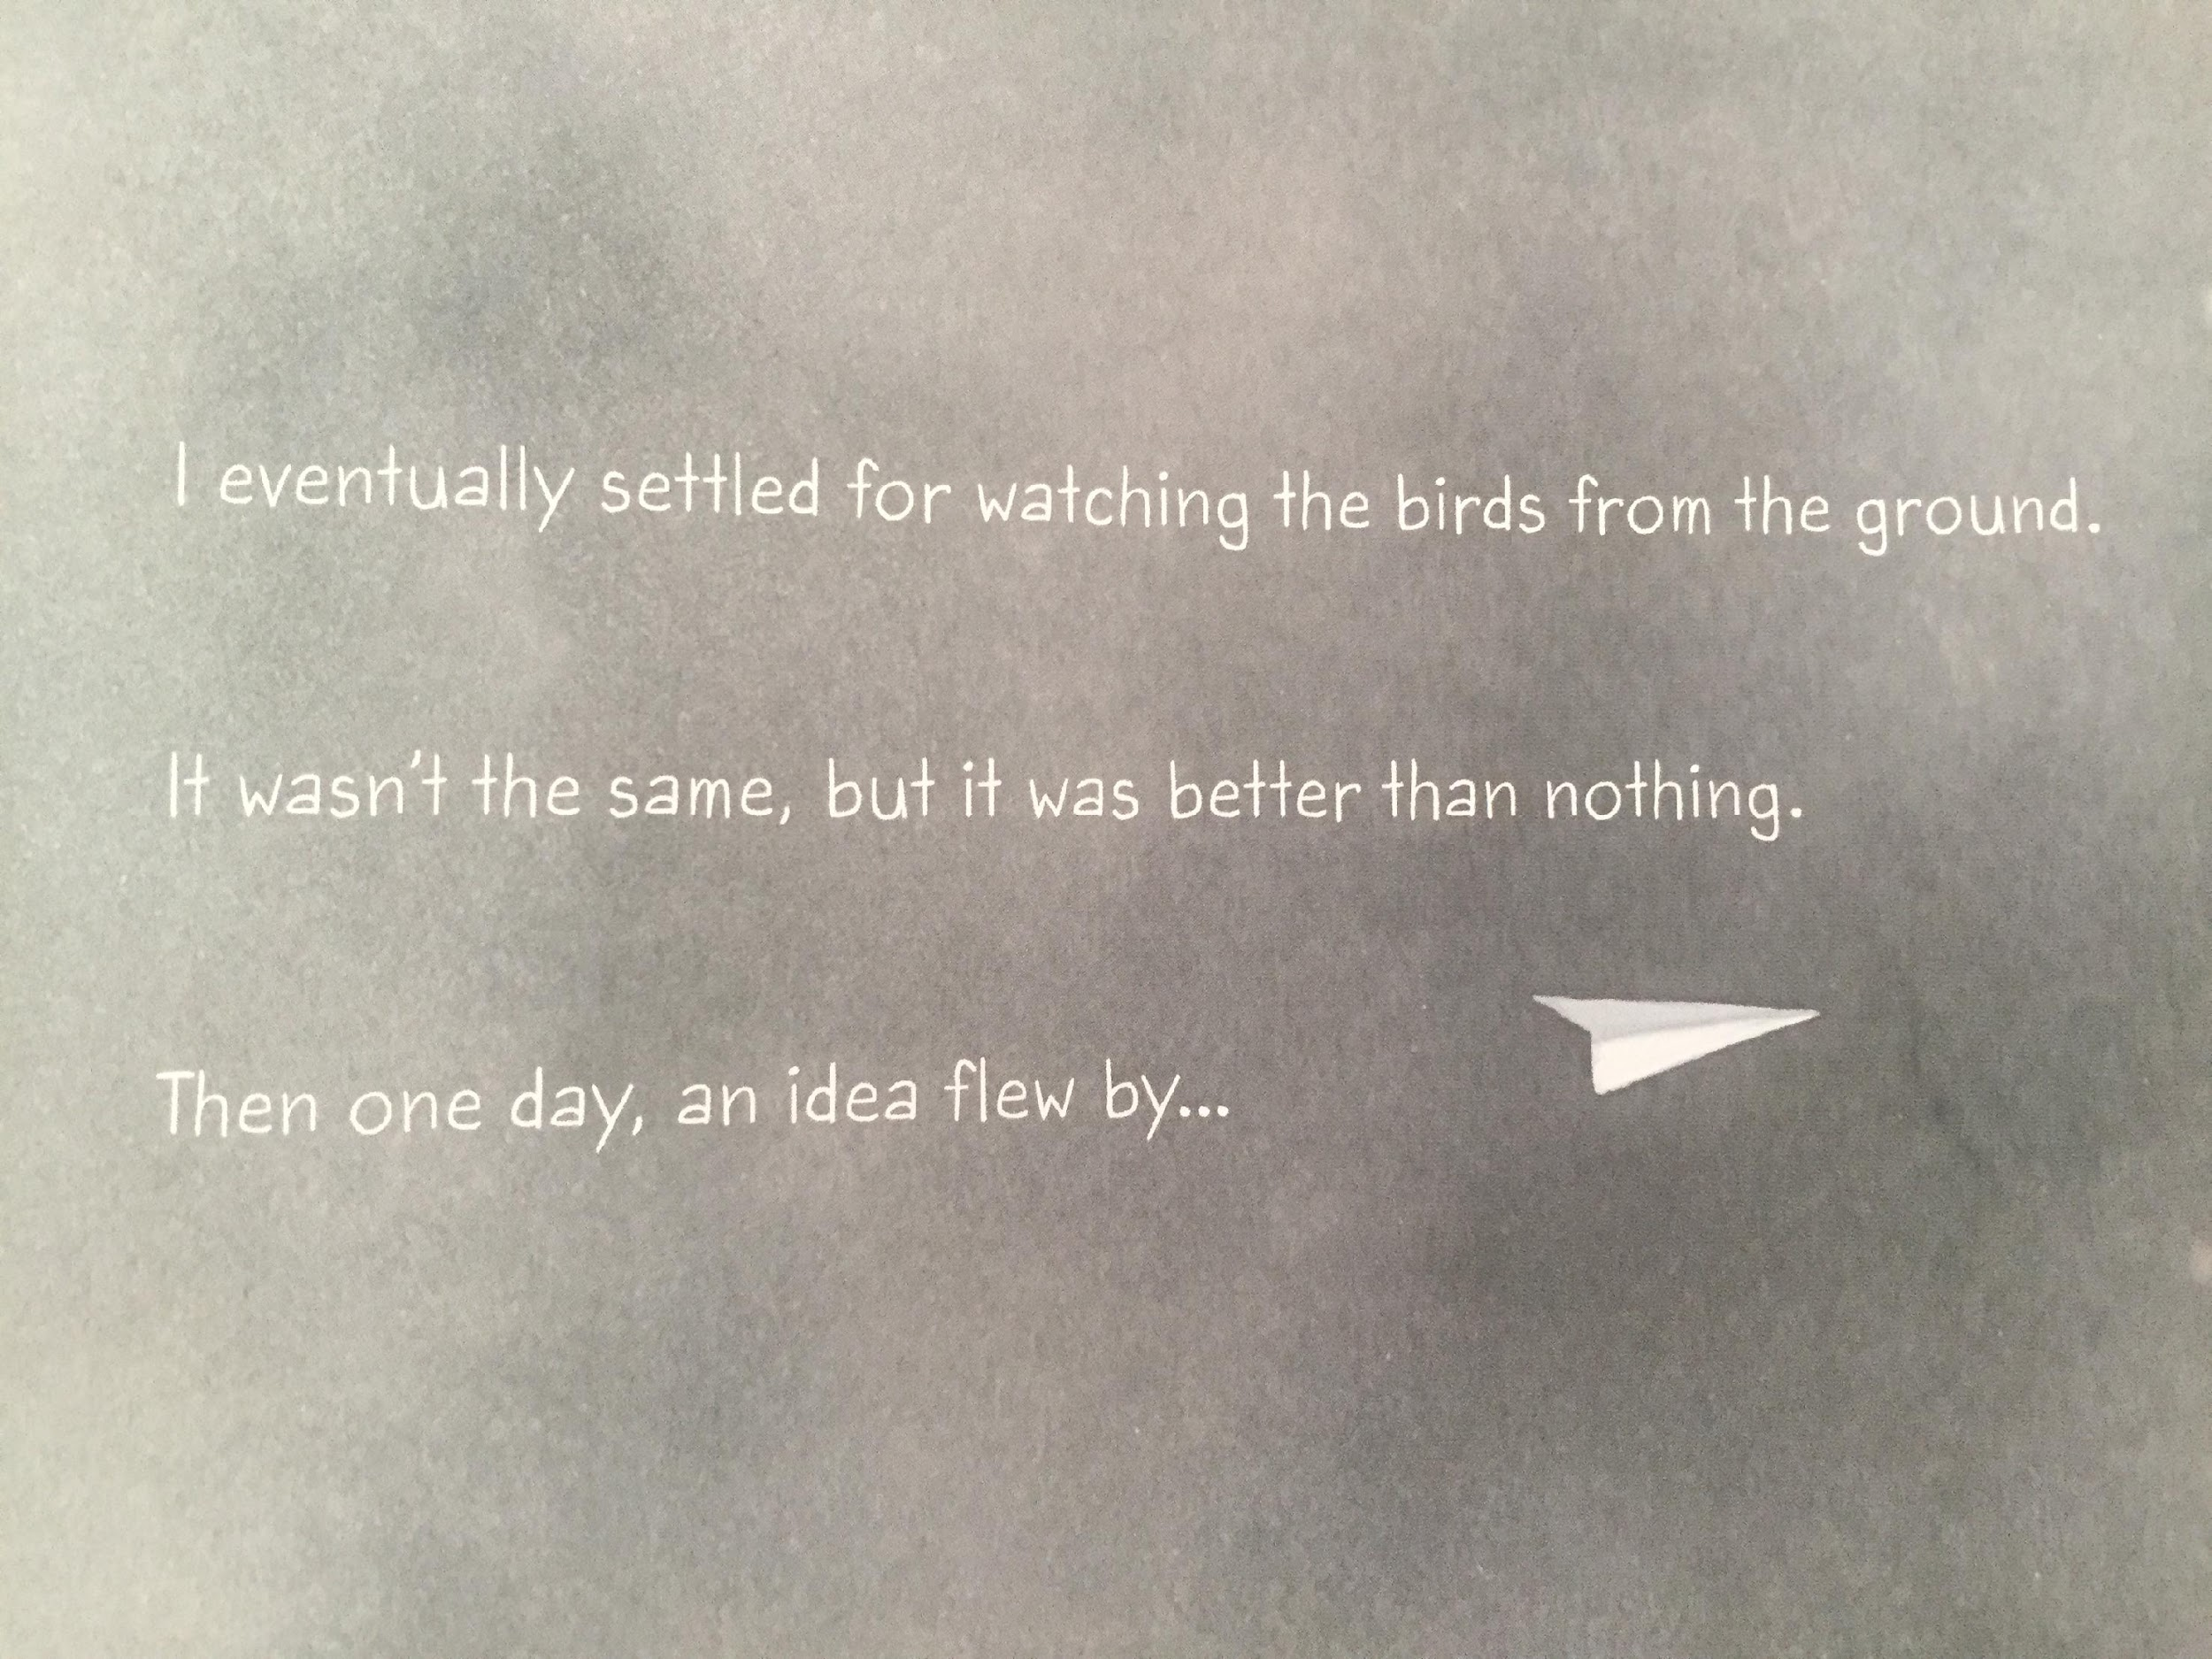
LI – to make links with my own life

Slide 14
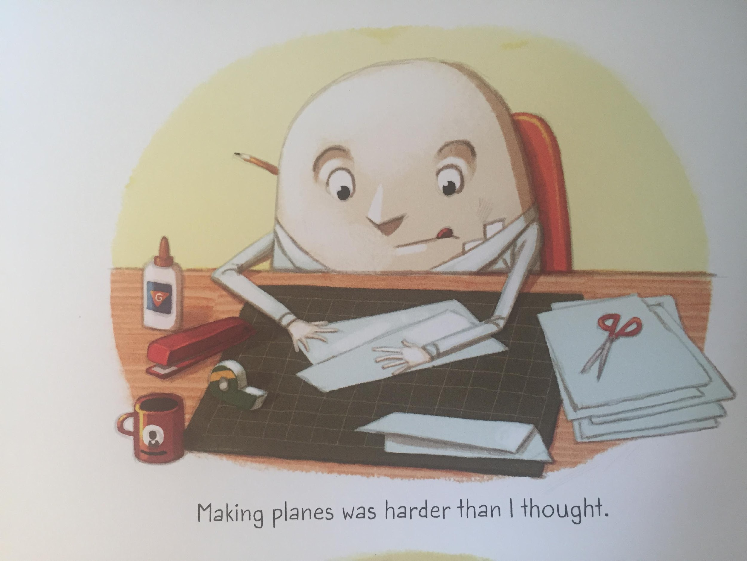
LI – to make links with my own life

Slide 15
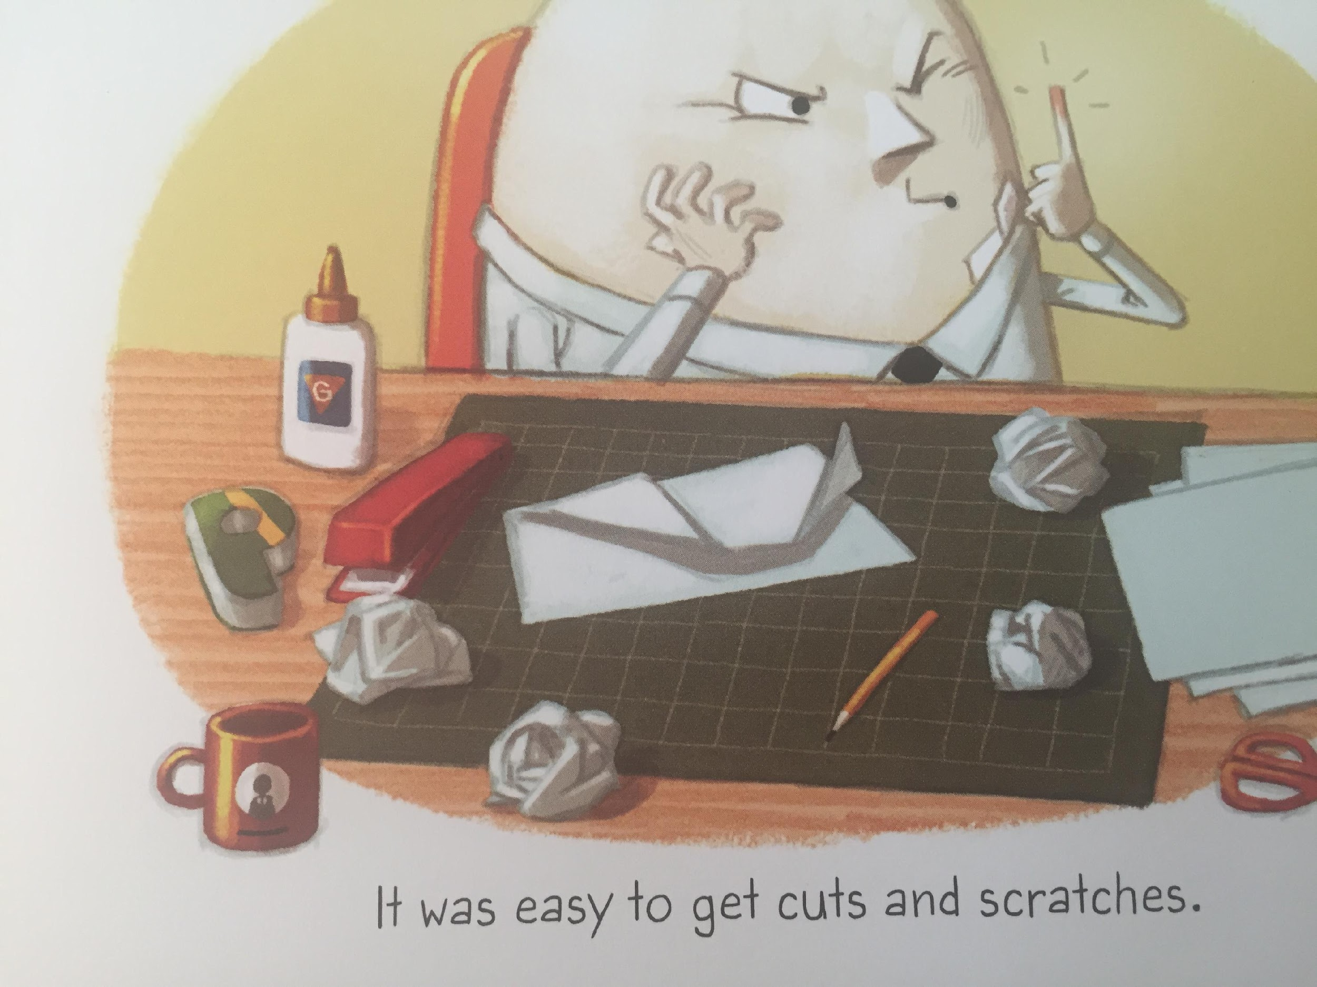
LI – to make links with my own life

Slide 16
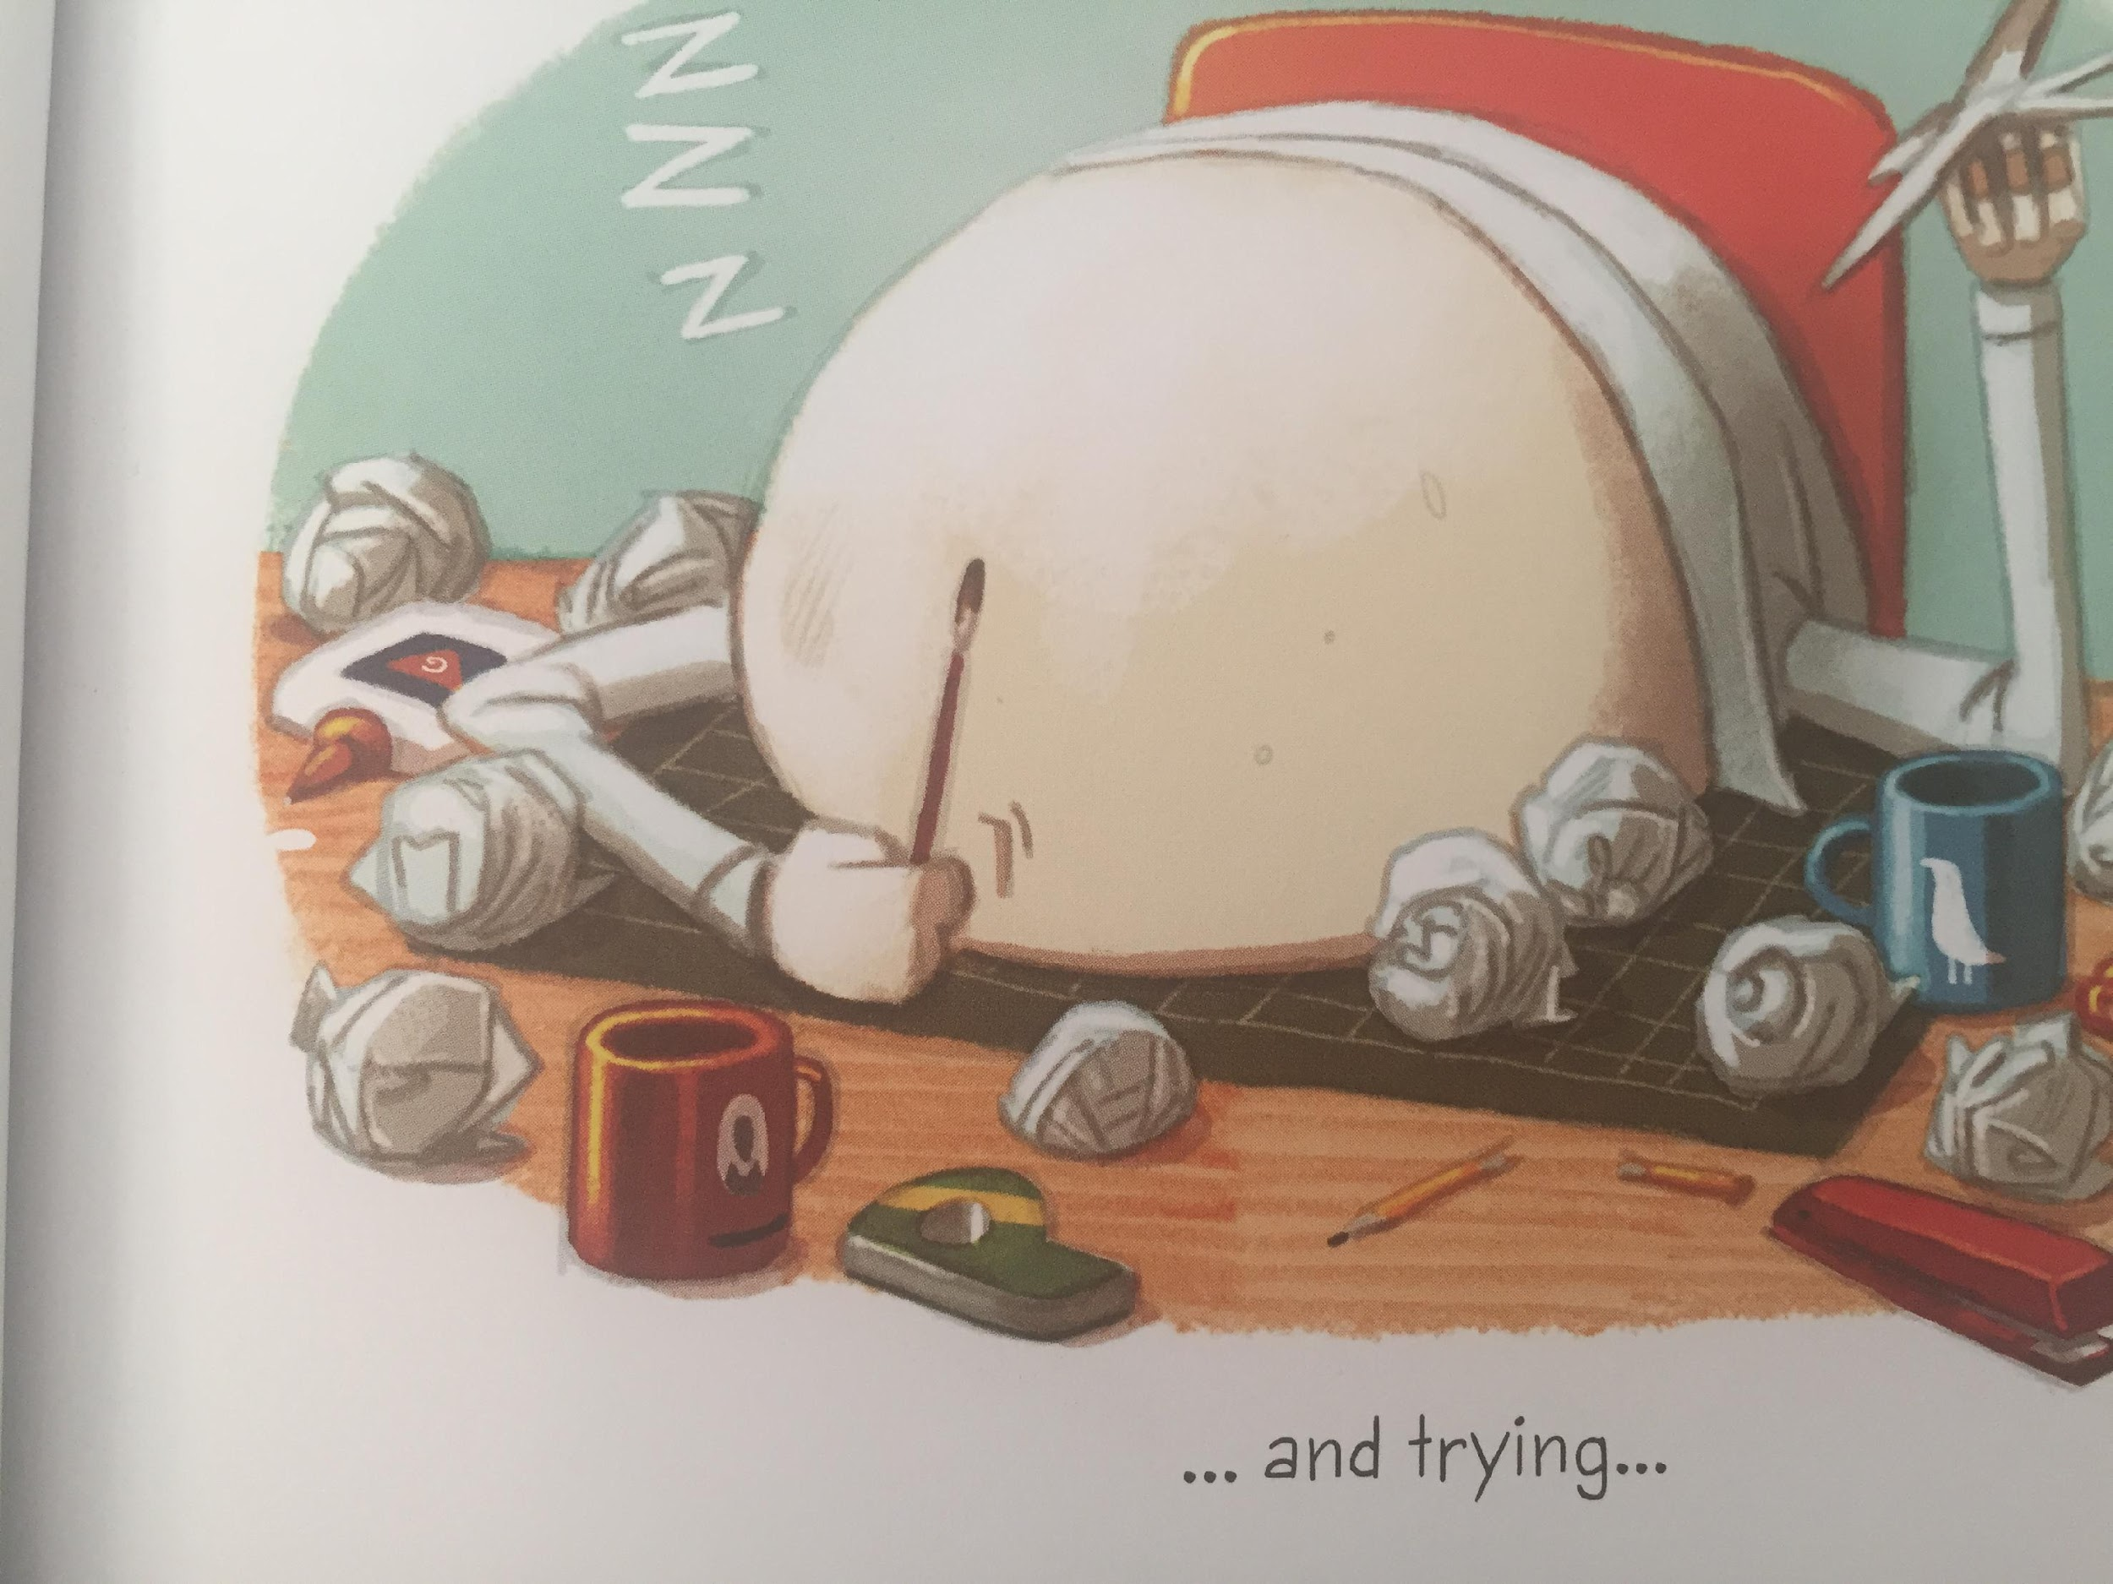
LI – to make links with my own life

Slide 17
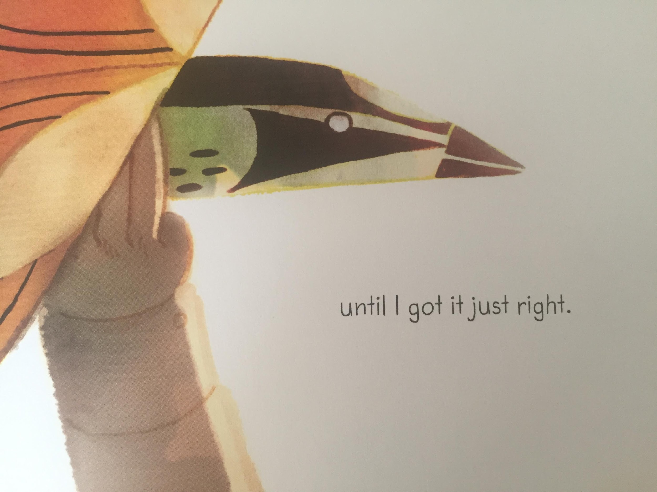
LI – to make links with my own life

Slide 18
What experience does this make you think of ?
This makes me think of ... because. ...

Slide 19
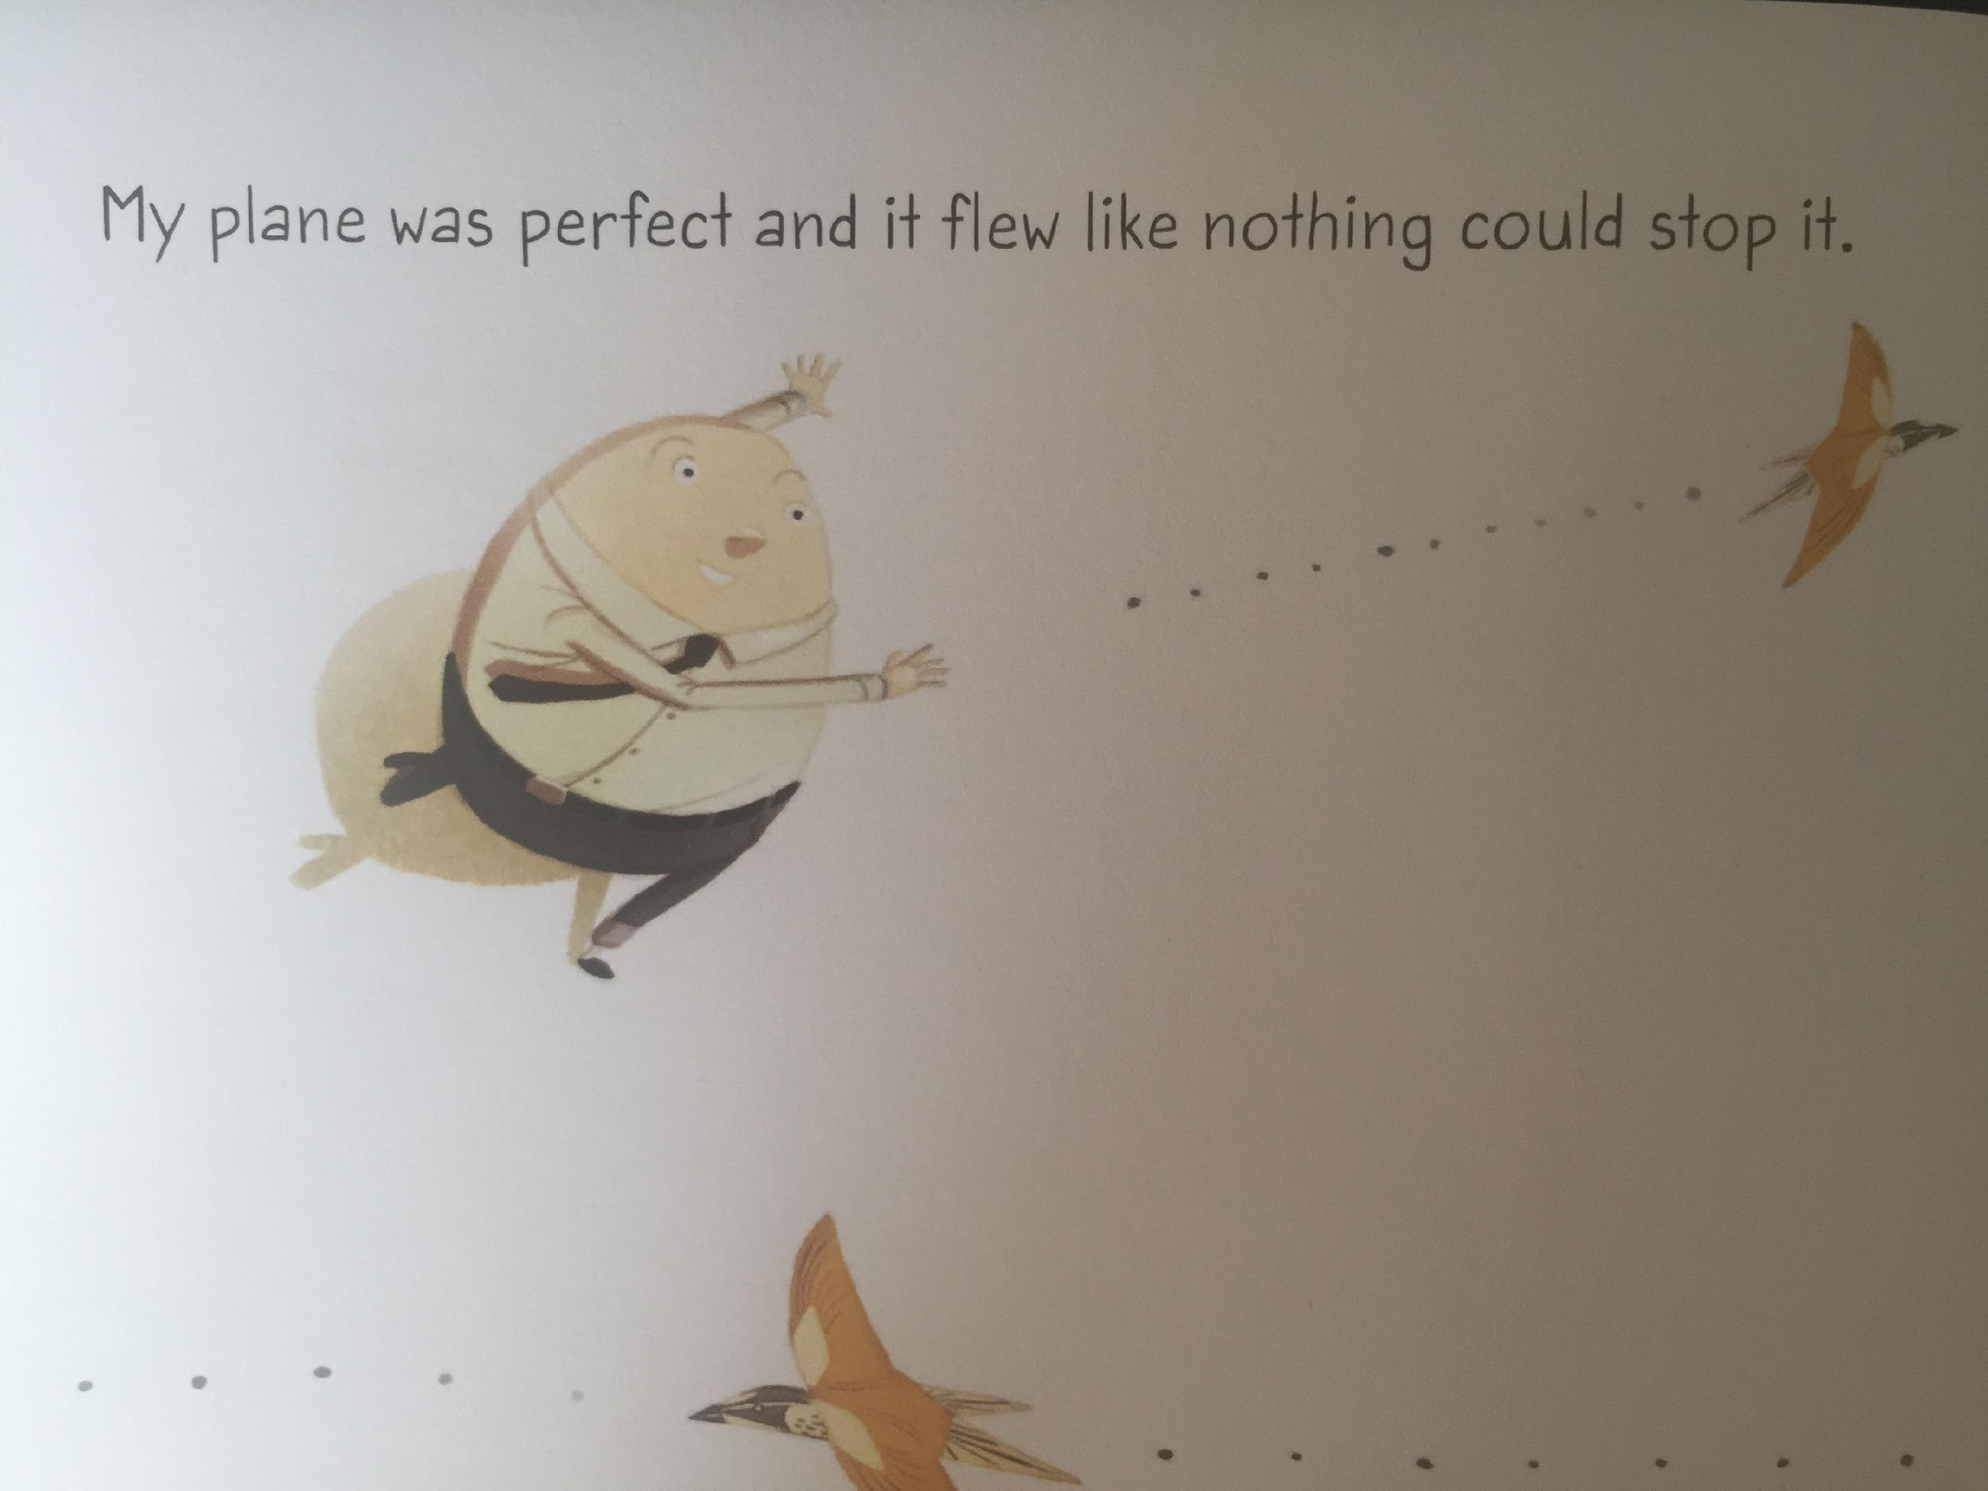

Slide 20
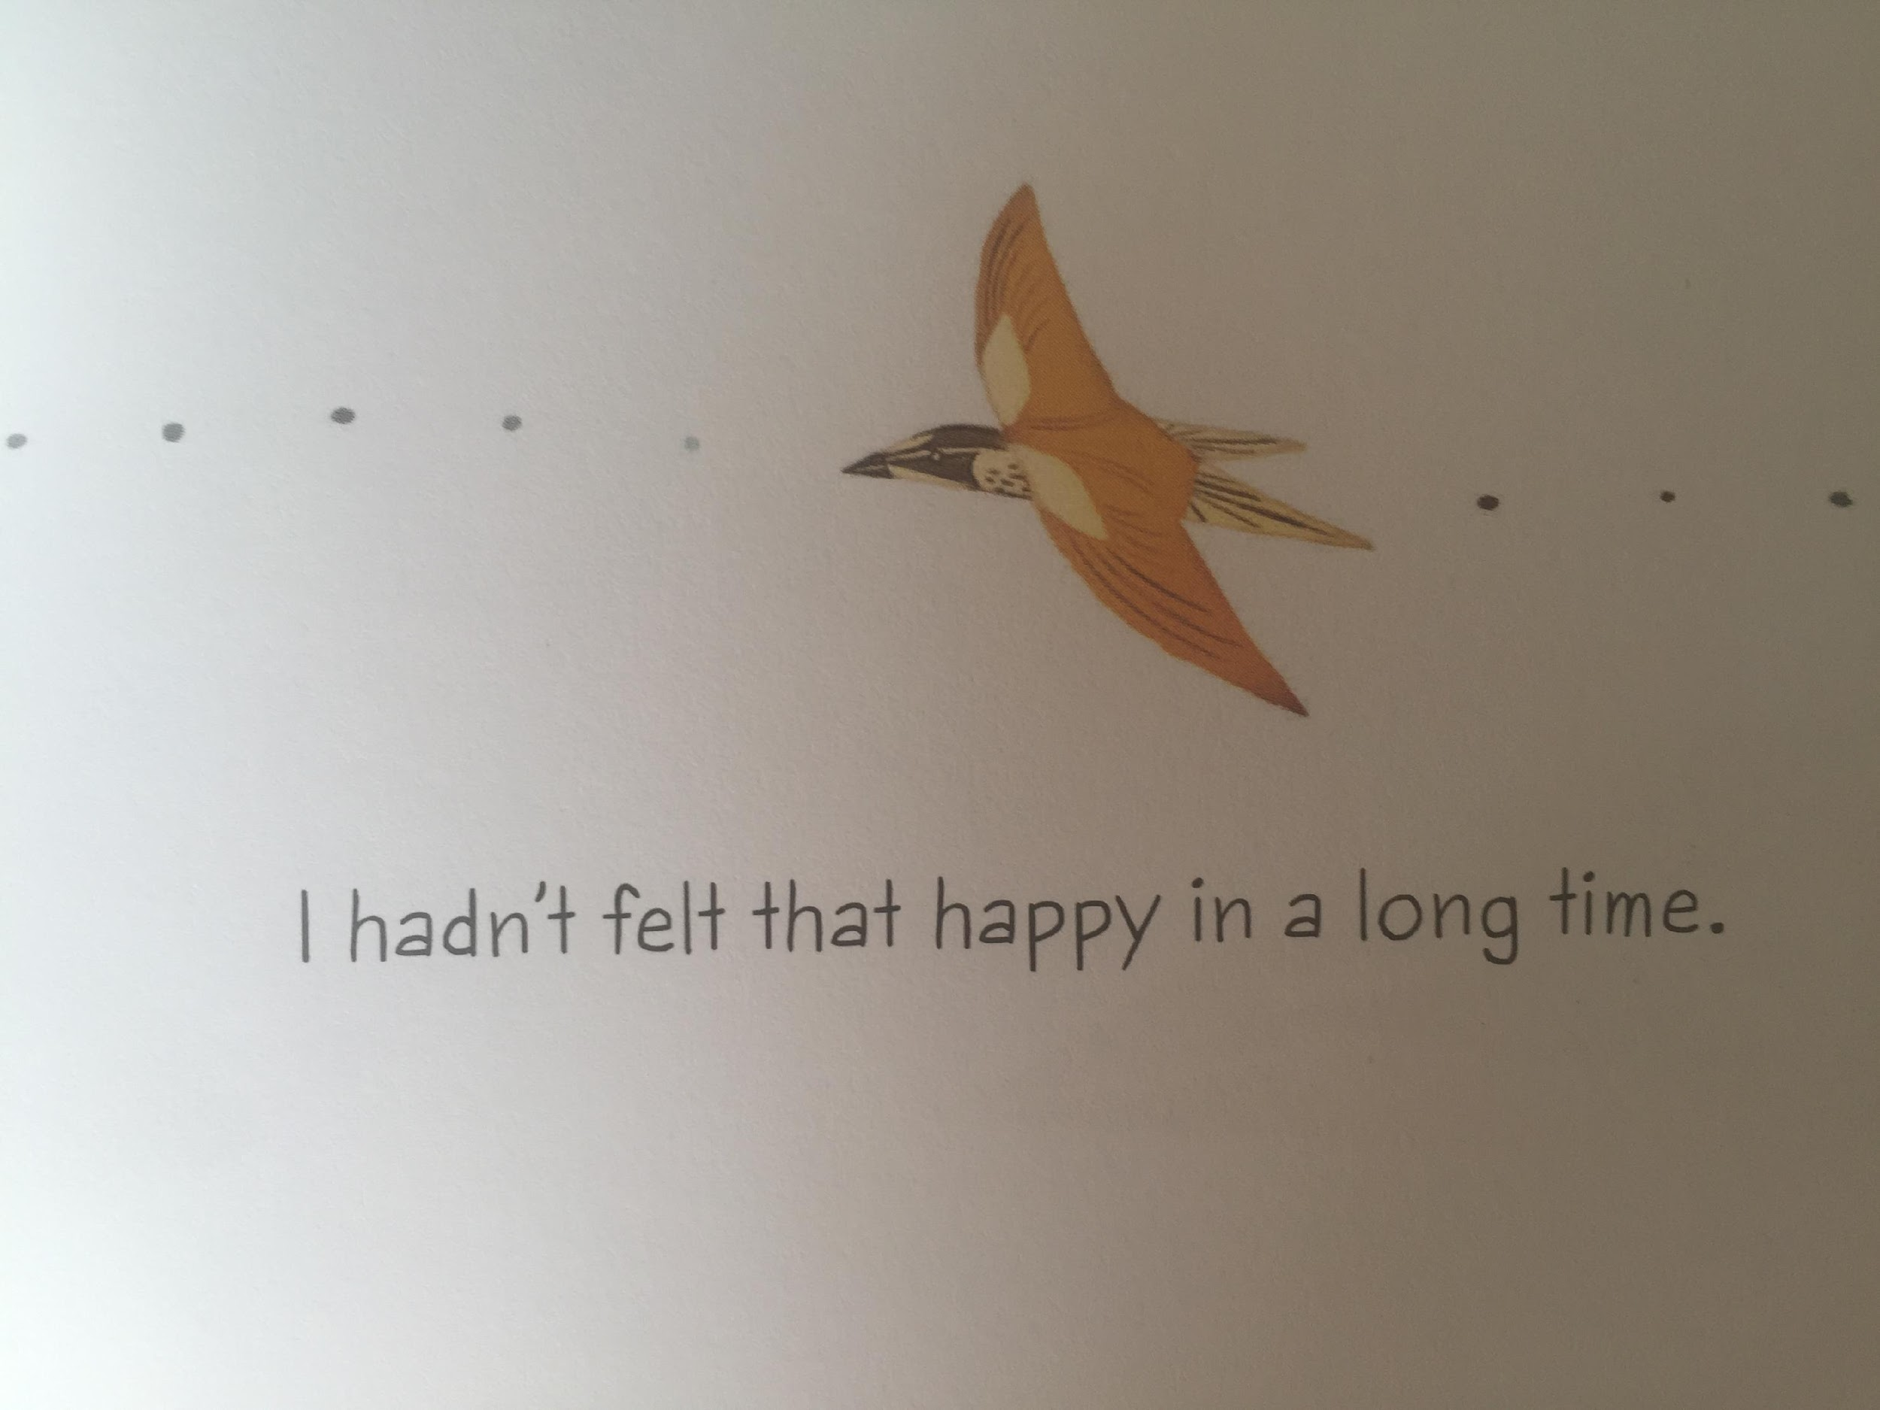
LI – to make links with my own life

Slide 21
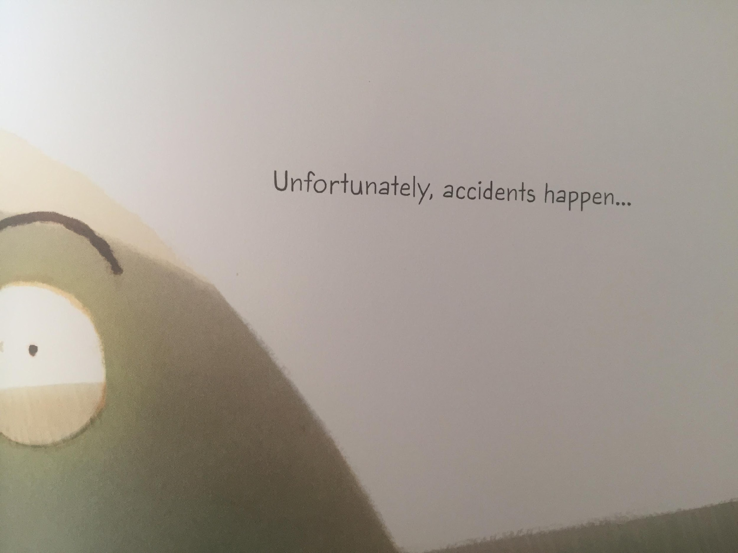
LI – to make links with my own life

Slide 22
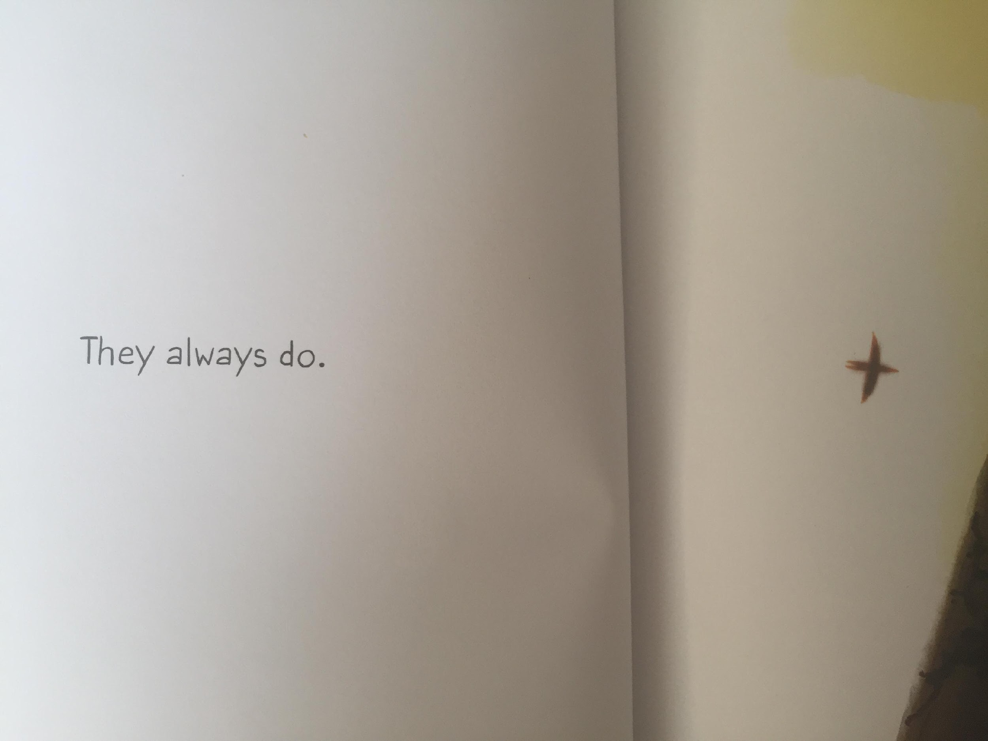
LI – to make links with my own life

Slide 23
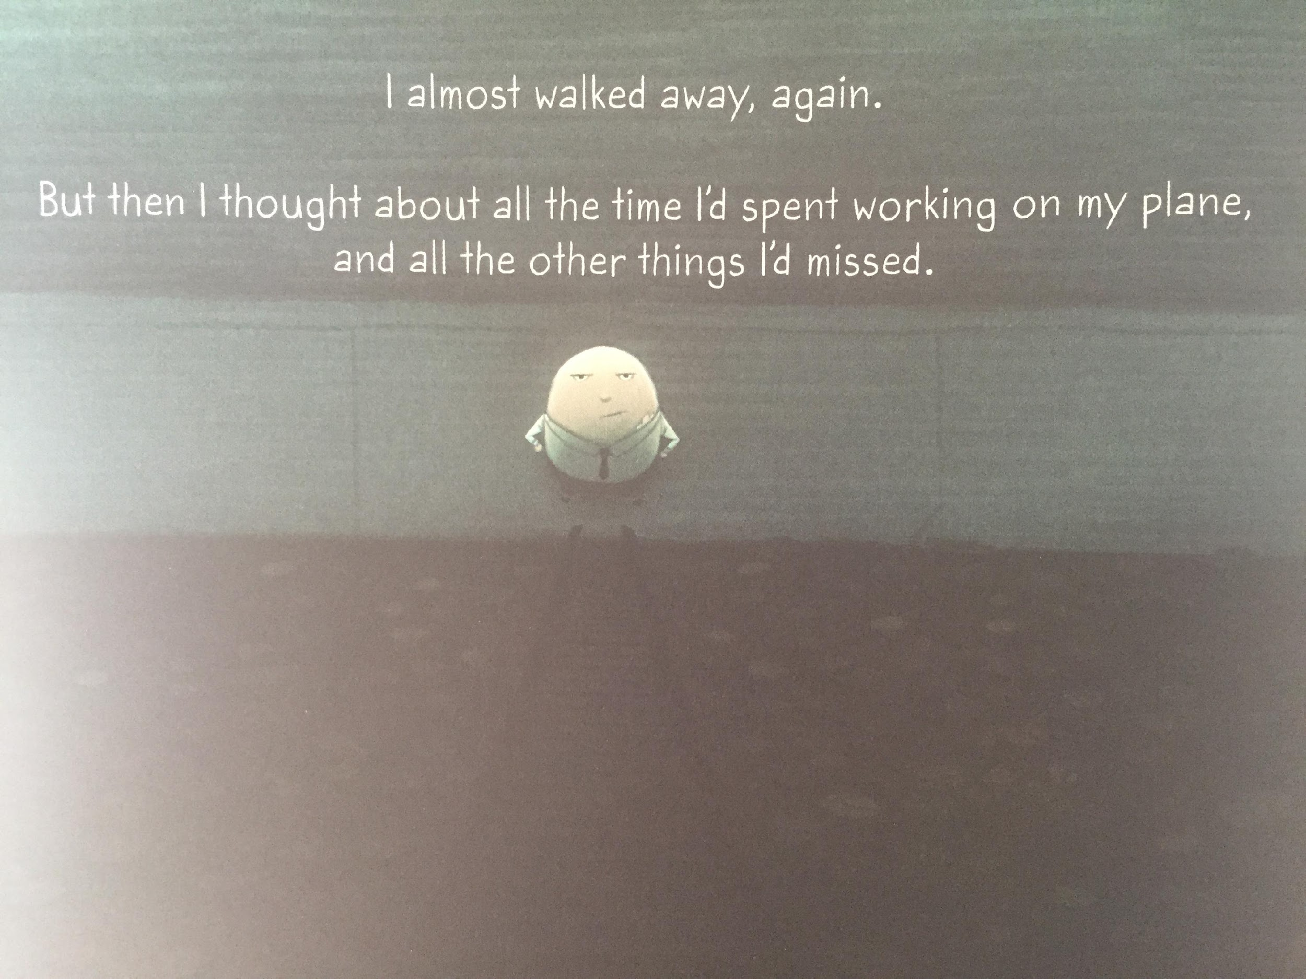

Slide 24
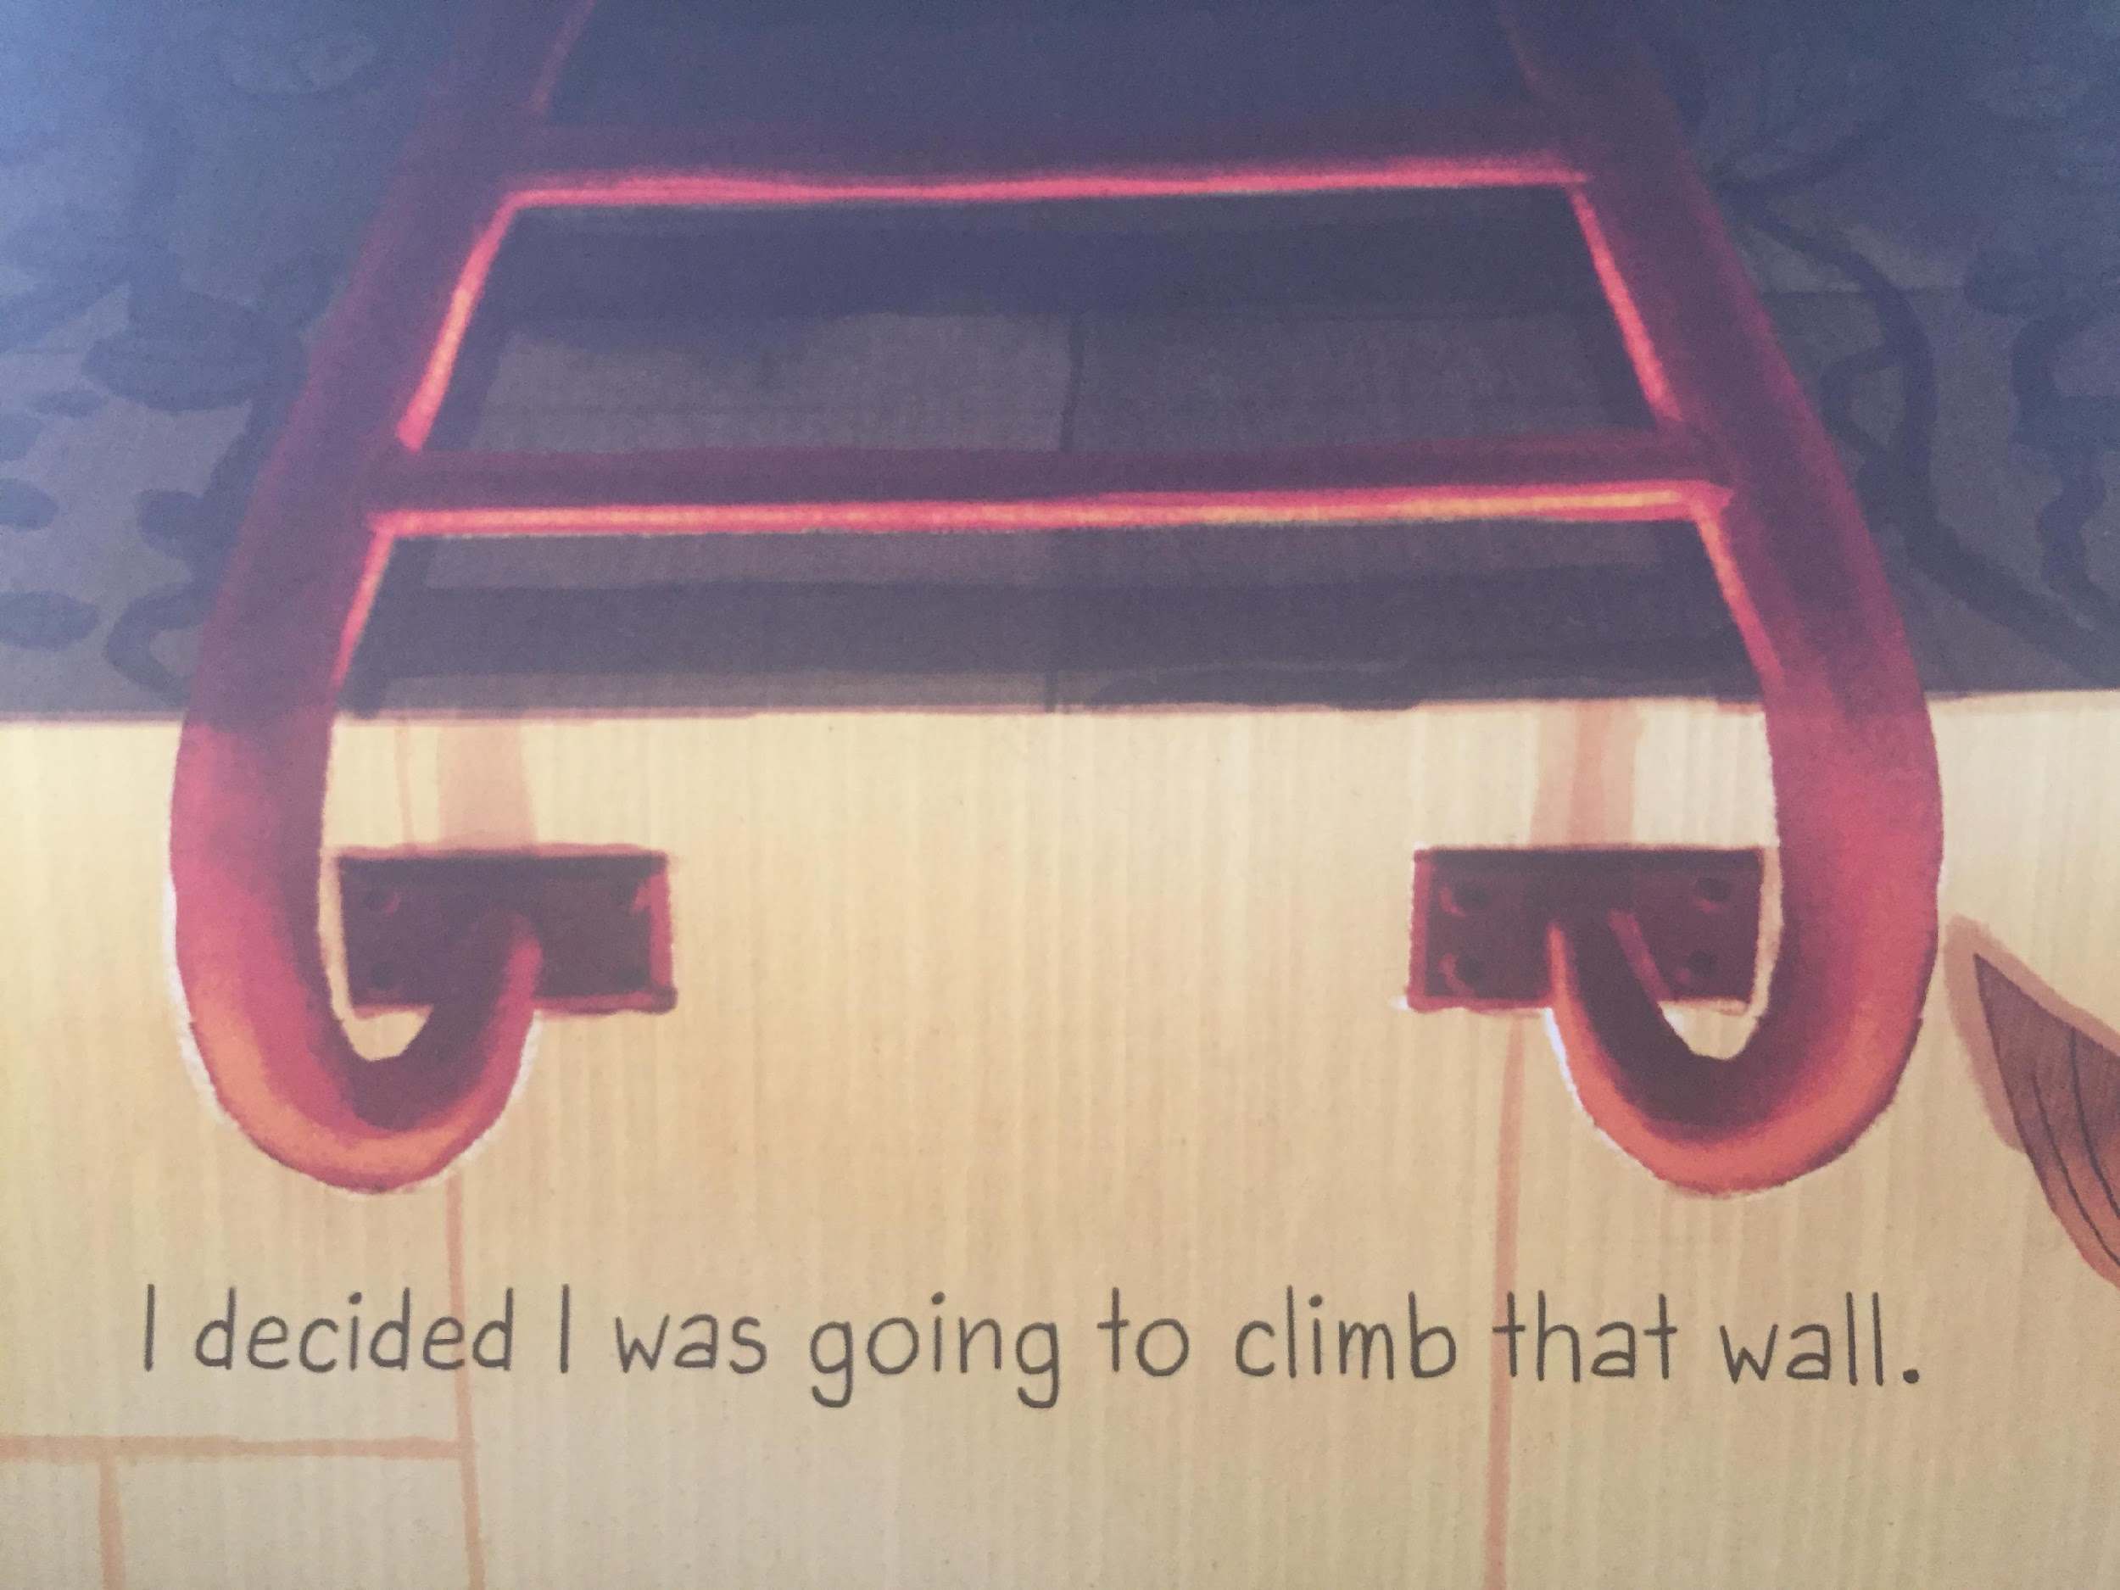
LI – to make links with my own life

Slide 25
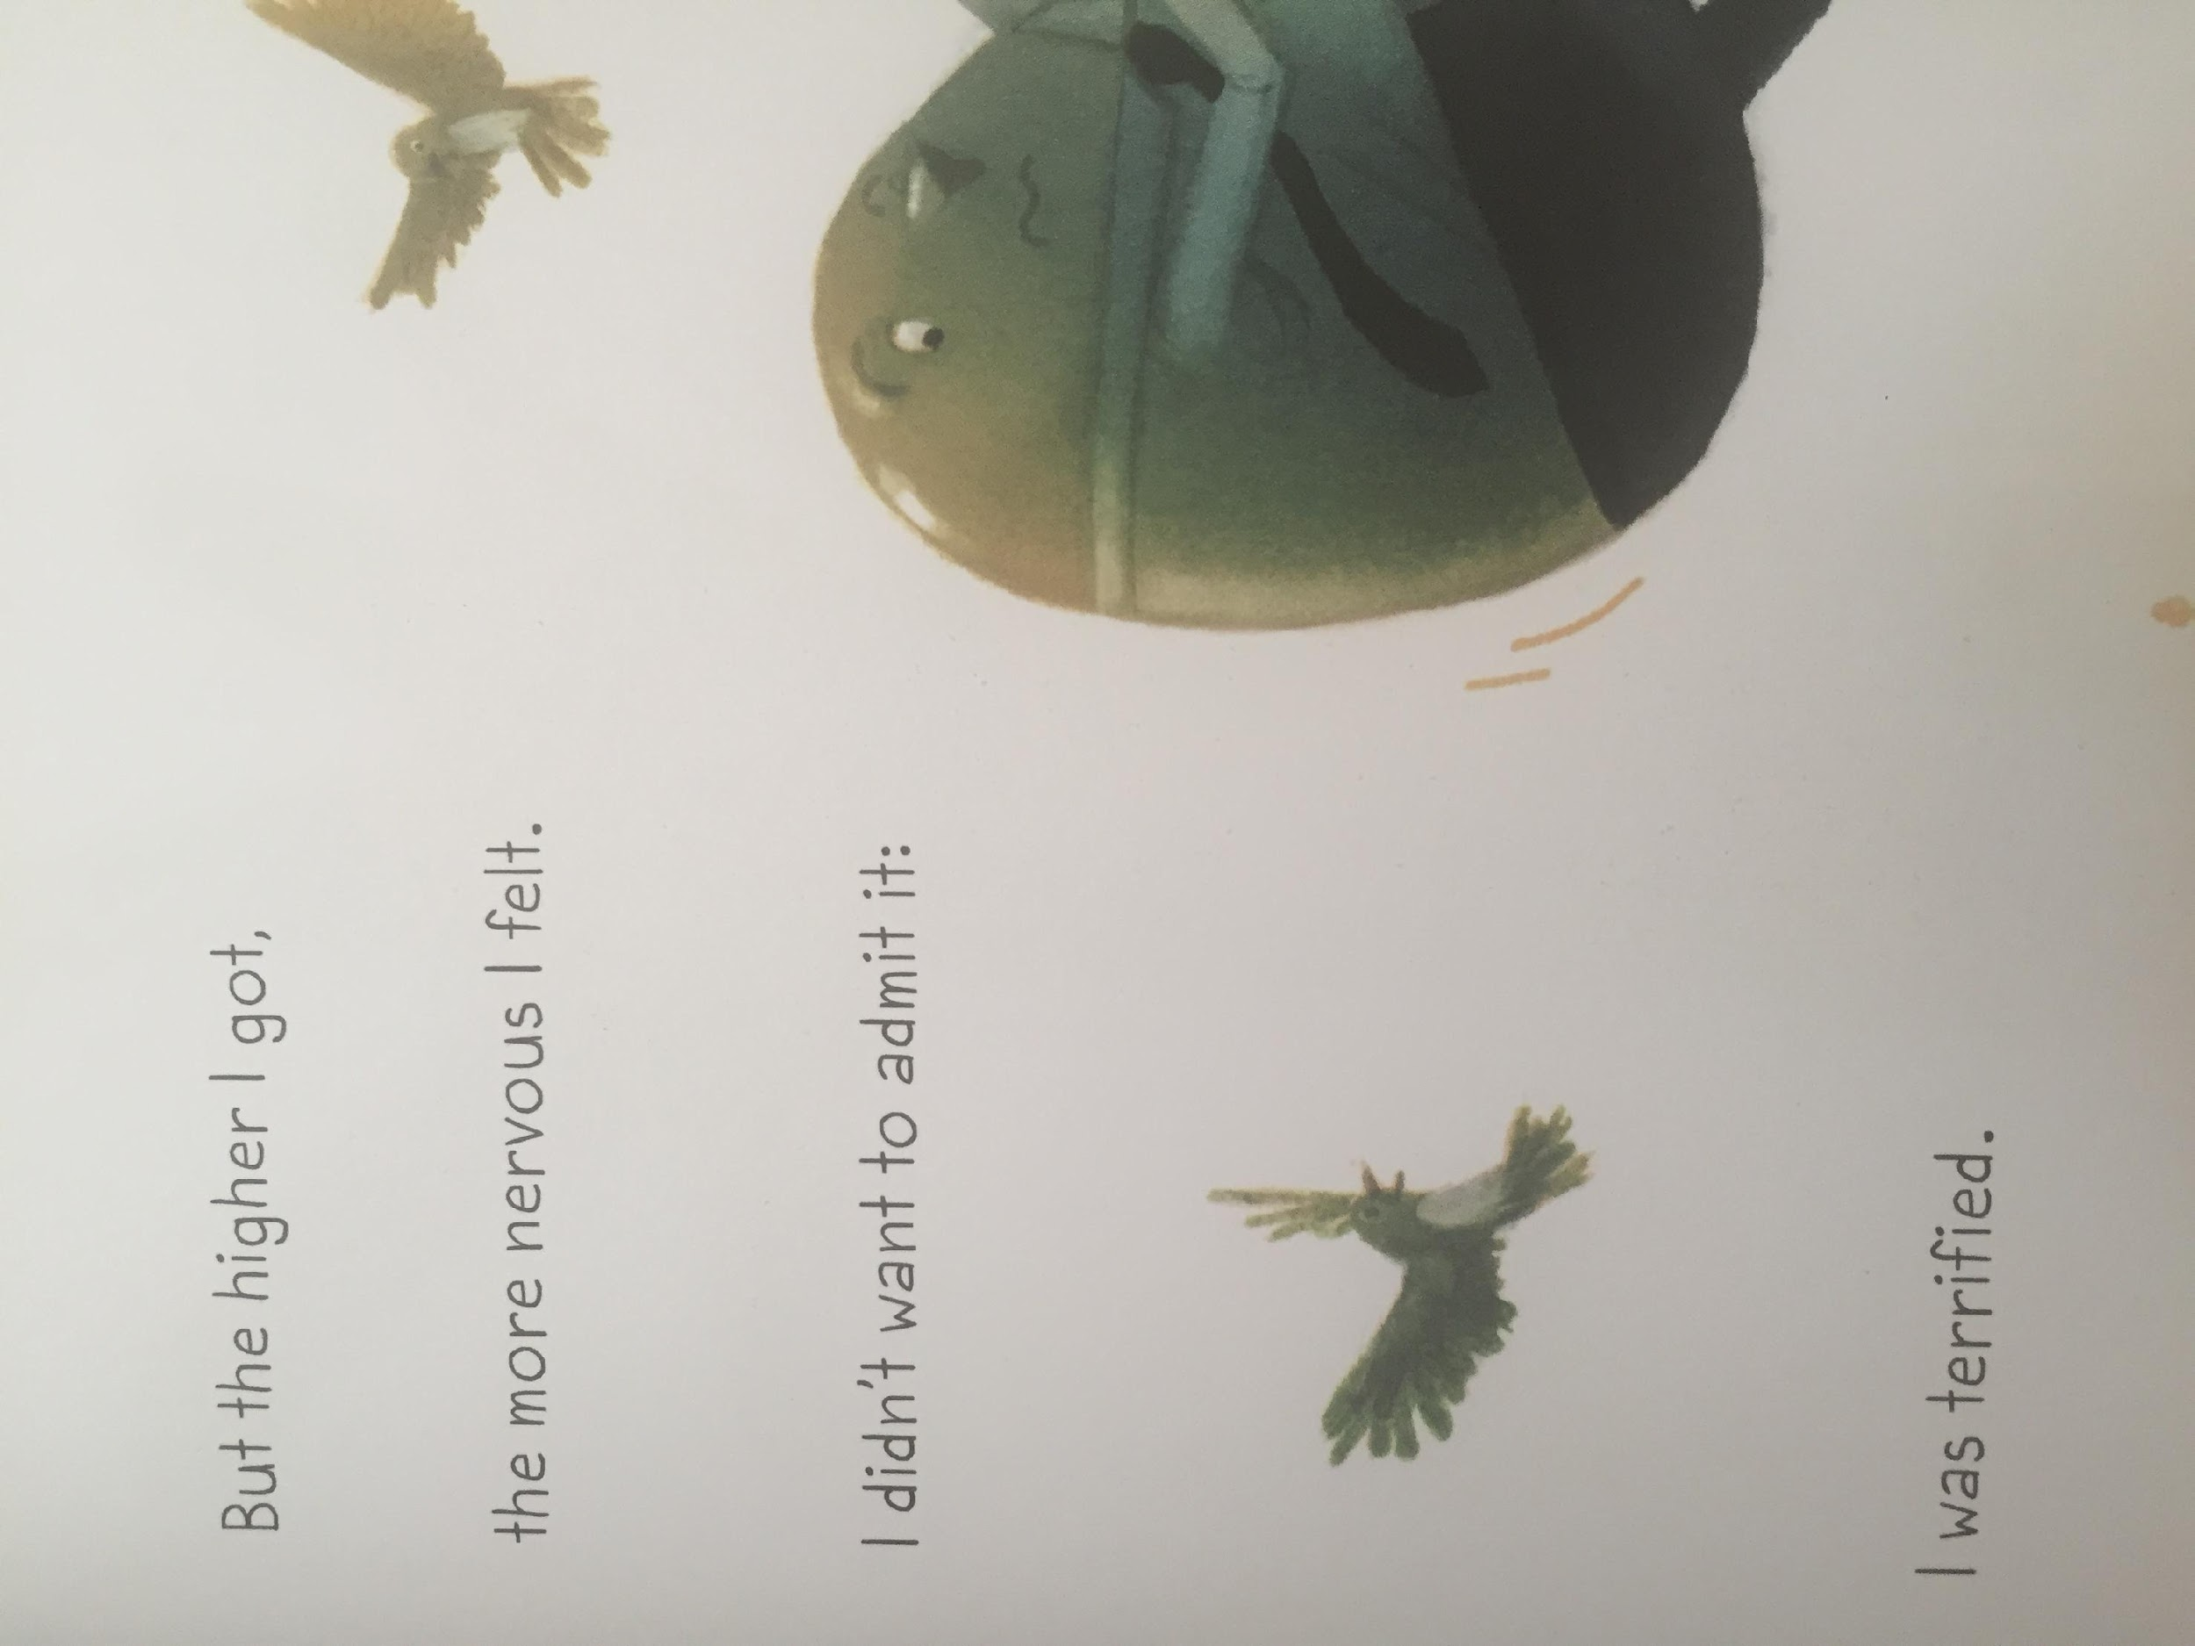

Slide 26
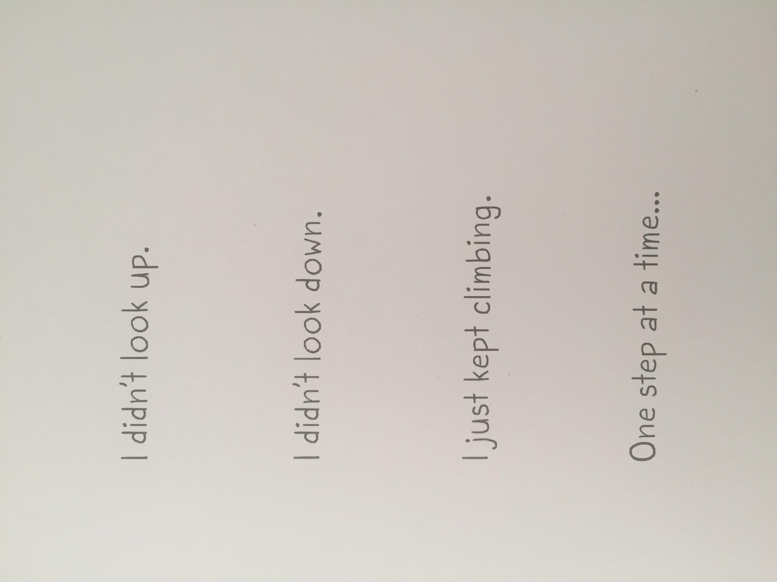
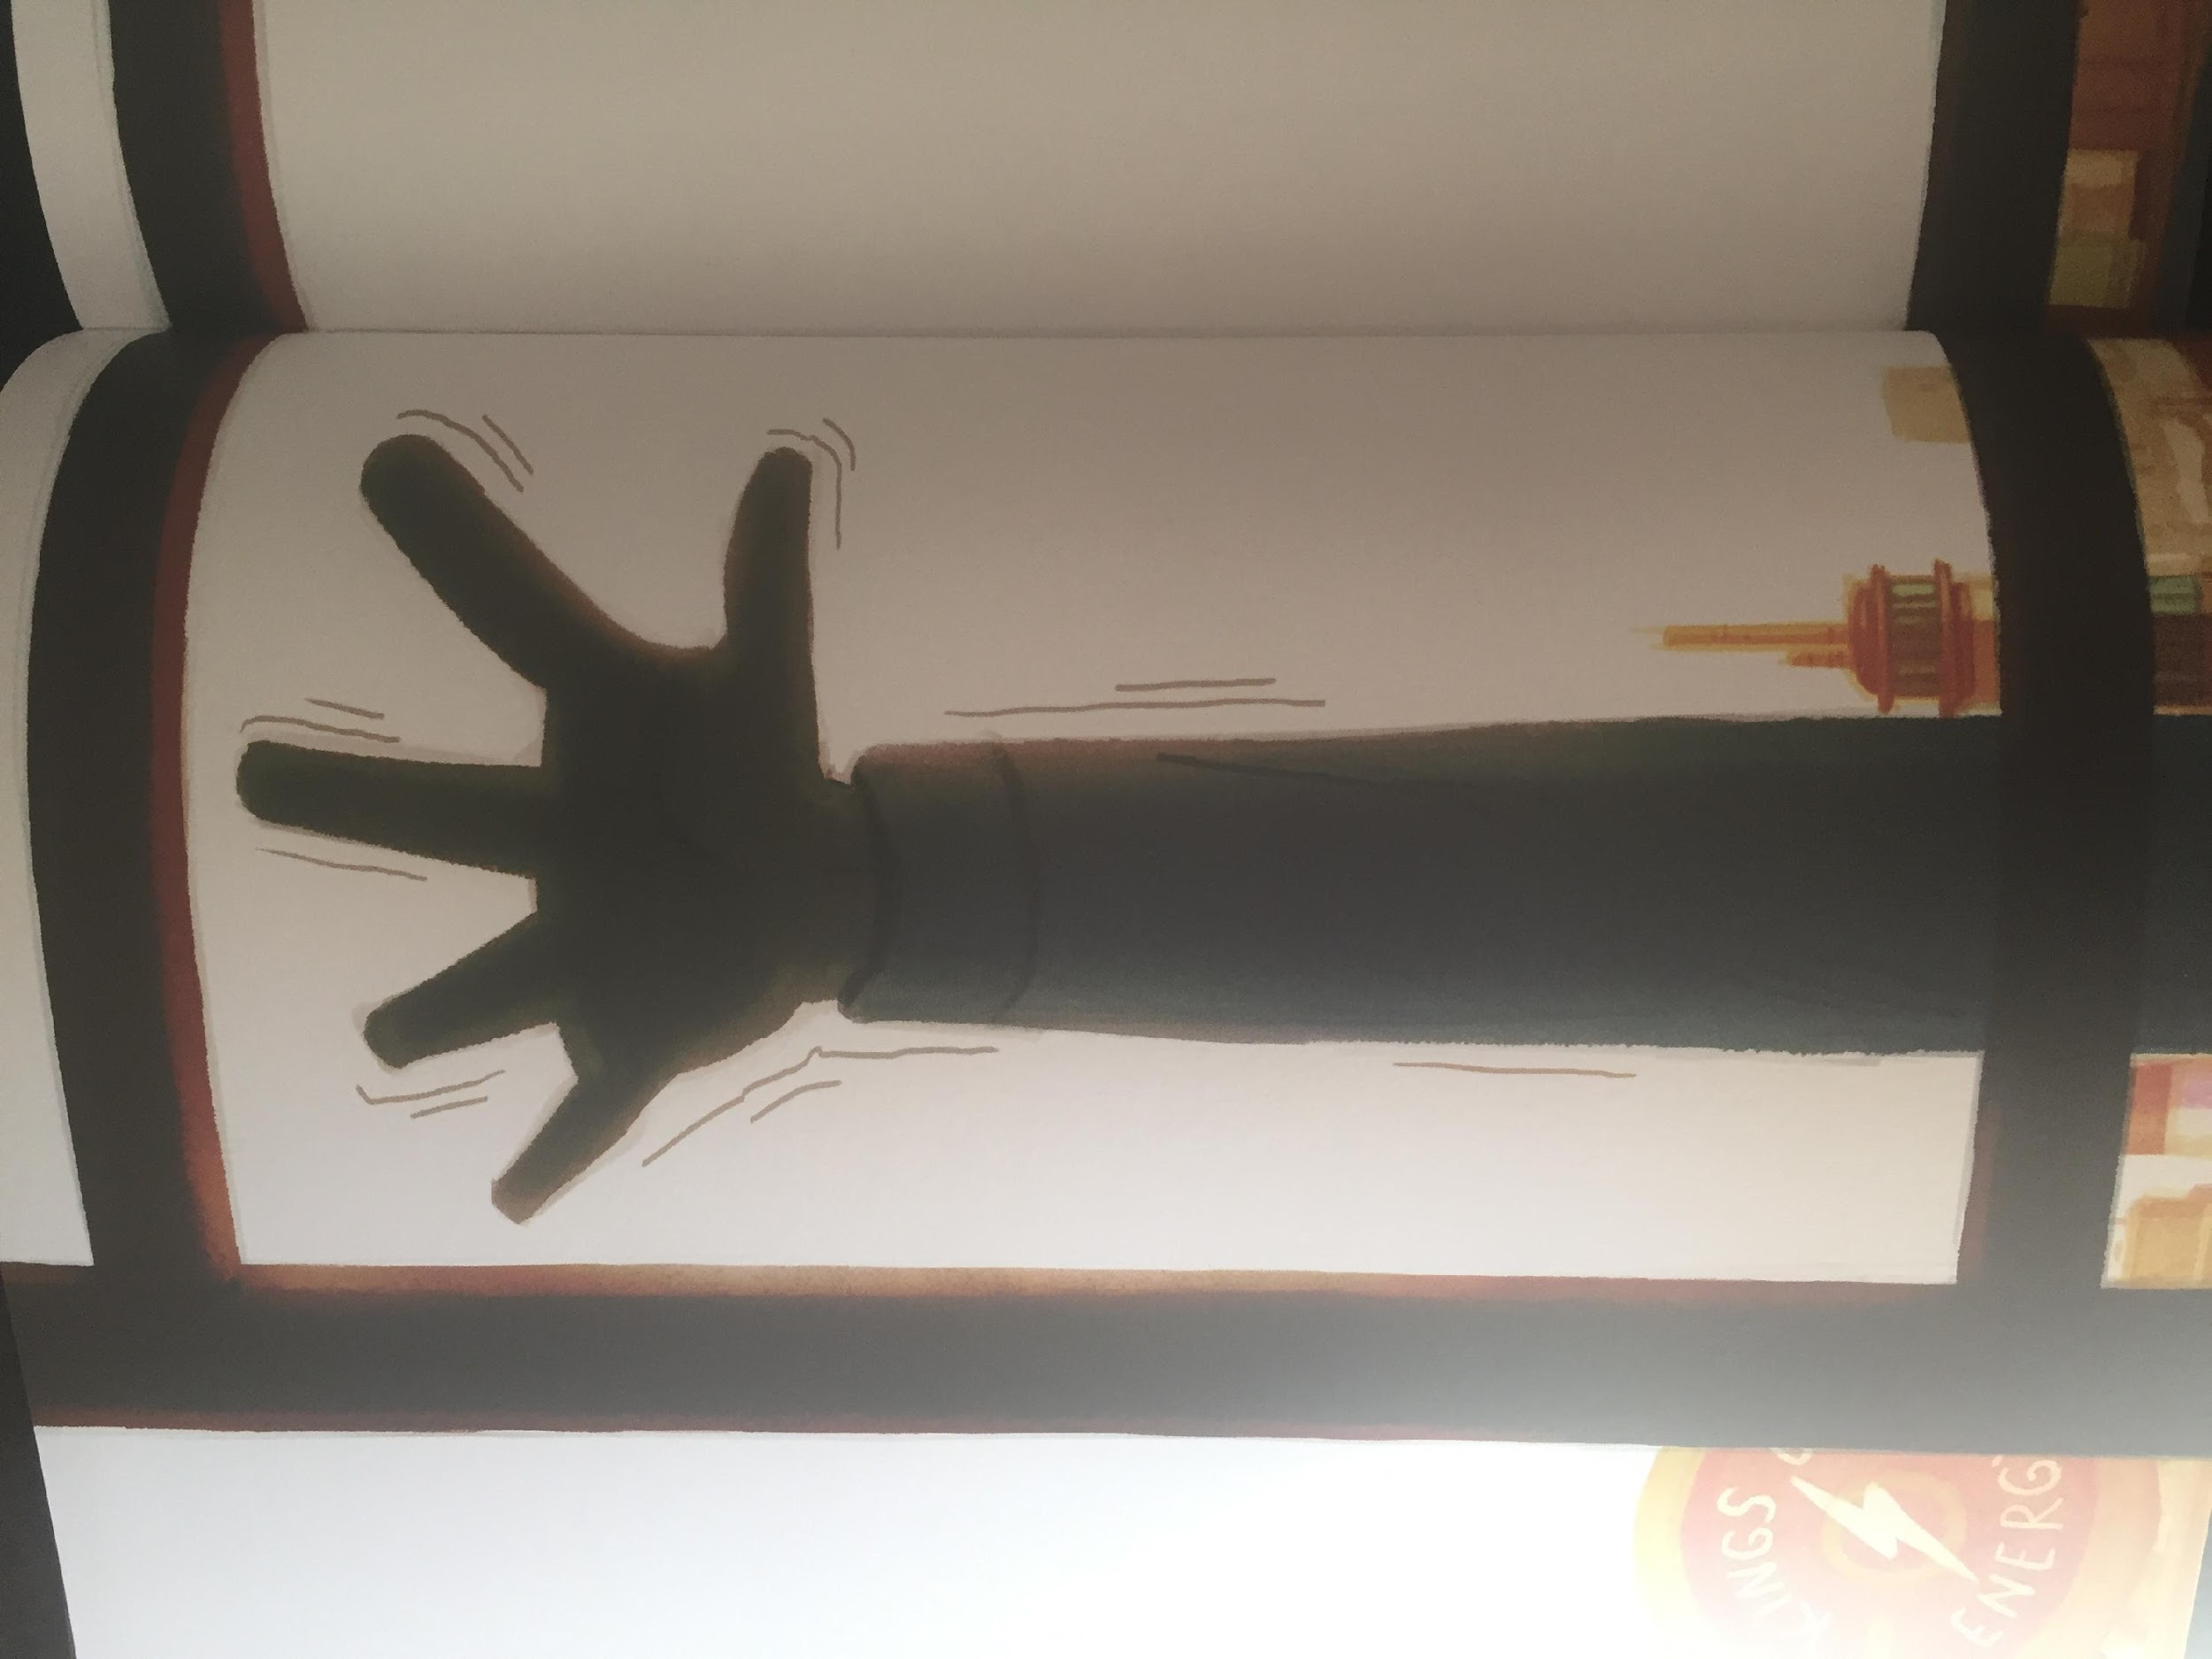
LI – to make links with my own life

Slide 27
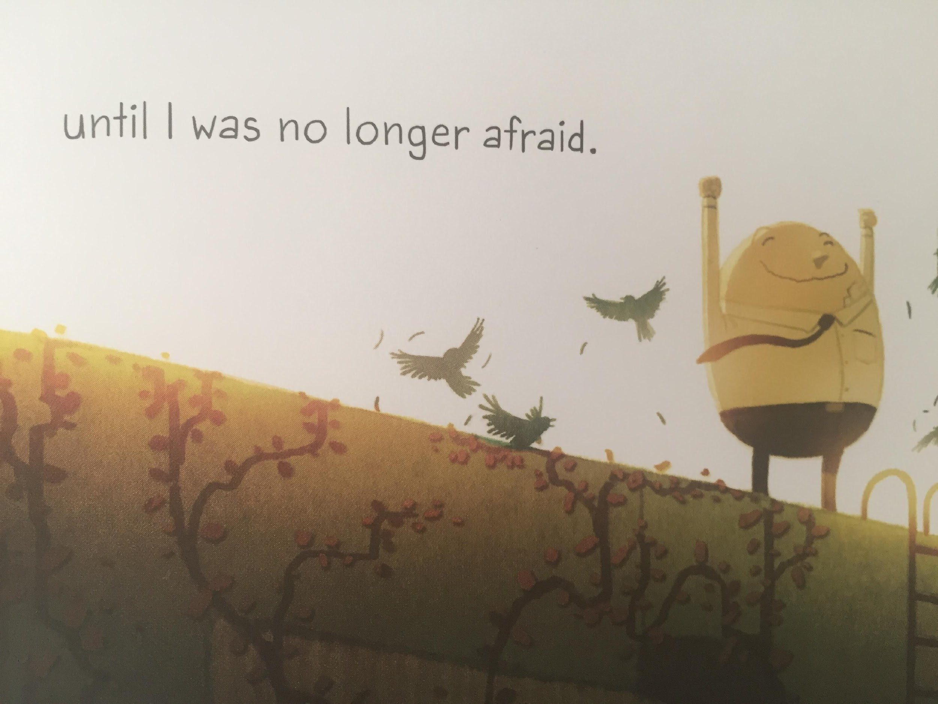

Slide 28
LI – to make links with my own life
Have you ever felt like this before?
This reminds me of ...

Slide 29
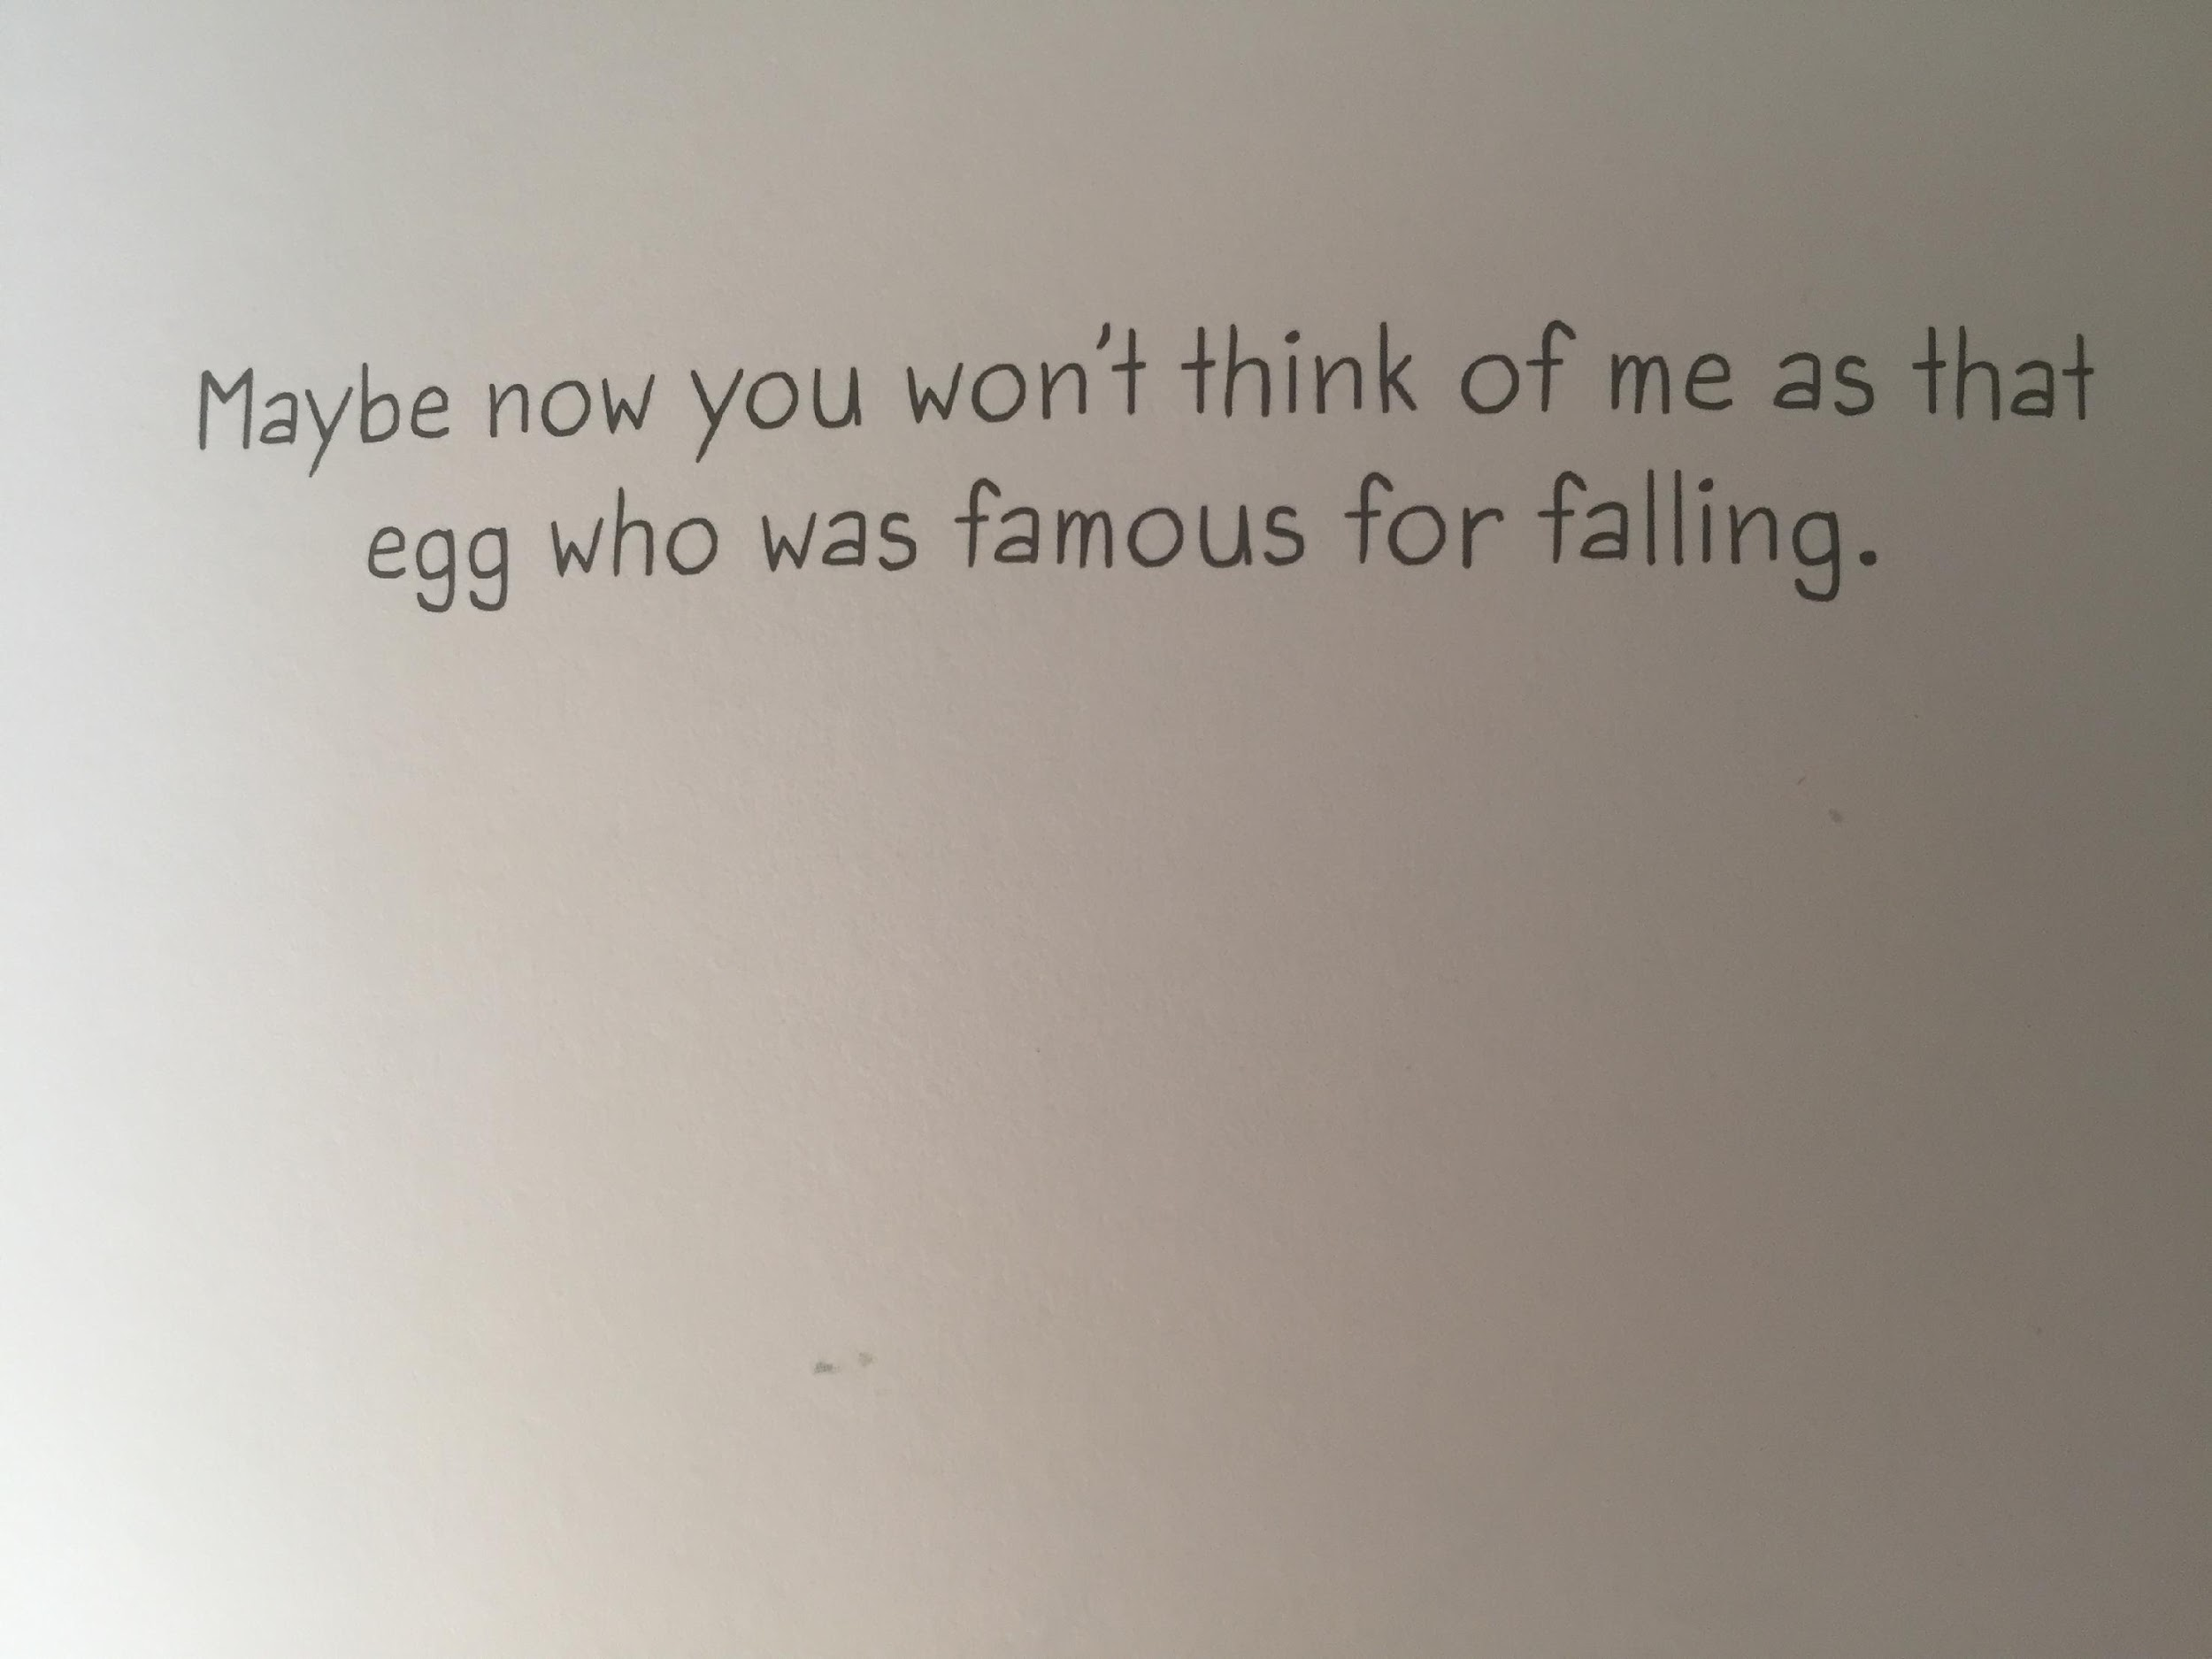

Slide 30
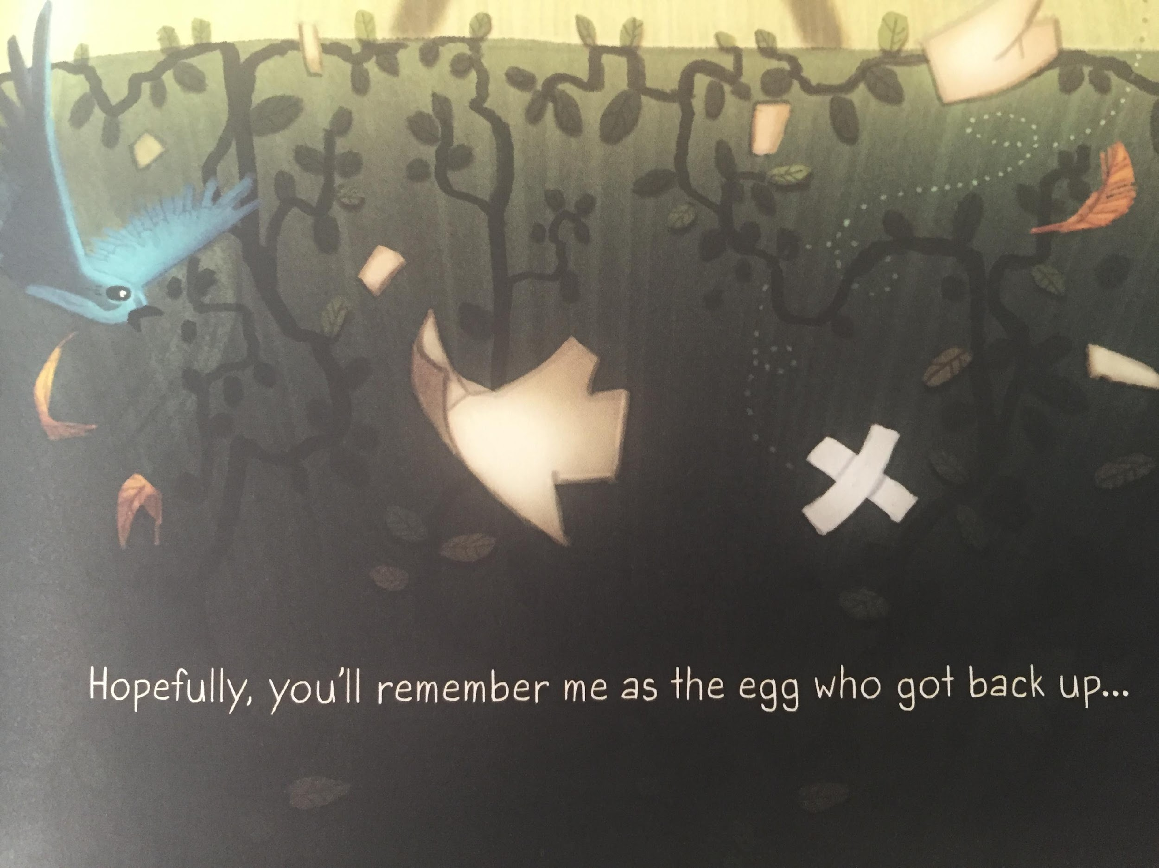
LI – to make links with my own life

Slide 31
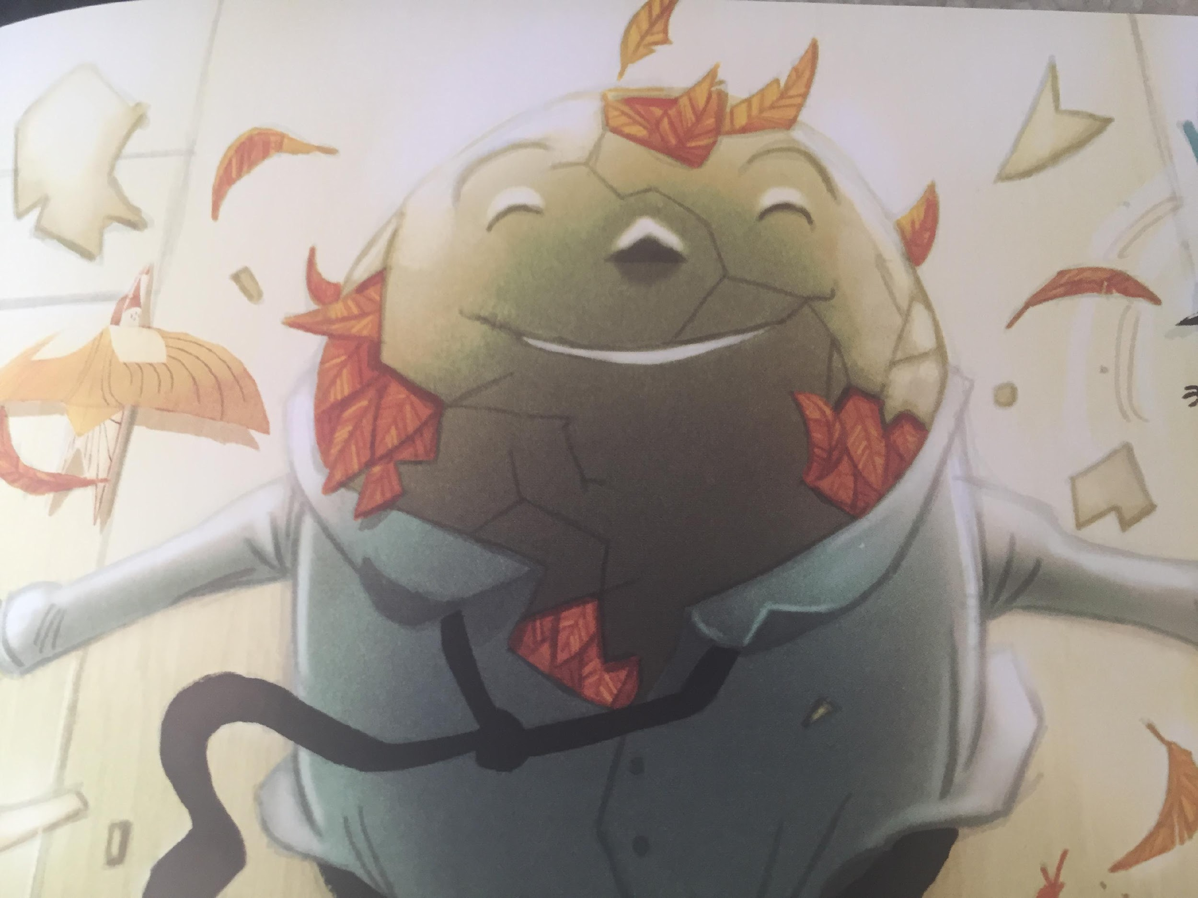

Slide 32
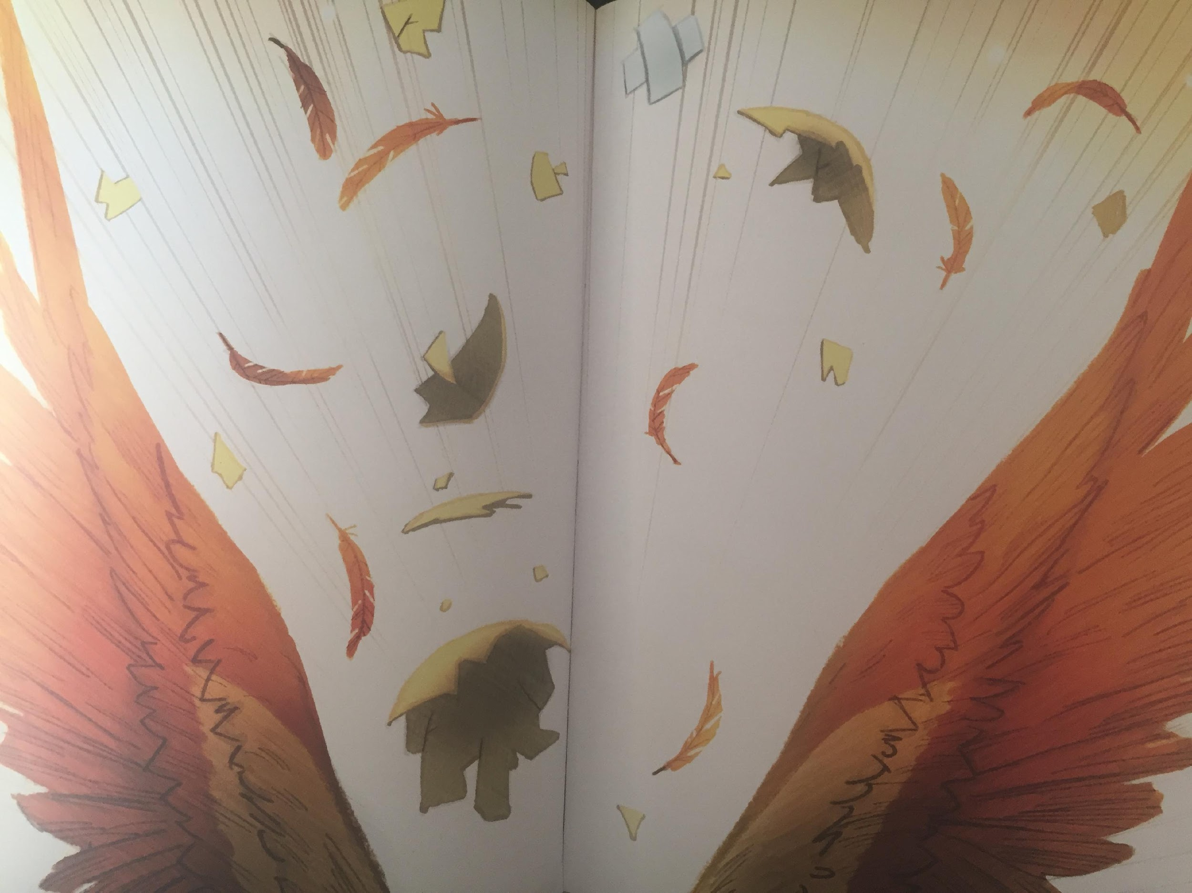
LI – to make links with my own life

Slide 33
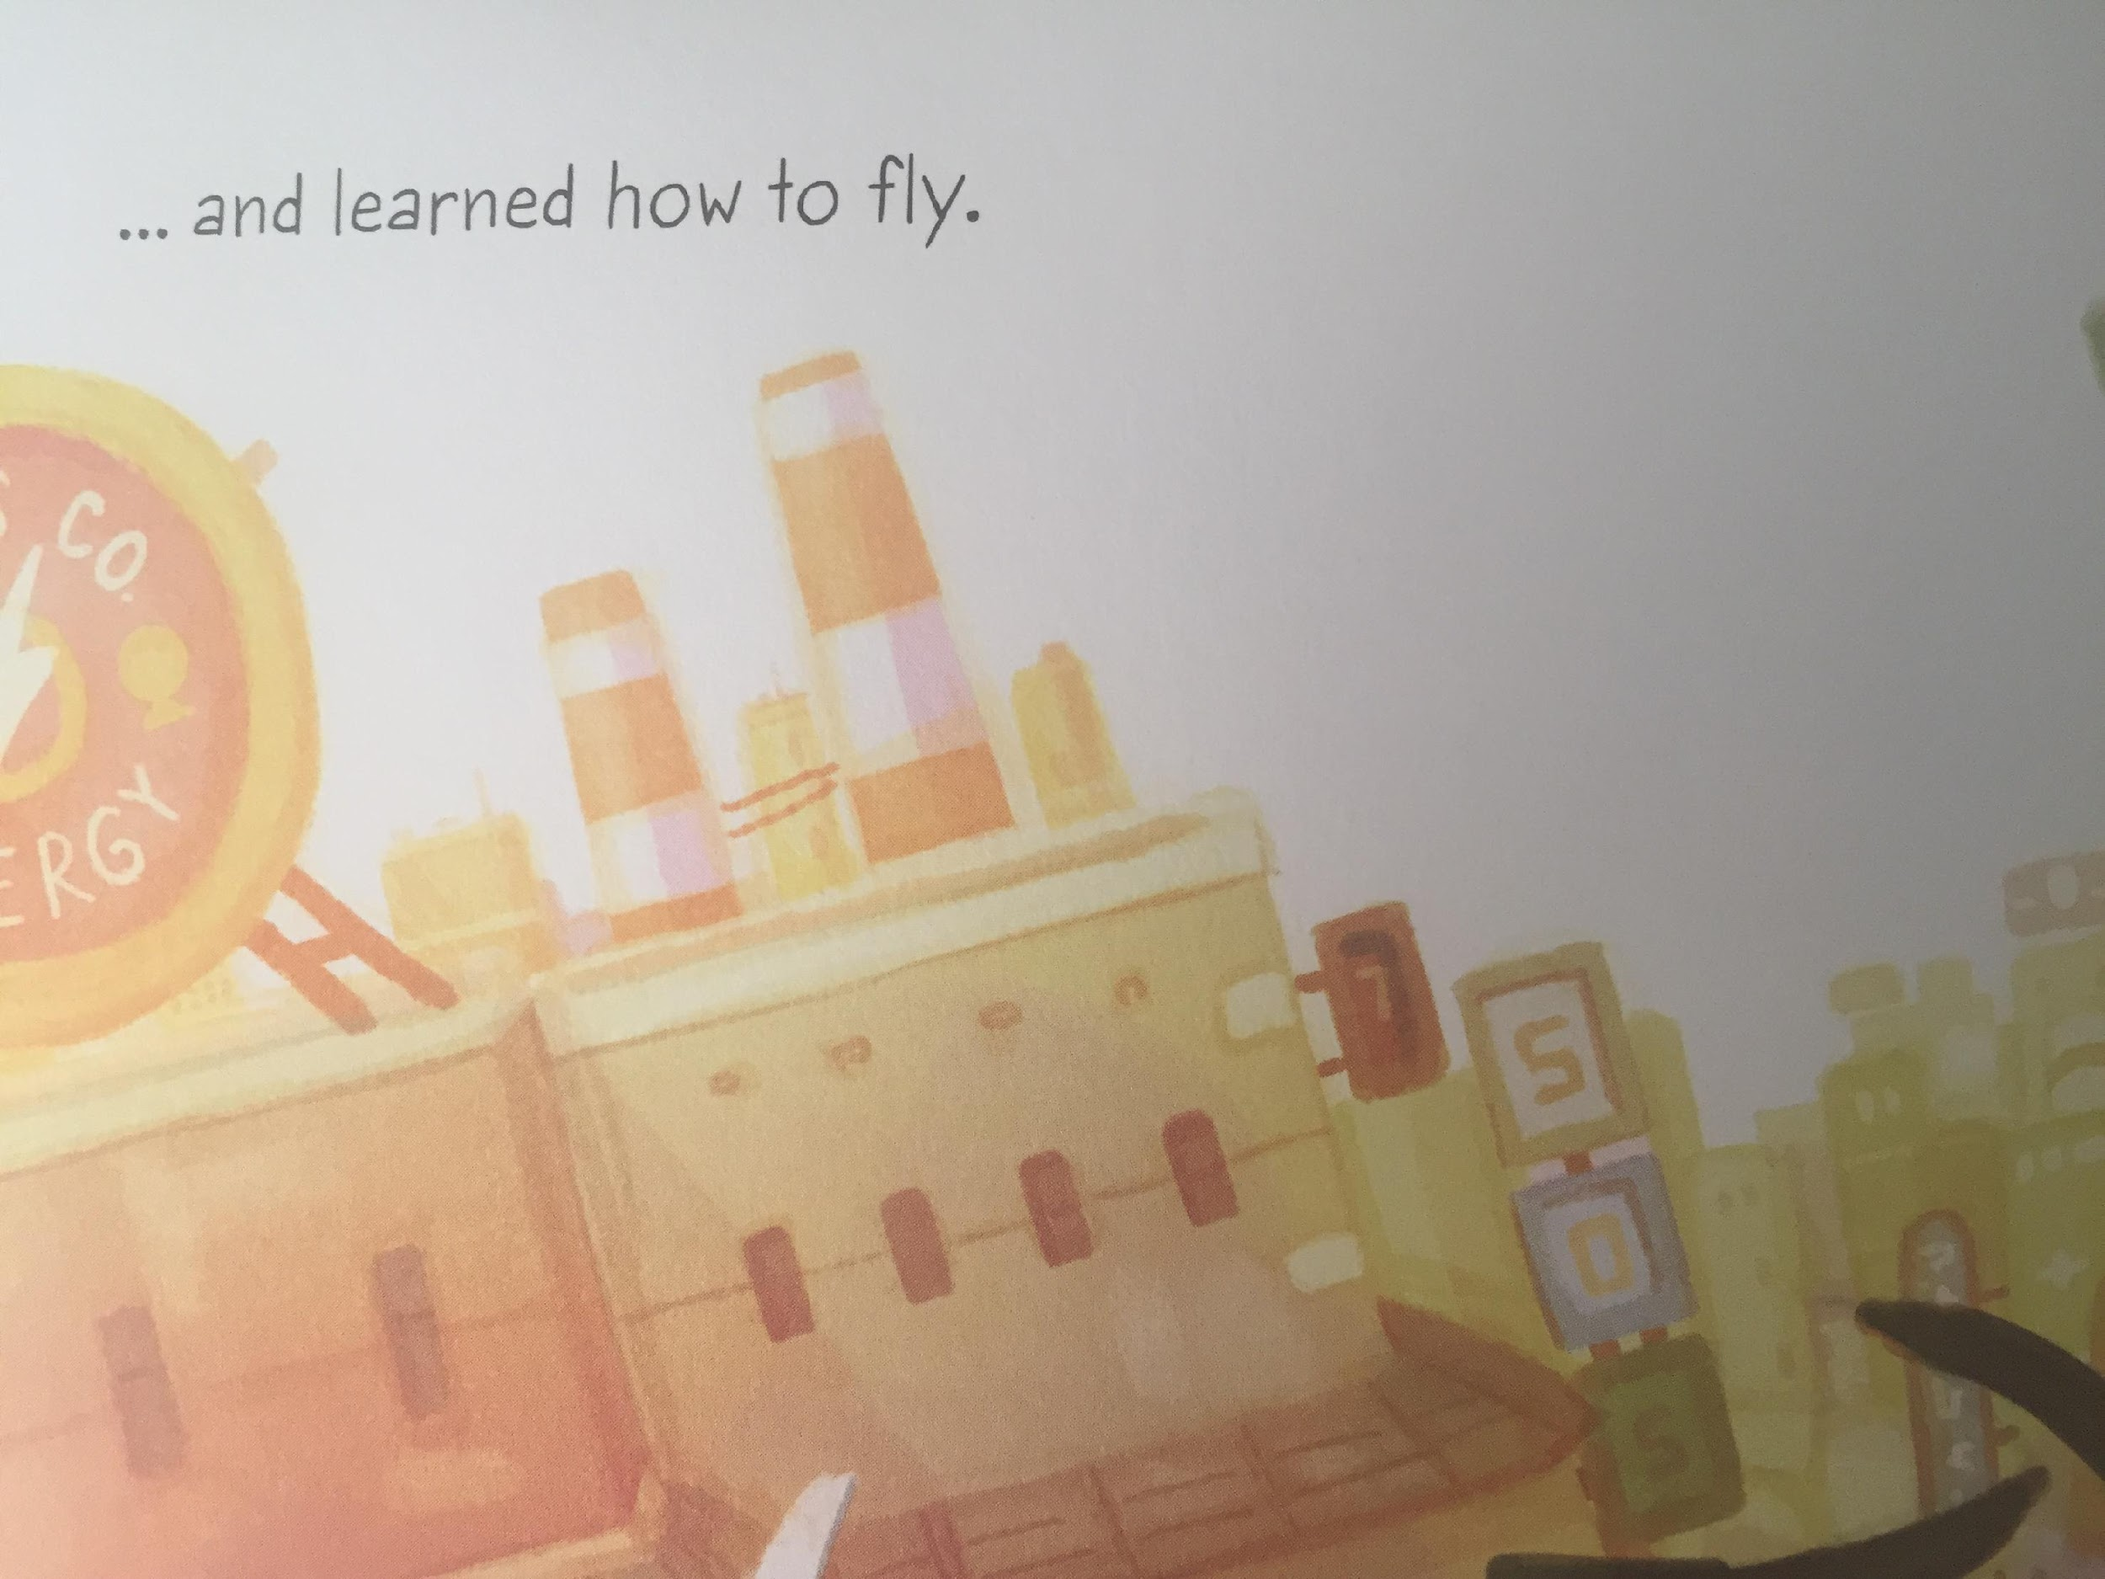

Slide 34


